Slide 1

ANNUAL IMPACT REPORT · OFFICEKIT CALIBRATION
Aqua Impact Story: a claim worth testing
Proof that a small watershed can change a whole neighborhood.
A documentary reference for public work, measured honestly.
6 sites · 12 months · 3 linked outcomes
CARE FOR THE PLACE · COUNT WHAT CHANGED
OfficeKit original clean-room calibration · fictional content · 2026-08-29
1 / 6

Slide 2
AQUA IMPACT STORY · BASELINE ASSESSMENT
02 / 06
Five pressure points converge on one connected intervention.
The map is not decoration: position tells us where the next action earns attention.
DIRECT-LABELLED SITES
W09 South inlet
55% pressure
THE READ-THROUGH
W04 Waterworks
68% pressure
W01 North bank
42% pressure
The geography changes the intervention.
Protect the connected sites first; visibility and activity follow from that choice.
W12 Community edge
31% pressure
12
sites assessed
5/12 sites · 430 ha in the connected catchment
286 ha
priority habitat
39
actions linked
OfficeKit original clean-room calibration · map regions are illustrative

Slide 3
AQUA IMPACT STORY · ACTION CHAIN
03 / 06
Three linked moves turn a visible problem into a durable result.
Each stage has a named output, a time window, and a measure that survives the handoff.
01
IDENTIFY
12 sites
Make the pressure legible
Jan–Mar
02
RESTORE
286 ha
Fund the connected repair
Apr–Sep
03
VALIDATE
144 samples
Prove the outcome travels
Oct–Dec
The chain is the evidence: no stage is allowed to hide the condition it inherits.
OfficeKit original clean-room calibration · values are fictional

Slide 4
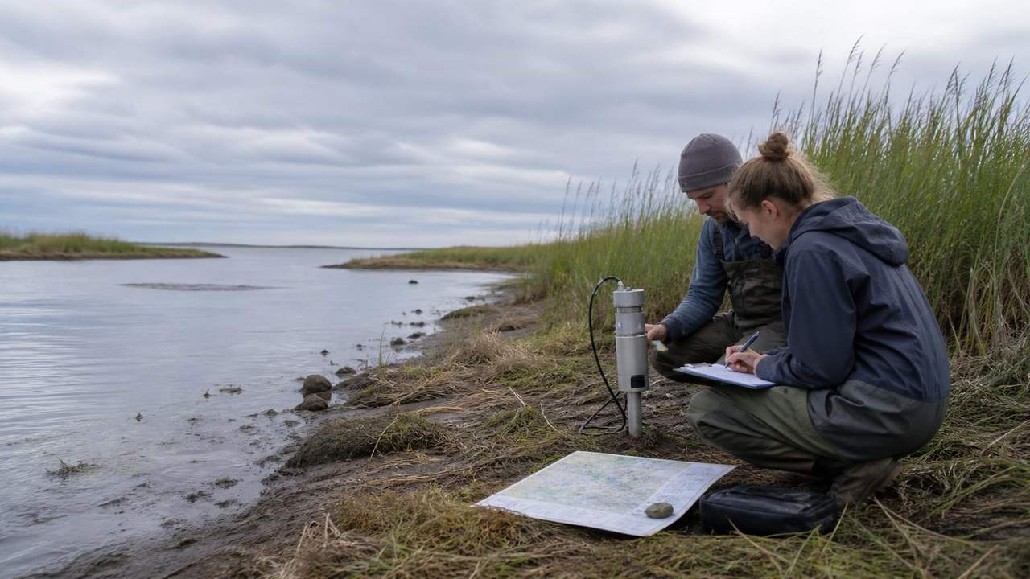

AQUA IMPACT STORY · FIELD EVIDENCE
04 / 06
From site repair to connected habitat, the proof stays close to the place.
Two field frames, one outcome ladder, and the limitation that keeps the claim honest.
MEASURED FOLLOW-THROUGH
286 ha
restored habitat
8.6 km
shoreline connected
BASELINE · SHORELINE PRESSURE
39
actions revisited
86.4%
survival at follow-up
FOLLOW-UP · CONNECTED HABITAT
Limit: follow-up covers one connected catchment, not every site.
OfficeKit original clean-room calibration · documentary images are authored assets

Slide 5
AQUA IMPACT STORY · OUTCOMES
05 / 06
Four signals align when the outcome is measured at the source.
Baseline, follow-up and change remain on the same line so the reader can audit the movement.
OUTCOME LEDGER
Water-quality compliance
66.0%
84.0%
+18.0 pp
MEASUREMENT BASIS
95.2%
Breeding success
52.0%
68.0%
+16.0 pp
of follow-up records carry a location, date, and named verifier.
Invasive control
14.0%
7.8%
−6.2 pp
Species return
20
247
+38 species
A clear result is still bounded by its sampling frame.
OfficeKit original clean-room calibration · values are fictional

Slide 6

2026 DIRECTION · DECISION FRAMEWORK
Protect the connected sites before expanding the story.
The next move is specific: scale what was measured, then return to the unresolved edge.
01
Scale
12 connected sites
02
Verify
144 samples by Q4
03
Return
One unresolved catchment
One network · one evidence chain · one next action
OfficeKit original clean-room calibration · fictional content · 2026-08-29
6 / 6

