Slide 1
Connected - Home
Presentation by: Weichen wang G00329371
Module: Research method in computing & IT
Lecturer: Martin kenirons

Slide 2
Overview
Introduction
Uses of Connected Home
Advantages of Connected Home
Disadvantages of Connected Home
Future of Connected Home
Conclusion

Slide 3
Introduction
Connected Home
”A connected home, sometimes also called a smart home, puts computer network technology to use for the added convenience and safety of families.”(Lifewire 2017).
Traditional wireless home automation device use special protocols like Z-Wave and ZigBee.

Slide 4
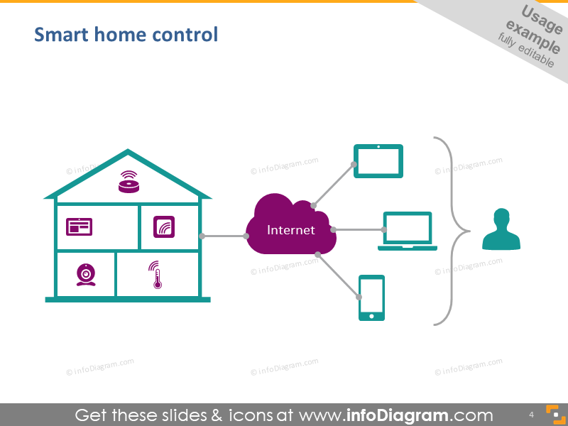
Introduction
Modern connected home devices use wireless network protocols to communicate with each other.（Wi-Fi）

Slide 5
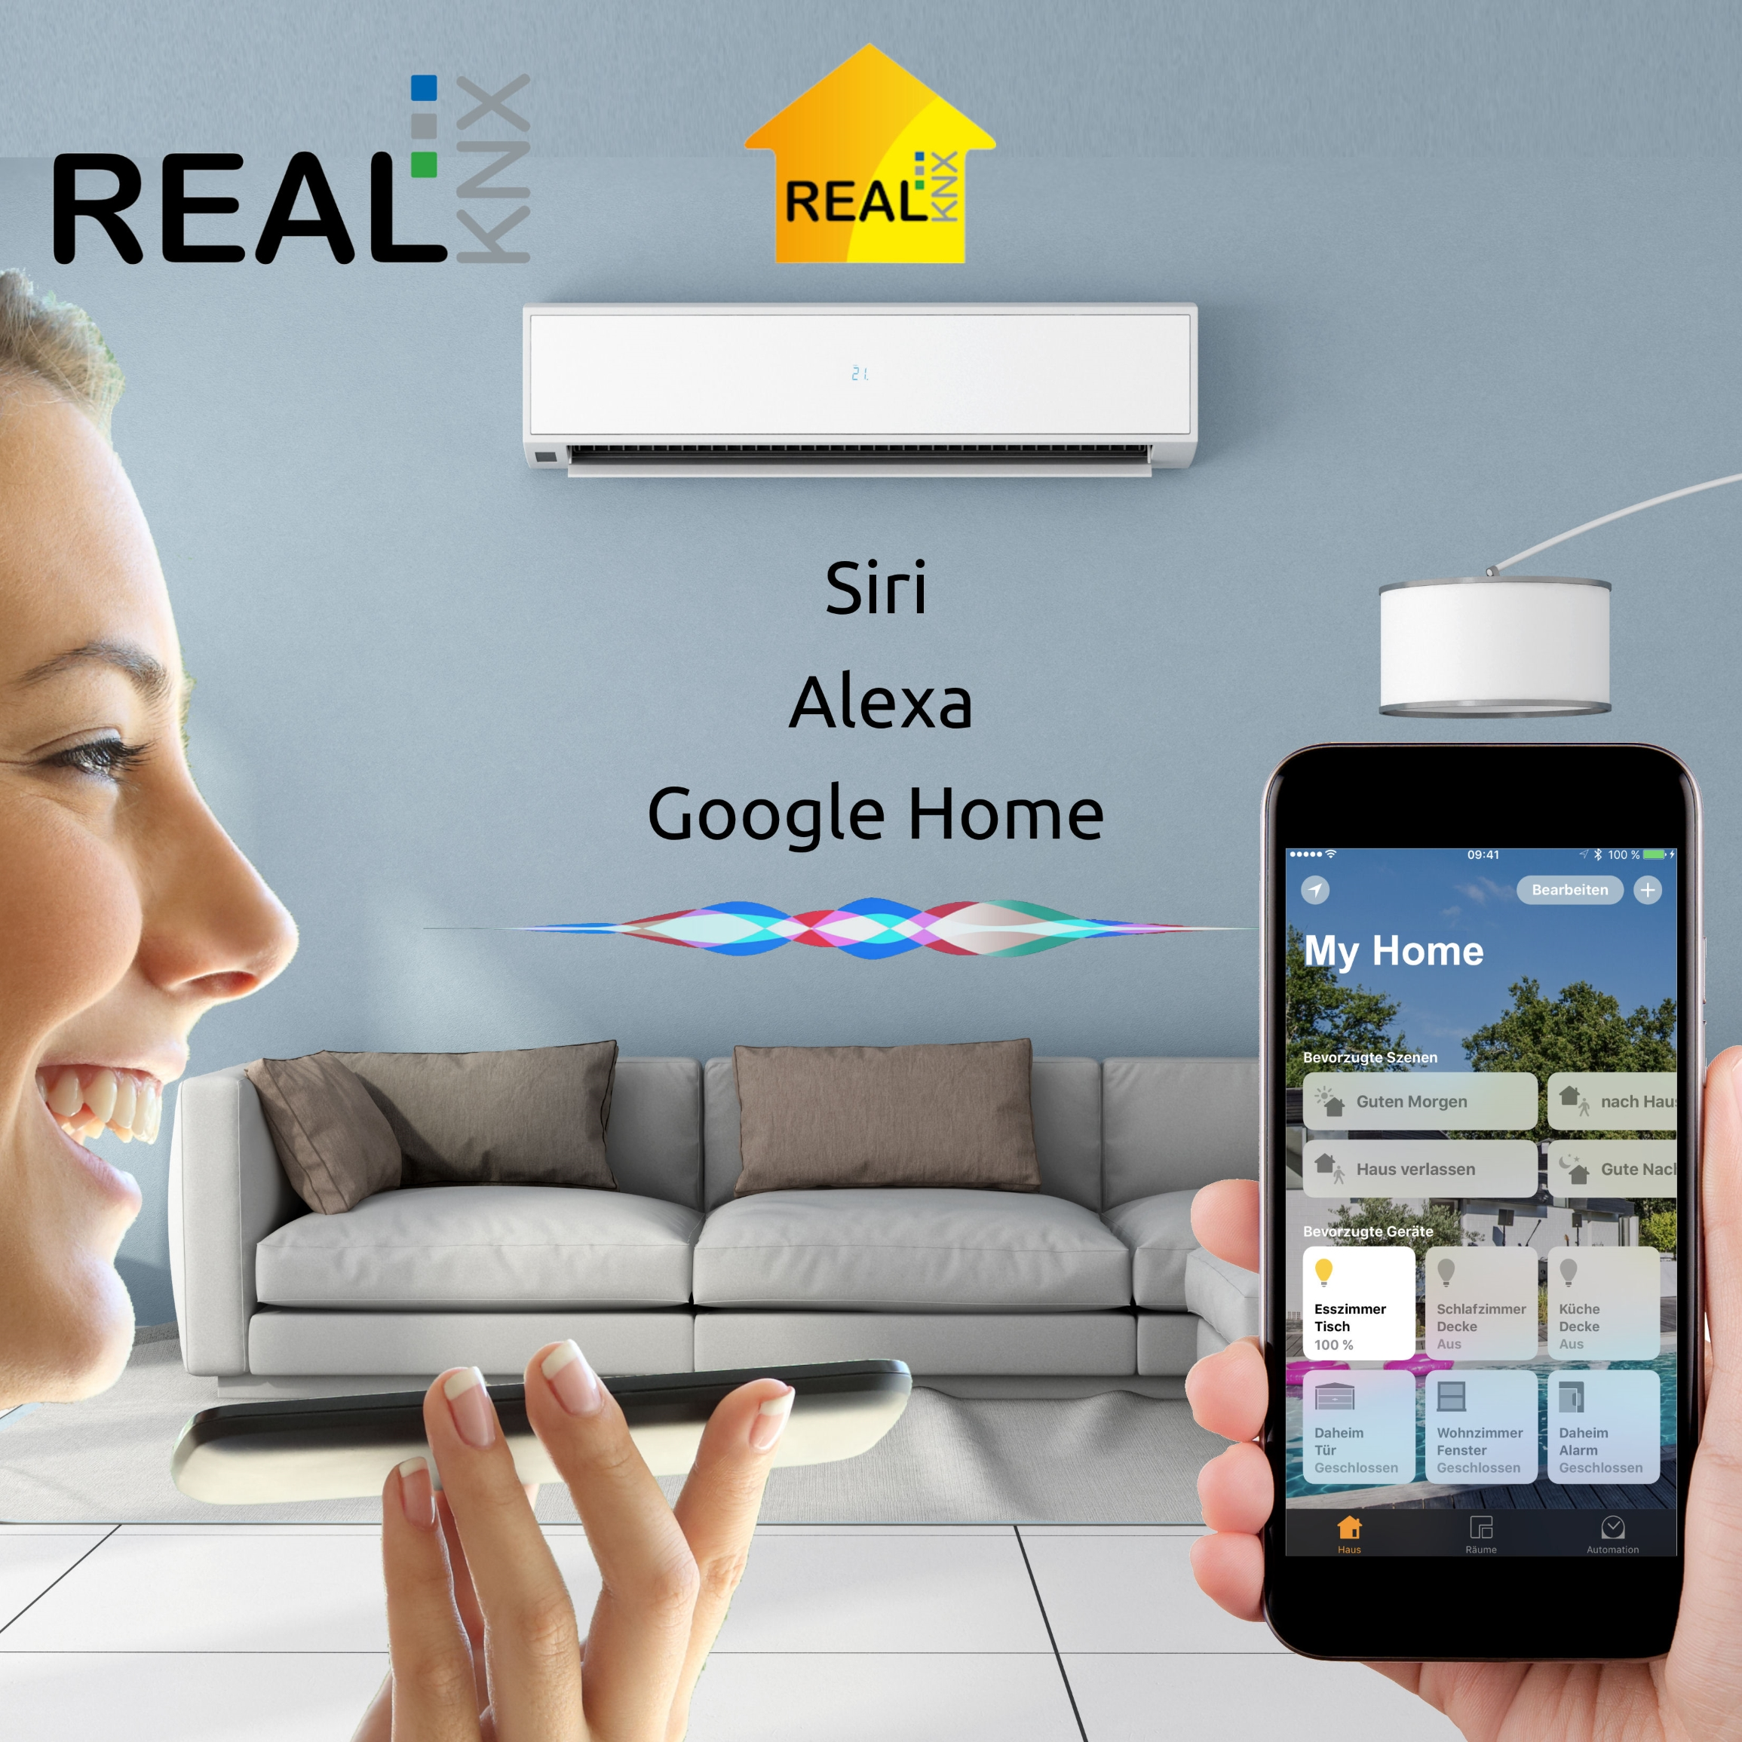
Uses of Connected Home
Could connect the devices and applications in home(through electronical products)
Could command
Through voice, remote control, pad, smartphone etc.

Slide 6
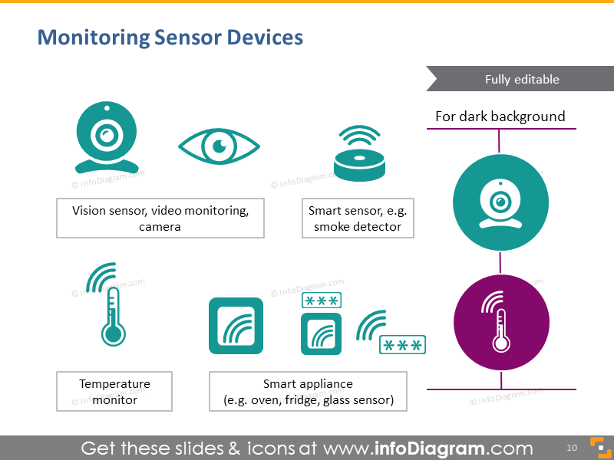
Uses of Connected Home

Slide 7
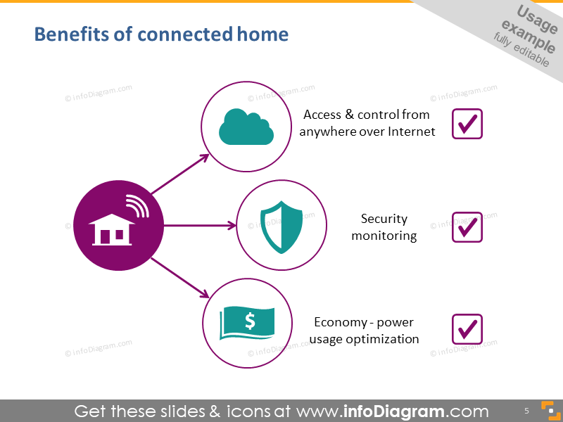
Advantages of Connected Home
Adding Convenience to Daily Life
Customization
Security
Ease of Use
Save Money and the Environment

Slide 8



Disadvantages of Connected Home
Cost (expensive)
Reliability (If network down)

Slide 9
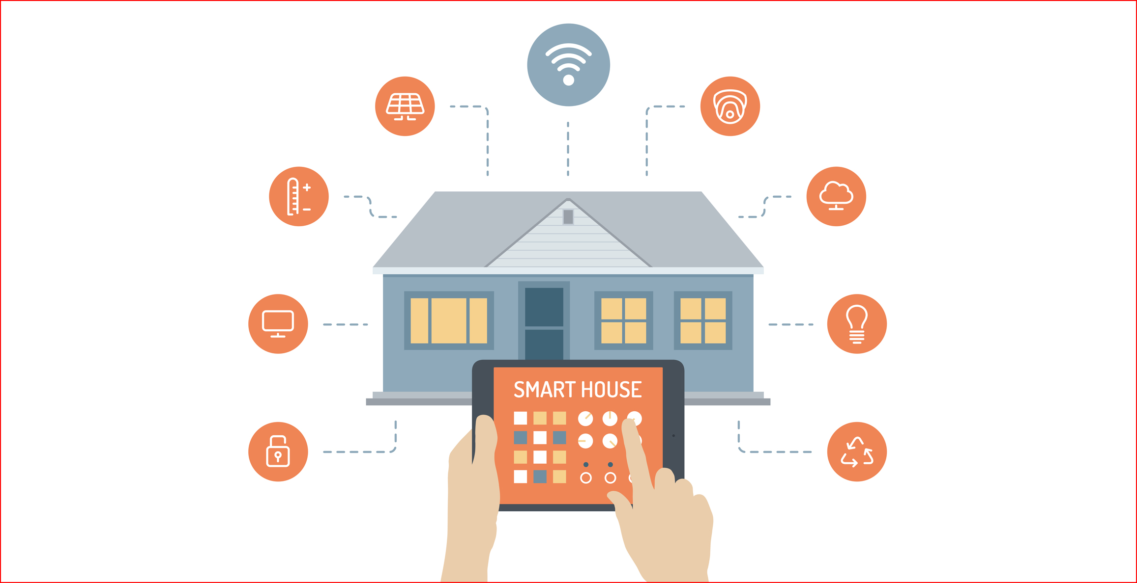
Future of Connected Home
Home Informatization
Ensure the interconnection

Slide 10
Conclusion
Connected Home used smart electronic products to control devices.
Connected Home could bring convenience, security and money-saving life
Connected Home costs too much, too dependent on the wireless network
Connected Home will be more and more informatization

Slide 11
References
Lifewire. (2017). What is a connected home (and why would you want one)?. [online] Available from: https://www.lifewire.com/introduction-to-connected-home-817684

Slide 12

End

