Slide 1
Build your Open Source projects using Azure DevOps
Bala Chirtsabesan

Slide 2
Open Source Software
Software ships with open source license
License allows software to be freely used (copied), modified, and shared (distributed) https://opensource.org/
Why open source?
Allows you to easily collaborate and share learnings with others
Open source at Microsoft : Many projects in .NET, Azure, etc https://opensource.microsoft.com/
Notes:
licenses that comply with the Open Source Definition
Open source licenses such as Apache License 2.0, MIT License, more info at https://opensource.org/

Slide 3
Version Control systems
Why version control? Backup and share code, revert changes, etc
Local version control. Eg: Copy folder locally
Centralized version control. Eg: TFVC, CVS
Distributed version control. Eg: Git

Slide 4
Git
Free, Open Source VC system started by Linux community
https://git-scm.com/book
No centralized server, all operations are local : git init, git add, git commit
Repositories (“Repos”) can be local or remote : git push, pull requests (PRs)
Git Service providers : GitHub, Azure Repos, GitLab, etc

Slide 5
DEMO
Develop really simple application for my organization
Write some code and add tests
Simple Web API that returns whether a number is prime or not (using VS and ASP.NET Core)
Add automated unit tests and test locally
Setup a CI (“build server” machine) and build solution
Build my solution on the build server
Run tests on the build server
Deploy and run the web application in Azure
Deploy the built solution to Azure
Notes:
Let’s dive right into a scenario.
Create a team project, add work items
Create PrimeWeb in VS, build and run locally
Add tests and run locally
Push repo to existing project on Azure Repos
Setup CI on build server (build solution and run tests)
Setup CD on build server (deploy to a test website)
Update welcome message in VS and push changes

Slide 6
VSTS is now Azure DevOps
To get started for free, simply go to : https://azure.com/devops

Slide 7
Azure DevOps
Set of modern services for development teams
Azure Boards : Work item tracking (Scrum / Kanban)
Azure Repos : Git repos, PRs, code search
Azure Pipelines : Continuous build / test (CI), continuous deploy (CD)
Azure Artifacts : Share packages (NuGet, npm, Maven)
Azure Test Plans : Manual and exploratory testing

Slide 8
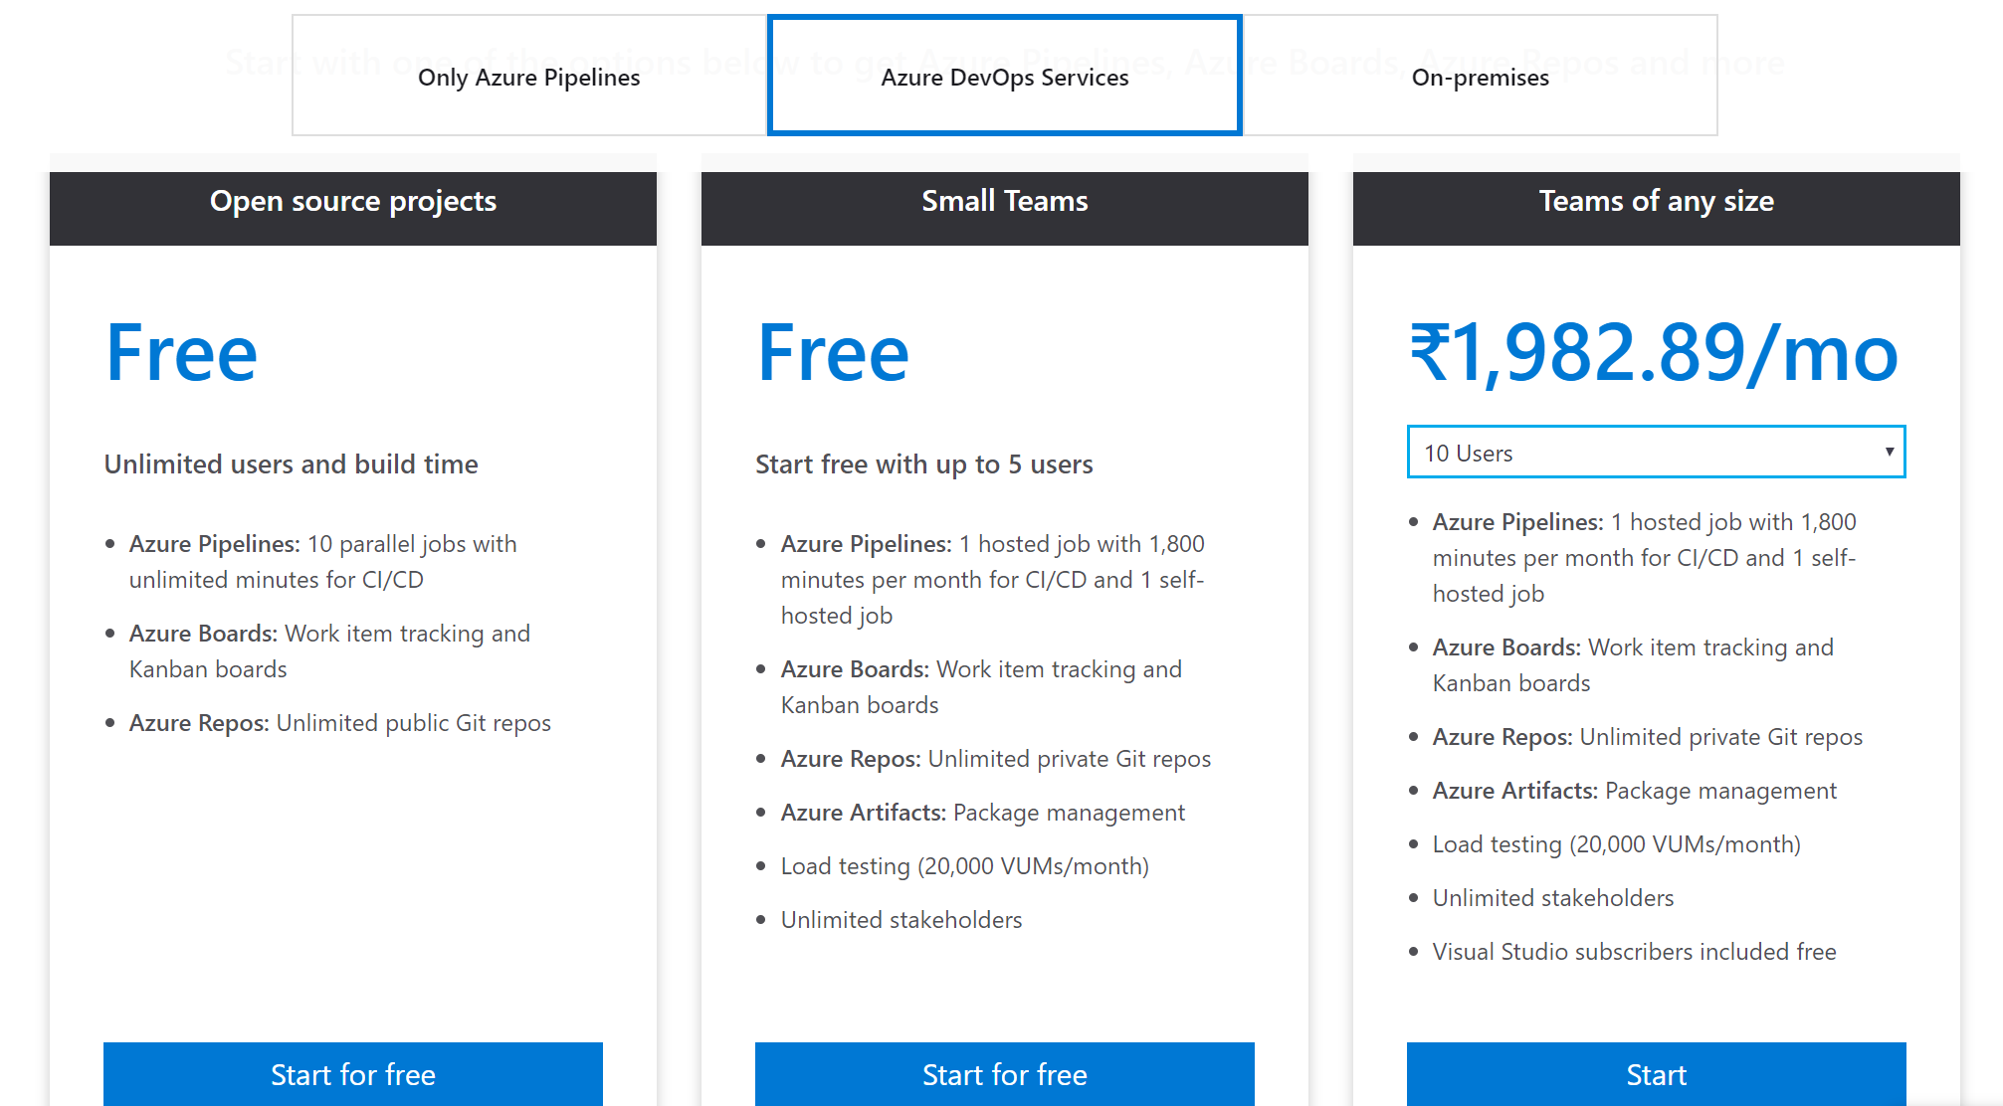
Azure DevOps Pricing

Slide 9
Source code URL
https://dev.azure.com/DotNetConf2018Friends/AzureDevOpsDemo

