Slide 1
W3C Community Group · PR #45
Separating Agent Identity
from DID Method
Trust Models
COMMON PROTOCOL
Agent Identity + HTTP
Authentication
BINDING LAYER
DID Method Binding Profiles
A 10-minute introduction and discussion guide
METHOD SPECIFICATION
did:wba
Open PR · 26 August 2026
Notes:
Good morning, or good afternoon, everyone. Today I would like to introduce Pull Request 45, titled “Split Agent Identity and DID method documents.” The central idea is simple: this pull request separates the common agent authentication mechanism from method-specific DID trust models. I will first explain why that separation matters, then walk through the five changed files, and finally highlight a few questions where review feedback would be especially useful.
[Sources]
- https://github.com/w3c-cg/ai-agent-protocol/pull/45

Slide 2
THE THESIS
This is an architectural split—not formatting
Common authentication becomes reusable; every DID method keeps its own trust and lifecycle rules.
5
3
1,869
Open
changed files
companion specifications
lines added
review status
One sentence to remember
PR #45 separates the common agent authentication mechanism from method-specific trust models.
Source: PR #45 metadata and summary
02
Notes:
The key point is that this is not merely an editorial move from one HTML file to several files. It creates a clearer standards architecture. The common HTTP authentication protocol can now be reused independently of any specific DID method. At the same time, did:wba, did:web, and did:webvh retain different resolution, validation, update, deactivation, and trust assumptions. The pull request changes five files, adds three companion specifications, and remains open for review. So the most useful review question is not whether the text was moved correctly, but whether the new boundaries are the right boundaries for interoperability and future extension.
[Sources]
- https://github.com/w3c-cg/ai-agent-protocol/pull/45

Slide 3
WHY SPLIT
The new structure makes trust boundaries visible
BEFORE
AFTER
protocol.html
agent-identity.html
Common HTTP authentication
• Agent identity model
• HTTP authentication
• did:wba lifecycle
• did:web / did:webvh compatibility
did-method-profiles.html
Method-specific validation
did-wba.html
One section mixed protocol, bindings, and method rules.
Identifier and lifecycle rules
protocol.html remains the index and migration surface.
03
Notes:
Previously, the Agent Identity section in protocol.html carried four different kinds of content: a general identity model, an HTTP authentication flow, the did:wba method specification, and compatibility rules for did:web and did:webvh. That made it easy to read did:wba as the center of the identity architecture. After this pull request, the common protocol, the binding layer, and the method specification are separate. protocol.html remains an entry point and migration surface. This is important because future DID methods can add a Binding Profile without rewriting the authentication protocol or inheriting did:wba-specific security assumptions.
[Sources]
- https://github.com/w3c-cg/ai-agent-protocol/pull/45

Slide 4
FIVE-FILE MAP
Each changed file now has one clear responsibility
FILE
ROLE
QUESTION ANSWERED
agent-identity.html
Common protocol
How an agent proves control of a DID key over HTTP
did-method-profiles.html
Binding layer
How each DID method is resolved and validated
did-wba.html
Method specification
How did:wba is created, resolved, updated, and deactivated
protocol.html
Index + migration
Where existing readers and fragment links are redirected
tests/test_identity_documents.py
Structural tests
What document integrity and compatibility anchors are checked
04
Notes:
The five files form a small standards stack. agent-identity.html answers the method-independent authentication question. did-method-profiles.html maps specific DID methods into that common protocol. did-wba.html contains the DID method itself. protocol.html becomes an index and preserves migration anchors. Finally, the Python test file checks structural integrity across the split. I will now use a short excerpt from each file to show that this responsibility separation exists in the actual text, not only in the pull request description.
[Sources]
- https://github.com/w3c-cg/ai-agent-protocol/pull/45

Slide 5
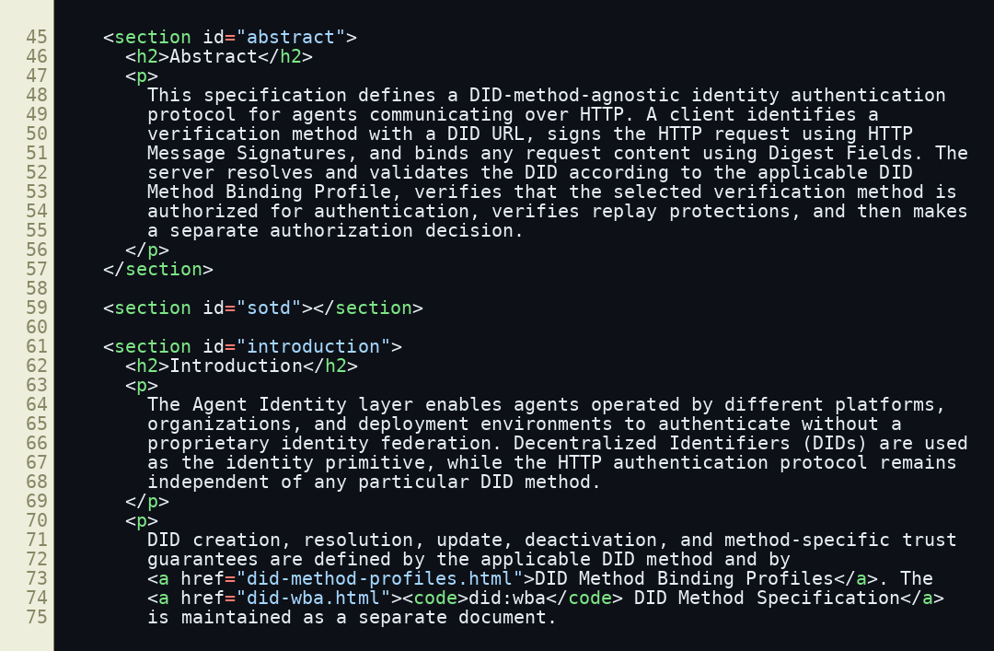
FILE 1 OF 5
agent-identity.html defines the shared contract
WHAT THE EXCERPT PROVES
• Independent of any specific DID method
• DID URL identifies the verification method
• HTTP Message Signatures bind the request
• Authorization remains a separate decision
Identity proof is common.
Trust validation is pluggable.
Source: agent-identity.html at PR head commit
05
Notes:
The abstract of agent-identity.html states the core contract. A client identifies a verification method with a complete DID URL, signs the HTTP request using HTTP Message Signatures, and binds request content with Digest Fields. The server resolves and validates the DID according to the applicable Binding Profile, checks that the key is authorized for authentication, verifies replay protection, and only then makes a separate authorization decision. Notice what this document does not define: it does not define the lifecycle of a DID method. That boundary is the foundation of the new architecture.
[Sources]
- https://github.com/w3c-cg/ai-agent-protocol/blob/56405b38710785077c290aba3770f70079bf9c02/agent-identity.html
- https://www.rfc-editor.org/rfc/rfc9421
- https://www.rfc-editor.org/rfc/rfc9530

Slide 6
COMMON FLOW
The server selects trust rules from the DID itself
1
2
3
Agent client
Verifier
Resolver
Signs method, URI, digest, time, nonce
Reads keyid and selects one Binding Profile
Returns a validated DID Document or failure
Then verify
DID key relation → signature → digest → replay window → authorization
401 = authentication failure · 403 = authenticated, but not permitted
06
Notes:
The client signs an HTTP request using RFC 9421. The keyid parameter is a complete DID URL pointing to the exact verification method. The verifier extracts the primary DID and chooses a resolver and Binding Profile from the DID method name inside that identifier. It validates the DID Document, checks deactivation state, dereferences the key, and confirms that the key appears in the authentication relationship. It then verifies the signature, content digest, timestamps, and replay protections. Only after successful authentication does authorization run. In practical terms, 401 means the identity proof failed; 403 means the identity was authenticated but is not allowed to access the resource.
[Sources]
- https://github.com/w3c-cg/ai-agent-protocol/blob/56405b38710785077c290aba3770f70079bf9c02/agent-identity.html
- https://www.rfc-editor.org/rfc/rfc9421
- https://www.rfc-editor.org/rfc/rfc9530

Slide 7
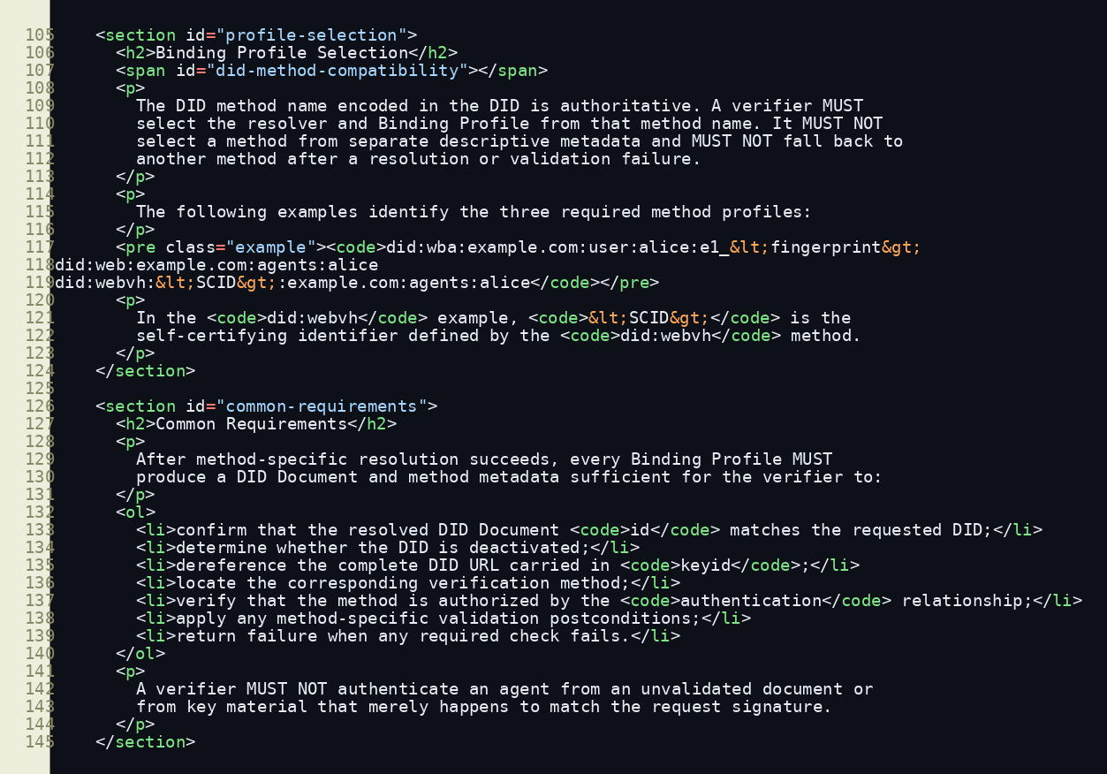
FILE 2 OF 5
Binding Profiles prevent method confusion
NORMATIVE RULE
The DID method name is authoritative.
No fallback
A failed did:web resolution cannot be retried as did:wba or did:webvh.
Why it matters
No downgrade to a weaker trust model.
Source: did-method-profiles.html at PR head commit
07
Notes:
The Binding Profiles document contains one especially important security rule: the DID method name encoded in the DID is authoritative. The verifier must select the resolver and profile from that method name, and it must not fall back to another method after resolution or validation fails. This prevents method confusion and downgrade behavior. A did:web identifier must be evaluated using did:web rules, not did:wba path fingerprints. A did:webvh identifier must have its verifiable history validated, rather than being treated as a static Web-hosted document. The common flow is shared, but the trust evidence is not interchangeable.
[Sources]
- https://github.com/w3c-cg/ai-agent-protocol/blob/56405b38710785077c290aba3770f70079bf9c02/did-method-profiles.html

Slide 8
BINDING PROFILES
One authentication flow supports three distinct trust models
METHOD
TRUST BASIS
PROFILE MUST VALIDATE
did:wba
DNS + HTTPS + Web PKI
HTTPS resolution; e1_ thumbprint and Data Integrity proof when applicable
did:web
DNS + HTTPS + Web PKI
Native did:web resolution; no did:wba-specific fingerprint or proof
did:webvh
SCID + verifiable history
Hash-linked update log, authorization, version, and deactivation state
Shared protocol does not mean shared security assumptions.
08
Notes:
The three current profiles share the same HTTP authentication sequence but rely on different trust foundations. did:wba uses ordinary Web resolution and, for the e1 path profile, adds a cryptographic path-to-key binding and a Data Integrity proof. Native did:web uses its own HTTPS resolution rules and must not be forced to satisfy did:wba-specific checks. did:webvh adds a self-certifying identifier and a verifiable, hash-linked update history, so a verifier must validate that history instead of accepting only the latest document. The Binding Profile is the adapter between the common protocol and each method’s specific security model.
[Sources]
- https://github.com/w3c-cg/ai-agent-protocol/blob/56405b38710785077c290aba3770f70079bf9c02/did-method-profiles.html
- https://github.com/w3c-cg/ai-agent-protocol/blob/56405b38710785077c290aba3770f70079bf9c02/did-wba.html

Slide 9
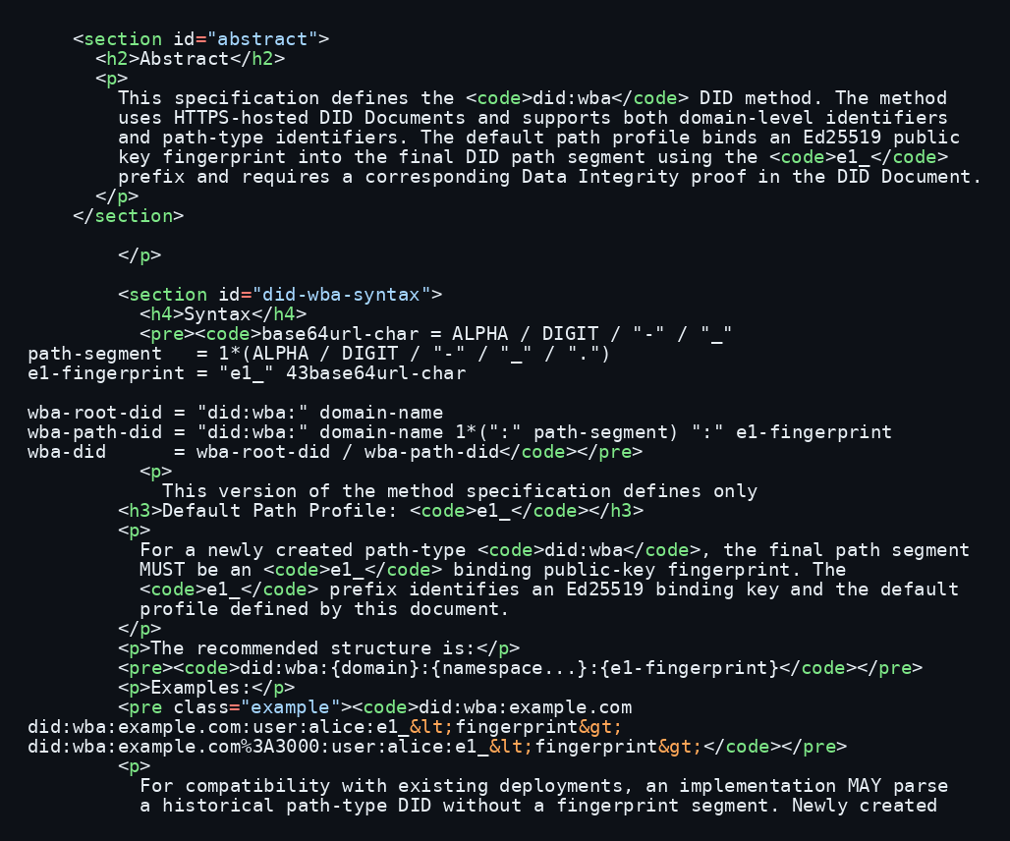
FILE 3 OF 5
did:wba is now a standalone DID method
THE E1_ PROFILE
Path contains an Ed25519 key thumbprint
↓
Verifier recomputes the RFC 7638 thumbprint
↓
DID Document proof binds the document to the key
Binding-key rotation changes the path DID.
Source: did-wba.html at PR head commit
09
Notes:
did-wba is now expressed as its own DID method specification. It defines identifier syntax and lifecycle operations: creation, resolution, update, and deactivation. The default e1 path profile places an Ed25519 public-key thumbprint in the final DID path segment. A verifier recomputes the RFC 7638 thumbprint from the binding public key and compares it with the identifier. The DID Document must also contain the required Data Integrity proof. Because the binding key contributes to the identifier, changing that key changes the path-type DID. Stable human-readable naming, if needed, belongs in an upper layer rather than being silently added to the authentication protocol.
[Sources]
- https://github.com/w3c-cg/ai-agent-protocol/blob/56405b38710785077c290aba3770f70079bf9c02/did-wba.html
- https://www.rfc-editor.org/rfc/rfc7638

Slide 10
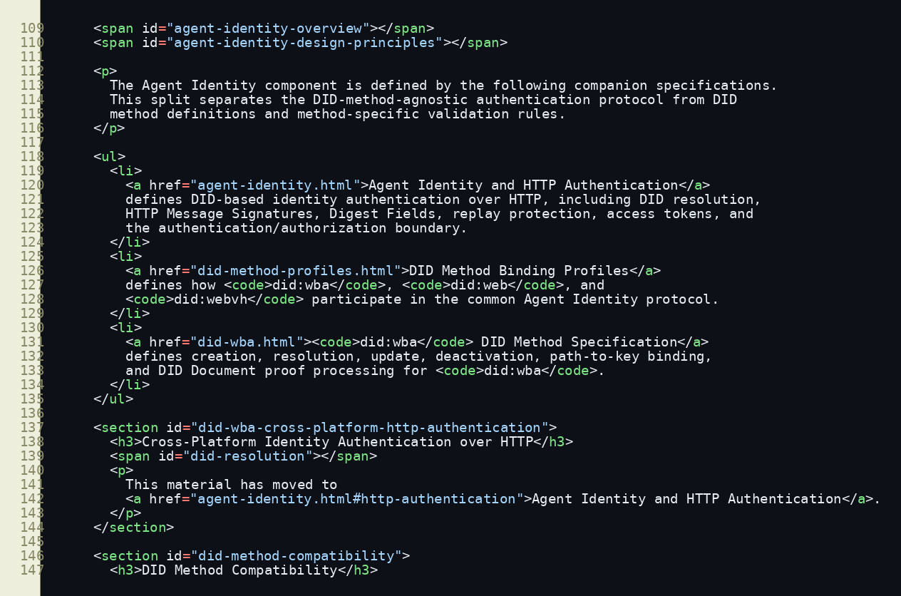
FILE 4 OF 5
protocol.html preserves entry points and old links
COMPATIBILITY STRATEGY
Keep the old address; move the normative content.
• #agent-identity remains
• Legacy anchors still resolve
• Readers land on migration notes
• No silent link breakage
Source: protocol.html at PR head commit
10
Notes:
protocol.html is not simply emptied. It remains the discoverable index for Agent Identity and points to the three companion specifications. The pull request also preserves earlier fragment identifiers as migration anchors. This matters for a living specification because external documents, issues, and implementations may already link into those fragments. The design therefore separates normative content while preserving navigation compatibility. Reviewers should still verify the rendered ReSpec pages and GitHub Pages behavior, because the current automated tests prove that anchors exist, but they do not prove the complete browser experience.
[Sources]
- https://github.com/w3c-cg/ai-agent-protocol/blob/56405b38710785077c290aba3770f70079bf9c02/protocol.html
- https://github.com/w3c-cg/ai-agent-protocol/pull/45

Slide 11
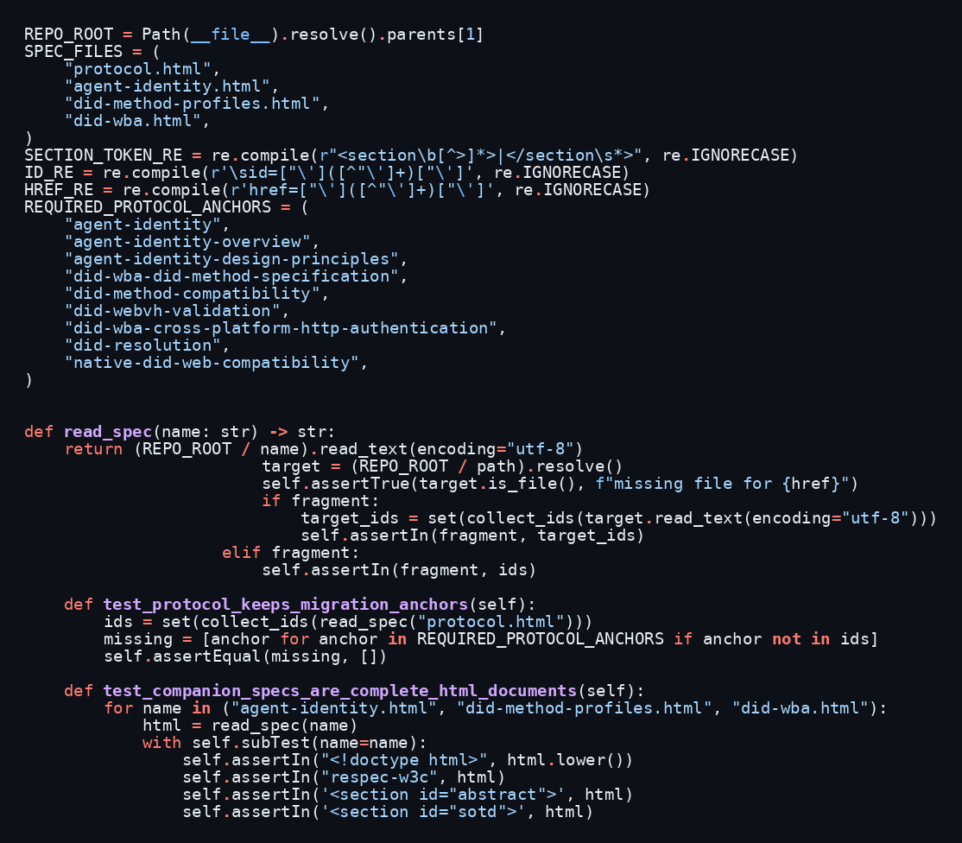
FILE 5 OF 5
Tests protect structure—not protocol behavior
COVERED
• Balanced section tags
• Unique HTML IDs
• Resolvable local links
• Migration anchors
• Complete ReSpec documents
STILL NEEDED
• ReSpec browser rendering
• HTTP signature test vectors
• Profile success / failure cases
• Replay and method-confusion tests
Source: tests/test_identity_documents.py at PR head commit
11
Notes:
The fifth file adds five structural tests. They check balanced section tags, unique IDs, local links, migration anchors, and the presence of complete ReSpec document scaffolding. These are useful protections for the split, and the current test suite passes. But they are not interoperability tests. They do not verify RFC 9421 signature vectors, e1 thumbprints and proofs, successful and failing resolutions for all three methods, replay behavior, or method-confusion attacks. So the tests support merging an editorial architecture, but additional work is still needed before calling the protocol implementation-ready.
[Sources]
- https://github.com/w3c-cg/ai-agent-protocol/blob/56405b38710785077c290aba3770f70079bf9c02/tests/test_identity_documents.py
- https://github.com/w3c-cg/ai-agent-protocol/pull/45

Slide 12
DISCUSSION
Interoperability details remain
1
Are the three specification boundaries clear?
Recommended outcome
Common protocol · binding profiles · did:wba method
Accept the document architecture.
2
Is method selection and no-fallback sufficiently explicit?
The DID string must be authoritative
3
What is the minimum interoperable crypto set?
Track crypto minimums, replay closure, and executable test vectors as explicit follow-up work—or resolve them before merge if the group expects implementation readiness now.
Algorithms, digest requirements, and test vectors
4
Is replay protection fully closed?
Nonce requirements, unique request identifiers, and cache behavior
12
Notes:
My overall assessment is that the architectural direction is correct. I would support the split. For discussion, I suggest four focused questions. First, are the boundaries among the common protocol, Binding Profiles, and did:wba method clear? Second, is selection from the DID itself, with no cross-method fallback, explicit enough? Third, should this pull request define a minimum interoperable cryptographic set, rather than leaving algorithms entirely implicit? Fourth, does the replay model need a stronger mandatory uniqueness requirement? My recommended outcome is to accept the architecture while making these interoperability items explicit follow-up work—or resolving them before merge if the group wants to treat the text as implementation-ready immediately. Thank you. I welcome your questions.
[Sources]
- https://github.com/w3c-cg/ai-agent-protocol/pull/45
- https://github.com/w3c-cg/ai-agent-protocol/blob/56405b38710785077c290aba3770f70079bf9c02/agent-identity.html
- https://github.com/w3c-cg/ai-agent-protocol/blob/56405b38710785077c290aba3770f70079bf9c02/did-method-profiles.html
- https://github.com/w3c-cg/ai-agent-protocol/blob/56405b38710785077c290aba3770f70079bf9c02/did-wba.html

Slide 13
FAQ
Short answers for likely W3C discussion questions
Identity methods
Authentication vs authorization
did:wba lifecycle
Use these as concise first answers; expand only when the chair asks for detail.
Notes:
The following slides are an appendix for questions and answers. The answers are intentionally short enough to deliver first, followed by detail only if needed.
[Sources]
- https://github.com/w3c-cg/ai-agent-protocol/pull/45

Slide 14
APPENDIX
FAQ · DID methods and Binding Profiles
Q1
Is did:wba intended to replace did:web?
No. They are separate DID methods with separate Binding Profiles. Native did:web participates without migration.
Q2
Why do we need a Binding Profile?
The HTTP authentication flow is common, but resolution, key binding, updates, deactivation, and trust evidence are method-specific.
Q3
Why is method fallback prohibited?
Fallback can apply the wrong trust assumptions and create method-confusion or downgrade vulnerabilities.
14
Notes:
For method questions, keep returning to the same distinction: one common authentication protocol, multiple method-specific trust models. did:wba does not replace did:web. A Binding Profile is necessary because the common verifier still needs method-specific instructions. And fallback is prohibited because a failure under one trust model must not be reinterpreted under another.
[Sources]
- https://github.com/w3c-cg/ai-agent-protocol/blob/56405b38710785077c290aba3770f70079bf9c02/did-method-profiles.html

Slide 15
APPENDIX
FAQ · Authentication, authorization, and tokens
Q4
Does an authenticated DID automatically get access?
No. Authentication proves control of an authorized DID key. Authorization remains a separate server decision.
Q5
Why issue an access token after DID authentication?
It is an optimization that avoids repeated DID resolution and signature verification. It does not replace the initial proof.
Q6
How does this relate to OAuth?
This PR defines DID-based HTTP authentication, not a complete delegation framework. OAuth can be layered on top; that integration is outside this PR.
15
Notes:
For authorization questions, the strongest short answer is that authentication and authorization are separate. The optional access token is a performance and session optimization after successful authentication and authorization. OAuth is compatible as an upper layer or delegated authorization framework, but this pull request does not attempt to define that integration.
[Sources]
- https://github.com/w3c-cg/ai-agent-protocol/blob/56405b38710785077c290aba3770f70079bf9c02/agent-identity.html
- https://www.rfc-editor.org/rfc/rfc9421
- https://www.rfc-editor.org/rfc/rfc9530

Slide 16
APPENDIX
FAQ · did:wba lifecycle and readiness
Q7
Why does changing the e1_ binding key change the DID?
Because the public-key fingerprint is part of the identifier. Stable user-facing naming belongs above the DID method.
Q8
Are legacy path DIDs without a fingerprint supported?
The text allows parsers to accept historical forms, but the exact legacy syntax and validation profile should be clarified.
Q9
Is the PR implementation-ready?
The architecture is strong, but minimum algorithms, replay uniqueness, anti-rollback behavior, and executable test vectors need further review.
16
Notes:
For did:wba questions, explain the consequence of self-certifying path binding plainly: if the key fingerprint is inside the identifier, changing the binding key changes the identifier. The document mentions historical path DIDs without a fingerprint, but their exact conformance profile is not fully specified. Finally, distinguish architectural readiness from implementation readiness. The split is coherent, while executable test vectors and several cryptographic details remain appropriate topics for follow-up.
[Sources]
- https://github.com/w3c-cg/ai-agent-protocol/blob/56405b38710785077c290aba3770f70079bf9c02/did-wba.html
- https://github.com/w3c-cg/ai-agent-protocol/blob/56405b38710785077c290aba3770f70079bf9c02/tests/test_identity_documents.py
- https://github.com/w3c-cg/ai-agent-protocol/pull/45

