Slide 1
RUM Community Group
2025-09-12 Edition

Slide 2
Agenda
Logistics
Next Meeting
Agenda
Request for feedback on w3c/navigation-timing/#193
Interop 2025 Updates
Interop 2026 Proposals
Unresponsive crash reports, Self Profiling

Slide 3
Logistics
Meeting cadence
2nd Friday of the Month
60 minutes
10am ET
Agenda Document
(bit.ly/rumcg-agenda)
Google Meet for Meetings
sub to rumcg-participants for invites
Chat on Web Performance Slack #w3c-rum-community-group
(invites)
public-rumcg@w3.org
(for discussions)
RUM CG Github Repo
github.com/w3c-cg/rum
Group details
Links
Meeting minutes?
RUM CG Tracking Project
github.com/orgs/w3c-cg/projects/1
Meeting Minutes via fireflies.ai
AI summary + transcript will be posted after
Full video recording also available

Slide 4
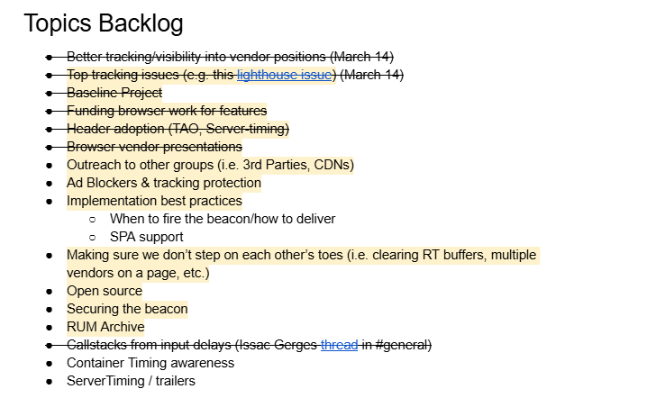
Next Meeting
Fri October 10th @ 10am EST
2nd Friday of each month
Topics?
RUM Archive?
(propose your topic here!)
Submit & Vote topics @ bit.ly/rumcg-agenda

Slide 5
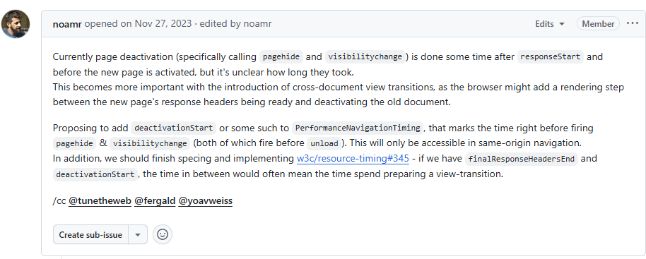
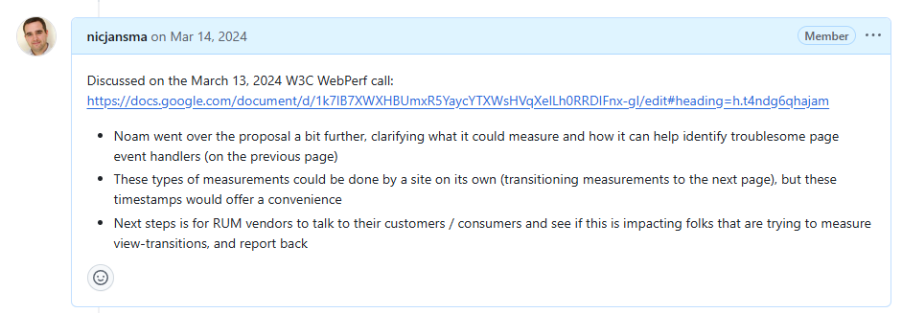
Proposal: add timestamp for when "activation" or "dismissal" starts
w3c/navigation-timing/#193
Request: Is anyone here interested in measuring this?
Do we have any websites or customers that are seeking visibility into e.g. troublesome event handlers on previous page causing delays?

Slide 6
Interop 2025 Updates
Announcements
https://webkit.org/blog/16458/announcing-interop-2025/
https://web.dev/blog/interop-2025
https://www.igalia.com/chats/interop2025
https://hacks.mozilla.org/2025/02/interop-2025/
What is it?
Collaboration between browser vendors and other platform implementors to provide users and web developers with high quality implementations of the web platform.
Each year we select a set of focus areas representing key areas where we want to improve interoperability.

Slide 7
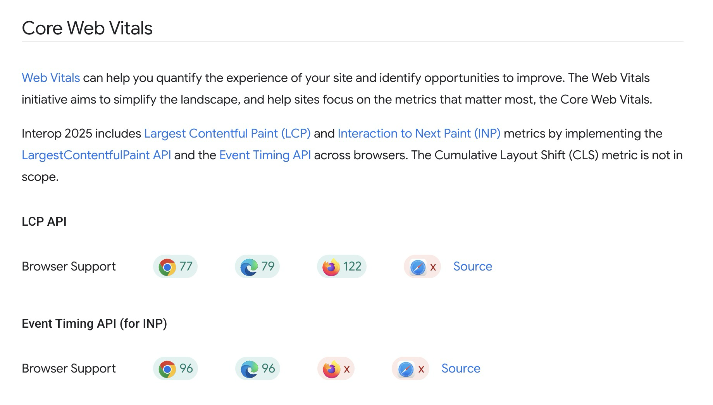
Interop 2025 Updates

Slide 8
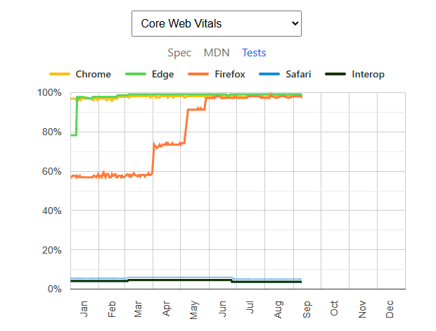
Interop 2025 Updates
https://wpt.fyi/interop-2025?feature=interop-2025-core-web-vitals
Proposal to revert navigation API test regression introduced by WebKit

Slide 9
Interop 2026 Proposals
https://github.com/web-platform-tests/interop/blob/main/proposal_guide.md
https://github.com/web-platform-tests/interop/blob/main/2026/README.md
Interop 2026 will open for proposals on September 4, 2025 and the overall timeline is as below. Please note that the timelines are subject to change.
Proposal submission window (~3 weeks): Sept 4th, 2025 through Sept 24th, 2025
Proposal selection: Before December 11th 2025
Scope of the Interop 2026 project published: the first half of February, 2026.

Slide 10
Interop 2026 Proposals
Interesting proposals already:
Core Web Vitals: CLS / Layout Shift
Long Animation Frames API
requestIdleCallback
JPEG XL image format
fetchLater
Speculation Rules?
ResourceTiming (WPT)?
CWV LCP + ET what's left?
Signature-Based SRI?
What else!?!?!?!
Next steps:
"voting" by Dec 11th

Slide 11
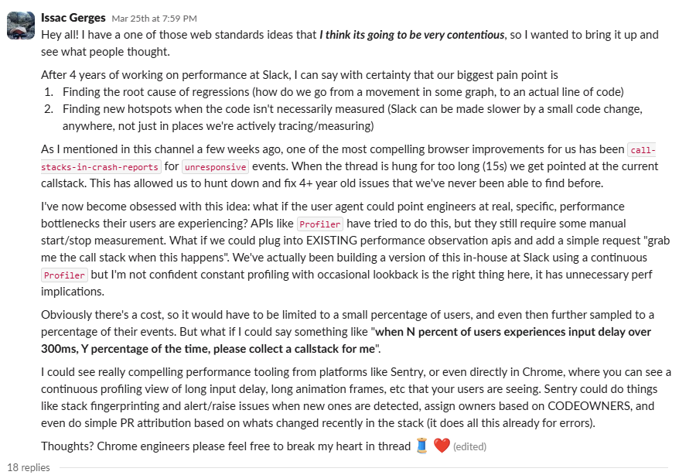
Unresponsive crash reports + Self Profiling
https://webperformance.slack.com/archives/C04BK7K1X/p1742947178736999

