Slide 1
RUM Community Group
2025-10-10 Edition

Slide 2
Agenda
Logistics
Next Meeting
Agenda
RUM CG meetup at perf.now() (RUM RUM)
Barry's Bytes
RUM Archive

Slide 3
Logistics
Meeting cadence
2nd Friday of the Month
60 minutes
10am ET
Agenda Document
(bit.ly/rumcg-agenda)
Google Meet for Meetings
sub to rumcg-participants for invites
Chat on Web Performance Slack #w3c-rum-community-group
(invites)
public-rumcg@w3.org
(for discussions)
RUM CG Github Repo
github.com/w3c-cg/rum
Group details
Links
Meeting minutes?
RUM CG Tracking Project
github.com/orgs/w3c-cg/projects/1
Meeting Minutes via fireflies.ai
AI summary + transcript will be posted after
Full video recording also available

Slide 4
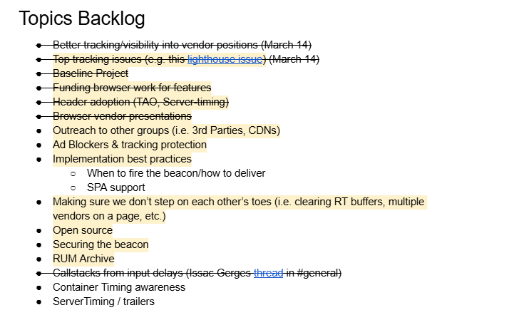
Next Meeting
Fri December 12th @ 10am EST
NOTE: Skipping November (W3C TPAC)
2nd Friday of each month
Topics?
RUM Archive?
(propose your topic here!)
Submit & Vote topics @ bit.ly/rumcg-agenda

Slide 5
RUM CG meetup at perf.now() (RUM RUM)
Attendees registered: 60ish
Informal discussions over lunch
What would you want to discuss with the group?
Reach out to Karlijn or Cliff
Google campus Amsterdam
Register here

Slide 6


Slide 7
Barry’s Bytes
Released
Lighthouse v13 has dropped old audits
No-Vary-Search now supported in HTTP Cache
Purpose HTTP header removed - use Sec-Purpose
Speculation Rules eagerness changes
Upcoming
CrUX Dashboard deprecation
Soft Navs - anyone experimenting? Any feedback?
Adding simple selector to Event Timing
CPU Performance API - Intent to Prototype
Other
Chrome DevTools MCP server
Addy published a post on Core Web Vitals history

Slide 8
Barry’s Bytes - non-Google/Chrome news
Safari Tech Preview supports INP behind a flag
Slow for keypresses - PR
Speculation Rules support merged into WebKit/Safari
Conservative prefetch only
More work to be done!
React supports DevTools Extensibility API (video)

Slide 9
RUM Archive
Link to deck
https://docs.google.com/presentation/d/1E8NdaSATHknsT3gibRZiAknS9vGL66E2g1ZBRf-1xfg/edit?usp=sharing

