Slide 1
RUM Community Group
2025-05-09 Edition

Slide 2
Agenda
Logistics
Next Meeting
Agenda
Header adoption (Timing-Allow-Origin, Server-Timing)

Slide 3
Logistics
Meeting cadence
2nd Friday of the Month
60 minutes
10am ET
Agenda Document
(bit.ly/rumcg-agenda)
Google Meet for Meetings
sub to rumcg-participants for invites
Chat on Web Performance Slack #w3c-rum-community-group
(invites)
public-rumcg@w3.org
(for discussions)
RUM CG Github Repo
github.com/w3c-cg/rum
Group details
Links
Meeting minutes?
RUM CG Tracking Project
github.com/orgs/w3c-cg/projects/1
Meeting Minutes via fireflies.ai (NEW)
AI summary + transcript will be posted after
Full video recording also available

Slide 4
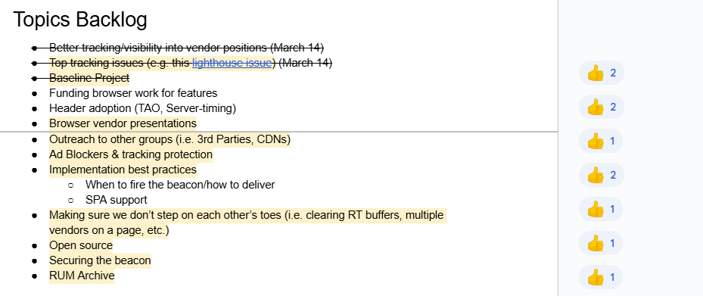
Next Meeting
Fri June 20th @ 10am EST
2nd (3rd this time!) Friday of each month
Topics?
Barry's Bytes (fetchLater, web-vitals v5?) (Barry Pollard)
Firefox interactionId (Nazim Can Altinova)
Unresponsive crash reports, Self Profiling (Issac Gerges)
(propose your topic here!)
Submit & Vote topics @ bit.ly/rumcg-agenda

Slide 5
Header Adoption
Background
Timing-Allow-Origin
Server-Timing
Benefits for
RUM Providers (automatically pick up additional metrics for customers)
Individual websites (ST allows peaking into back-end, TAO allows better Page Weight metrics)
Existing
Stats: HTTP Archive, mPulse(?), etc
CDN: CloudFlare, Akamai, Fastly, CloudFront, etc
Hosting providers: Shopify
Individual website
Goals
Increasing adoption
CDNS
Third-party resources - can highlight best performance / competitive advantage
Standardization of Server-Timing
Proposals

Slide 6
https://www.w3.org/TR/server-timing/
This specification enables a server to communicate performance metrics about the request-response cycle to the user agent. It also standardizes a JavaScript interface to enable applications to collect, process, and act on these metrics to optimize application delivery.

Slide 7
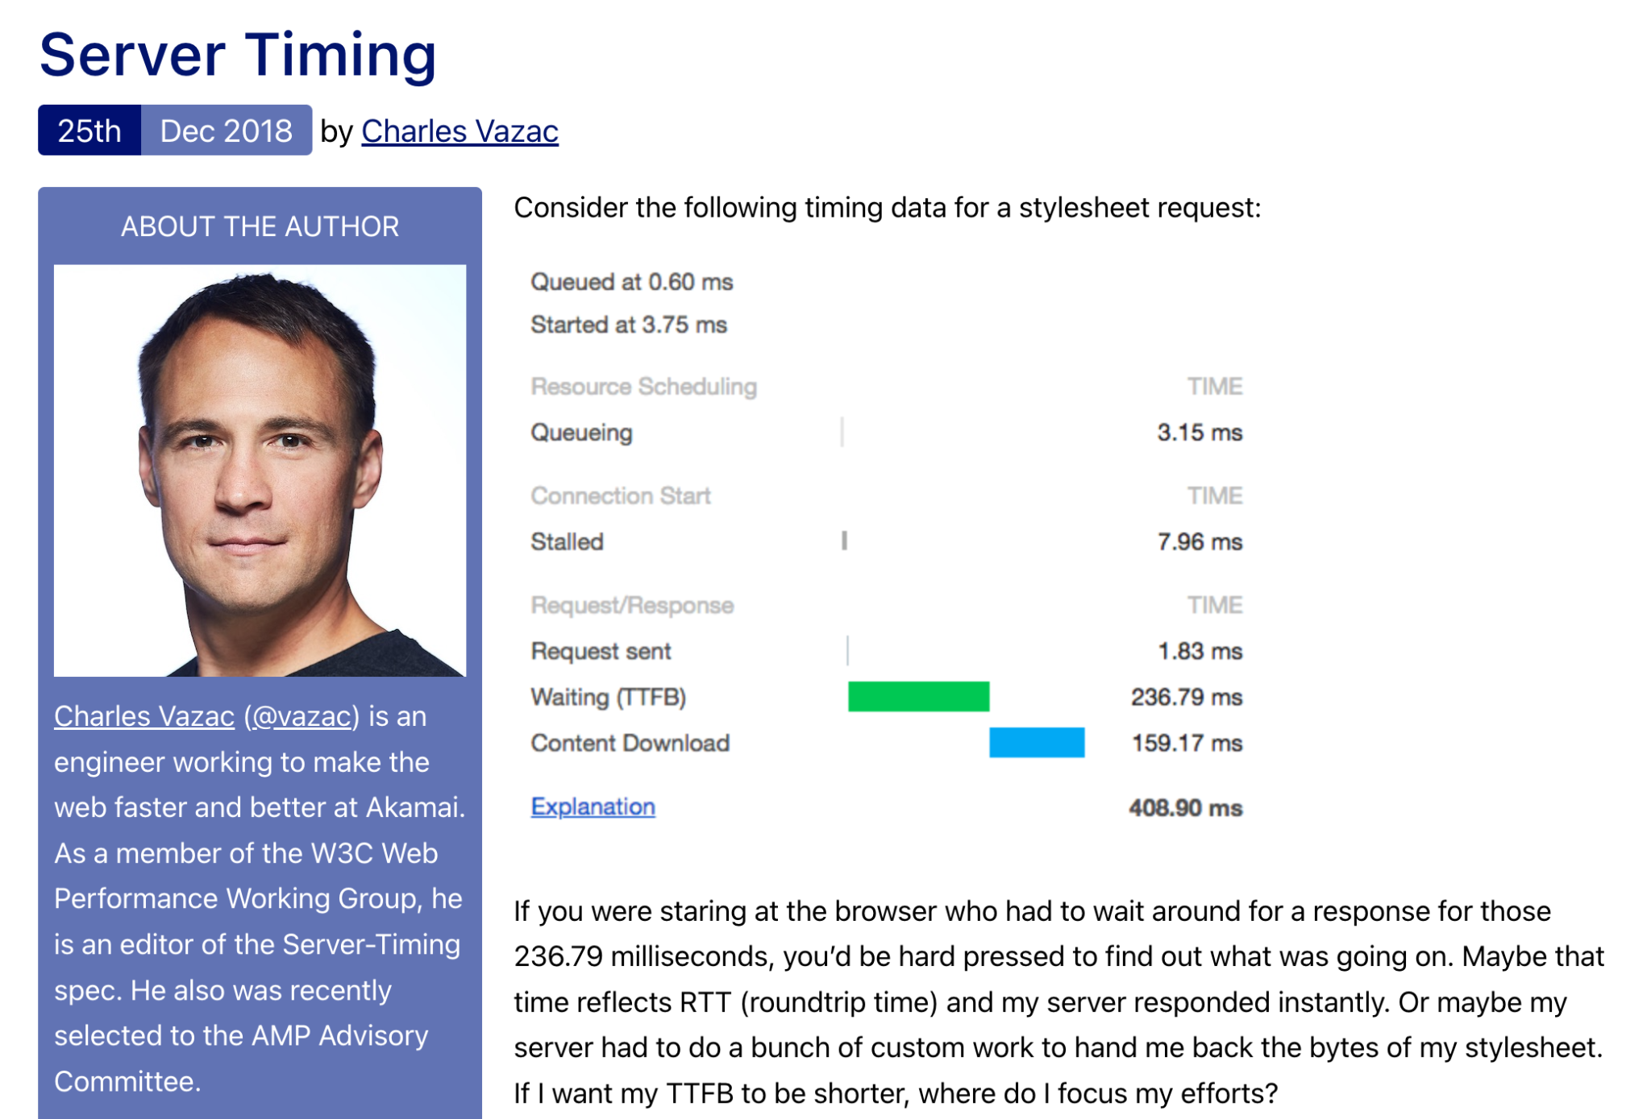

Slide 8
CDN use cases
Cache Hit/Cache Miss – Was the resource served from the edge, or did the request have to go to origin?
Latency – How much time does it take to deliver a packet from A to B. Also measured by round trip time (RTT).
Origin Time – How much time did the request spend from your origin? (In the case of a cache miss, this should be zero.)
Edge Time – How much time was spent at the CDN? This can include a lot of different service layers, not just serving from cache. For example, processing of web application firewall (WAF) rules, detecting bots or other malicious traffic though security services, and growing in popularity, edge compute.

Slide 9
Cache/Proxy Info in the Wild
Akamai (via mPulse)
server-timing: cdn-cache; desc=[HIT|MISS]
server-timing: edge; dur=[n]
server-timing: origin; dur=[n]
CloudFront (via console option)
server-timing: cdn-upstream-layer;desc="EDGE",cdn-upstream-dns;dur=0,cdn-upstream-connect;dur=69,cdn-upstream-fbl;dur=562,cdn-cache-miss,cdn-pop;desc="DEN52-P3",cdn-rid;desc="5McHcGf1pCMEZKUtTuHH-UI7Co2qq-817CJu_cD7oVUo9BmxBtpIHQ==",cdn-downstream-fbl;dur=563
CloudFlare (optional, via workers)
cf-cache-status: [HIT|MISS]
server-timing: cf_cache;desc=MISC,worker;dur=[n]
Fastly (optional, via VCL)
Server-Timing: time-start-msec;dur=1544705663920,time-elapsed;dur=0,fastly-pop;desc=LCY,hit-state;desc=HIT
Shopify
server-timing: processing;dur=15, db;dur=5, asn;desc="7922", edge;desc="DFW", country;desc="US", theme;desc="Prestige", pageType;desc="index", servedBy;desc="8jlx", requestID;desc="4ab33c3d-21e6-425a-9754-a6f42a27d36f"
server-timing: cfRequestDuration;dur=48.999786, earlyhints
via SpeedCurve blog

Slide 10
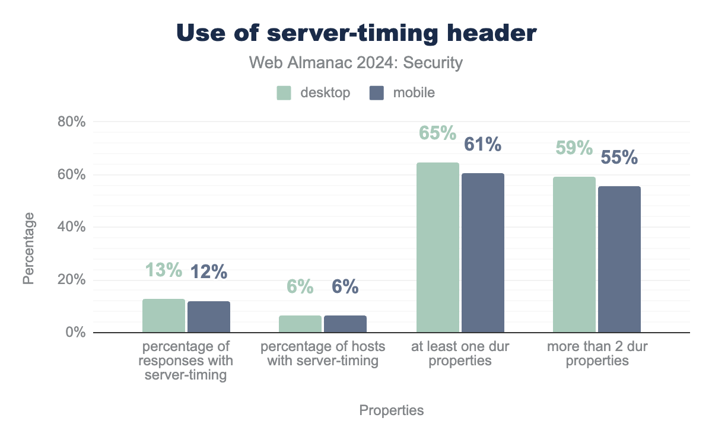
Market Adoption - ServerTiming
https://almanac.httparchive.org/en/2024/security

Slide 11
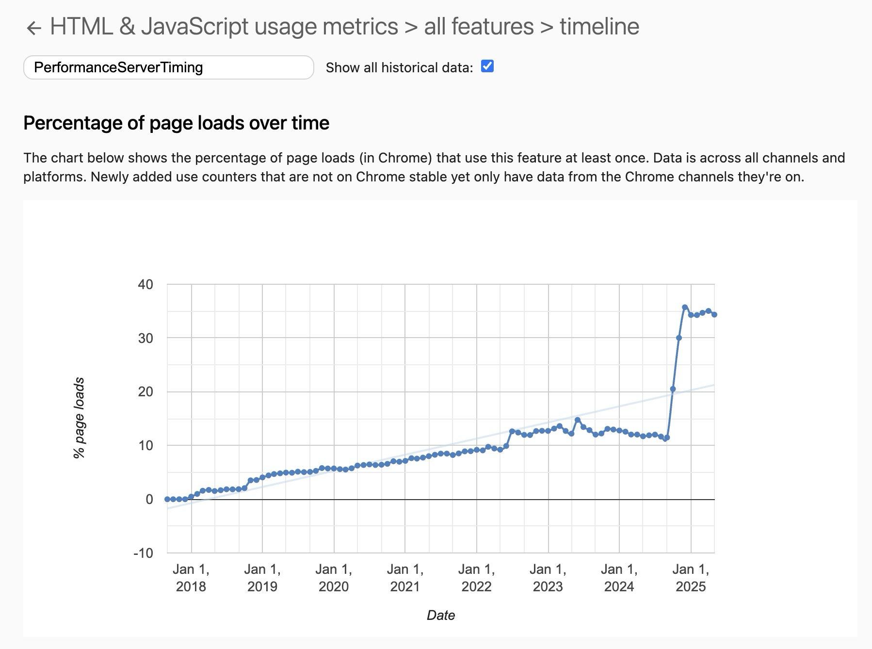
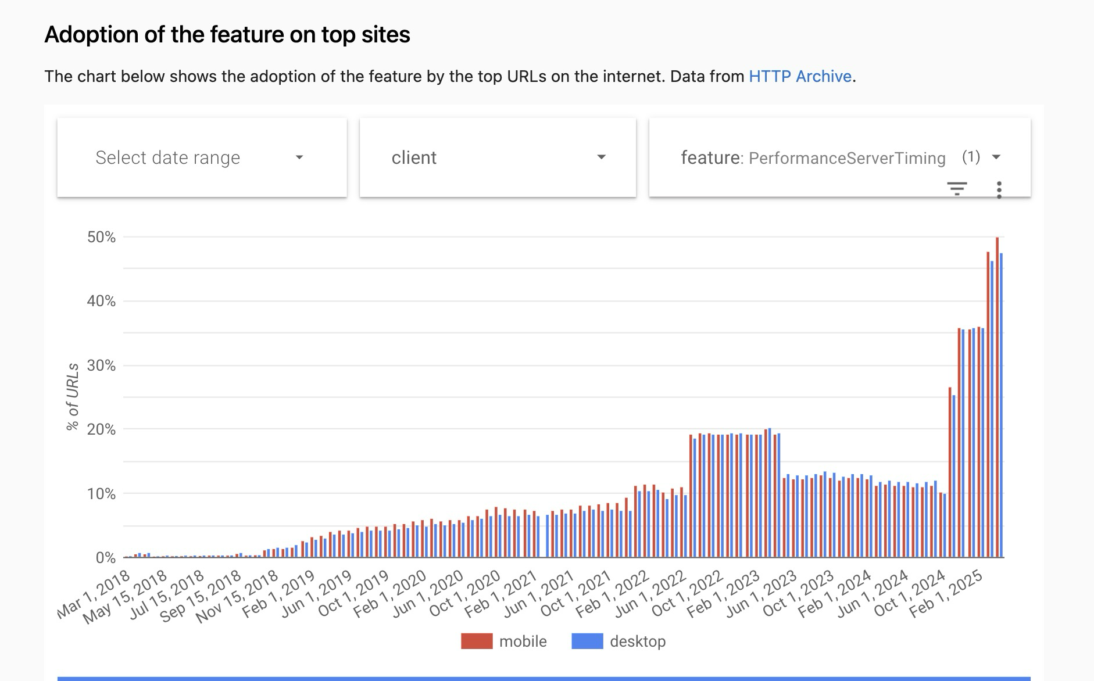
Market Adoption
Chrome Usage: reading Server Timing (via RUM) - 34%

Slide 12
Common Usage Patterns
n name description
7,477,954,019 cdn-cache HIT,MISS,REVALIDATE,
7,472,902,622 edge LAX,MIA,IAD,ORD,EWR,SJC,SEA,BNA,,ATL,DFW
1,820,031,999 origin
143,888,787 cld-fastly hit,miss
76,662,949 cfExtPri
30,405,740 cld-akam hit,hit-near,miss
29,949,816 content-info
11,719,359 cloudinary
5,636,156 cache EDGE,hit-front,PASS
5,214,501 proto h2,h3,h1
5,202,476 rcomp ae
5,108,605 pop TOJ,BRU,NRT,TYO,ITM,FRA,PAR,LCY,MAD,LHR,MUC,SIN,VIE,AMS,HKG,LON,MXP,LIN,ICN,LIS
3,804,892 cfCacheStatus HIT,DYNAMIC,EXPIRED,MISS
2,643,364 cld-cloudflare hit,miss
2,607,629 inner
2,592,911 cfReqDur
2,167,172 total-response
1,993,652 cfRequestDuration
1,963,095 cfHdrFlush
1,479,460 imagery
1,479,460 imageryFetch
920,919 cdntime
920,919 clientrtt
920,919 clienttt
817,759 ef
817,119 crt
via 2025 mPulse RUM data (so biased towards Akamai CDN)

Slide 13
Other Use Cases?
Other platform providers?
RUM Support?
mPulse
RUM Vision
SpeedCurve
??

Slide 14
What about TAO?
The Timing-Allow-Origin HTTP response header field can be used to communicate a policy indicating origin(s) that may be allowed to see values of attributes that would have been zero due to the cross-origin restrictions.

Slide 15
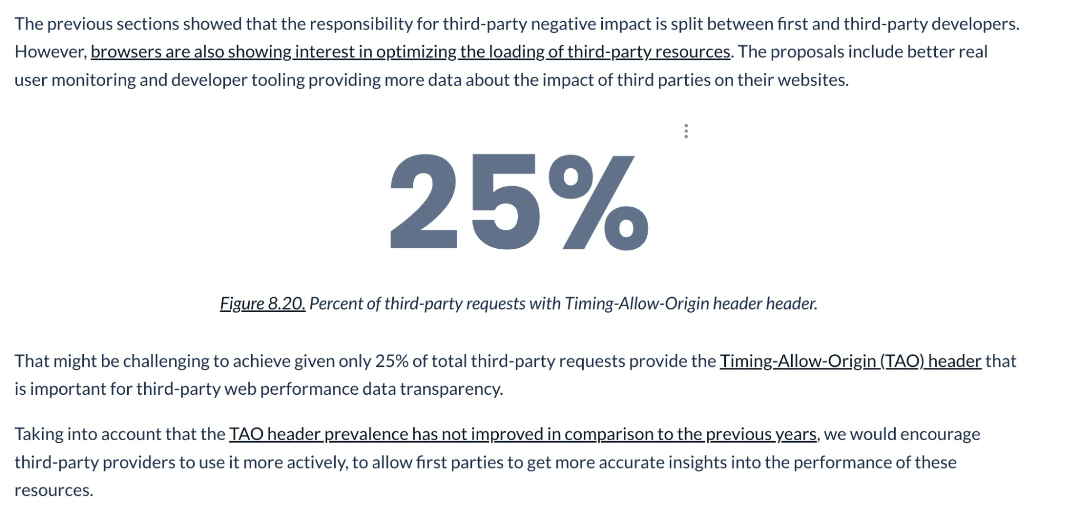
Market Adoption - TAO
https://almanac.httparchive.org/en/2022/third-parties#fig-20

Slide 16
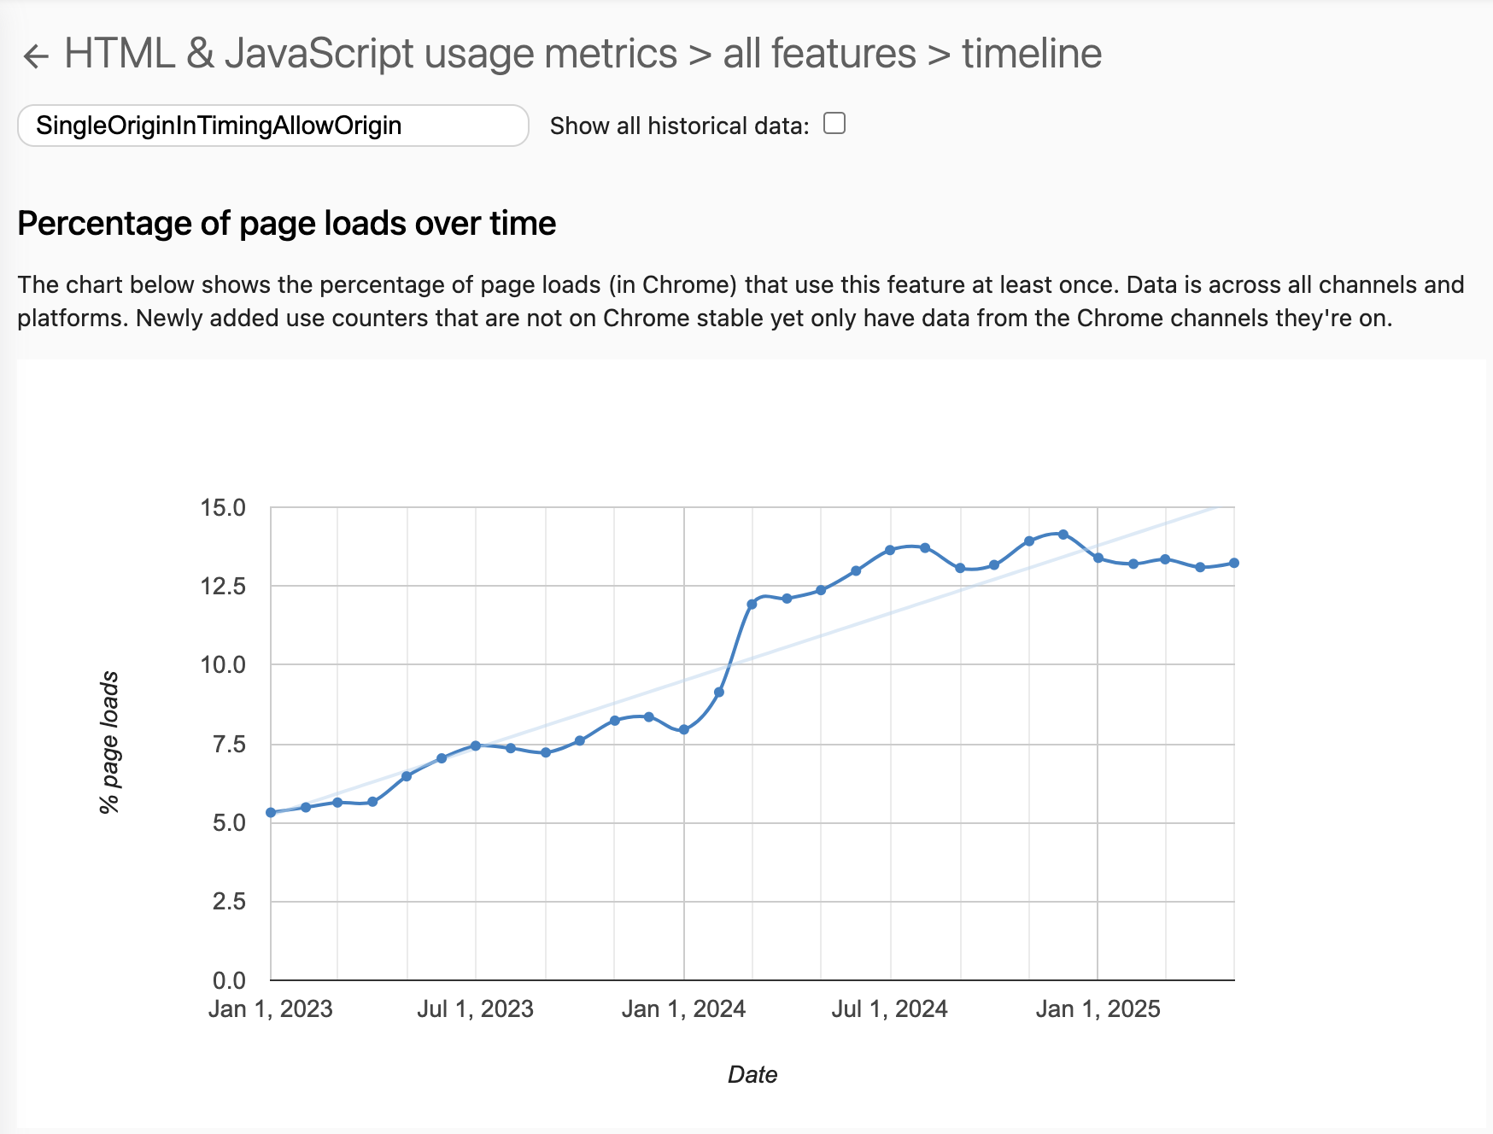

Slide 17
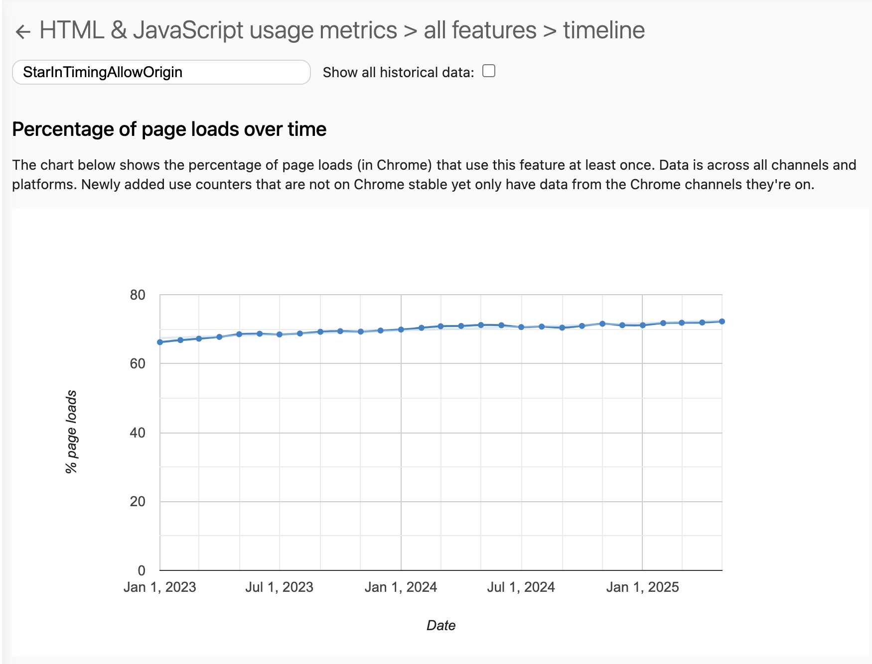

Slide 18
Call for Help
Adoption?
Timing-Allow-Origin
Server-Timing
CDNs: Naming conventions?
https://www.speedcurve.com/blog/server-timing-time-to-first-byte/
e.g. cdn-cache; edge; origin

Slide 19
Ideas
RUMCG best practices documents
TAO for Third-Parties
ServerTiming Naming Conventions or Registry
Use-Case documents for both of the above
RUM Archive list of top third-parties not including Timing-Allow-Origin
File RUMCG issues for top 3P not using TAO
HTTP Archive Third-Parties chapter update (in 2022 but not in 2024)
WebPerfWG anything we can change? IFRAME opt-in?

