Slide 1
RUM Community Group
2026-02-11 Edition

Slide 2
Agenda
Agenda for March / 2026
Container Timing
Barry's Bytes / Chrome update (-Barry)

Slide 3
Logistics
Meeting cadence
2nd Wednesday of the Month
60 minutes
10am ET
Agenda Document
(bit.ly/rumcg-agenda)
Google Meet for Meetings
sub to rumcg-participants for invites
Chat on Web Performance Slack #w3c-rum-community-group
(invites)
public-rumcg@w3.org
(for discussions)
RUM CG Github Repo
github.com/w3c-cg/rum
Group details
Links
Meeting minutes
RUM CG Tracking Project
github.com/orgs/w3c-cg/projects/1
Meeting Minutes via fireflies.ai
AI summary + transcript will be posted after
Full video recording also available

Slide 4
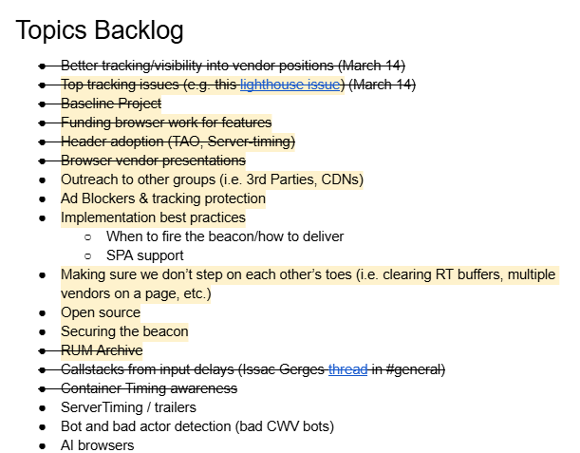
Next Meeting
Wed March 11th @ 10am EST
2nd Wednesday of each month
Topics?
Interop 2026 updates
CWV across the browsers
TAO / ServerTiming header adoption updates
CPU Perf API
Unused preload RUM - Yoav
Submit & Vote topics @ bit.ly/rumcg-agenda

Slide 5
let's go

Slide 6
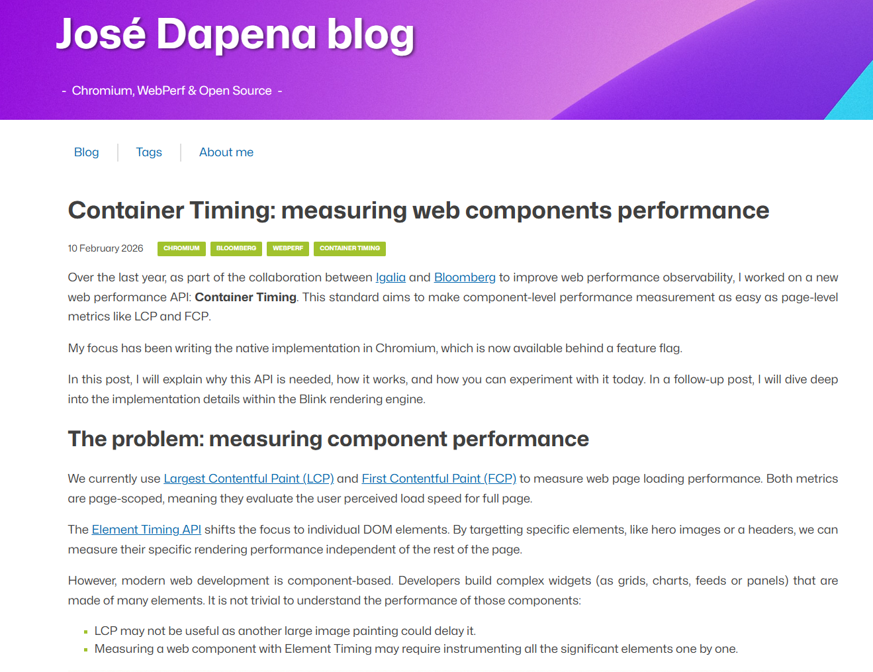
Container Timing

Slide 7

Barry's Bytes
Safari INP reporting slower than actually
https://webkit.org/b/305251
Not currently in 26.3 beta so might not be fixed until 26.4?
144 - Speculation Rules prerender_until_script origin trial
https://developer.chrome.com/blog/prerender-until-script-origin-trial
145 - Soft Navigations in Performance traces -
https://bsky.app/profile/tunetheweb.com/post/3mdzlhcq5tc2d
145 - Use of CssPixels in LayoutShift API
https://chromestatus.com/feature/5155103518228480
can affect if you have any CSS debugging tolls
145 - Add presentationTime/paintTime
https://chromestatus.com/feature/5162859838046208
https://web.dev/blog/lcp-and-inp-are-now-baseline-newly-available?hl=en#are_there_any_differences_in_the_implementations
146 - Device Memory Changes
https://chromestatus.com/feature/6330376953921536

