Slide 1
RUM Community Group
2026-03-11 Edition

Slide 2
Agenda
Interop 2026 updates (Nic)
Unused Preload RUM (Yoav)
Core Web Vitals (CWV) across the browsers (All)
Server-timing header adoption updates (Cliff)

Slide 3
Logistics
Meeting cadence
2nd Wednesday of the Month
60 minutes
10am ET
Agenda Document
(bit.ly/rumcg-agenda)
Google Meet for Meetings
sub to rumcg-participants for invites
Chat on Web Performance Slack #w3c-rum-community-group
(invites)
public-rumcg@w3.org
(for discussions)
RUM CG Github Repo
github.com/w3c-cg/rum
Group details
Links
Meeting minutes
RUM CG Tracking Project
github.com/orgs/w3c-cg/projects/1
Meeting Minutes via fireflies.ai
AI summary + transcript will be posted after
Full video recording also available

Slide 4
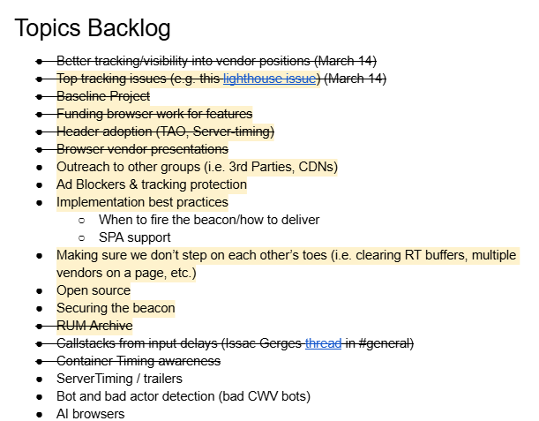
Next Meeting
Wed April 8th @ 10am EST
2nd Wednesday of each month
Topics?
Bot and bad actor detection (bad CWV bots)
AI browsers
Submit & Vote topics @ bit.ly/rumcg-agenda

Slide 5
here we go yo

Slide 6
Interop 2026
https://web.dev/blog/interop-2026 (blog)
https://wpt.fyi/interop-2026 (dashboard)
Carryover Evaluation for Core Web Vitals
https://github.com/web-platform-tests/interop/issues/1173
> Thank you for proposing Carryover evaluation for Core Web Vitals for Interop 2026.
> We want to let you know it was not selected to be part of Interop this year.
Not included for 2026:
CLS
scheduler
requestIdleCallback
Speculation Rules

Slide 7
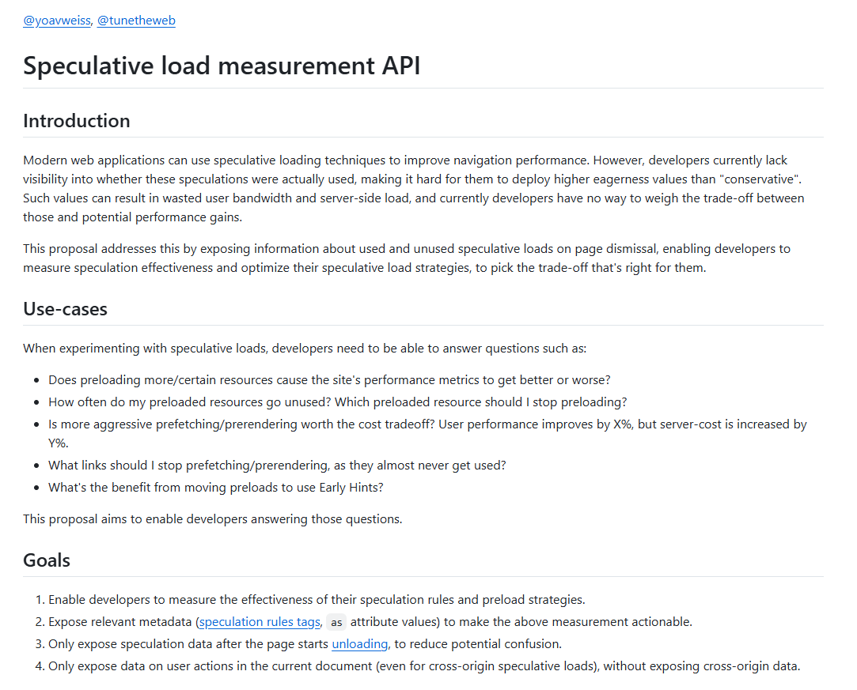
Unused Preload RUM
https://github.com/WICG/speculative_load_measurement/blob/main/README.md

Slide 8
CWV Across Browsers
RUM Archive Analysis:
https://colab.research.google.com/drive/1y11hnB_me7kIEbM1di-0h0pWCpM9v_wY?usp=sharing

Slide 9
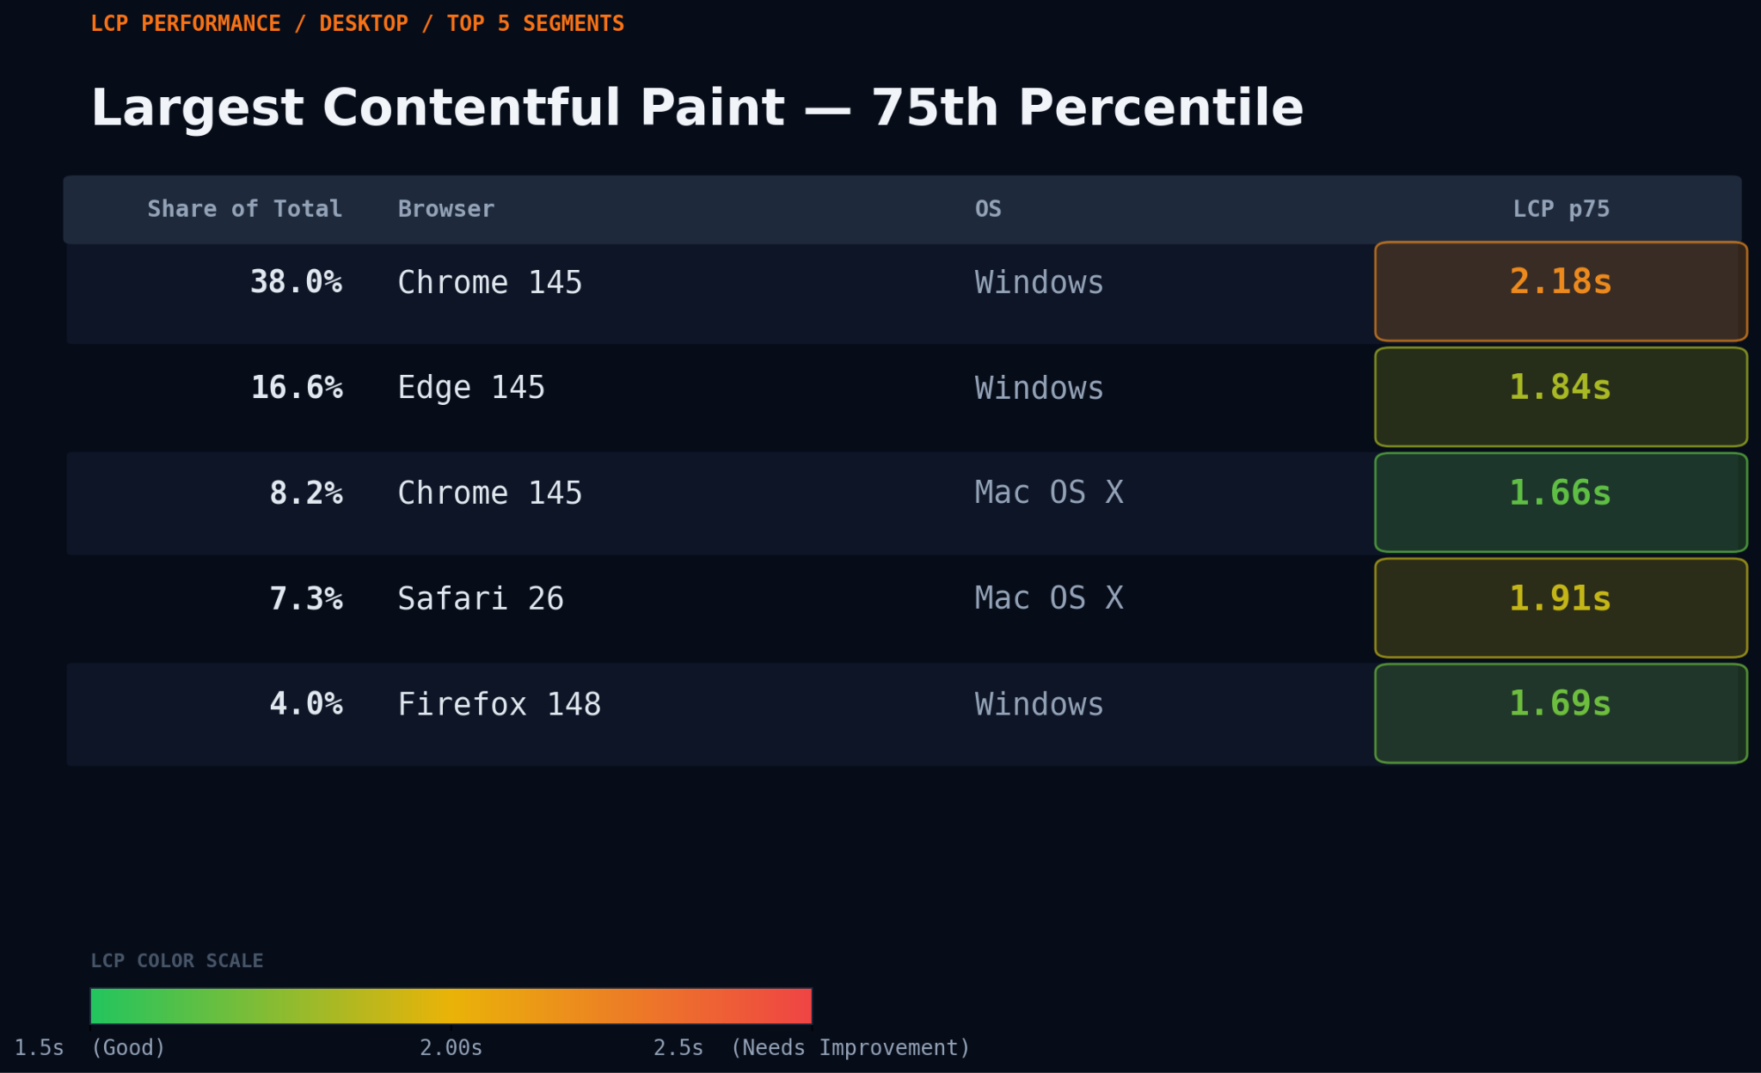
SpeedCurve - Desktop

Slide 10
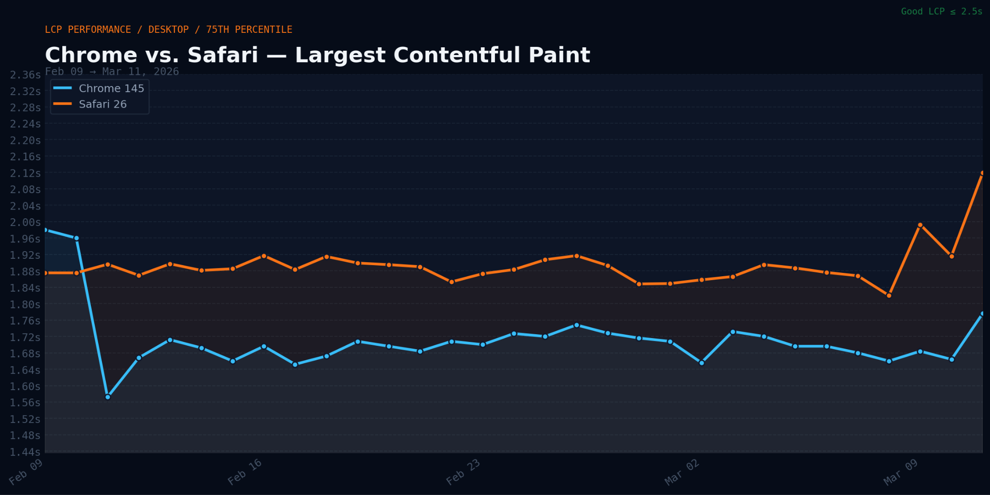
1.91s
1.66s
SpeedCurve - Desktop (Mac OS X)

Slide 11
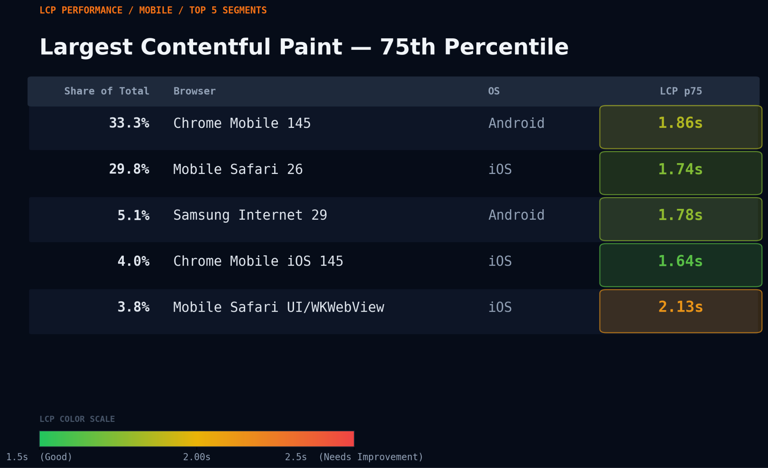
SpeedCurve - Mobile

Slide 12
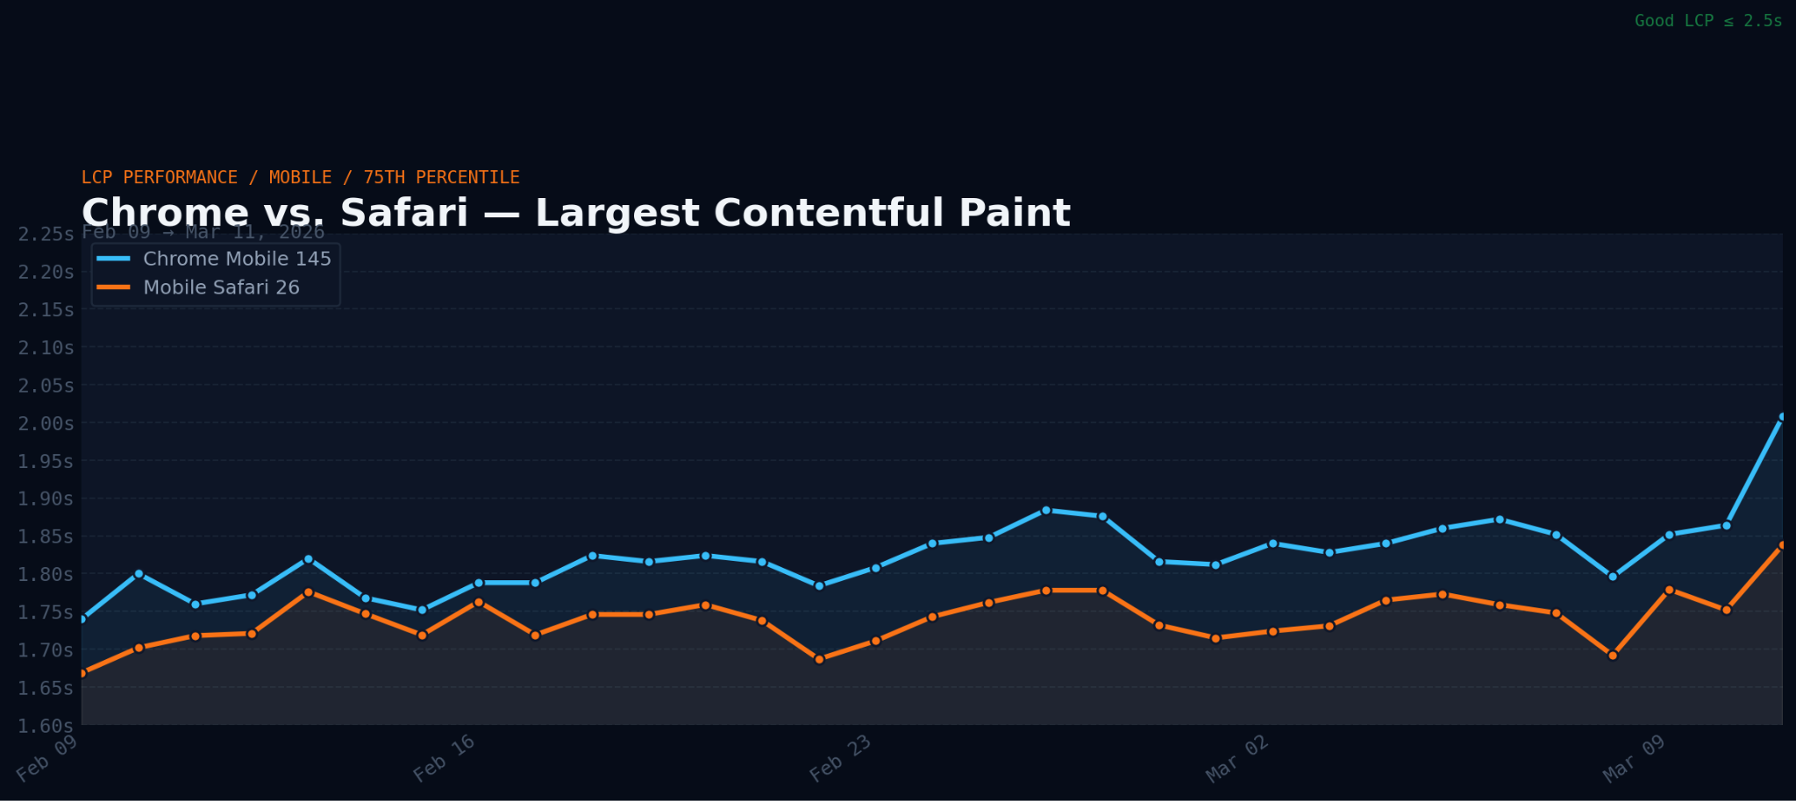
SpeedCurve Data - LCP on Mobile
1.86s
1.74s
SpeedCurve - Mobile

Slide 13
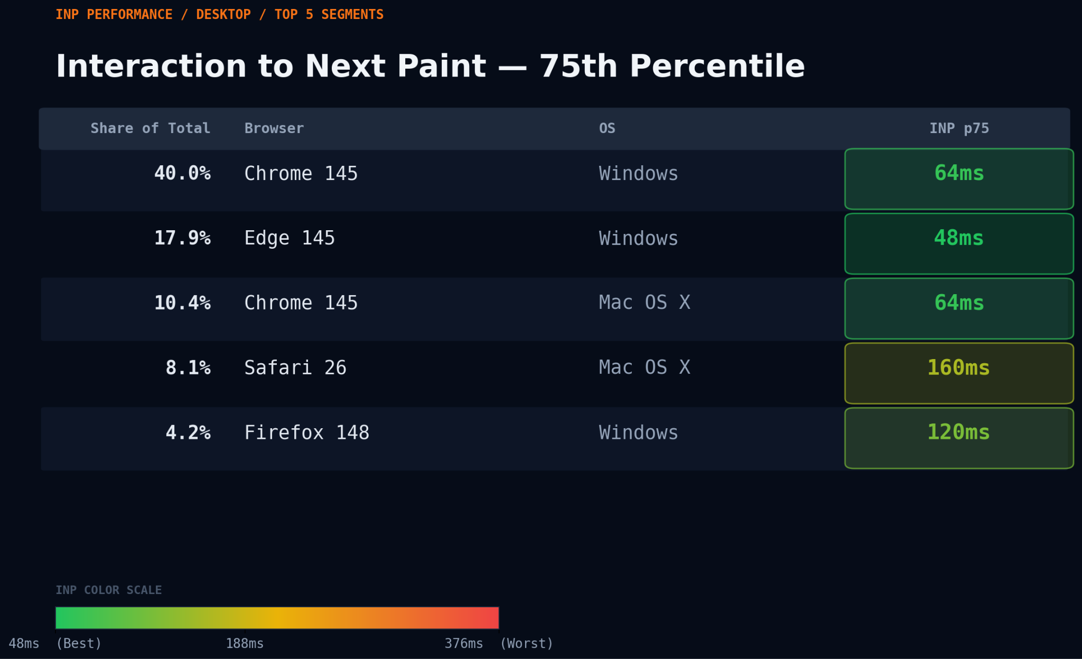
SpeedCurve - Desktop

Slide 14
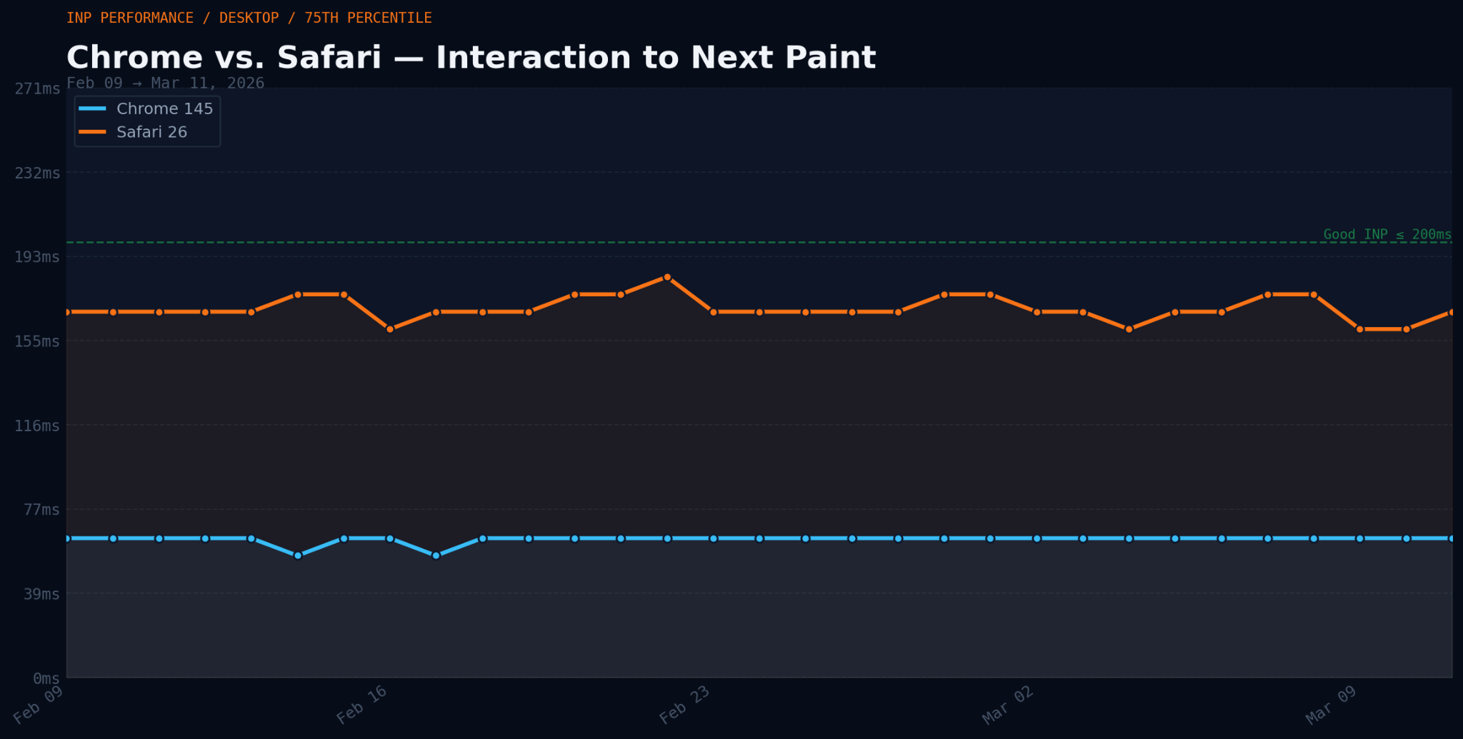
SpeedCurve Data - INP on Desktop
160ms
64ms
SpeedCurve - Desktop (Mac OS X)

Slide 15
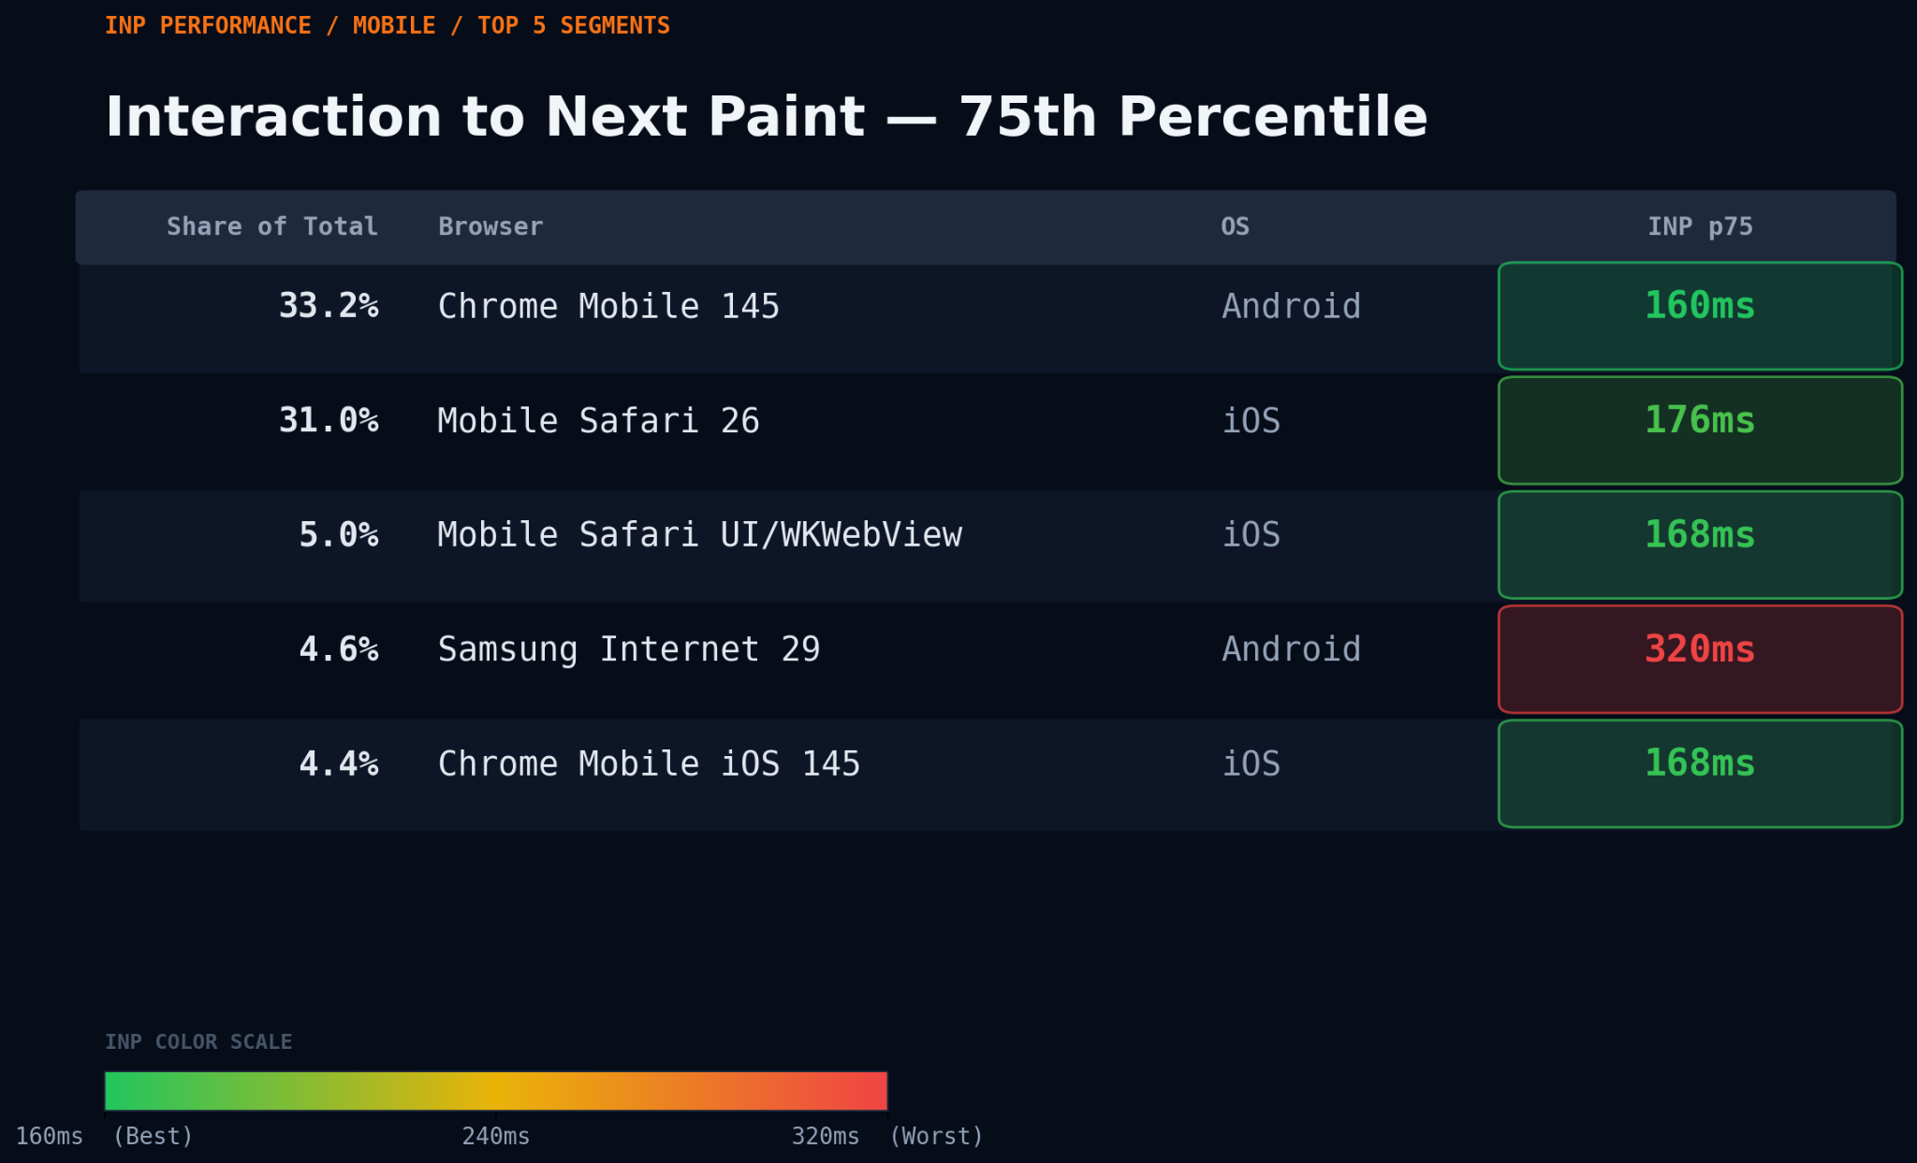
SpeedCurve Data - INP on Mobile
SpeedCurve - Mobile

