Slide 1
RUM
Community Group
2026-08-12 Edition

Slide 2
Agenda
Keeping an Eye On:
  Declarative Performance Observer
  NavigationTiming landing attribute
Barry's Bytes
ABC revisit - Agentic Browsers

Slide 3
Logistics
Meeting cadence
  2nd Wednesday of the Month
  60 minutes
  10am ET
Agenda Document
  (bit.ly/rumcg-agenda)
Google Meet for Meetings
  sub to rumcg-participants for invites
Chat on Web Performance Slack #w3c-rum-community-group
  (invites)
public-rumcg@w3.org
  (for discussions)
RUM CG Github Repo
  github.com/w3c-cg/rum
  Group details
  Links
  Meeting minutes
RUM CG Tracking Project
  github.com/orgs/w3c-cg/projects/1
Meeting Minutes via fireflies.ai
  AI summary + transcript will be posted after
  Full video recording also available

Slide 4
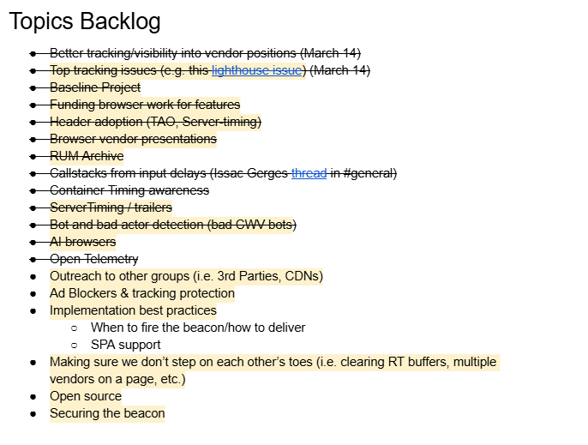
Next Meeting
Wed September 9th @ 10am EST
  2nd Wednesday of each month
Topics?
  ?
Submit & Vote topics @ bit.ly/rumcg-agenda

Slide 5
Keepin' an Eye On

Slide 6
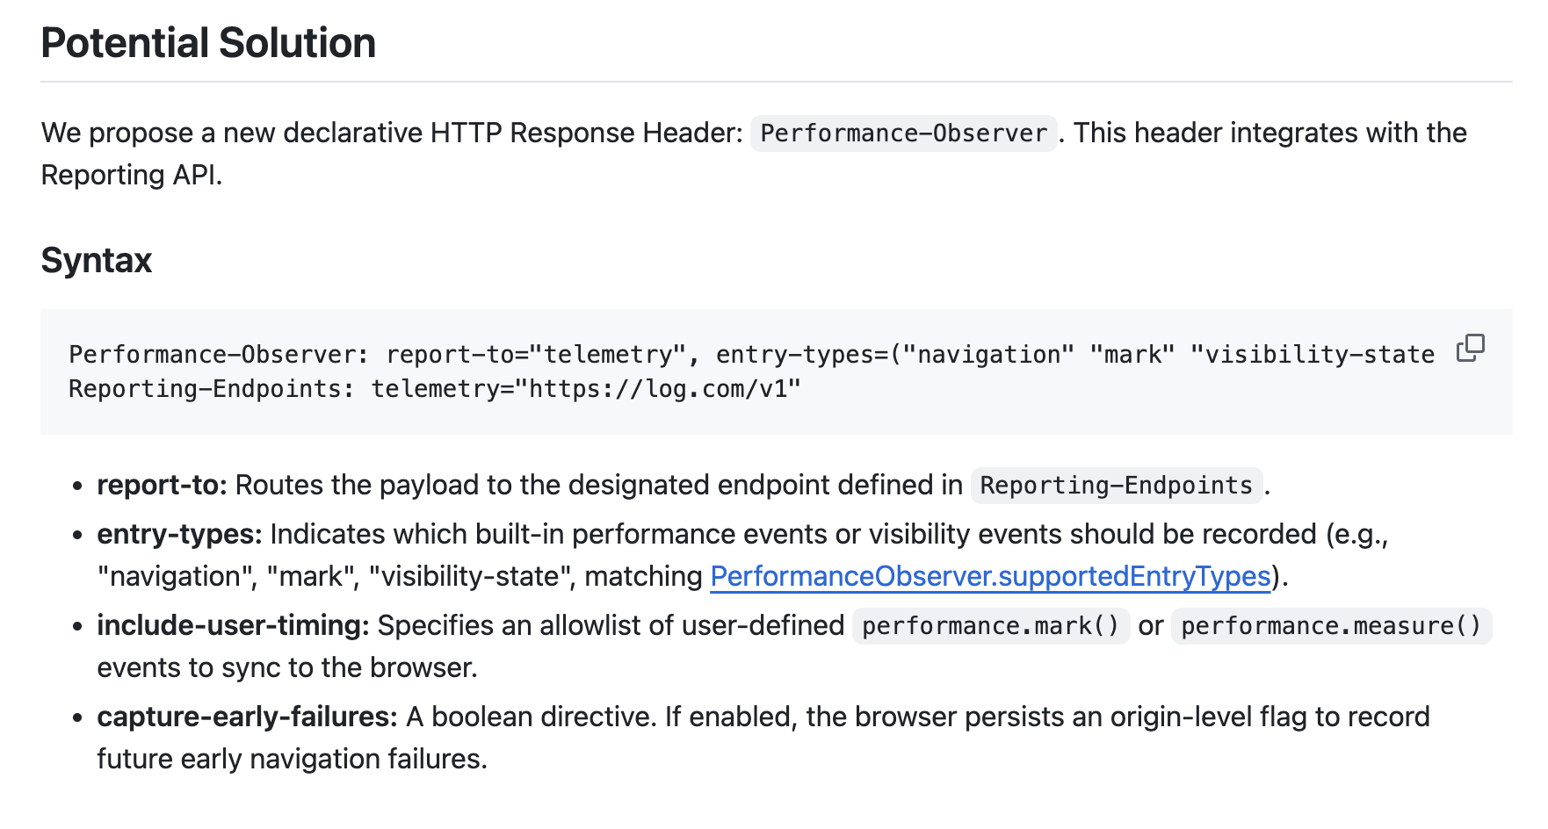
Declarative Performance Observer
https://github.com/explainers-by-googlers/declarative-performance-observer
Presented to WebPerfWG June 18

Slide 7
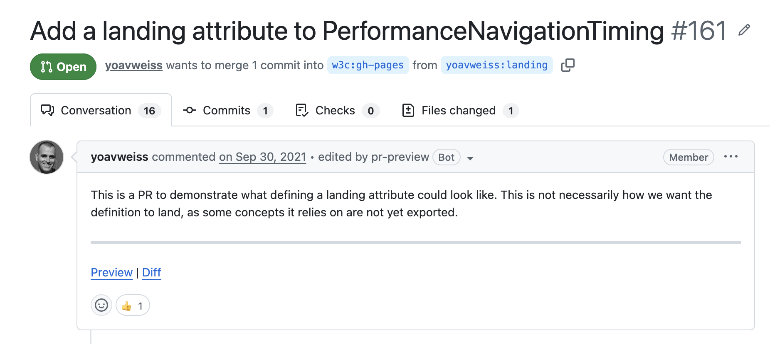
NavigationTiming landing attribute
https://github.com/w3c/navigation-timing/pull/161

Slide 8


Slide 9
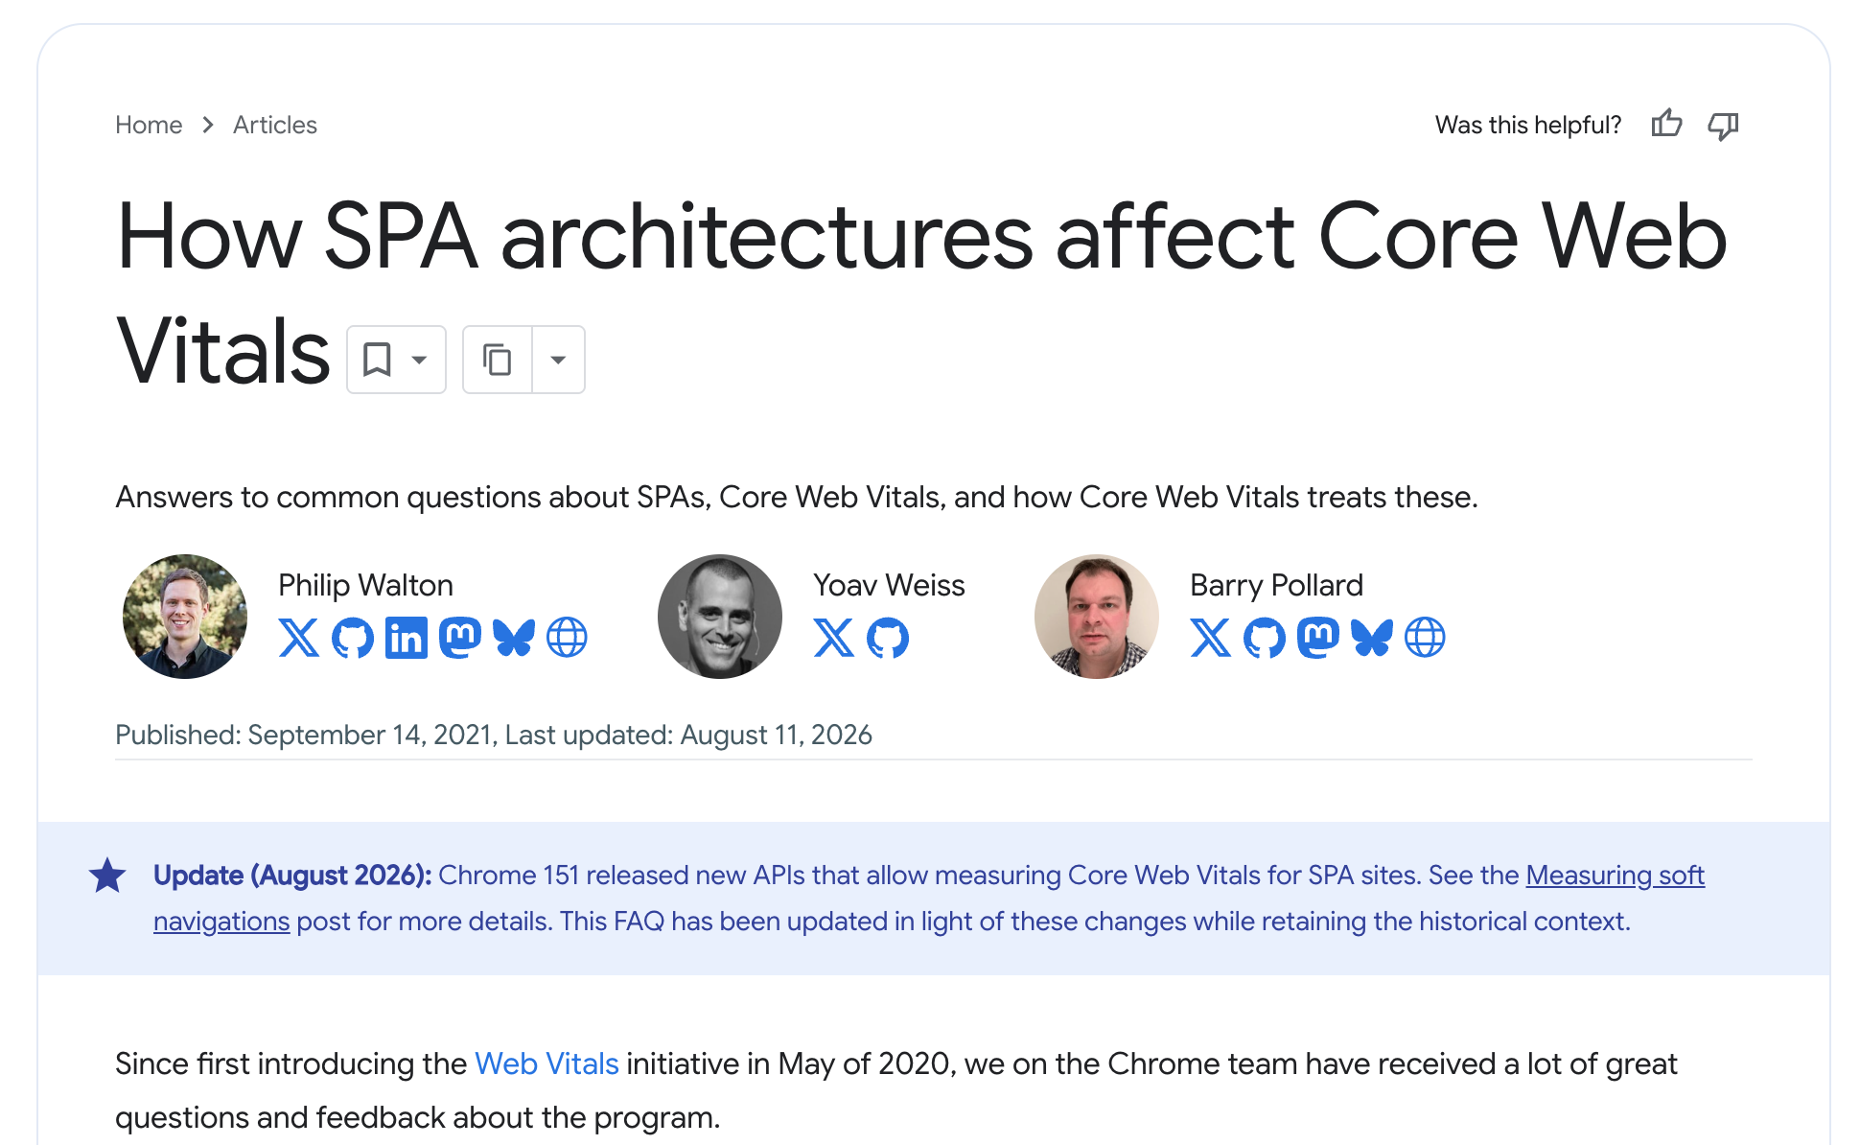
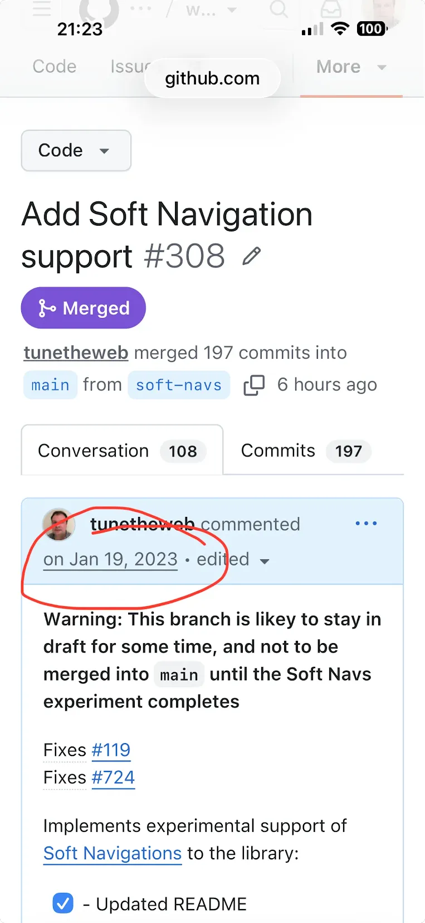
Soft Navigations have landed!

Slide 10
Soft Navigations - what was the issue again?
Traditional multi-page web site
The first load and follow up loads are counted.
Single-page application
Only the first page load is reported to RUM and CrUX
Average reported to RUM/CrUX: 5s
4s
5s
Average reported to RUM/CrUX: 3.17s
3s
3s
3s
3s
3s
Actual average: 1.66s
1s
1s
1s
1s
1s
First
Load
Product Page 1
Product Page 2
Product Page 3
Product Page 4
Product Page 5
First
Load
Product Page 1
Product Page 2
Product Page 3
Product Page 4
Product Page 4

Slide 11
Soft Navigations - what was the issue again?
Traditional multi-page web site
The first load and follow up loads are counted.
Single-page application
Only the first page load is reported to RUM and CrUX
Average reported to RUM/CrUX: 5s
4s
5s
Average reported to RUM/CrUX: 3.17s
3s
3s
3s
3s
3s
Actual average: 1.66s
1s
1s
1s
1s
1s
First
Load
Product Page 1
Product Page 2
Product Page 3
Product Page 4
Product Page 5
First
Load
Product Page 1
Product Page 2
Product Page 3
Product Page 4
Product Page 4
Metrics are incomplete/wrong.
Blind to soft navigation load time.
Issues are attributed to the wrong page.

Slide 12
Soft Navigations - what is it?
Two new performance APIs landed, unflagged, in Chrome 151 (stable July 28th):
  PerformanceSoftNavigation
    Triggers when a soft nav happens. Allows slicing CLS and INP.
  InteractionContentfulPaint
    Triggers when an interaction causes a paint. Allows measuring soft LCP.
  MDN documentation in progesss (content#45053, compat data#30195).
Web-vitals v6 includes support
  Opt in! Not on by default.
  Need to include URL when beaconing back metrics.
  Does not include support for measuring yourself (though TTFB could be used for that).
CrUX support is coming
  No ETA… yet.
  Experimental at first.

Slide 13
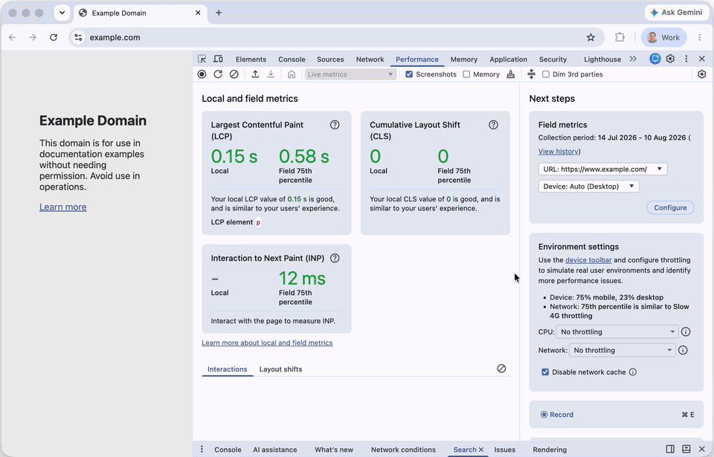
Soft Navigations - DevTools support
Chrome 144
added Nav* and LCP* markers to traces.
Chrome 152
adds support to
Live Metrics
(on by default).
Chrome 153
adds support to trace Insights
(on by default).

Slide 14

Soft Navigations caveats

Slide 15
Soft Navigations - caveats
Chromium only (including Edge, Opera, Vivaldi…etc.)
  More on this later...
The browser’s definition of “soft navigation” may differ from yours. Or your frameworks.
MPAs may have soft navigations
Hard Navs metrics change
  LCP does not change. But blended LCP changes the overall “score”.
  INP is only measured up until the first soft nav. Better attribution to the page that has INP issues.
  CLS is only measured up until the first soft nav. Better attribution to the page that has CLS issues.
Soft Navs are different
  Content is already loaded. Resources are not requested.
  Measures from click start (includes event handling).

Slide 16
What to do about non-supporting browsers?
Can fake it
This has been tried before with limited success…
LCP very difficult (impossible?) to measure this way.
INP possible.
CLS basically non-issue (Chromium only).
Can accept Chromium is now different
Not ideal, but was the case for a long time (and still is for CLS).
Can ignore until better cross-browser compatibility
Not recommended, valuable data in there now, you’d miss out on.
No ETA on when/if this will happen.
Can measure both where supported
Measure SPA for better attribution and to match CrUX.
Measure non-SPA to understand differences between browsers.

Slide 17
What to do about non-supporting browsers?
Can fake it
This has been tried before with limited success…
LCP very difficult (impossible?) to measure this way.
INP possible
CLS basically non-issue (Chromium only).
Can accept Chromium is now different
Not ideal, but was the case for a long time (and still is for CLS).
Can ignore until better cross-browser compatibility
Not recommended, valuable data in there now, you’d miss out on.
No ETA on when/if this will happen
Can measure both where supported
Measure SPA for better attribution and to match CrUX
Measure non-SPA to understand differences between browsers
Try it!
If it’s valuable, then let the other browsers know!

Slide 18
Soft Navigations - Questions and Feedback
Are your customers asking for this?
Are you planning on using this?
If not, why not?
What are you doing for the cross-browser story?
What else can we (Chrome) do for this? In Chrome, in web-vitals, in Tooling, in docs, in specs?
Any bugs/issues discovered?

Slide 19
Agentic Browser RUM

Slide 20
Agentic Browser RUM
Slides @ https://docs.google.com/presentation/d/1s9kuZMgddIvafvyRczdxmDvjDSwm3aqA74PuOCmB6dQ/

