Slide 1
RUM Community Group
2025-03-14 Edition

Slide 2
Agenda
Logistics
Next Meeting
Agenda
Baseline updates
Interop 2025 overview
RUMCG Issue Tracking

Slide 3
Logistics
Meeting cadence
2nd Friday of the Month
60 minutes
10am ET
Agenda Document
(bit.ly/rumcg-agenda)
Google Meet for Meetings
(invites - Google Group for invites only)
Chat on Web Performance Slack #w3c-rum-community-group
(invites)
public-rumcg@w3.org
(for discussions)
RUM CG Github Repo (NEW)
github.com/w3c-cg/rum
Group details
Links
Meeting minutes?
RUM CG Tracking Project
github.com/orgs/w3c-cg/projects/1

Slide 4
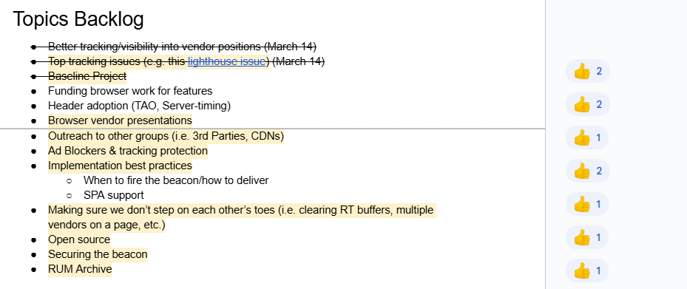
Next Meeting
Fri April 11th @ 10am EST
2nd Friday of each month
Topics?
Funding browser work for features
Header adoption (Timing-Allow-Origin, Server-Timing)
Submit & Vote topics @ bit.ly/rumcg-agenda

Slide 5
Baseline
Presentation from Tony Conway (Google), Gilberto Cocchi (Google)

Slide 6
Interop 2025
Announcements
https://webkit.org/blog/16458/announcing-interop-2025/
https://web.dev/blog/interop-2025
https://www.igalia.com/chats/interop2025
https://hacks.mozilla.org/2025/02/interop-2025/
What is it?
Collaboration between browser vendors and other platform implementors to provide users and web developers with high quality implementations of the web platform.
Each year we select a set of focus areas representing key areas where we want to improve interoperability.

Slide 7
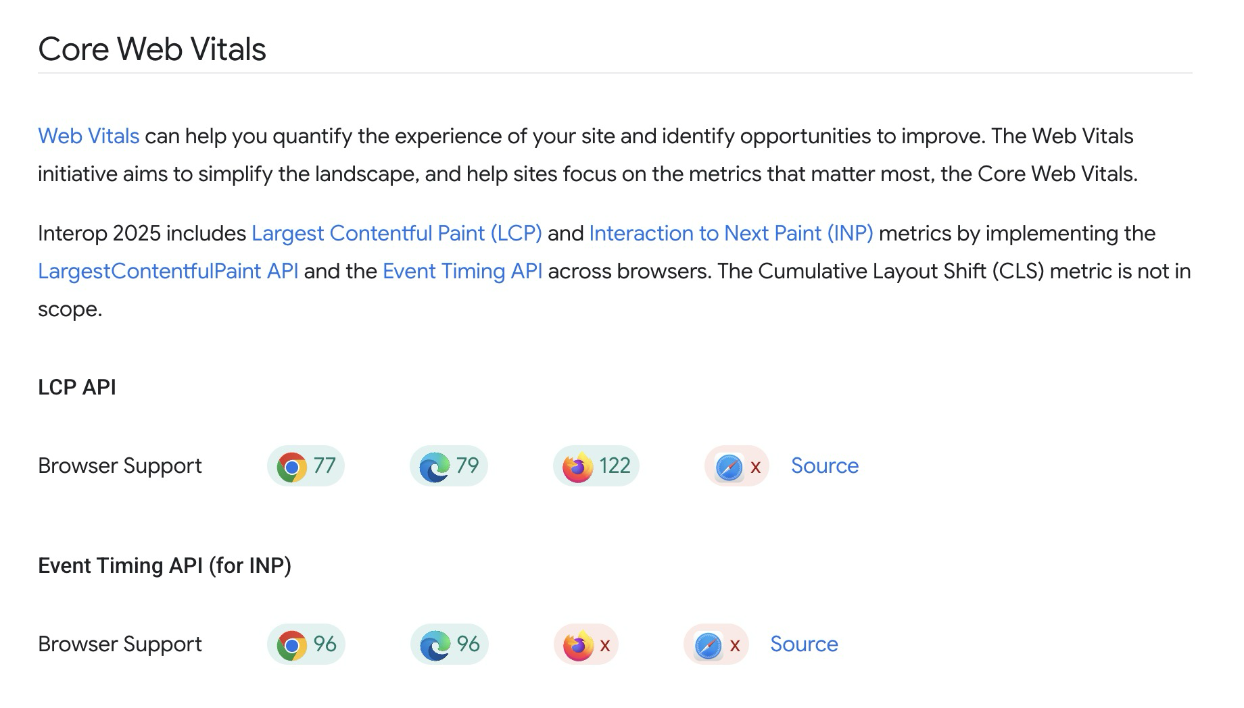
Interop 2025

Slide 8
RUMCG Issue Tracking
What do we (RUMCG) care about?
Track ideas, bugs
Outputs could be:
Bring in-development ideas to WICG or WebPerf WG
Push for development of non-interoperable features (e.g. funding)
Proposal with Github Projects
Solicitation of Issues and Ideas to Include

Slide 9
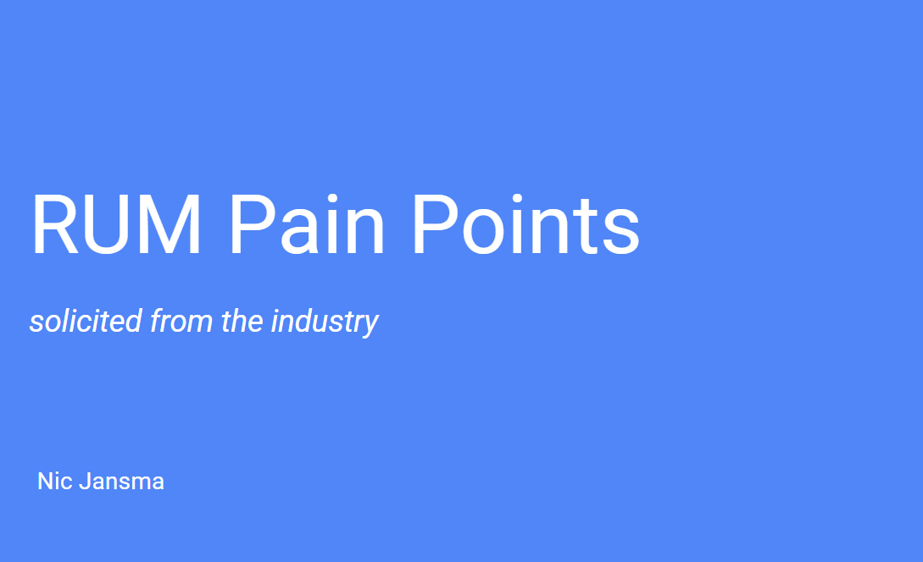
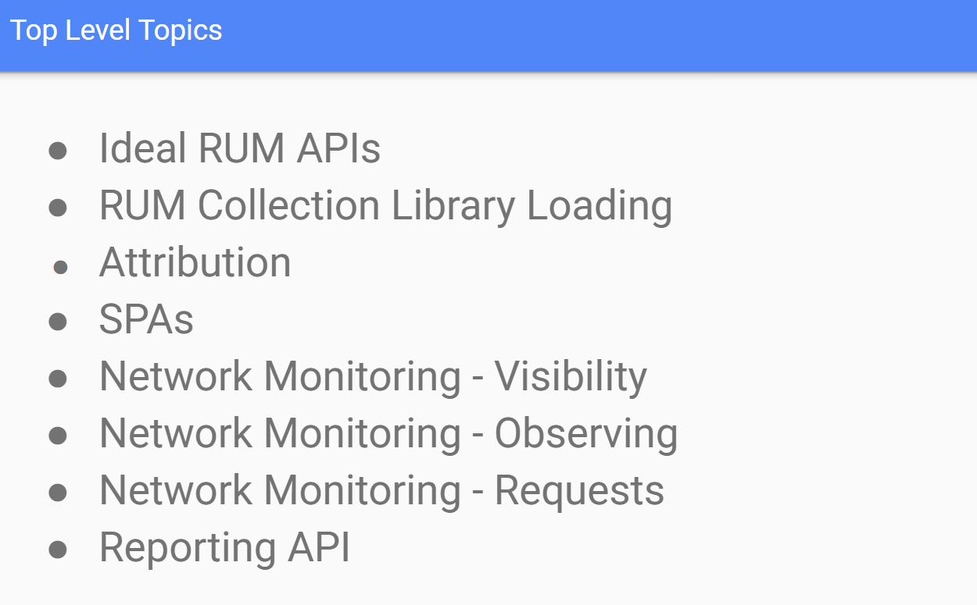
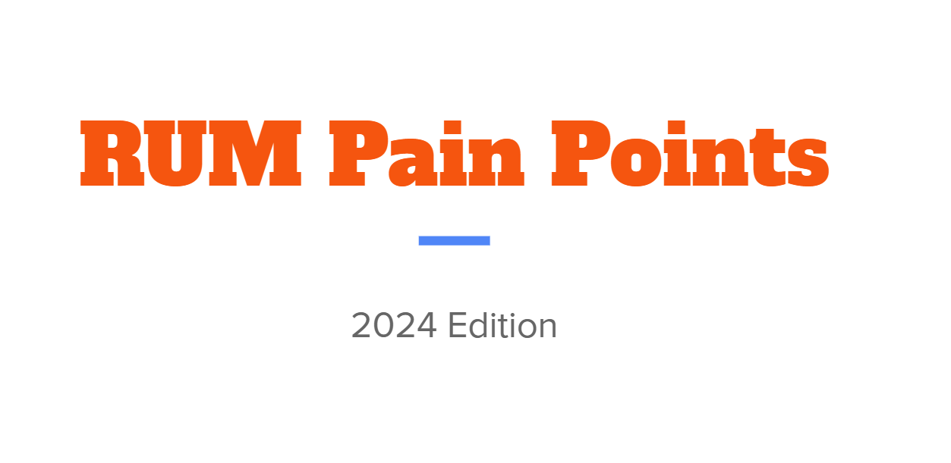
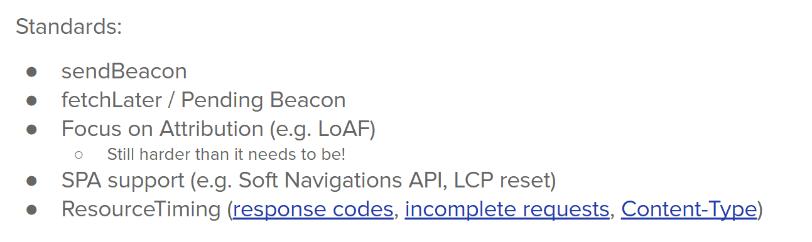
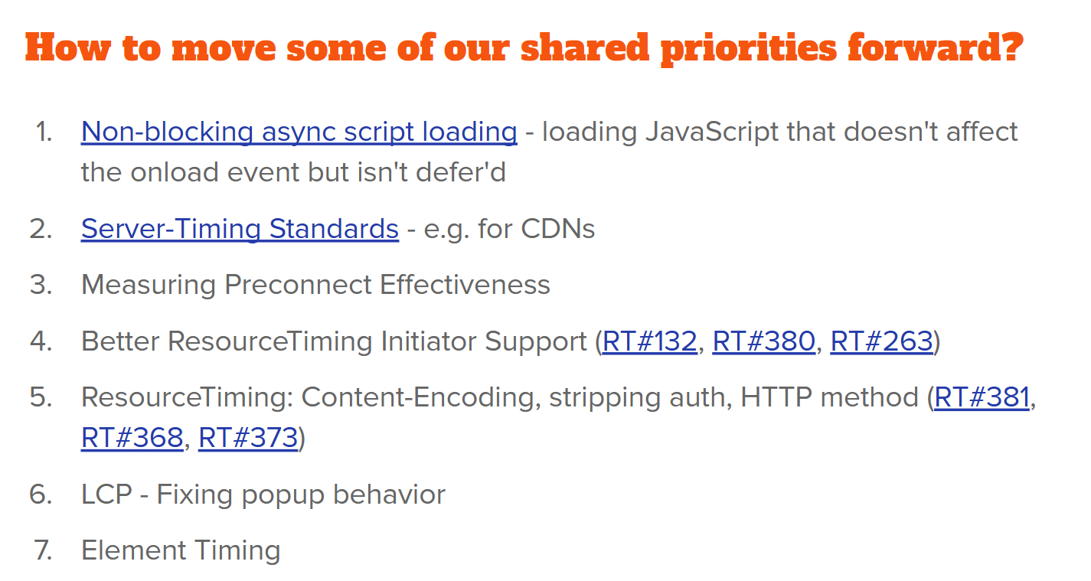
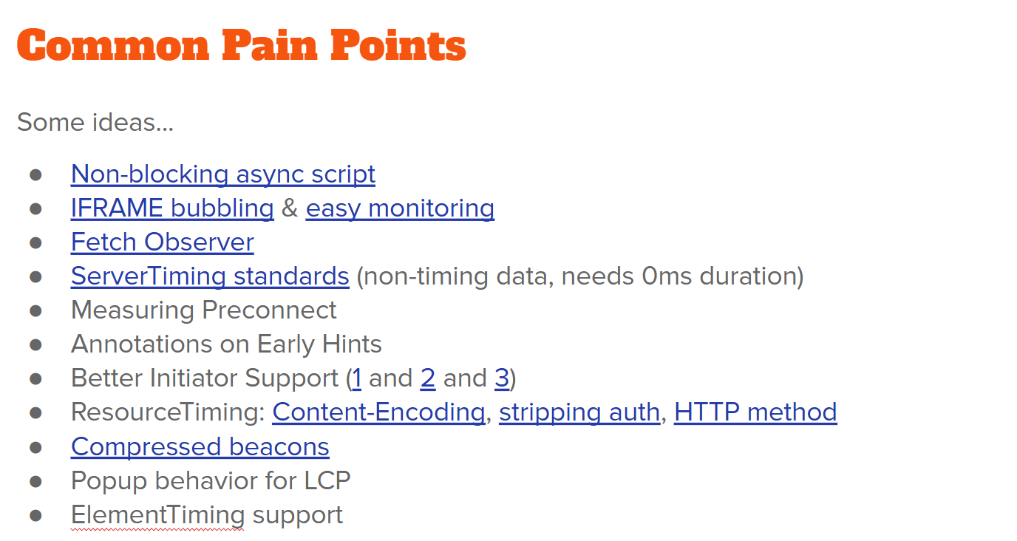
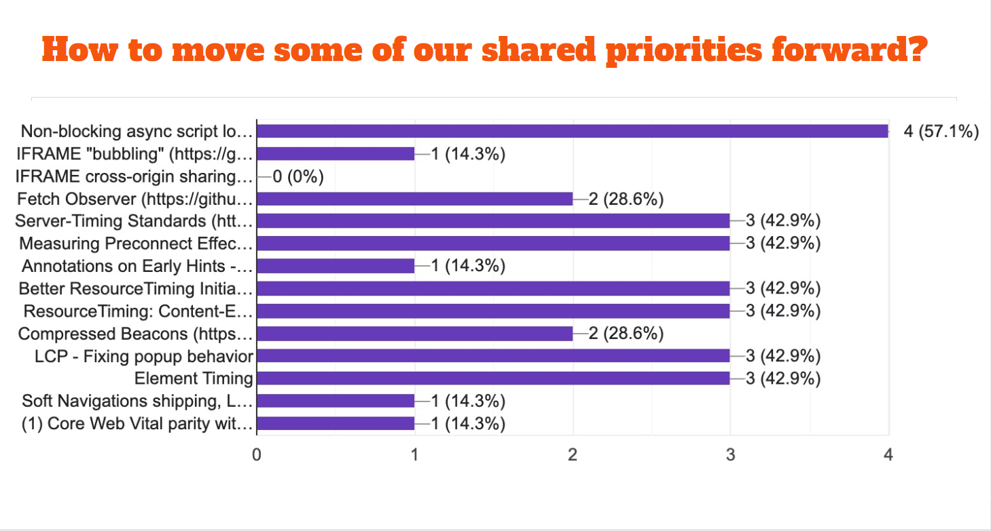

Slide 10
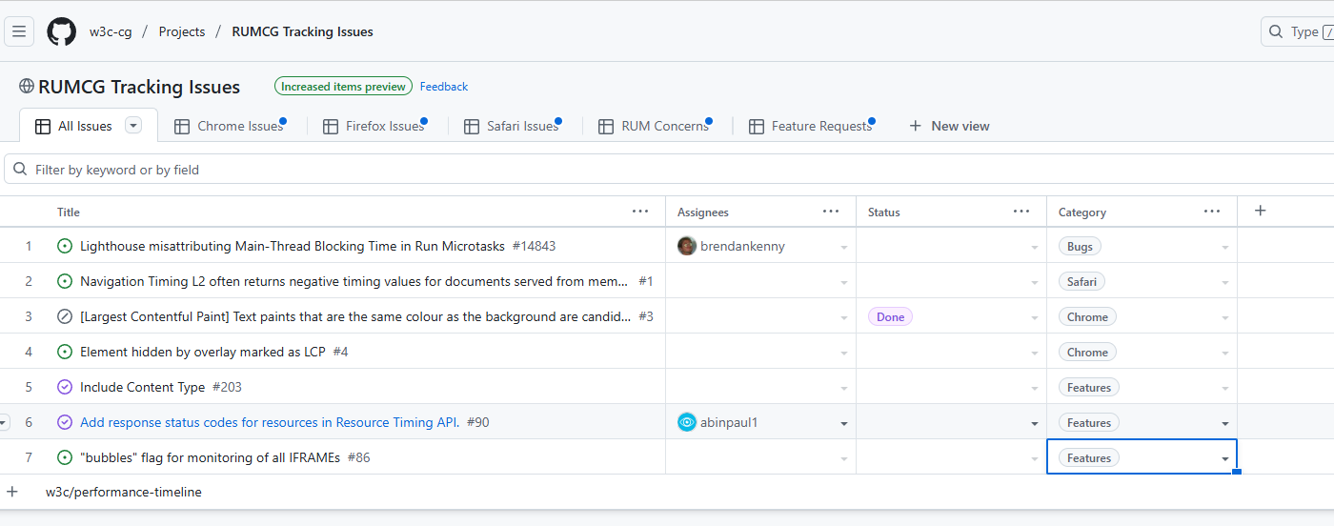
Github Project

