Slide 1
RUM CG
Agentic Browsers
2026-09-09

Slide 2
Agenda
What are Agentic Browsers?
What can they do?
How can they be detected?
What does it matter for RUM?

Slide 3
What are Agentic Browsers?
AI browser: Adds features like summaries, writing help, chat sidebar
Agentic browser: LLM + browser + agent, and the LLM can navigate, click, fill forms, and complete multi-step tasks on behalf of a user without the user driving each action
  Consumer: ChatGPT Atlas (retired) / Desktop, Perplexity Comet, Dia, Opera Neon, Fellou
  Browser Features / Extensions: Chrome Auto Browse (Gemini), Microsoft Edge Browse with Copilot, Google Project Mariner (Chrome extension), Claude for Chrome, Composite, MultiOn (extension mode)
  Developer Frameworks: Browser Use, Stagehand, Skyvern, AutoGen, Eko (Fellou's framework)
  Cloud Browser Infrastructure: Browserbase, Steel, Hyperbrowser, Anchor Browser, Scrapybara, Bright Data Agent Browser
Human in the loop
Full autonomous

Slide 4
Where do they run?
 | Examples | Detection Difficulty
Local (user's machine) | Atlas, Comet, Dia, Chrome Auto Browse, Edge Copilot, Claude for Chrome, Composite, Polar, Strawberry, Opera Neon | Hardest — real IP, real TLS, real cookies, real fingerprint
Cloud (remote sandbox) | ChatGPT Agent Mode, Manus, Browserbase, Steel, Runner H, Claude Computer Use | Easier — datacenter ASN, potential TLS mismatches, framework signals

Slide 5
How do they view and act?
 | Agents | Detection Implication
DOM/Accessibility tree | Browser Use, Stagehand, Comet (sidebar), Atlas (sidebar) | Faster, leaves DOM access traces
Screenshots (vision) | ChatGPT Agent Mode, Claude Computer Use, Runner H | Pause-act-pause timing pattern; no DOM parsing
Hybrid (both) | Manus, Claude for Chrome, Comet (agent mode), Atlas (agent mode) | Mixed signals

Slide 6
What can they do?
Navigation
  Clicking, scrolling, typing, switching tabs
Forms
  Contact, government, insurance, job applications
Shopping
  Comparing prices, browsing multiple sites, checkout
Data Migration
  Extract/convert information

Slide 7
How can they be detected?
User-Agent
  Most do not add identifiers to UA string or Client Hints (look like Chromium)
  Some only send tokens to the mothership, e.g. ChatGPTBrowser to chatgpt.com
  Google-Agent, Manus AI notable exceptions
Web Bot Auth
  Only ChatGPT Atlas (discontinued) + Desktop Agent mode, Google Chrome Auto Browse / Google-Agent, Anchor Browser
Referral
  May change the referrer to e.g. https://www.perplexity.ai
Often have ad / gtm / RUM blockers
  Intentionally trying to hide that traffic from observability

Slide 8
How can they be detected? pt 2
JavaScript APIs
  navigator.webdriver (most disable this)
  HeadlessChrome in UA (most disable this)
  CDP (Runtime.enable) (most disable this)
Behavior
  Mouse / pointer
  Vision timing
  Typing patterns
  Scrolling precision
  DOM mutations during agent mode (overlays, highlights, progress indicators)
Inconsistencies
  Sec-Fetch-*
  Client Hints
  Header Ordering
Fingerprinting
  Network / TLS / H2
  IP / ASN

Slide 9
How much traffic is from Agentic Browsers?
?

Slide 10
What does it matter for RUM?
Many of these are actively blocking ads, GTM, third-party scripts
  RUM gets less visibility
Do Agents (or their users) care how long it takes to load a webpage?
  More tolerant of page load delays / web vitals than a human?
Web Bot Auth?
  More suitable for Crawlers, not as much for Agents?
  No JavaScript / RUM API?

Slide 11
What should the RUM community do?
Stick our heads in the sand?
Advocate for Agentic browsers to self-identify?
  JavaScript API / events (could support multi-modal human<>agent handoff)
    Best for human-in-the-loop agentic browsers where control goes back and forth
      canBeAgenticDriven()
      isBeingAgenticDriven()
  User-Agent token (also available via JavaScript)
    Best for fully-autonomous browsers
  Client Hint header (also available via JavaScript)
    Best for fully-autonomous browsers

Slide 12
Speed of User Experience
Sergey Chernyshev

Slide 13

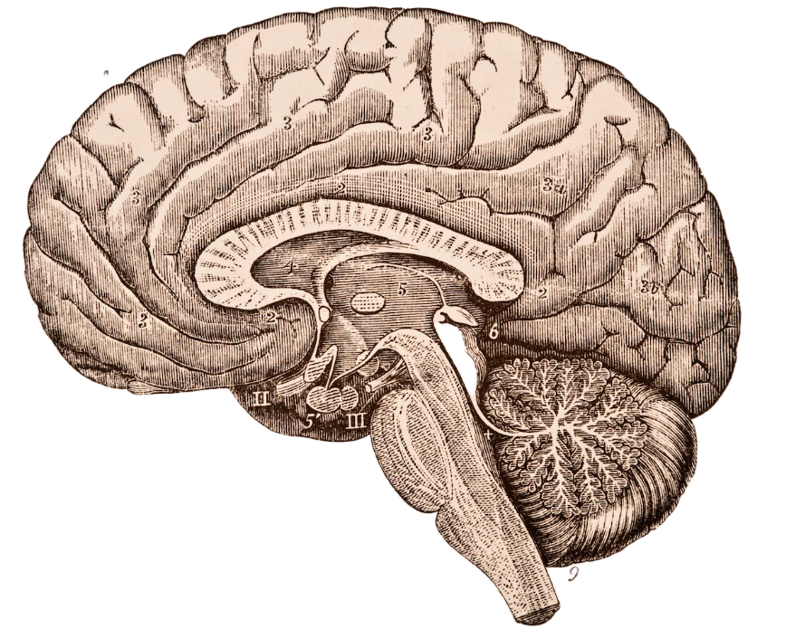
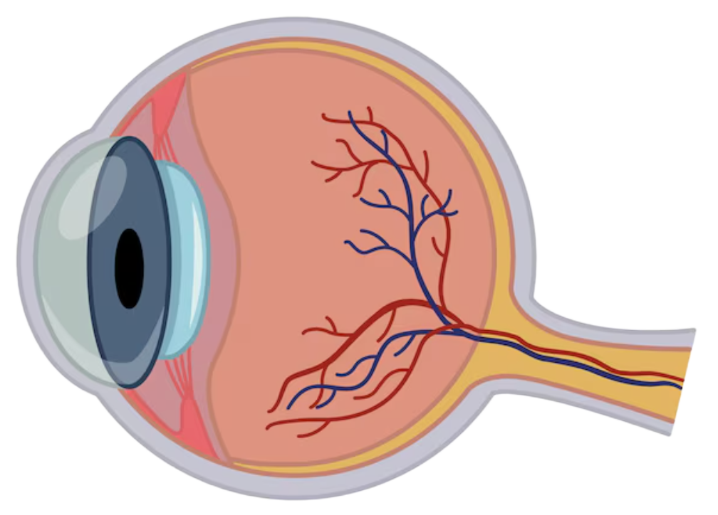


Users
younger
RUMCG members
INTERNET

Slide 14


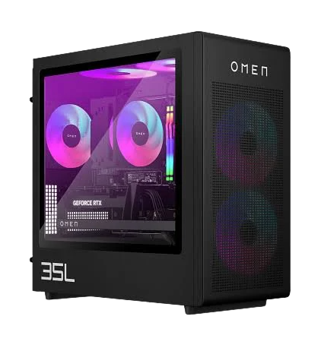

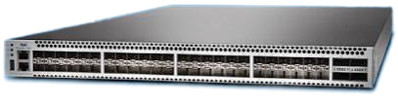

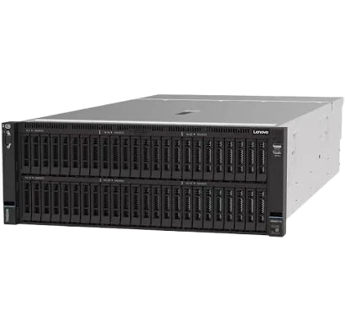
WEB
Notes:
Steve Souders: High Performance Web Sites - 14 Rules For Faster Pages:
https://www.youtube.com/watch?v=arz3jhMfUx0

Slide 15
Bots
WEB

Slide 16
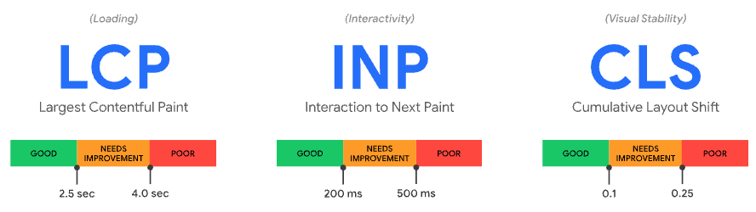
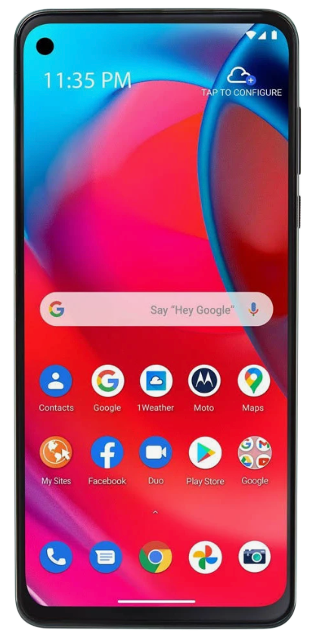
WEB
Notes:
Core Web Vitals - first published
https://web.dev/articles/vitals#core-web-vitals

Slide 17



AI
WEB

Slide 18
WEB

Slide 19
User Experience
?
INTERNET

Slide 20

User Experience
INTERNET

Slide 21

User Experience
SUX
INTERNET

