Slide 1
RUM
Community Group
2026-09-09 Edition

Slide 2
Agenda
Agentic Browsers
Interop 2027

Slide 3
Logistics
Meeting cadence
  2nd Wednesday of the Month
  60 minutes
  10am ET
Agenda Document
  (bit.ly/rumcg-agenda)
Google Meet for Meetings
  sub to rumcg-participants for invites
Chat on Web Performance Slack #w3c-rum-community-group
  (invites)
public-rumcg@w3.org
  (for discussions)
RUM CG Github Repo
  github.com/w3c-cg/rum
  Group details
  Links
  Meeting minutes
RUM CG Tracking Project
  github.com/orgs/w3c-cg/projects/1
Meeting Minutes via fireflies.ai
  AI summary + transcript will be posted after
  Full video recording also available

Slide 4
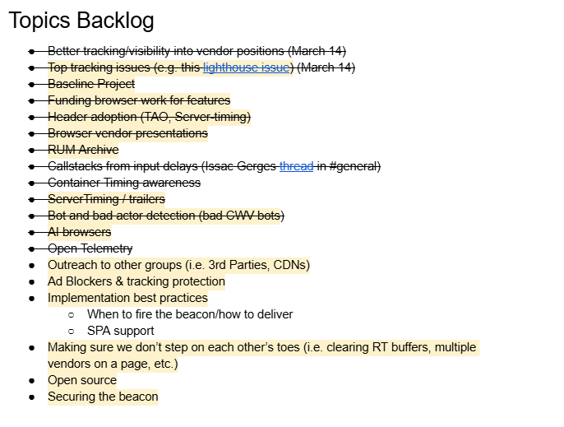
Next Meeting
Wed October 14th @ 10am EST
  2nd Wednesday of each month
Topics?
  ?
Submit & Vote topics @ bit.ly/rumcg-agenda

Slide 5
Agentic Browser RUM

Slide 6
Agentic Browser RUM
Slides @ https://docs.google.com/presentation/d/1s9kuZMgddIvafvyRczdxmDvjDSwm3aqA74PuOCmB6dQ/

