Slide 1
RUM Community Group
2026-04-08 Edition

Slide 2
Agenda
Performance Timeline option per-paint (performance-timeline#228) (Michal)
TAO and ServerTiming Header Adoption Updates (Cliff)
RUM ABCs (AI, Bots and Crawlers) (Philip et. al)

Slide 3
Logistics
Meeting cadence
2nd Wednesday of the Month
60 minutes
10am ET
Agenda Document
(bit.ly/rumcg-agenda)
Google Meet for Meetings
sub to rumcg-participants for invites
Chat on Web Performance Slack #w3c-rum-community-group
(invites)
public-rumcg@w3.org
(for discussions)
RUM CG Github Repo
github.com/w3c-cg/rum
Group details
Links
Meeting minutes
RUM CG Tracking Project
github.com/orgs/w3c-cg/projects/1
Meeting Minutes via fireflies.ai
AI summary + transcript will be posted after
Full video recording also available

Slide 4
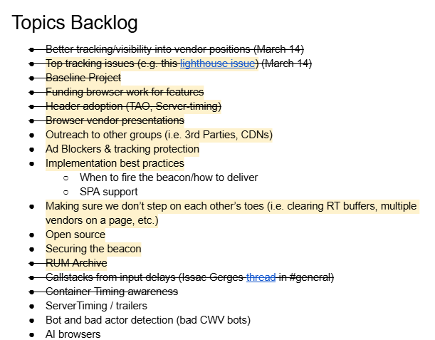
Next Meeting
Wed May 13th @ 10am EST
2nd Wednesday of each month
Topics?
?
Submit & Vote topics @ bit.ly/rumcg-agenda

Slide 5
let's do this

Slide 6
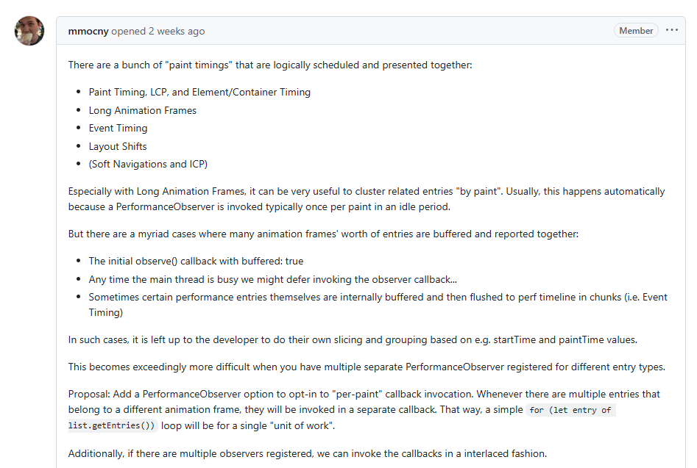
Performance Timeline option per-paint
https://github.com/w3c/performance-timeline/issues/228

Slide 7
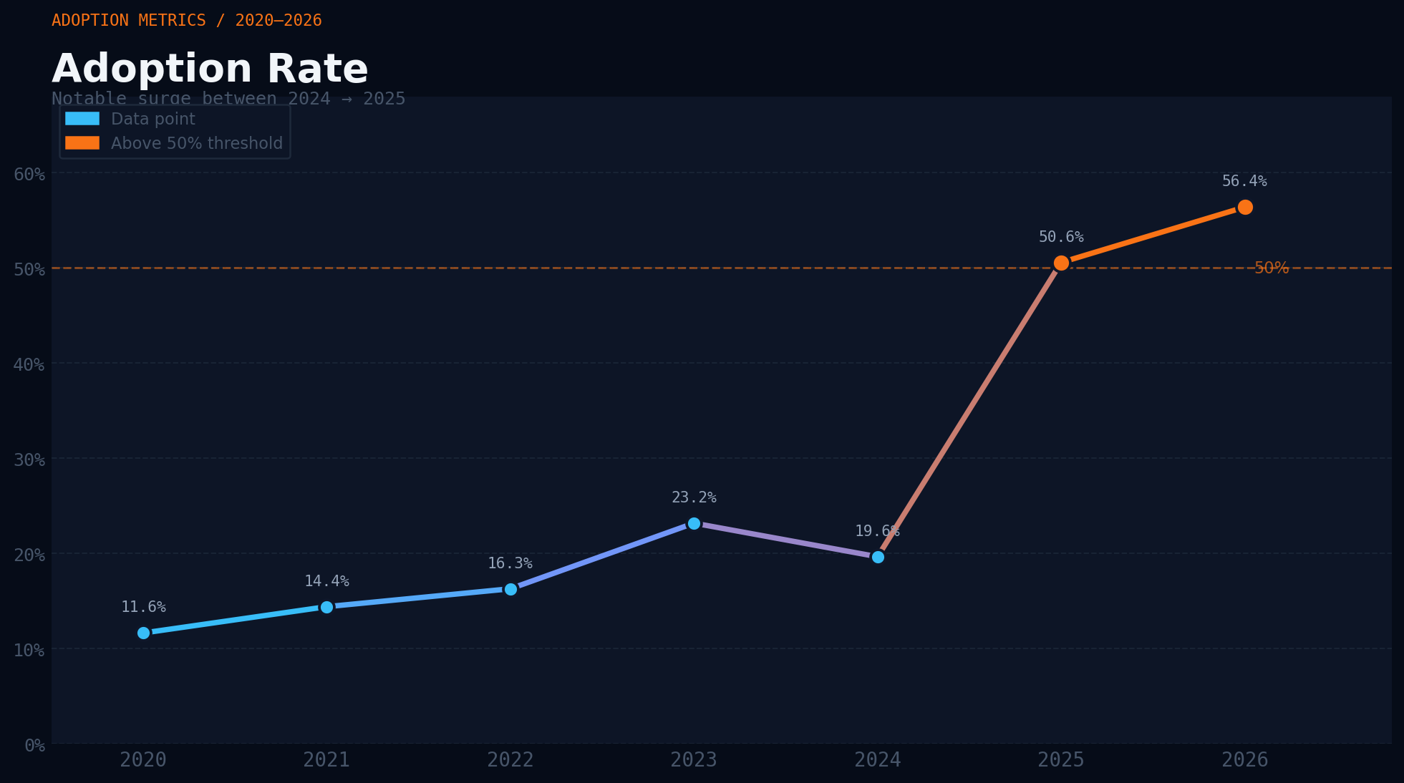
Server-Timing Header Adoption
HTTP Archive: 2020 - 2026

Slide 8
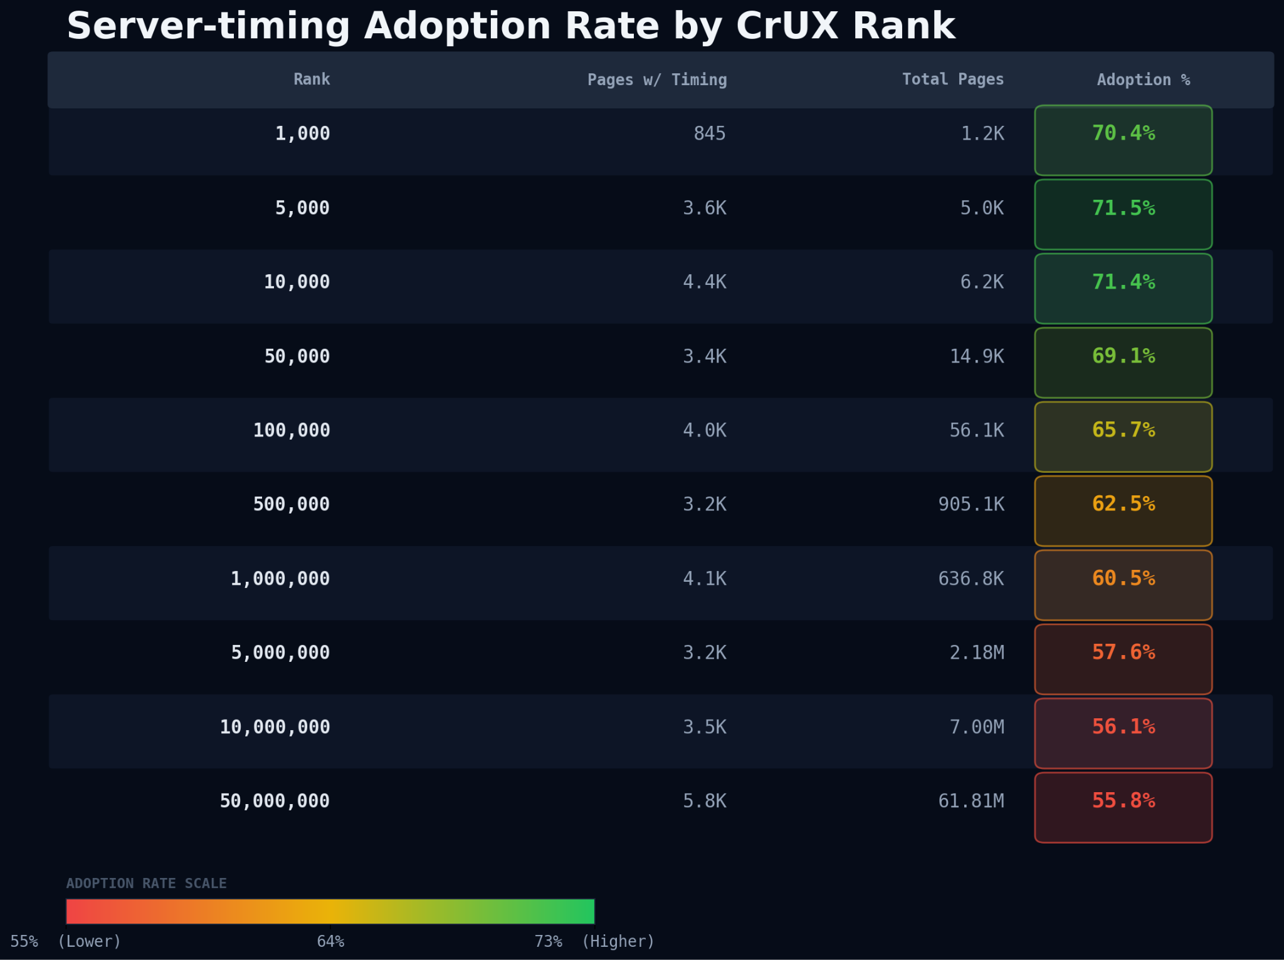
HTTP Archive: Feb 2026
Notes:
The trend is consistent. Adoption starts strong at ~71% for top 1K–10K ranked sites and gradually declines to ~56% for the top 50M, suggesting that the largest, most popular sites are actually better at implementing Server Timing than the long tail. In reality, likely b/c these sites are larger, more prevalent brands using a CDN or potentially Shopify to deliver their content.

Slide 9
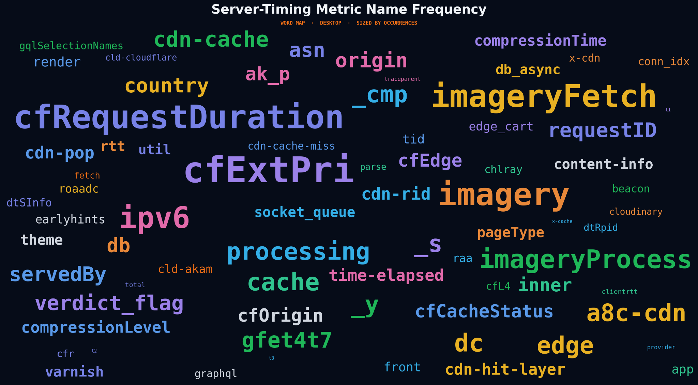
ServerTiming Header Adoption
HTTP Archive: Feb 2026

Slide 10
RUM ABCs (AI, Bots and Crawlers)
Most AI bots don't execute JavaScript or send an mPulse beacon
Our security team has helped us identify which of our beacons did come from AI bots (~0.005%)
The most interesting thing is the difference in which pages are viewed

Slide 11
Four types of AI Bots
AI Training Crawlers Used to train AI models
AI Search Crawlers Used to provide search summaries
AI Fetchers Act on a user's behalf to answer a very specific question via simple web requests. These do not maintain state.
AI Agents Act on a user's behalf to perform complex tasks like "but me a good pair of sneakers at the best rate". These maintain state and have memory.

Slide 12
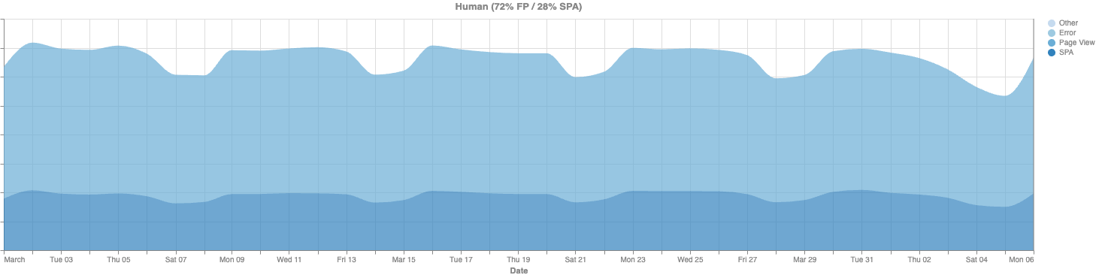
Human v/s Bot Behavio(u)r
Human traffic has a 70-30 split between full page (including bfcache) and SPA hits.

Slide 13
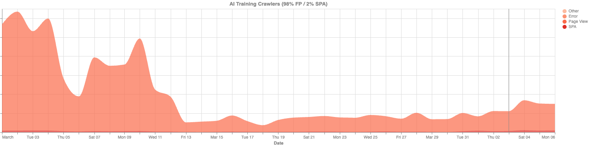
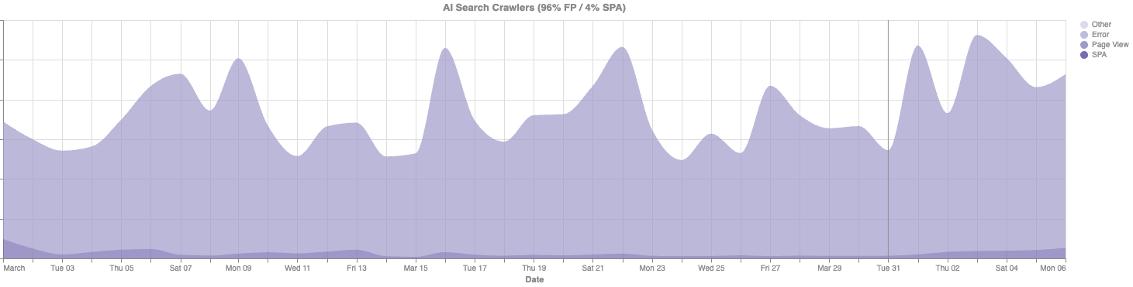
Human v/s Bot Behavio(u)r
Training & Search Crawlers have a 95-5 split between full page and SPAs

Slide 14
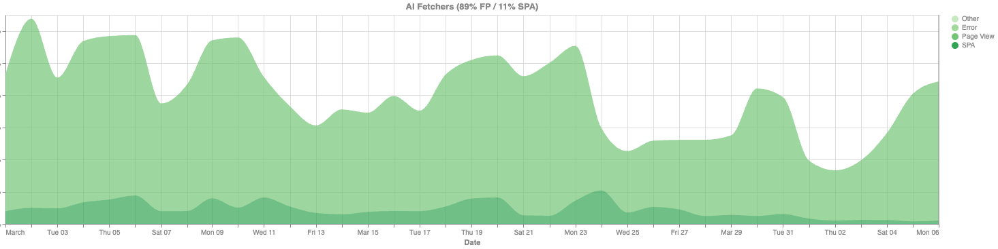
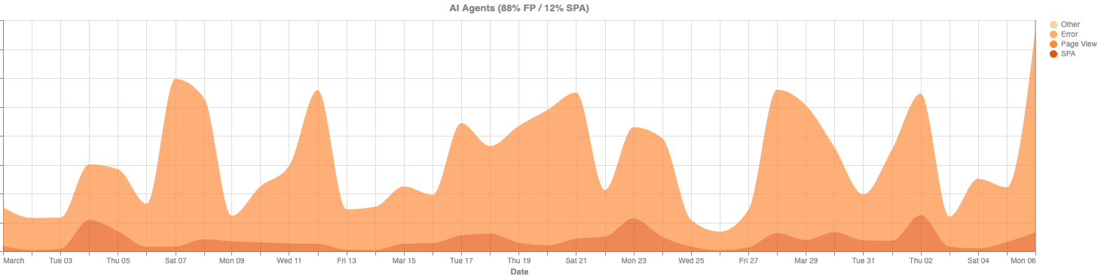
Human v/s Bot Behavio(u)r
Fetchers and Agents have an 88-12 split between full page and SPAs

Slide 15
Human v/s Bot Behavio(u)r
Summary
Human: 72% Full Page v/s 28% SPA
Training Crawlers: 98% Full Page v/s 2% SPA
Search Crawlers: 96% Full Page v/s 4% SPA
Fetchers: 89% Full Page v/s 11% SPA
Agents: 88% Full Page v/s 12% SPA
Our data also shows 80% bounce rate for AI bots, but I'm not confident in that.

Slide 16
RUM ABCs (AI, Bots and Crawlers)
Questions:
How much do we think bots present in RUM data?
How could / should AI crawlers identify themselves?
User Agent, IP, ASN?
Web Bot Auth (https://github.com/cloudflare/web-bot-auth)
https://github.com/ai-robots-txt/ai.robots.txt
How could / should AI/agentic browsers identify themselves?
Comet, Atlas, Neon, etc
Do "they" even care about performance?

