Slide 1
RUM Community Group
2025-08-08 Edition

Slide 2
Agenda
Logistics
Next Meeting
Agenda
Unresponsive crash reports, Self Profiling (Issac Gerges)
Chrome Soft Navigation Origin trial (Gilberto Cocchi)

Slide 3
Logistics
Meeting cadence
2nd Friday of the Month
60 minutes
10am ET
Agenda Document
(bit.ly/rumcg-agenda)
Google Meet for Meetings
sub to rumcg-participants for invites
Chat on Web Performance Slack #w3c-rum-community-group
(invites)
public-rumcg@w3.org
(for discussions)
RUM CG Github Repo
github.com/w3c-cg/rum
Group details
Links
Meeting minutes?
RUM CG Tracking Project
github.com/orgs/w3c-cg/projects/1
Meeting Minutes via fireflies.ai
AI summary + transcript will be posted after
Full video recording also available

Slide 4
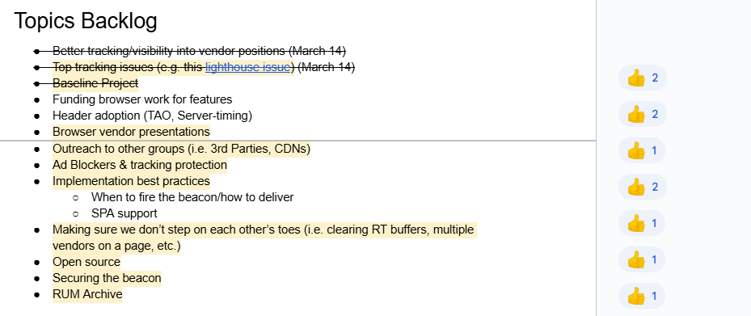
Next Meeting
Fri September 12th @ 10am EST
2nd Friday of each month
Topics?
(propose your topic here!)
Submit & Vote topics @ bit.ly/rumcg-agenda

Slide 5
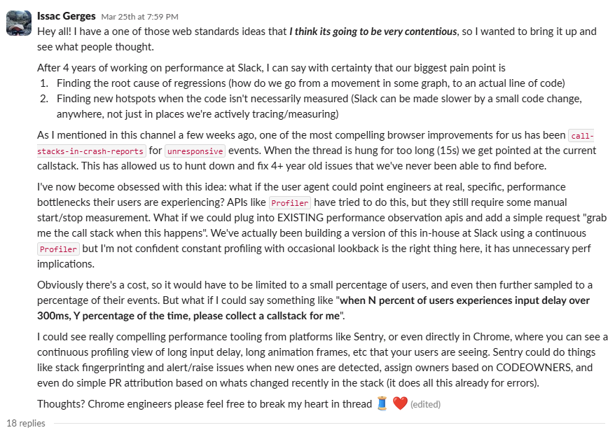
Unresponsive crash reports + Self Profiling
https://webperformance.slack.com/archives/C04BK7K1X/p1742947178736999

