Slide 1
RUM Community Group
2025-04-25 Edition

Slide 2
Agenda
Logistics
Next Meeting
Agenda
RUMCG Issue Tracker
Funding work for browser features

Slide 3
Logistics
Meeting cadence
2nd Friday of the Month
60 minutes
10am ET
Agenda Document
(bit.ly/rumcg-agenda)
Google Meet for Meetings
(invites - Google Group for invites only)
Chat on Web Performance Slack #w3c-rum-community-group
(invites)
public-rumcg@w3.org
(for discussions)
RUM CG Github Repo (NEW)
github.com/w3c-cg/rum
Group details
Links
Meeting minutes?
RUM CG Tracking Project
github.com/orgs/w3c-cg/projects/1

Slide 4
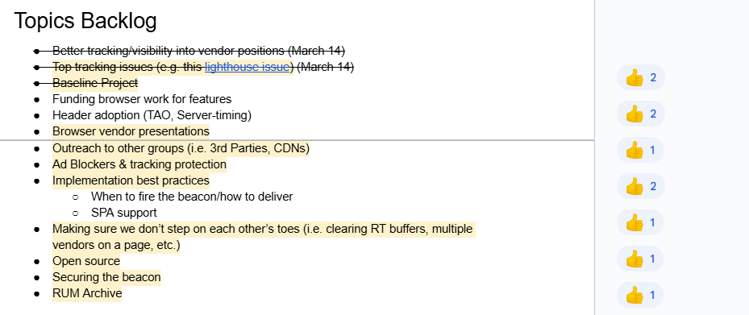
Next Meeting
Fri May 9th @ 10am EST
2nd Friday of each month
Topics?
Header adoption (Timing-Allow-Origin, Server-Timing)
(propose your topic here!)
Submit & Vote topics @ bit.ly/rumcg-agenda

Slide 5
RUMCG Issue Tracking
What do we (RUMCG) care about?
Track ideas, bugs
Outputs could be:
Bring in-development ideas to WICG or WebPerf WG
Push for development of non-interoperable features (e.g. funding - next discussion!)
Proposal with Github Projects
Solicitation of Issues and Ideas to Include
https://github.com/orgs/w3c-cg/projects/1

Slide 6
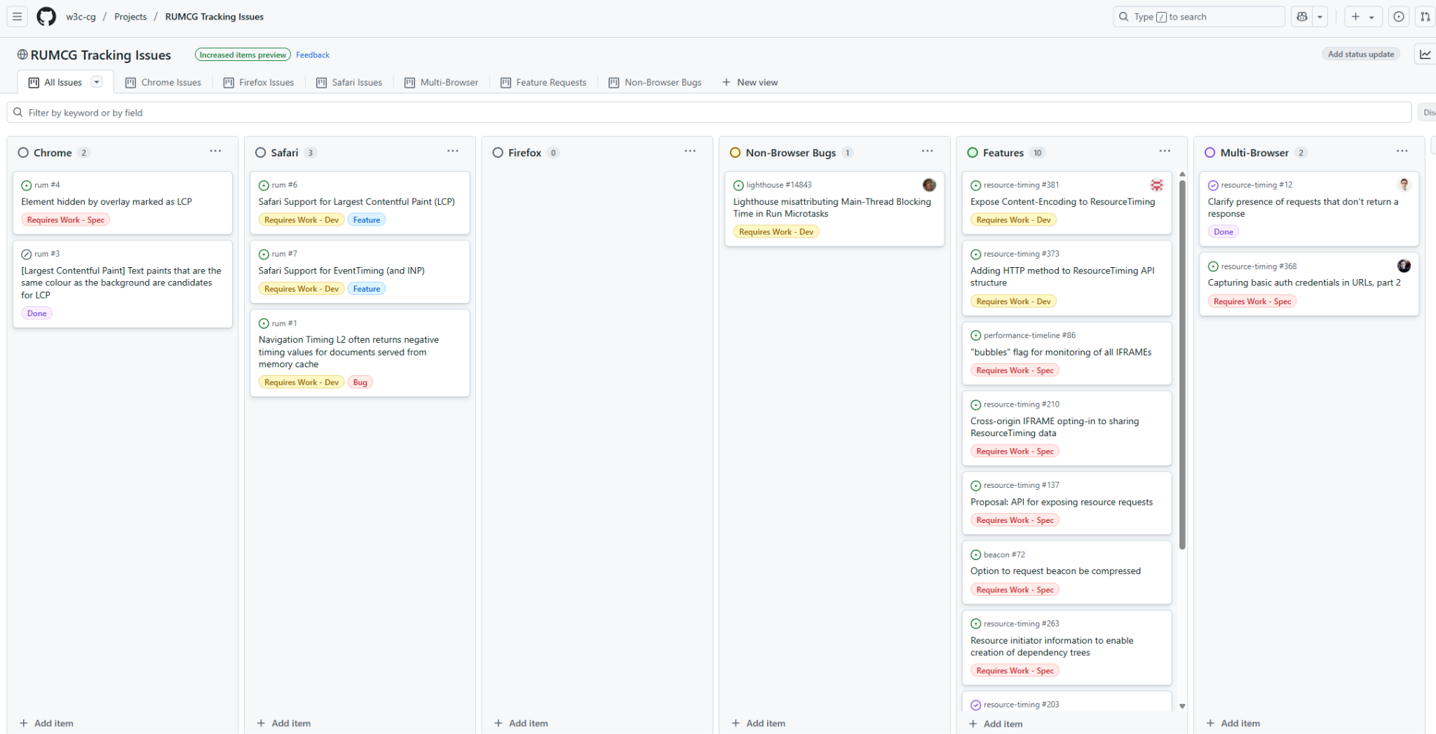
Github Project
https://github.com/orgs/w3c-cg/projects/1

Slide 7
Funding work for browser features
Somewhat of a follow-up to a session at WebPerfDays 2024 in Amsterdam before perf.now().
Goal:
Better understand how we (as a community) might pool resources to try to push specific browser features forward.
Examples (discussed at WPD):
LCP in Safari
EventTiming in Safari
Review how Container Timing has been developed and where it could go
Igalia
https://www.igalia.com/
Open source consultancy

