Slide 1
RUM
Community Group
2026-10-14 Edition

Slide 2
Agenda
Interop 2027

Slide 3
Logistics
Meeting cadence
  2nd Wednesday of the Month
  60 minutes
  10am ET
Agenda Document
  (bit.ly/rumcg-agenda)
Google Meet for Meetings
  sub to rumcg-participants for invites
Chat on Web Performance Slack #w3c-rum-community-group
  (invites)
public-rumcg@w3.org
  (for discussions)
RUM CG Github Repo
  github.com/w3c-cg/rum
  Group details
  Links
  Meeting minutes
RUM CG Tracking Project
  github.com/orgs/w3c-cg/projects/1
Meeting Minutes via fireflies.ai
  AI summary + transcript will be posted after
  Full video recording also available

Slide 4
RUM RUM
Nov 18 (before perf.now())
https://www.eventbrite.com/e/w3-rum-community-group-real-user-meeting-google-amsterdam-tickets-1991177652961?aff=erelpanelorg
Agenda
  The state of the web going into 2027: ABC
  Browser updates - Chrome (Barry)
  Browser updates - Firefox (?)
  Browser updates - Safari (?)
  BFCache (Gilberto)
  BEACON

Slide 5
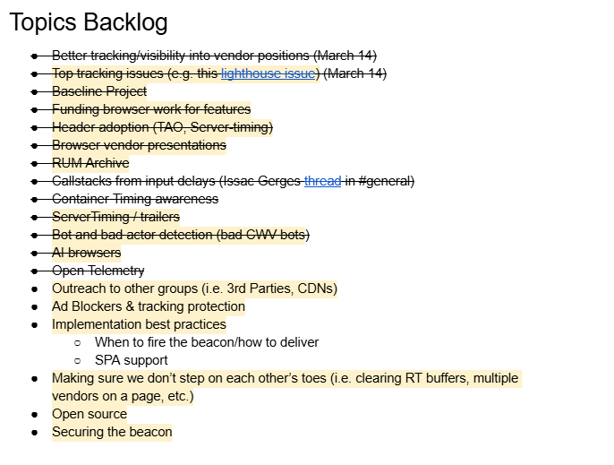
Next Meeting
Wed December 9th @ 10am EST
  SKIPPING 2026-11-11 - RUMRUM @ perf.now
  2nd Wednesday of each month
Topics?
  ?
Submit & Vote topics @ bit.ly/rumcg-agenda

Slide 6
Interop 2027

Slide 7
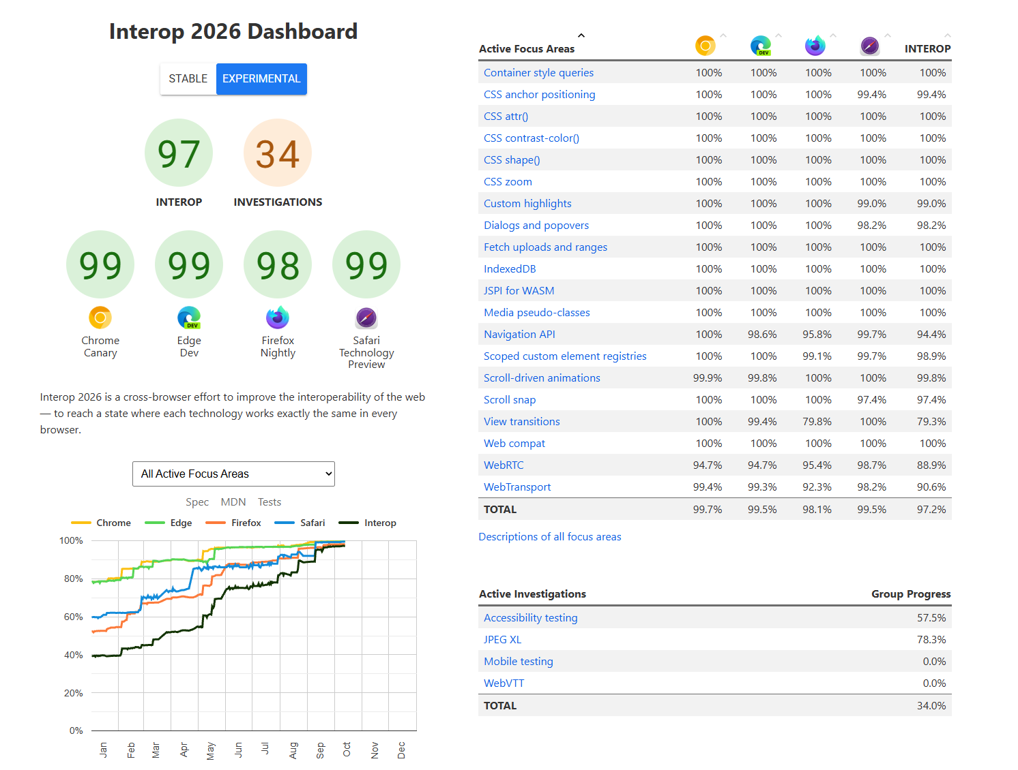
Interop 2027
https://github.com/web-platform-tests/interop
Team Members:
Apple
Bocoup
Google
Igalia
Microsoft
Mozilla

Slide 8
Interop 2027
Scope
The Interop Project is a collaboration between organizations that implement web technology in browser engines. It defines a metric based on a set of web technologies that we collectively believe to be important to improve interoperability. This metric publicly keeps track of that work by using automated tests to score how much progress each participating browser has made reaching the shared goals.
There are many fantastic ideas for what the web could become. But the Interop Project is not the place to begin making those dreams a reality. This is a place to focus on interoperable implementations of ideas that have already been defined in detail in web standards. And it’s a place to focus on interoperability through the use of automated tests to evaluate whether or not a particular browser matches what the web standard says it should be doing. In order for this to be possible, the Interop Project only focuses on specific kinds of web technology.
Everything chosen for the next year’s project must be defined in a sufficiently mature standards-track web specification. If there is no web standard, then there is no definition of what a particular technology “should” be doing. The Interop Project is not an organization for defining web standards. That work is important, and must happen in the appropriate bodies, not here.
Everything chosen for the next year’s project must be testable using automated tests on existing testing platforms. A proposal cannot be accepted if there are no automated tests to evaluate conformance to the web standard; if it’s not possible to test the technology being proposed; or if the tests would need to run in environments that are not yet available on the infrastructure for Web Platform Tests (for example, in 2022 and 2023, testing on mobile operating systems was not possible).
If there is a particular blocker making it hard to test a certain feature, that could make for a good Investigation Project proposal. And ideas about how the WPT/Interop Project testing infrastructure can be improved for the future can be proposed as Investigation Projects, to be considered as work for the Interop Project to take on in the next year.

Slide 9
Interop 2027
Timeline
Interop 2027 proposal submission window ended on September 23rd, 2026. The overall timeline is as below. Please note that the timelines are subject to change.
Proposal submission window (~3 weeks): Sept 3rd, 2026 through Sept 23rd, 2026
Proposal selection: Before December 17th 2026
Scope of the Interop 2027 project published: the first half of February, 2027
https://github.com/web-platform-tests/interop/blob/main/2027/selection-process.md

Slide 10
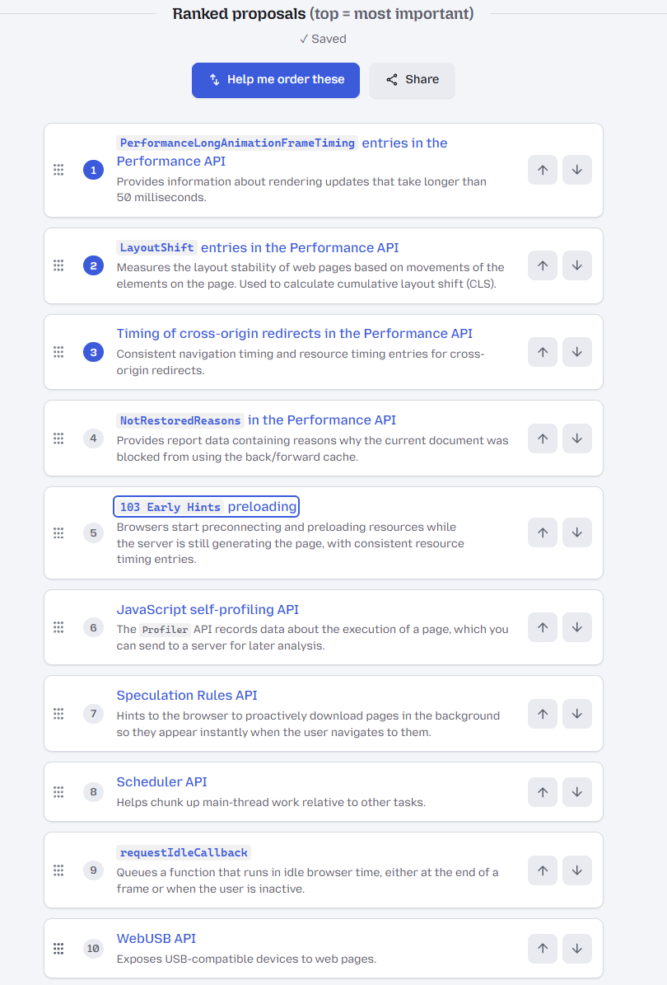
Ranking
https://interop-rank.fxdx.dev/

Slide 11
RUM / WebPerf Related
Layout Instability API (CLS)
Long Animation Frames (LoAF)
Cross-origin redirect and Navigation Timing / Resource Timing
NotRestoredReasons API
103 Preload and Resource Timing
JavaScript profiler API
scheduler.yield
Speculation Rules

Slide 12
TPAC 2026

Slide 13
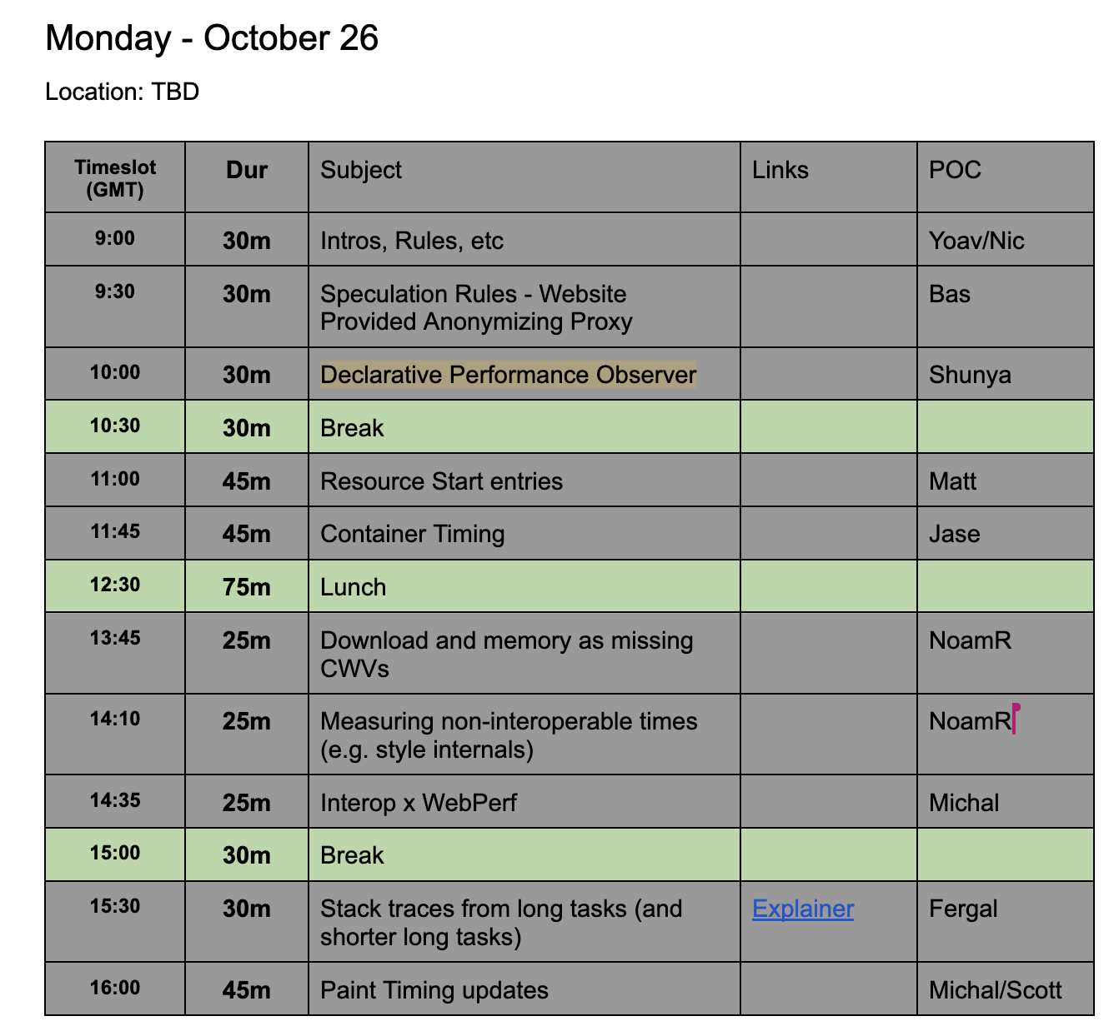
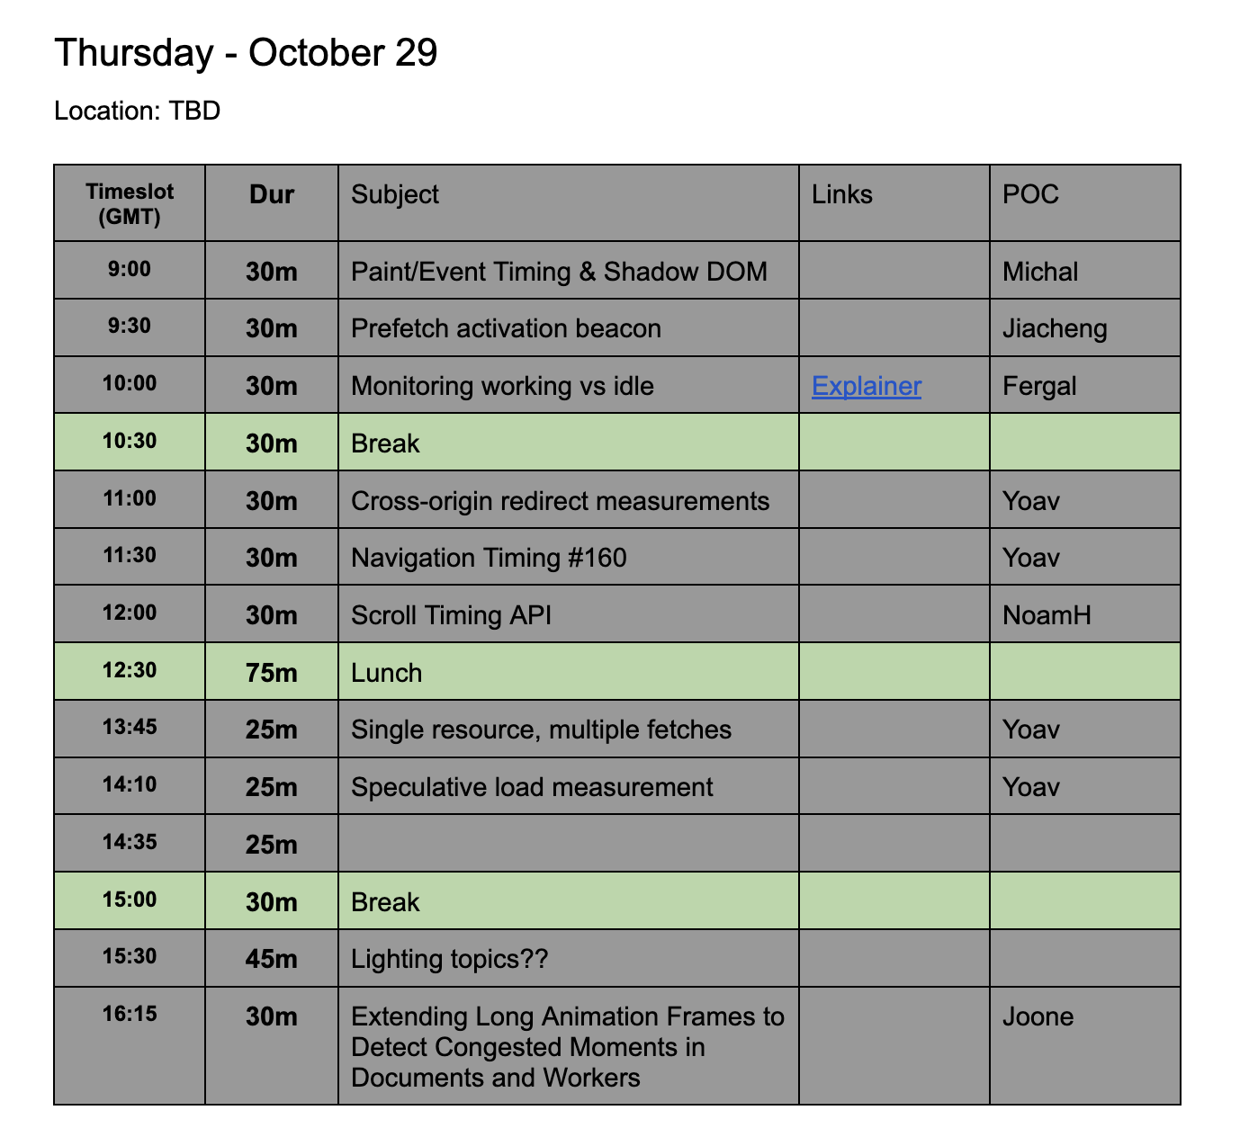
TPAC 2026
WebPerf WG: https://docs.google.com/document/d/1etdM-hCu-zpQvG-ovA-qQF3xvGk_SyfVzgX5jamVYHI/edit?tab=t.0#heading=h.odc700in1ypg

