Slide 1
W3C Agents on The Web (WebAgents) CG
The Web as a Platform for Agents
Architectural design ideas from the Interoperability Report
Andrei Ciortea, Rem Collier, Ege Korkan, and Antoine Zimmermann

Slide 2
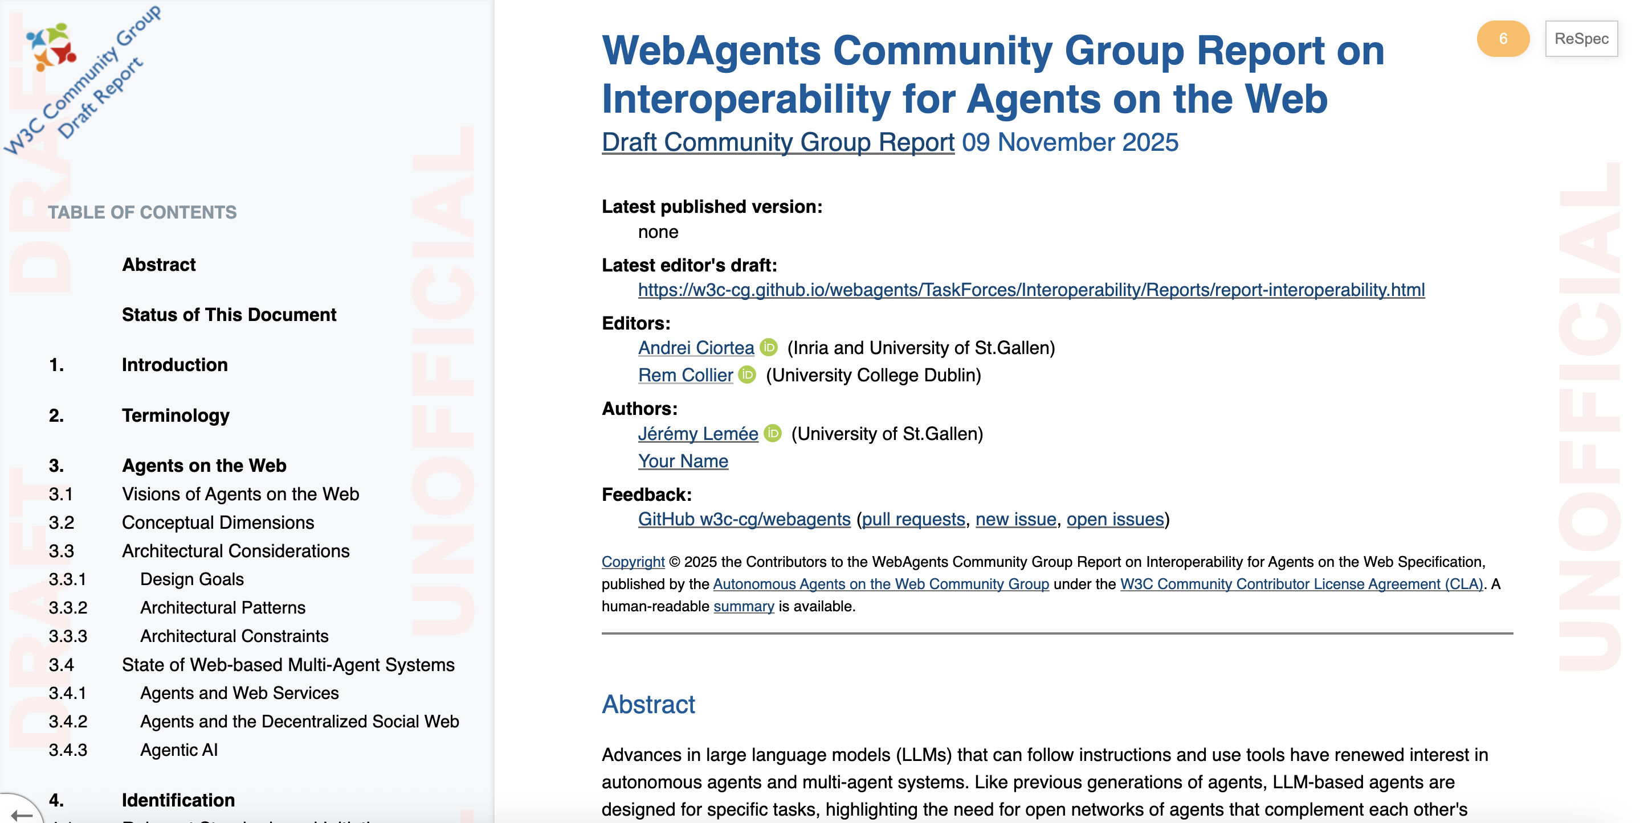
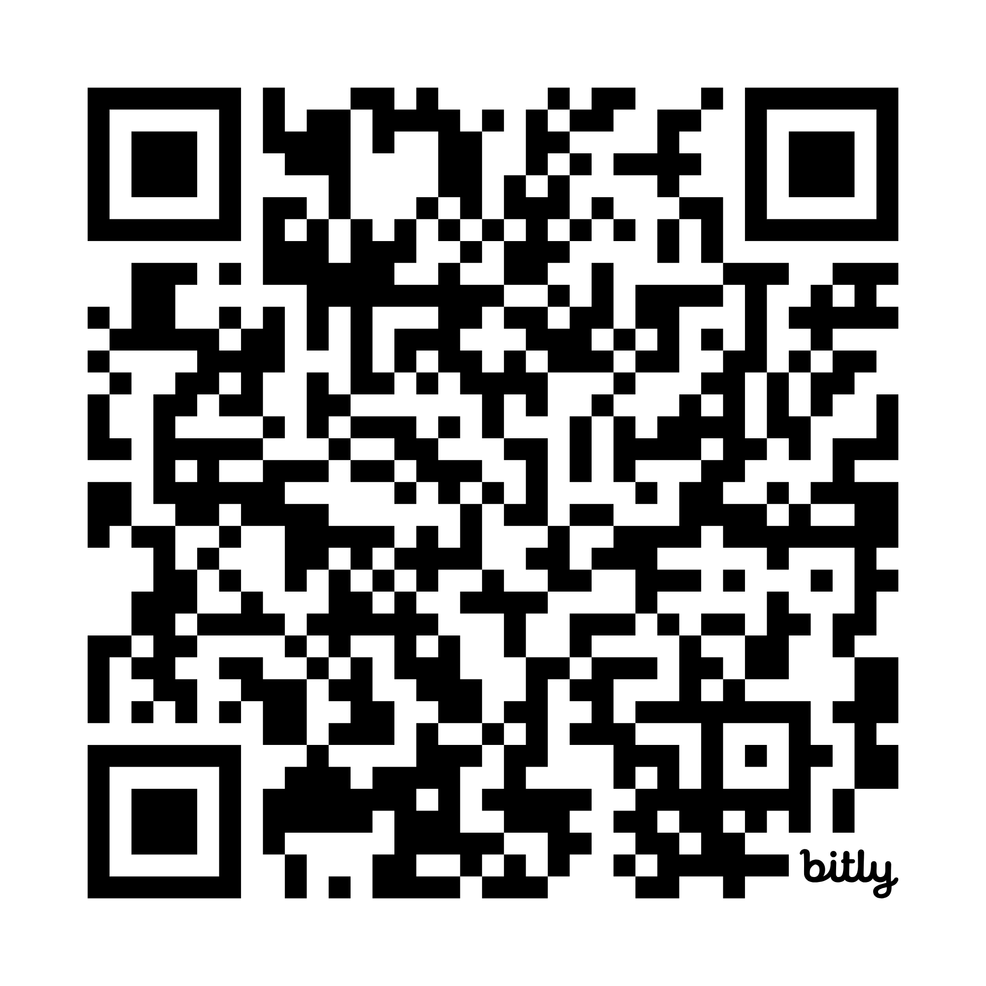
Interoperability Report
https://bit.ly/webagents-interop
What should be the role of the Web in
the emerging landscape of Agentic AI?
What are the relevant standards within
and maybe also outside the W3C?
What are the standardization gaps
(if any)?

Slide 3
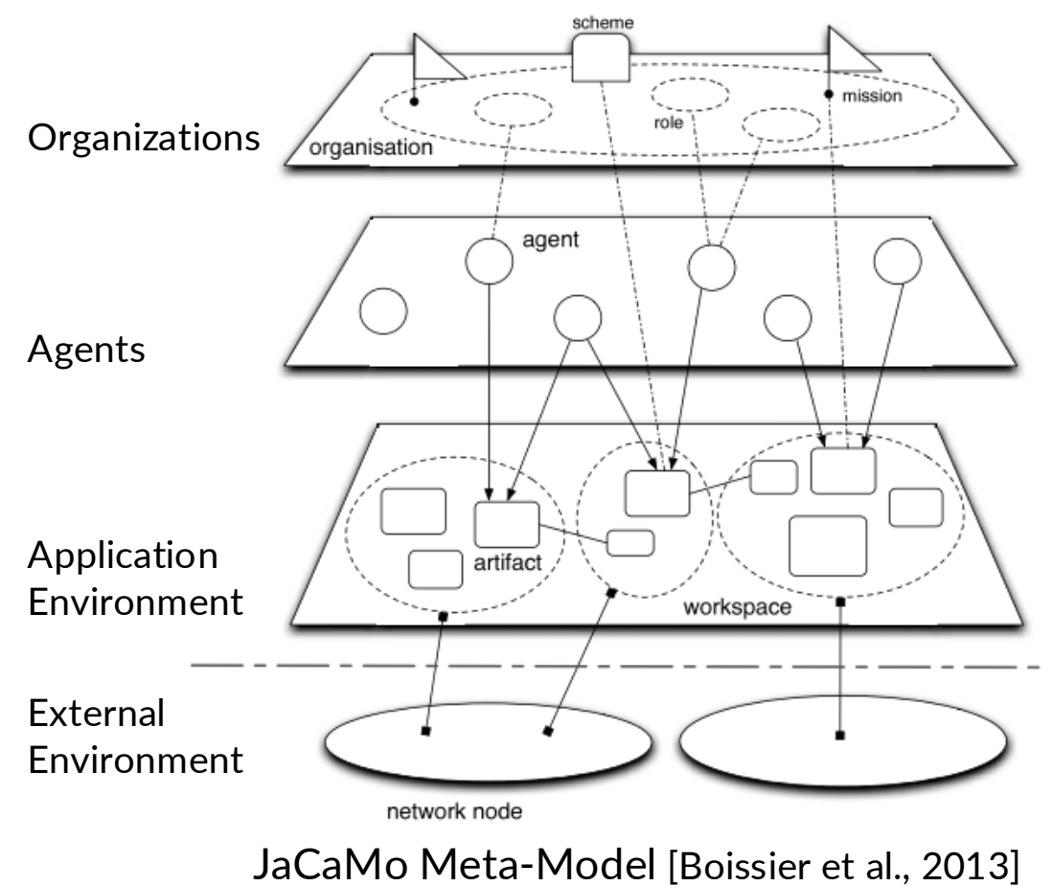
A Layered View of Multi-Agent Systems
Agents
Goals, reasoning and autonomy
Environment
Resources, state and controls
Interaction
Messages and coordination
Organization
Roles, rules and commitments
A shared lens for goals, architectural patterns and standards

Slide 4
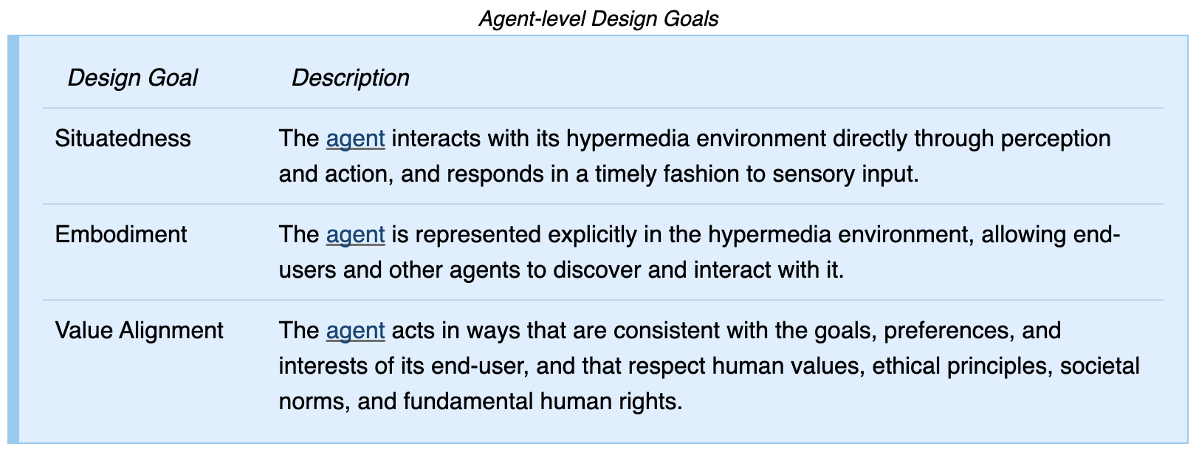
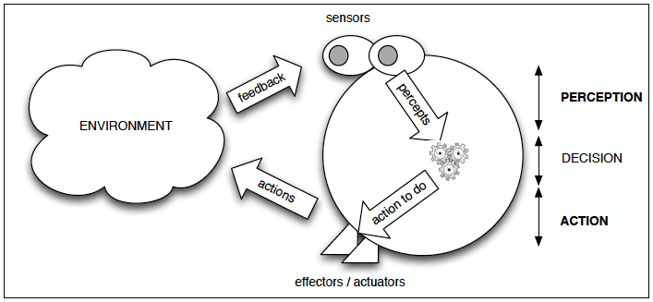
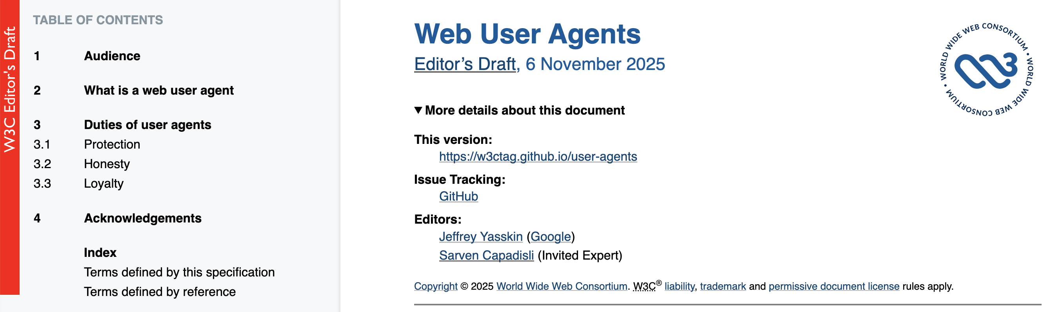

Web Agent Design Goals: Agent Level
Defining characteristic of agents
Enables agents to discover and interact with one another on the open Web
Fundamental not only to intelligent agents but also to Web user agents in general
World Wide Web
[Bordini et al., 2007]
https://w3ctag.github.io/user-agents/
Rafel Bordini et al., Programming Multi-Agent Systems in AgentSpeak using Jason. John Wiley & Sons, 2007.

Slide 5
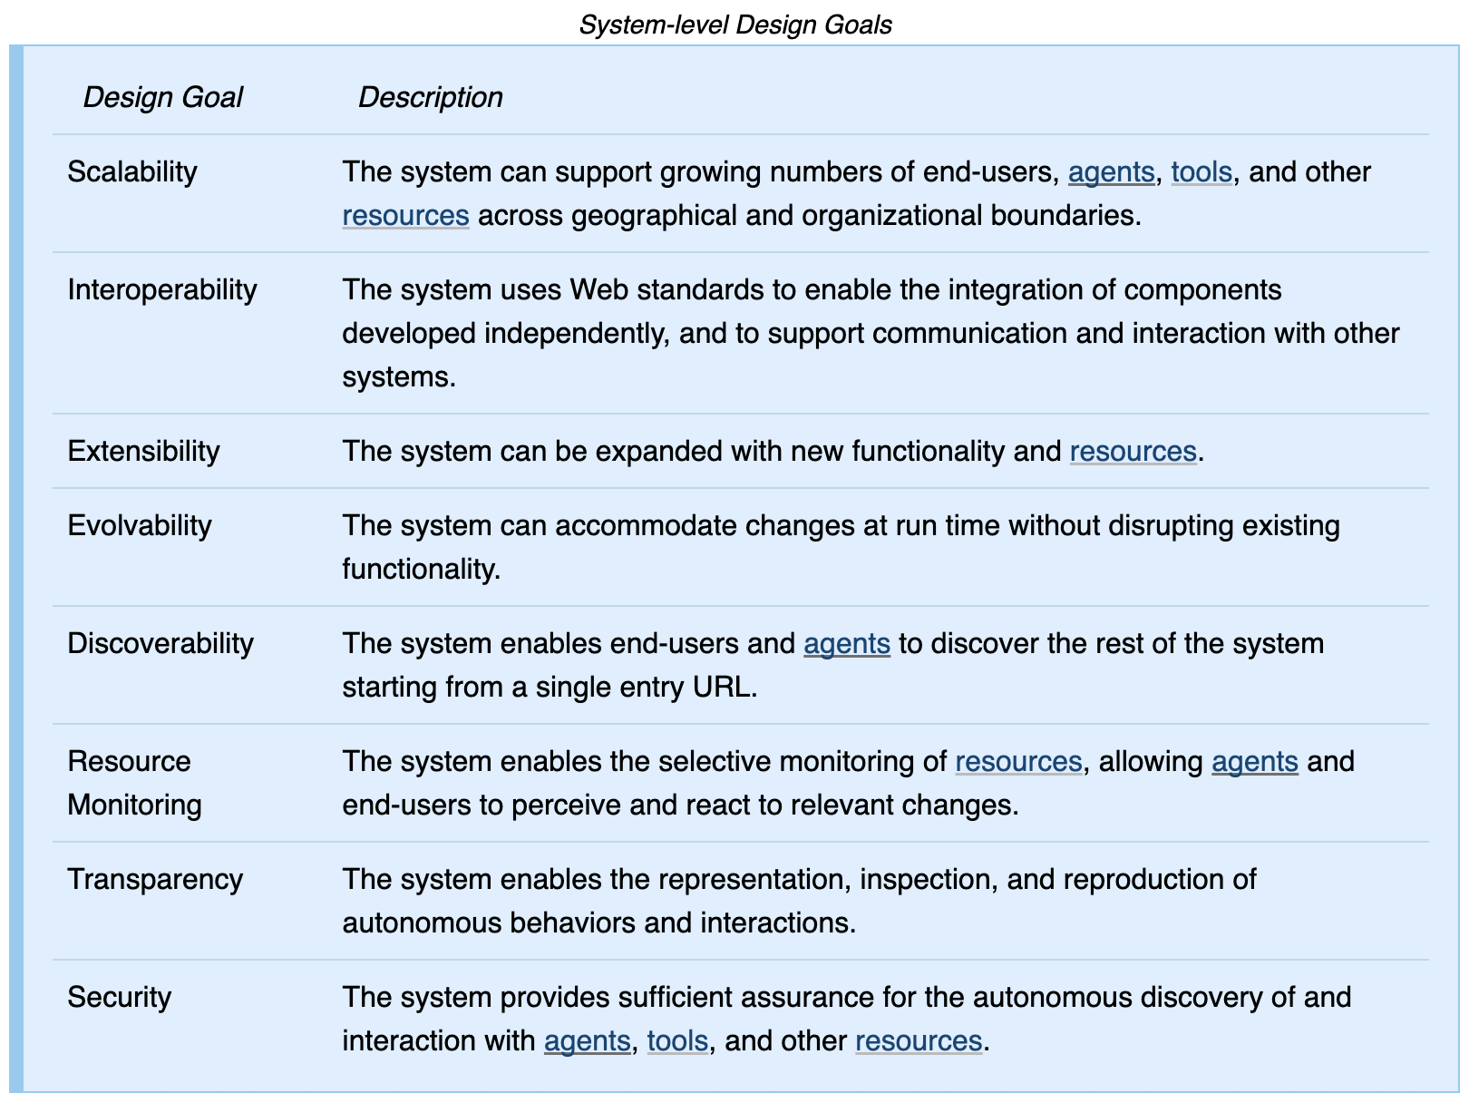
Web Agent Design Goals: System Level
Central design goals for deploying MAS at scale on the open Web
Observation: core strengths of the Web as a world-wide, open, and long-lived system
Hypothesis: MAS can inherit these strengths if they align with the Web architecture
Necessary for agents to perceive their hypermedia environments
Prerequisite for accountability, explainability, and trust
Critical for agents
on the open Web

Slide 6
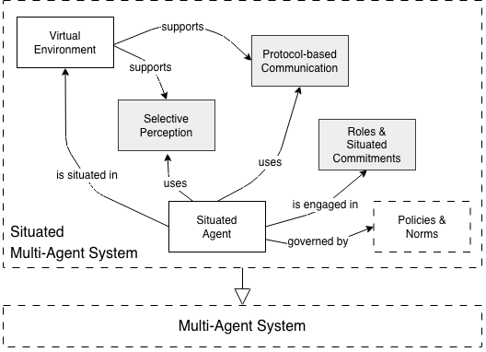

Architectural Patterns for MAS
Danny Weyns: Architecture-based Design of Multi-Agent Systems. Springer. 2010.

Slide 7
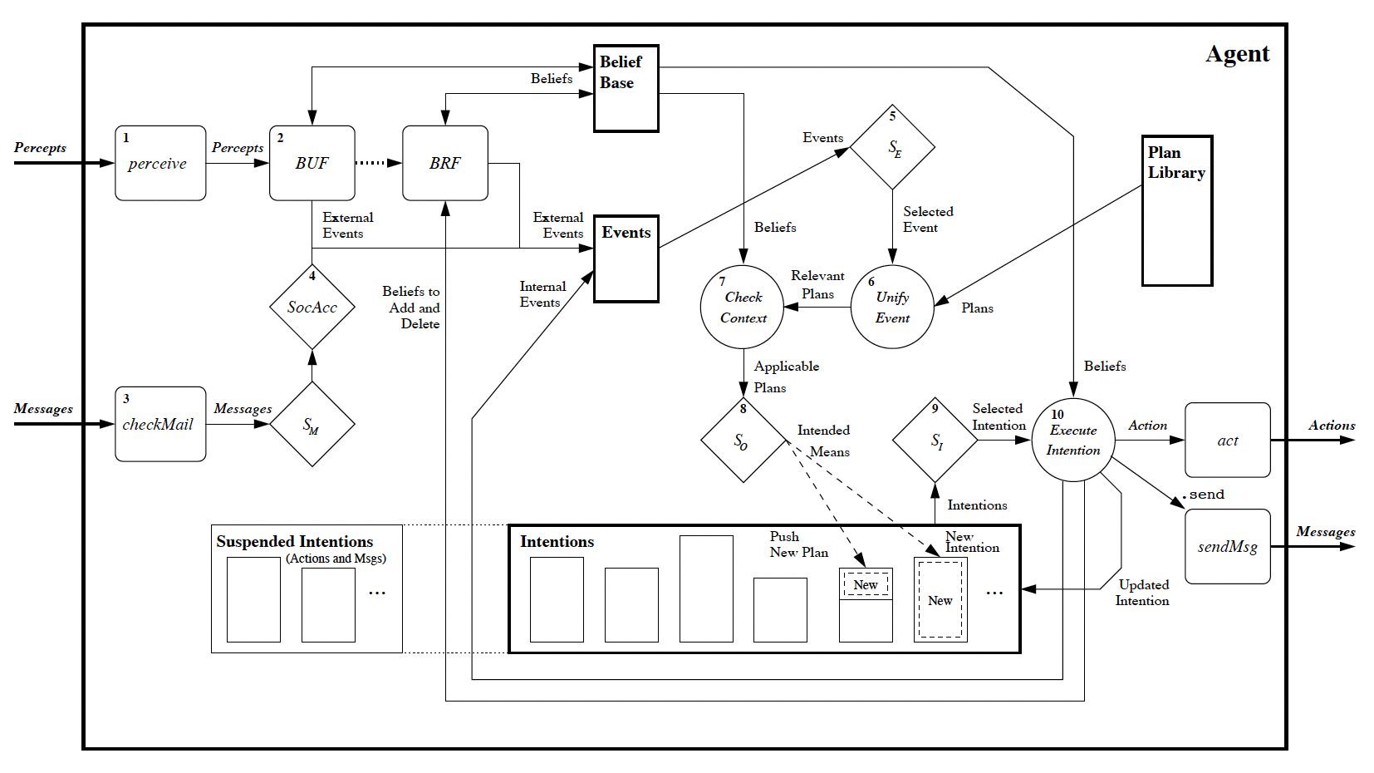
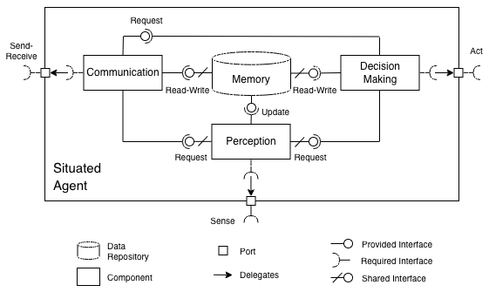
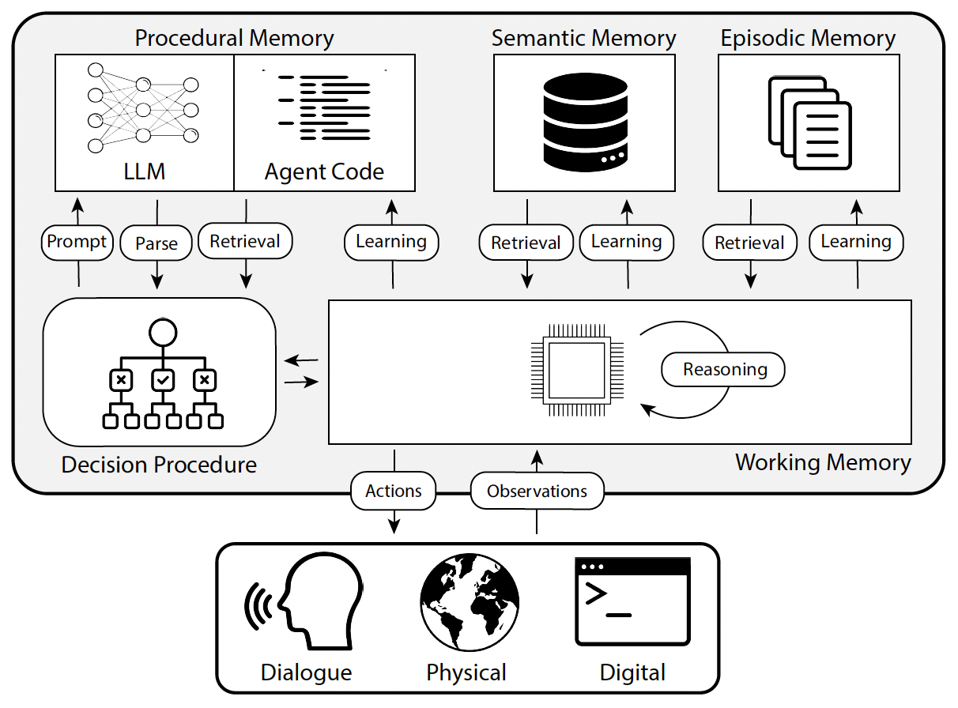
Architectural Patterns for MAS
Sense
Receive
Message
Memory (belief base, plan library)
Perception
Communication
Decision Making
Act
Send
Message
Jason Architecture for BDI Agents
[Bordini et al., 2007]
Memory
Decision
Making
Act
Sense?
Note: not all components or their interfaces may be needed in a given implementation
Cognitive Architectures for Language Agents (CoALA)
[Summers et al., 2024]
Rafel Bordini et al., Programming Multi-Agent Systems in AgentSpeak using Jason. John Wiley & Sons, 2007.
Theodore R. Sumers et al., Cognitive Architectures for Language Agents, TMLR, 2024. https://arxiv.org/abs/2309.02427

Slide 8
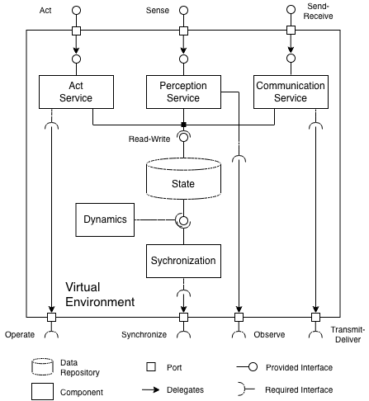
Architectural Patterns for MAS
Note: not all components or their interfaces may be needed in a given implementation
x
Local Machine
Host with MCP Client
x
Local Machine
Agent with UTCP Client
MCP Protocol
Node 1
MCP Server
Web
APIs
UTCP
Protocol
An adaptation layer
Web APIs
Tool 1
UTCP Manuals
Node 2
Tool 2
Remote Service
Tool Provider
Remote Machine
Model Context Protocol
(MCP)
Universal Tool Calling
Protocol (UTCP)
MCP example adapted from:
https://modelcontextprotocol.io/specification/2025-06-18/architecture#core-components

Slide 9
Open vs Controlled Environments
Controlled environments
Open environments
A single curator selects what agents, resources and services exist.
The domain of multiple curators.
Process meanings and changes are reconciled by the curator.
Processes reflect different perspectives and evolve independently.
Access rights and responsibilities are pre-assigned by the curator.
Rights and responsibilities established at runtime through diverse means.
Openness demands agents that can discover and work with unfamiliar resources, services and other agents.

Slide 10
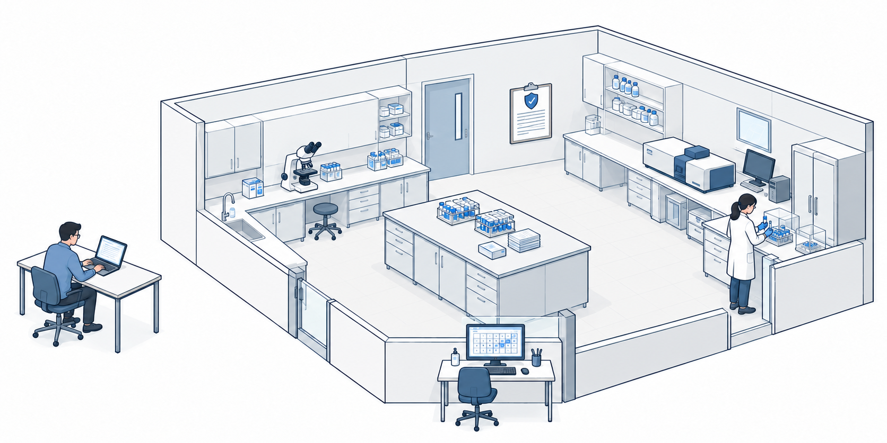
A laboratory task
“Find a suitable instrument, reserve it within my budget,
and tell me when it is ready.”

Slide 11
The MCP/A2A laboratory
A2A: delegate and track
Research agent
MCP
Lab MCP server
Facility agent
Find · reserve · read status

Slide 12
How MCP and A2A support the laboratory
Laboratory concern | MCP contribution | A2A contribution
Find suitable equipment | Tools and resources expose catalogues, capabilities and availability. | A facility agent finds and proposes suitable equipment.
Understand processes and policies | Resources, tool descriptions and policy queries provide relevant information. | A facility agent explains or manages procedures and checks requirements.
Respond to change | Notifications or queries expose changes; application logic assesses their impact. | Task updates communicate effects on delegated work; agents coordinate a response.

Slide 13
How Open is this?
MCP and A2A offer | Openness requires
Descriptions of known tools and agents | Finding and assessing capabilities across unfamiliar environments
Tool use and task delegation | Understanding how to act within local processes, policies and commitments
Environmental context and task updates | Relating changes to ongoing work and deciding how to adapt
MCP and A2A support interaction.
Effective action depends on context about the environment.

Slide 14

Describing interaction with WoT
Descriptions connect capabilities to concrete interactions
The lamp
The instrument
Property
On / off
Availability
Action
Toggle
Start analysis
Event
Lamp failure
Analysis completed
WoT Discovery finds descriptions. Forms describe access to properties, actions and events.

Slide 15
Resources combine state and controls
Reservation
https://lab.example/reservations/42
Current state
Interaction controls
Relationships
Confirmed
Instrument A · 10:00–11:00
Cancel
Observe status
Instrument
Requester · access policy
A resource stereotype supplies shared expectations.
Its representation supplies current state and concrete controls.

Slide 16
The Web/hypermedia laboratory
Agent interaction: A2A
Discover / act
Inspect / act
Research agent
Linked lab resources
Facility agent
Instrument · reservation · policy
Subscribed updates
Discover facility agent
Discover
MCP server
Use
tools
MCP server

Slide 17
How the Web supports the laboratory
Laboratory concern | Web / hypermedia contribution
Find suitable equipment | Follow linked descriptions of instruments, capabilities and availability, and discover relevant interfaces.
Understand processes and policies | Inspect linked requirements and policies; use controls offered for the resource’s current state.
Respond to change | Observe resource updates, inspect their effect on the reservation and identify available next steps.
Resource navigation, tool use and agent delegation
can refer to the same shared environment.

Slide 18
Working with an unfamiliar laboratory
The same research agent
Facility A
Facility B
Instrument A · Local processes and policies
Instrument B · Different processes and policies
MCP / A2A
Web / hypermedia
Inspect tool and resource descriptions, or ask the facility agent about its procedures.
Inspect linked resources and controls describing current state and available interactions.
MCP/A2A can support a shared environment; hypermedia makes it the organizing principle.
Both require interpretation, suitability assessment and authorization.

Slide 19
When ongoing work changes
Both approaches must support awareness, interpretation and response.
Change | What must the agent establish?
Booking policy changes | What changed, does it affect this reservation, and what can I do now?
The instrument fails | What happens to the booking and commitments, and who must act?
Another agent takes over | What is the current state, what was agreed, and what authority does the replacement need?
How do MCP/A2A and Web/hypermedia help agents respond to change?

Slide 20
When ongoing work changes
Both approaches must support awareness, interpretation and response.
Change | For MCP/A2A
Booking policy changes | Read changed policy and booking via resources/tools; infer next steps from descriptions or facility dialogue.
The instrument fails | Query booking and obligations; use recovery tools or delegate resolution to the facility agent.
Another agent takes over | Load persisted task context and booking state; establish authority before continuing through tools or delegation.
MCP resources and notifications can expose change.
The implementation connects observations, state and available actions.

Slide 21
When ongoing work changes
Both approaches must support awareness, interpretation and response.
Change | For Web/Hypermedia
Booking policy changes | Inspect linked policy and reservation; assess the impact and use the controls currently offered.
The instrument fails | Inspect booking state and commitments; follow offered recovery controls or contact the responsible agent.
Another agent takes over | Follow the reservation URI to shared state, commitments and controls; establish the replacement’s authority.
Representations explicitly connect state, relationships and controls.
Observation, interpretation and authority still require design.

Slide 22
How the Web support the design goals
Architectural feature | Goals it can support
Linked, recognizable resource descriptions | Discoverability and interoperability
Observable state and explicit interaction controls | Resource monitoring and situatedness
Persistent shared resources and explicit commitments | Transparency and evolvability
Described access requirements and enforced permissions | Security and safeguards for value alignment
These features support the goals; they do not guarantee them.

Slide 23
Why standards matter
LLMs can already access the Web. What do standards add?
From Inference
To Shared Conventions
Interpret what “Book” commits each party to
Use shared definitions of reservation states and commitments
Enact local processes from descriptions
Represent requirements and interaction controls explicitly
Reconstruct ongoing work from conversations
Maintain shared references to current state and commitments
Shared conventions reduce inference and bespoke integration across independently developed agent systems.

Slide 24
Building on an existing standards ecosystem
Role | Examples | Contribution
Already used by MCP/A2A | OAuth; OpenID Connect; OpenAPI security schemes in A2A | Authorization, identity-provider discovery and security requirements
Additional environment descriptions | RDF/RDFS/OWL, JSON-LD, SHACL; WoT TD and Discovery | Shared models, validation, discovery and interaction descriptions
Policies, evidence and updates | ODRL, Verifiable Credentials, PROV, WebSub | Requirements and duties, verifiable claims, provenance and updates
Further non-W3C specifications | OpenAPI / Arazzo AsyncAPI / CloudEvents XACML | API operations and workflows Event channels and envelopes Access-policy evaluation
Compose these foundations into coherent environments.
Adopting a protocol does not establish the whole architecture.

Slide 25
The Web as a platform for agents
The Web helps us move from connecting agents to capabilities towards designing the shared environments in which they act.
Web architecture provides foundations for doing this across independent curators.

