Slide 1

Quick onboarding of devices to Prosys Forge Using WoT

Slide 2
Outline
1
2
3
4
Company Intro
WoT Demo Architecture
Live Demo
What Else Forge Offers

Slide 3
Company Intro

Slide 4

Iivo Yrjölä
MSc from Aalto University
Lead Engineer at Prosys OPC
Customer support and integration
Team Lead, Support & Integration

Slide 5


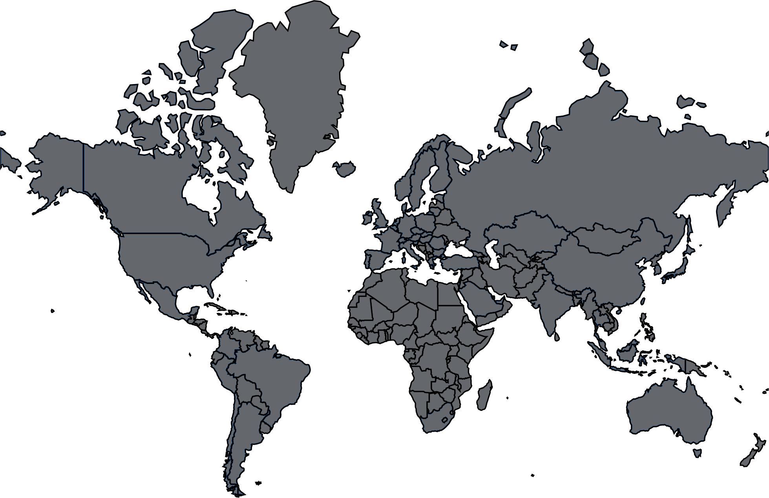
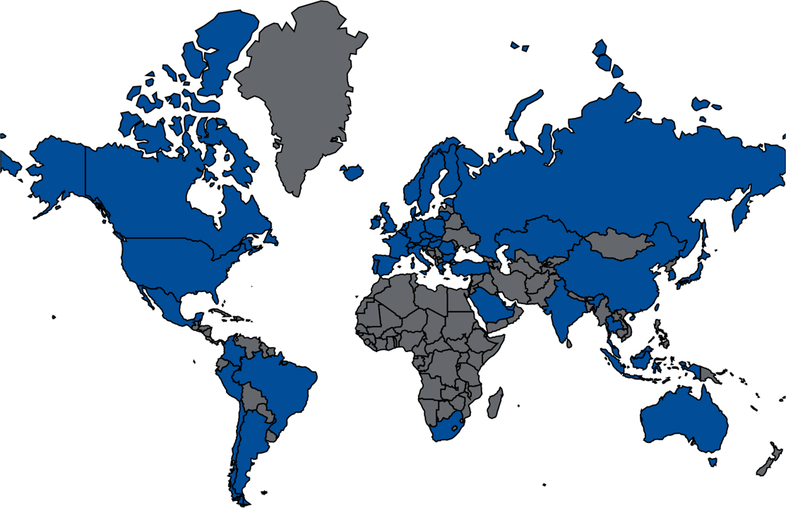
Prosys OPC
Founded in 1995
Global expert in
OPC UA solutions and information modeling
IT/OT integration
Industrial Security
An active member of the OPC Foundation and Open Industry 4.0 Alliance
Espoo,
Finland
50+ countries
1000+ customers

Slide 6






Our Product Family
Developer Tools
Integration & Visualization
Simulation & Testing

Slide 7
Why WoT Matters
Traditional industrial onboarding
With WoT + Forge
Manual protocol integration
Vendor-specific configuration
Custom engineering effort
Slow deployment
Self-describing devices
Faster onboarding
Standardized metadata
Easier integration into IT/OT systems
Reduced engineering work
“WoT helps scale industrial integration.”

Slide 8
WoT Demo

Slide 9
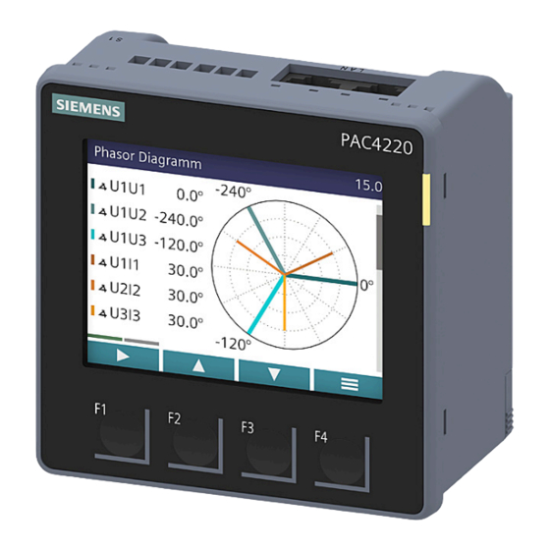
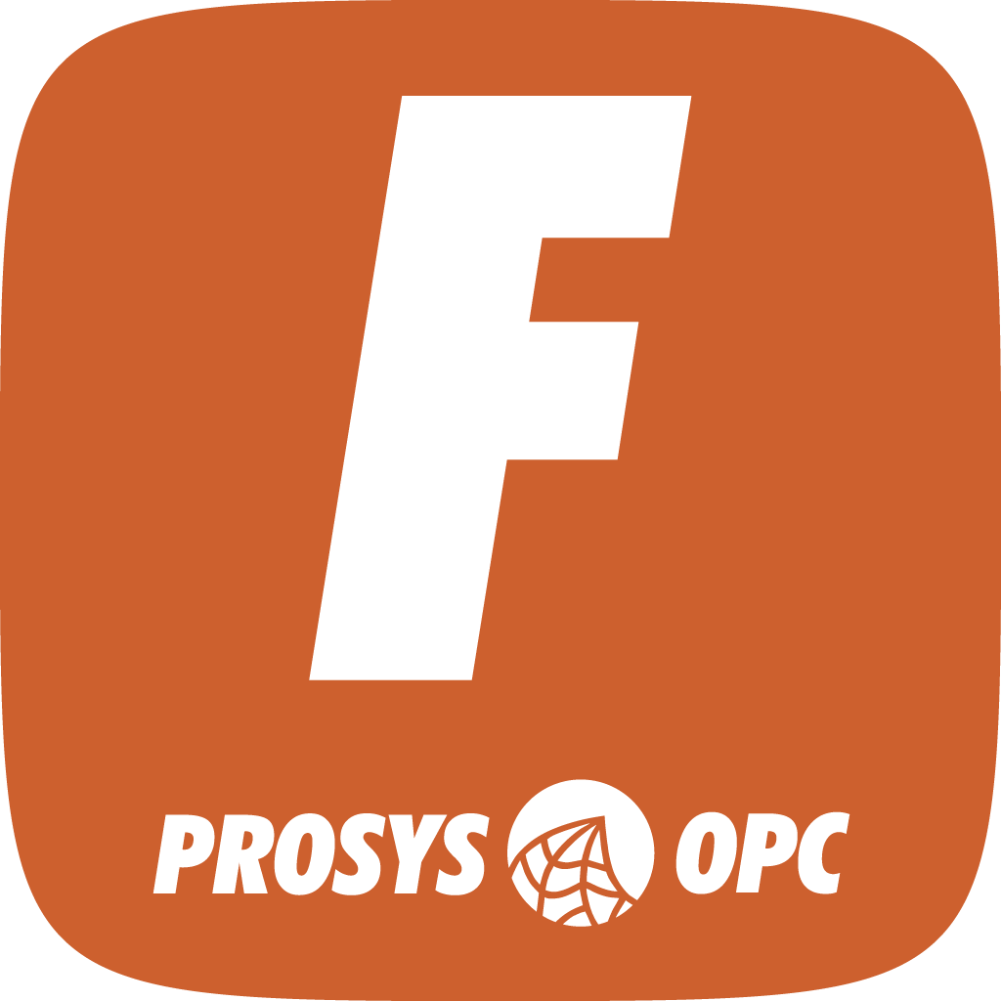
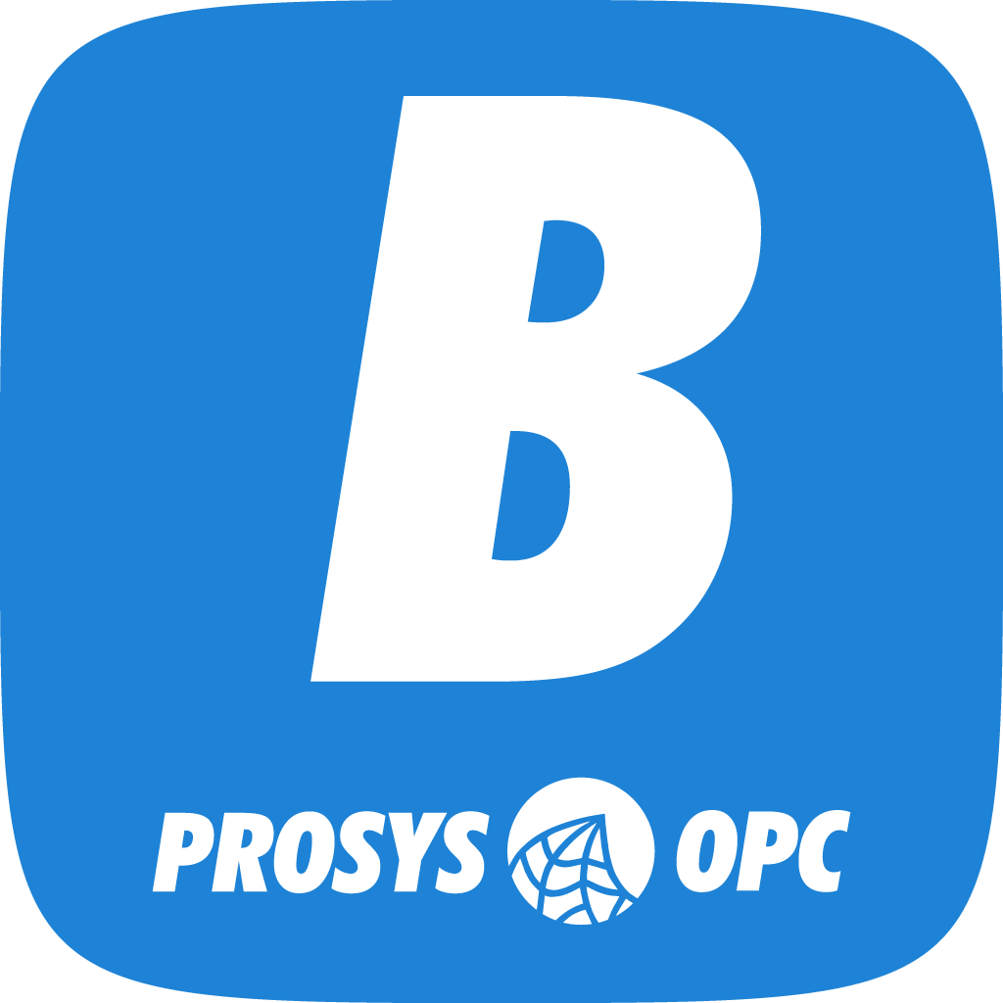
Components
Siemens PAC4220
Power Monitoring Device
Modbus
WoT Thing Description
Forge
Integration platform
OPC UA Companion Specifications
http://opcfoundation.org/UA/IA/
http://opcfoundation.org/UA/ECM/
Browser
OPC UA Client
InfluxDB
History buffer database for Forge
Grafana
Dashboarding tool

Slide 10
Architecture
Running in containerized environment
Local network access to the device
Access to public internet to connect to Cloud Library

Slide 11
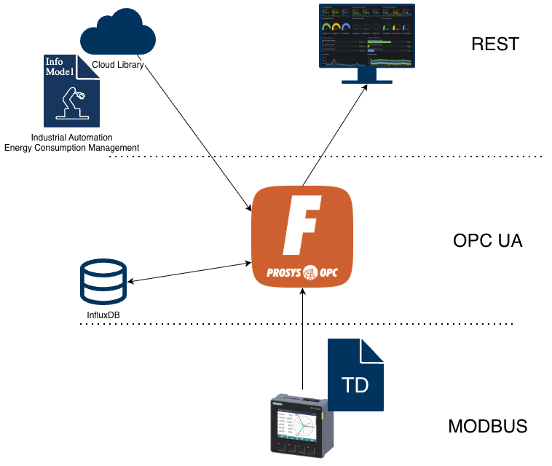
The key point is that the device onboarding logic becomes reusable and standardized instead of device-specific engineering.
OPC UA Companion Specification gives additional value for further integration.

Slide 12
Live Demo

Slide 13
And much more…

Slide 14
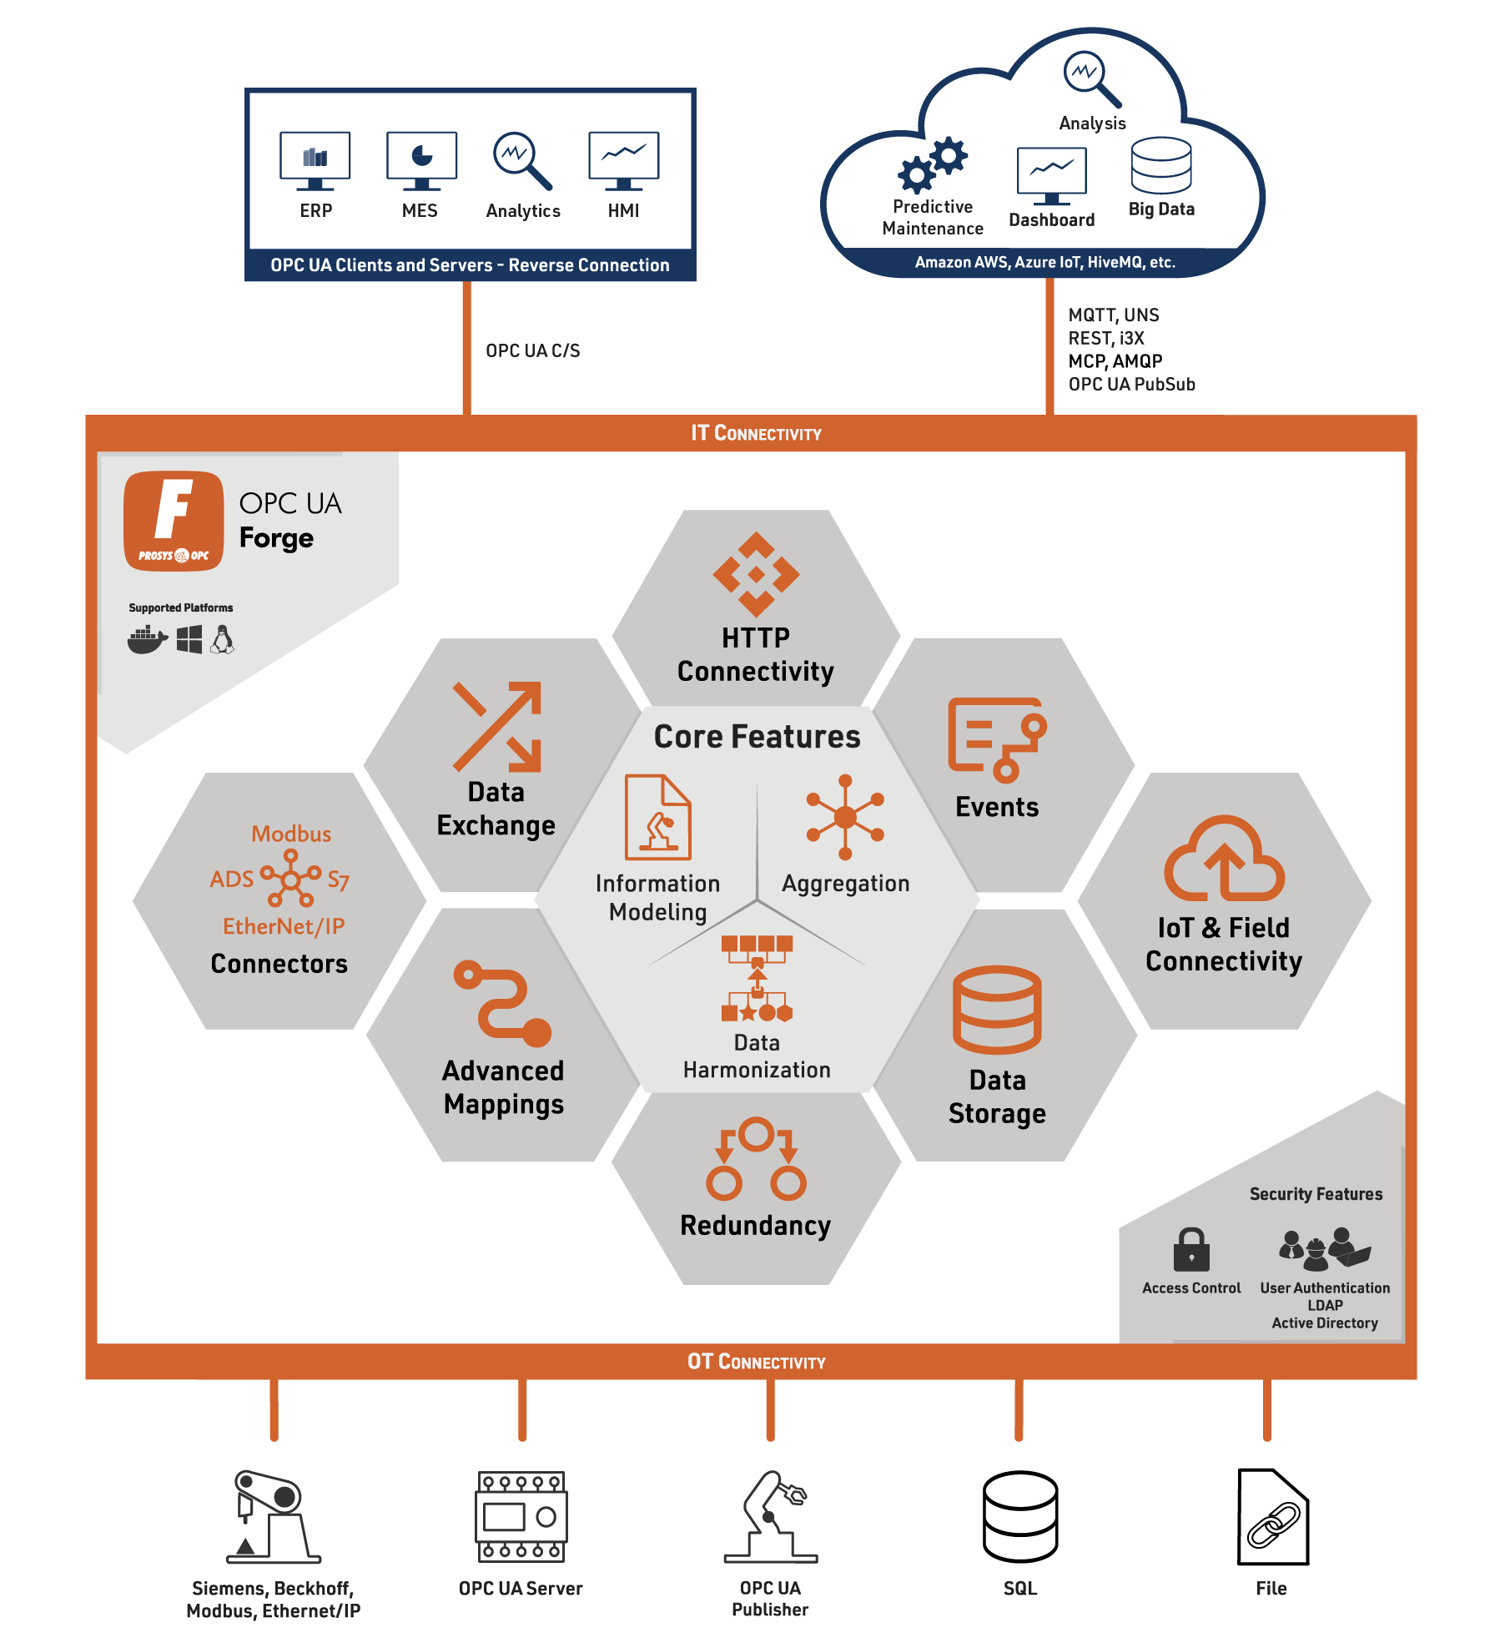
Prosys Forge
Industrial DataOps & Edge Application
OPC UA Server as the core
Variety of south- and northbound connectivity
Business logic tools
Windows, Linux, Container
Web configurator
OpenAPI REST API

Slide 15
Contact us
Email: iivo.yrjola@prosysopc.com Office: +358 9 420 9007

