Slide 1
Data Facades Community Group
Welcome meeting
27 October 2025
https://www.w3.org/groups/cg/facade-x/
public-facade-x@w3.org

Slide 2
Introductions
Affiliation and Background
Why are you here?
What do you expect from the Community Group?

Slide 3








Community Group Objective
The group's primary goal is to foster the long-term stability and broader adoption of the approach for accessing heterogeneous web data using data façades
Data Façade
RDF

Slide 4

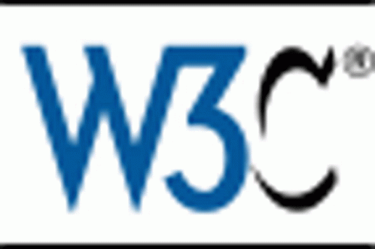

How did we get here?
2020
2021
2023
2025
EU H2020 SPICE Project
Facade-X: An Opinionated Approach to SPARQL Anything @ Semantics 2021
Open Source Project SPARQL Anything
Knowledge Graph Construction with a Façade. In: TOIT
W3C Community Group
Improved Engineering Growing open source community

Slide 5
Reference publications
L. Asprino, E. Daga, J. Dowdy, A. Gangemi, and P. Mulholland. “Materialisation approaches for Façade-based data access with SPARQL”. in: Semantic Web Journal (), (to appear)
P. Warren, P. Mulholland, E. Daga, and L. Asprino. “Path-based and triplification approaches to mapping data into RDF: user behaviours and recommendations”. In: Semantic Web 15.6 (2025), pages 2479–2505. ISSN: 2210-4968. DOI: 10.3233/SW-243585
L. Asprino, E. Daga, A. Gangemi, and P. Mulholland. “Knowledge Graph Construction with a Façade: A Unified Method to Access Heterogeneous Data Sources on the Web”. In: ACM Transactions on Internet Technologies 23.1 (2023). ISSN: 1533-5399. DOI: 10.1145/3555312
E. Daga, L. Asprino, P. Mulholland, and A. Gangemi. “Facade-X: An Opinionated Approach to SPARQL Anything”. In: Proceedings of the 17th International Conference on Semantic Systems (SEMANTiCS 2021). Edited by M. Alam, P. Groth, V. de Boer, T. Pellegrini, and H. J. Pandit. Volume 53. IOS Press, 2021, pages 58–73. DOI: 10.3233/SSW210035
M. Ratta, E. Daga, and L. Asprino. “PySPARQL Anything Showcase”. In: Proceedings of the 21st ESWC Conference (ESWC 2024) - Poster and Demo track. 2024
E. Daga and L. Asprino. “The SPARQL Anything project”. In: The Web Conference 2021 - DevTrack. 2021
L. Asprino, E. Daga, J. Dowdy, P. Mulholland, A. Gangemi, and M. Ratta. “Streamlining Knowledge Graph Construction with a façade: The SPARQL Anything project”. In: Proceedings of the 2nd EuropeaN Data conference On Reference data and SEmantics (ENDORSE 2023). 2023. DOI: https://data.europa.eu/doi/10.2830/343811

Slide 6
Community Group Objectives
Developing the Façade-X Method
Creating Standard Mappings (Profiles)
Establishing a Process for New Formats
Developing the SPARQL Dialect
Collaborating with Other W3C Groups
Fostering Community and Business Engagement
Supporting the Development of Implementations
…

Slide 7
Community Group organisation
5 Supporters: Enrico Daga, Luigi Asprino, Julian Rojas, Ivo Velitchkov, Mathias Vanden Auweele
Chairs: Enrico Daga, Luigi Asprino (Anyone Else?)
15 Participants

Slide 8
Meetings
Monthly meetings
Meetings will be recorded
Minutes will circulate at the end of the meeting

Slide 9
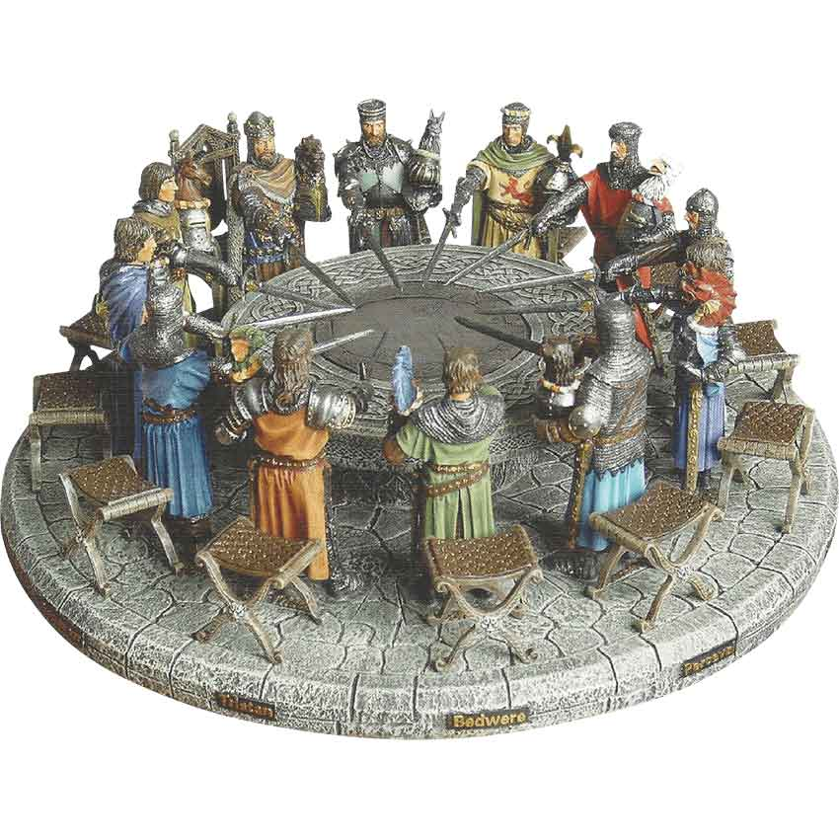
Discussion
Roadmap
Façade-X specification:
Specify metamodel
FX voc (ontology)
Specify mappings
…
Management
Colab space: GitHub
Websites and templates: spec templates..
Reports (?)
…
AOB:
Members’ sharing sessions
Webinars
…

Slide 10
Roadmap (proposal)
Consolidation and standardization of the approach, meta-model(s) and SPARQL Dialect
?

