Slide 1




An e-government working Experience
The CiTel Project
“Telematic Front Office for Citizen”
Leader of the Project - Franco Chesi
W3C Office in Italy - Oreste Signore
Private firms - Maurizio Pallotti
CMG Poland – The CiTel Project - Italy

Slide 2
Framework
The Ci-Tel project was born in the context of the Rete Telematica Regionale Toscana
In 2002 the Ci-Tel project has been proposed in the framework of the multi-project E-Toscana in the selection advertised by M.I.T.
The total cost is about 3.36 million euro
Some of the Technological partners are: Regulus, Cedaf
The Scientific partner is: W3C Office in Italy
Notes:
1) Tuscany Telematic Regional Net : is used by local administrations to develop a comprehensive envirronment for technological innovation and Information Society.
Recently,in February 2002, a first advance of 120 million Euro was given to finance e-government projects. The projects must at the end receive the evaluation by PA organisms. A system of "co-financing" was provided, where e-government public funds could cover only a part of the total amount of the projects, up to 50%, the rest of the expenses should be financed directly by the project proponents. The CiTel e-government plan is in the fourth position in the selection advertised by Ministry of Technological Innovation (MIT)
630 Keuro as M.I.T. co-financing, 1.1 invested by privates firms and 1.1 Meuro by Municipality of Pisa
San Miniato, Volterra….

Slide 3
In-progress Report
The project began in 2002 and must be completed before the summer 2005
The 90% of the schedules for the different services are already ready
In the next slide it is to see how far is Tuscany with the project
Notes:
The work is quite finished.
And on line services are already operative in several cities in the neightbourhood (evidenziare alcuni problemi)

Slide 4
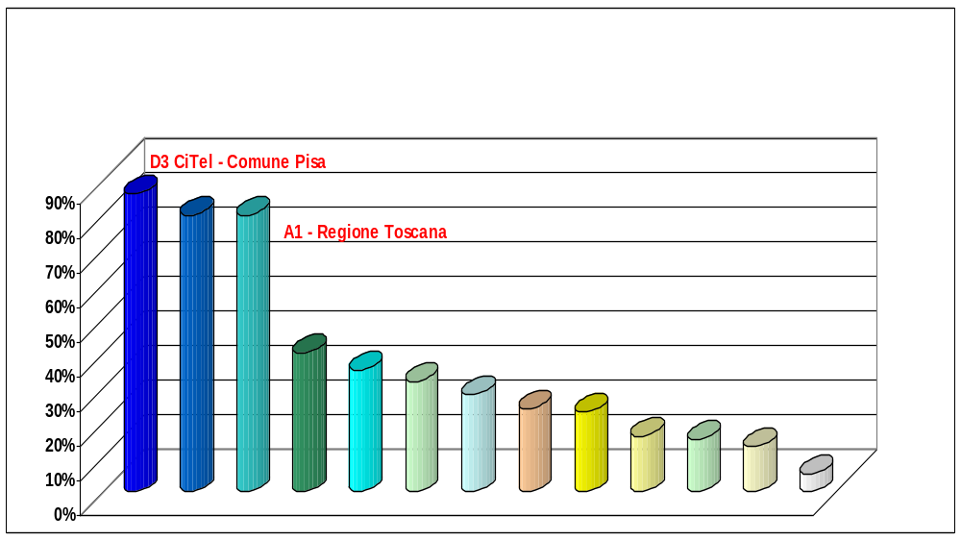
In-progress Report of the e-government project in Tuscany
Source
M. I. T.
Notes:
This is a graph from the M.I.T. report for the month of March
As you can see the running of our project if compared with others is OK

Slide 5
Achievements
The services are intended for people that are resident in seven of the cities in the neighbourhood
The project releases about 60 services
The citizen may use several media
The citizen will be admitted to services after being identified througt credentials
The website is www.e.comune.pisa.it

Slide 6
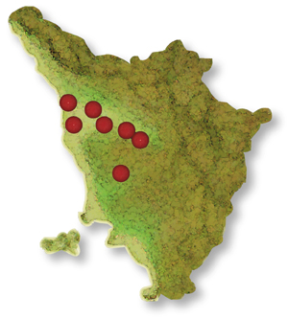


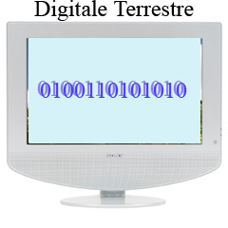

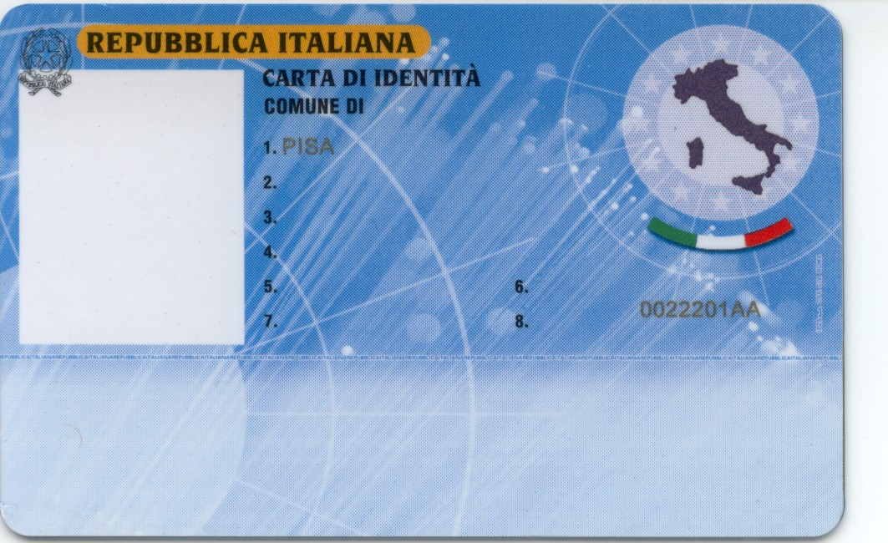
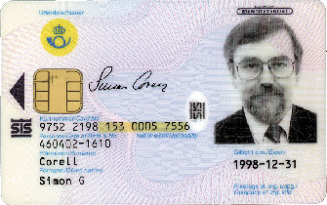


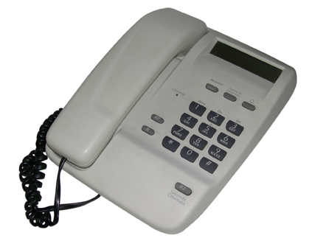
Tuscany - Italy
An SMS reminds me about the deadline for the registration of my son to the nursery-school.
So I am sure that I’ll remember to register him, I’ll do it and
then I can check if he/she has been entered on the list.
Web Services
Open standard
SOAP-XML
Digital TV
Front Office
CiTel
PIN
Notes:
This is the core of my presentation
The citizen will be admitted to services after being identified through various levels of credentials, starting from the login and password (low credential) to the Electronic Identity Card (strong credential) and the digital signature.
Citizens may access the services directly from their own PC, from a mobile phone, or thanks to telematic kiosks that will be installed in several points of the city
Citizens who can’t have access to advanced technologies will find as ever information through the information-offices of the city, and contacting the Call Center to a free number. The operator will be able to answear in a way more complete than in the past, retrieving the information requested by the citizen through fixed identification codes.
in the exemple is to see a Citizen that thinks .........
among the services we can provide already the citizens with : payments on-line, account statements form firms, building declarations , access own data, self statement and so on
It’s very important the right side of this slide because if the front office box has realized the frameword that include
The yellow vertical arrow stands for safe connection between the seven municipality and the front office of CiTel and in order to change the date is possible to use xml and soap….
The data of the back office remain where they are so there is a completely de-coupling between the ones from back-office and the others from Front-office

Slide 7
Tecnological issues
The Base Framework is the main architectural component of the system and it makes possible different processes as:
  Authentication and Authorization Management
  Menu management
  Log management
  .....
The front office acquired its own information through web services
Services have been structured separating various logical events:
  Presentation (user interface)
  Application logic
  Integration with Back-Office

Slide 8
Reuse
E-government projects are going to reuse the base framework:
- ET-Web - Municipality of Catania
- FromCi - Municipality of Vicenza
New entry to reuse citel modules
- Municipality of Pietrasanta
- Municipality of San Miniato
Notes:
The project was used also for other puplic administration services, but according to me it is too difficult to use the same project for everything and it is better to create an other project to reuse for different realities

Slide 9
Future Planning
An other project “T-CiTel” has been already presented. It has been one of the 29 projects in Italy which got funding in the framework of a contest for digital terrestrial television transmissions, managed by the Ministry for Innovation and Technologies.
The project can be employed in a lot of other area in the future as in the :
  Building Area
  School Area
  Payments Area
  Demographic Area
  Tourism Area
  Municipal Police Area
  Citizen Area

