Slide 1


W3C eGovernment Activity
Oreste Signore
22nd October 2008
Interoperability’s laboratories: iGovernment border places

Slide 2

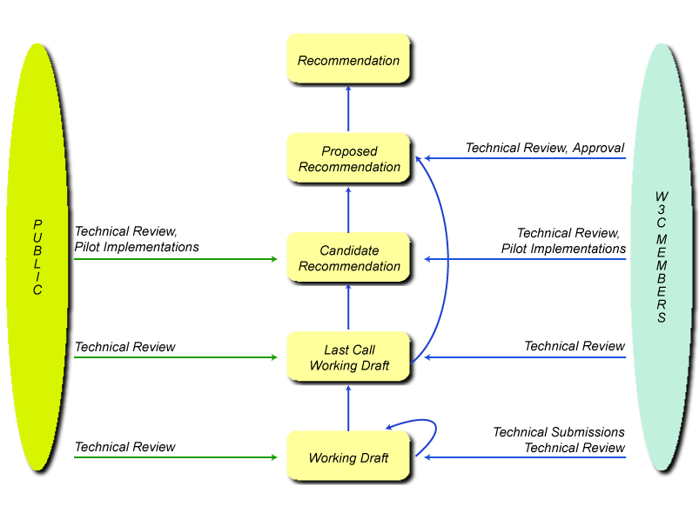
The World Wide Web Consortium (W3C) is an international consortium where Member organizations, a full-time staff, and the public work together to develop Web standards.
W3C's mission is: To lead the World Wide Web to its full potential by developing protocols and guidelines that ensure long-term growth for the Web.
The primary goal of an Interest Group is to bring together people who wish to evaluate potential Web technologies and policies. An Interest Group is a forum for the exchange of ideas

Slide 3
The eGovernment Interest Group
  part of the eGovernment Activity.
  mission:
    to explore how to improve access to government through better use of the Web
    achieve better government transparency using open Web standards at any government level (local, state, national and multi-national)
  3 eGovernment-related workshops so far:
    European Symposium on eGovernment [report]
    Gijón, Spain, 1-2 February 2007
    Toward More Transparent Government: Workshop on eGovernment and the Web [report]
    Washington DC, USA, 18-19 June 2007
    Role of Mobile Technologies in Fostering Social Development
    São Paulo, Brazil, June 2-3 2008
  launched June 2008
    36 participants (23 from 17 organizations + 13 Invited Experts)

Slide 4
Activity to tackle issues in three main areas:
  Usage of Web Standards (Open Standards)
    Gather information about the areas where best practice guidelines are needed
    Provide input on how to ease standards compliance
  Participation and Transparency
    Identify ways to improve government transparency and openness
    Identify ways to increase citizenship participation
    Identify ways to increase citizens and business use of eGovernment services
  Seamless Integration of Data
    Identify how to advance the state-of-the-art in data integration strategies

Slide 5
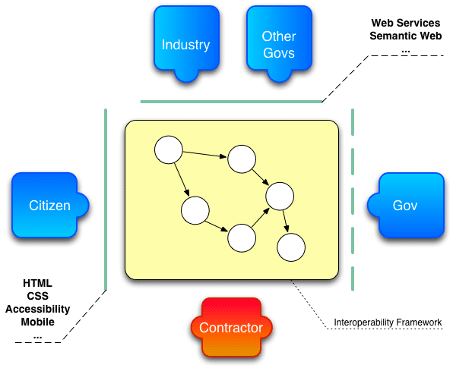
Open Standards Policies
  Governments should not require people to purchase particular software to access information
  Promote longevity of information
  Openness helps to maximize reuse of knowledge
    Colleagues, departments, agencies, citizens, companies, other governments, other partners
  Open standards promote research

Slide 6
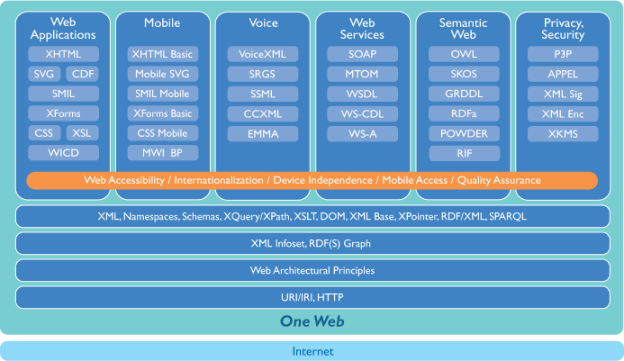
Applications must be conformant with …
… W3C standards

Slide 7
Participation
  Find ways to engage the users (collaborative tools)
  Change, Innovate
… and Transparency
  Accessible Web site
  Open Government Information

Slide 8
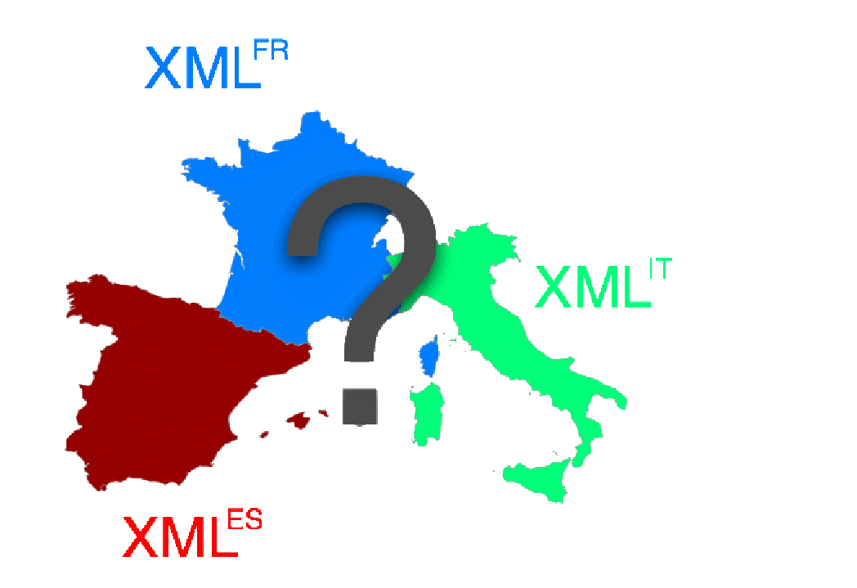
Data Integration
  XML is not always enough
Linked Data
  No more scraping
    Cost, maintenance
  Start simple
    RSS, Atom, Microformats, GRDDL, RDFa
  No need to throw away your existing systems, build on top
  Metadata are the goal (data mashups)
    Linking Open Data project

Slide 9

(Photo source: NY Times)
Mobile Web for Social Development
  W3C goal: to make the Web accessible, relevant, usable and useful for under-privileged populations and rural communities

Slide 10

Titolo
( DIAPOSITIVA TESTO CON ELENCO PUNTATO)
HELVETICA 18pt
Formal work has just started
We don’t have the solutions!
  trying to identify challenges
Dependencies
  Other W3C WGs (WAI, Web Services, Semantic Web, …)
  External Groups (CEN, European Commission, OASIS, World Bank, …)
Consider joining W3C and the group
References:
  José M. Alonso josema@w3.org
  (much material comes from his slides)
  eGovernment at W3C: http://www.w3.org/2007/eGov/
  If it isn’t on the web it doesn’t exist!
  Slides at:
    http://www.w3c.it/talks/2008/esiig2008/esiig2008.ppt
    http://www.w3c.it/talks/2008/esiig2008/esiig2008.odp
    http://www.w3c.it/talks/2008/esiig2008/esiig2008.pdf

