Slide 1
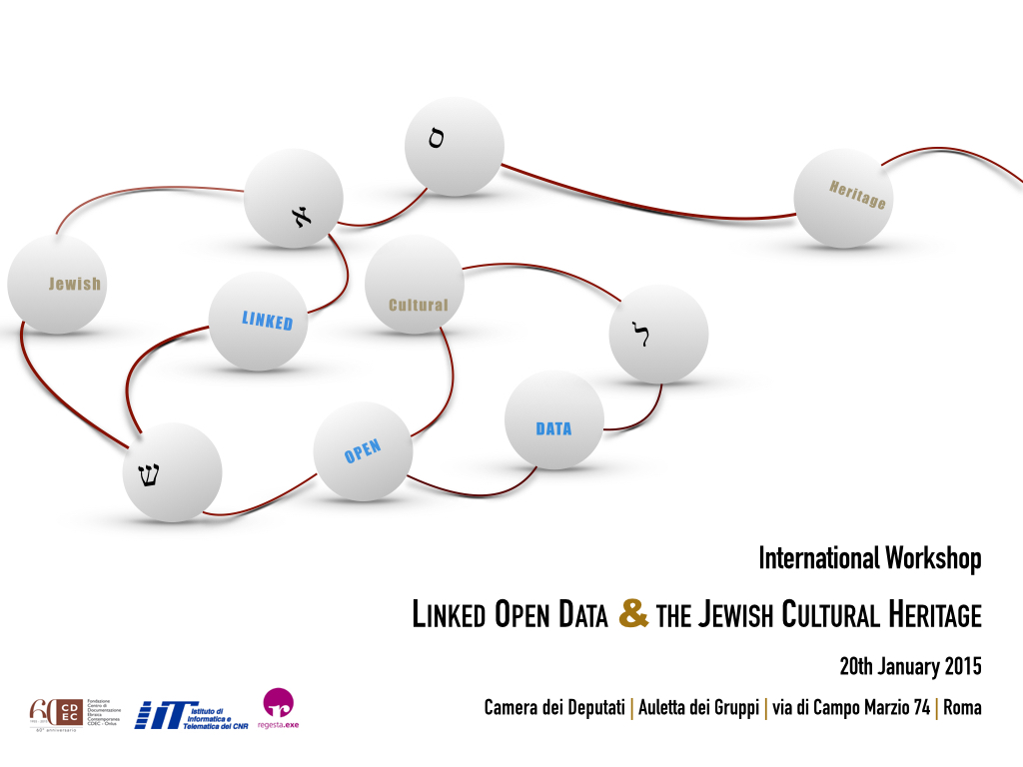


International Workshop
Linked Open Data & the Jewish Cultural Heritage
Rome, 20th January 2015
Linked Open Data: a short introduction
Oreste Signore
(W3C Italy)
Slides at: http://www.w3c.it/talks/2015/lodjch/

Slide 2

Talk layout
The birth of Linked Open Data (LOD)
Linked Open Data
  benefits, principles, levels
Web of Data & Semantic Web
  Data integration
  RDF (Resource Description Framework)
One step forward: ontology
Conclusion

Slide 3
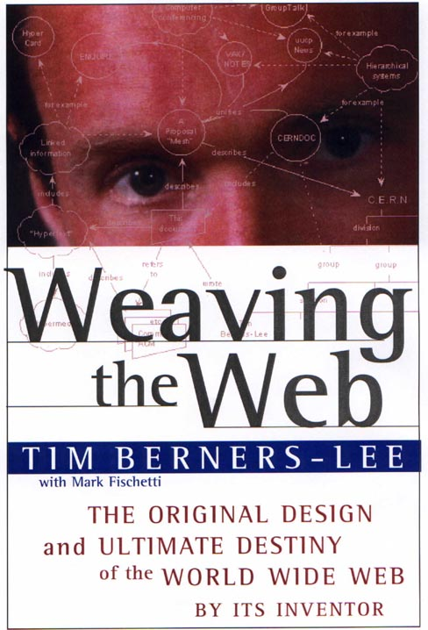
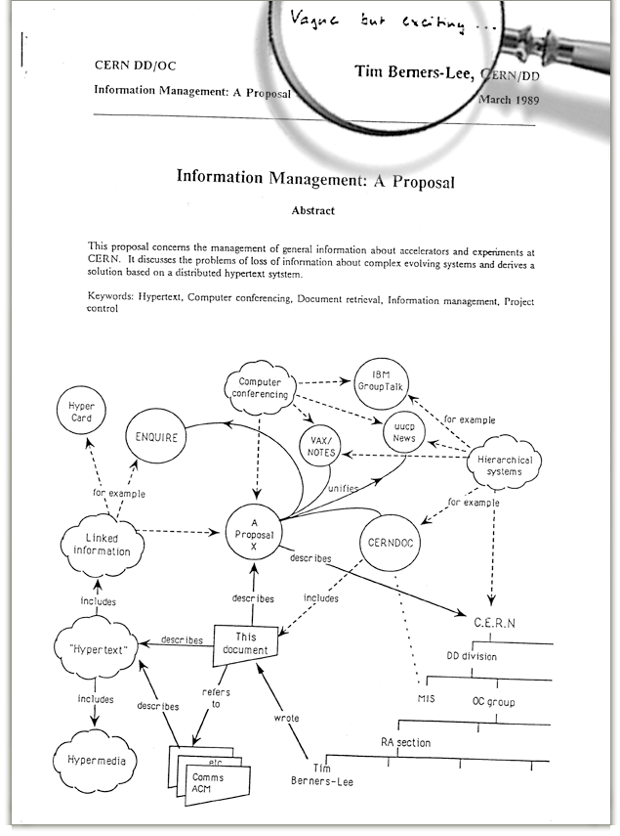


Once upon a time…
1970(?) A boy was talking with his father:
  How to make a computer intuitive, able to complete connections as the brain did
1980, while at CERN:
  Suppose all the information stored on computers everywhere were linked.
  Suppose I could program my computer to create a
  space in which anything could be linked to anything…
  There would be a single, global information space.
1989 Vague but exiciting
…and there was the Web…
1994
  “The very first International World Wide Web
  Conference, at CERN, Geneva, Switzerland, in
  September 1994”
  http://www.w3.org/Talks/WWW94Tim/
1999 Semantic Web Activity in W3C
(now: Data Activity)
2007 LOD (W3C Linking Open Data project)

Slide 4

Web architecture
Decentralization
Basics
  URI
    The most fundamental innovation of the Web
    Can address everything (resources, concepts)
  HTTP
    Format negotiation
    Protocol to fetch resources
  HTML
    Structuring documents
RDF (Resource Description Framework)
  will be for the Semantic Web what HTML has been for the Web

Slide 5
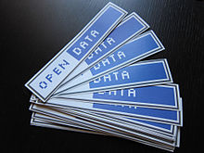
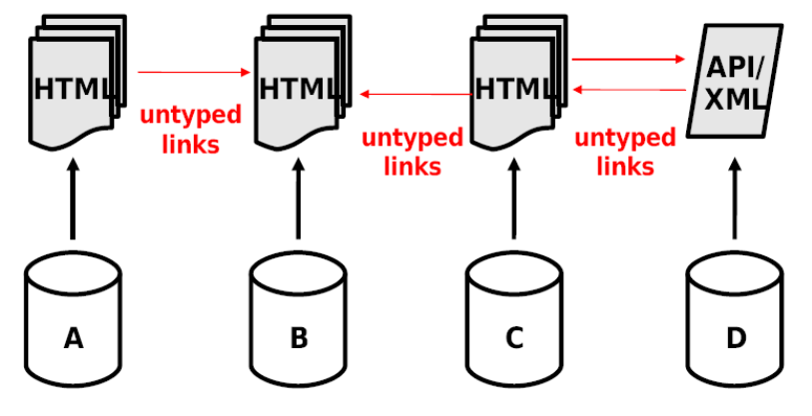
LOD: the benefits (1)
From the Web of Documents …
  A global filesystem
  Documents are the primary objects
  (Fairly structured)
  documents connected by
  untyped links
  Implicit semantics of
  content and links
  Designed for human consumption
  Simplicity … but disconnected data

Slide 6
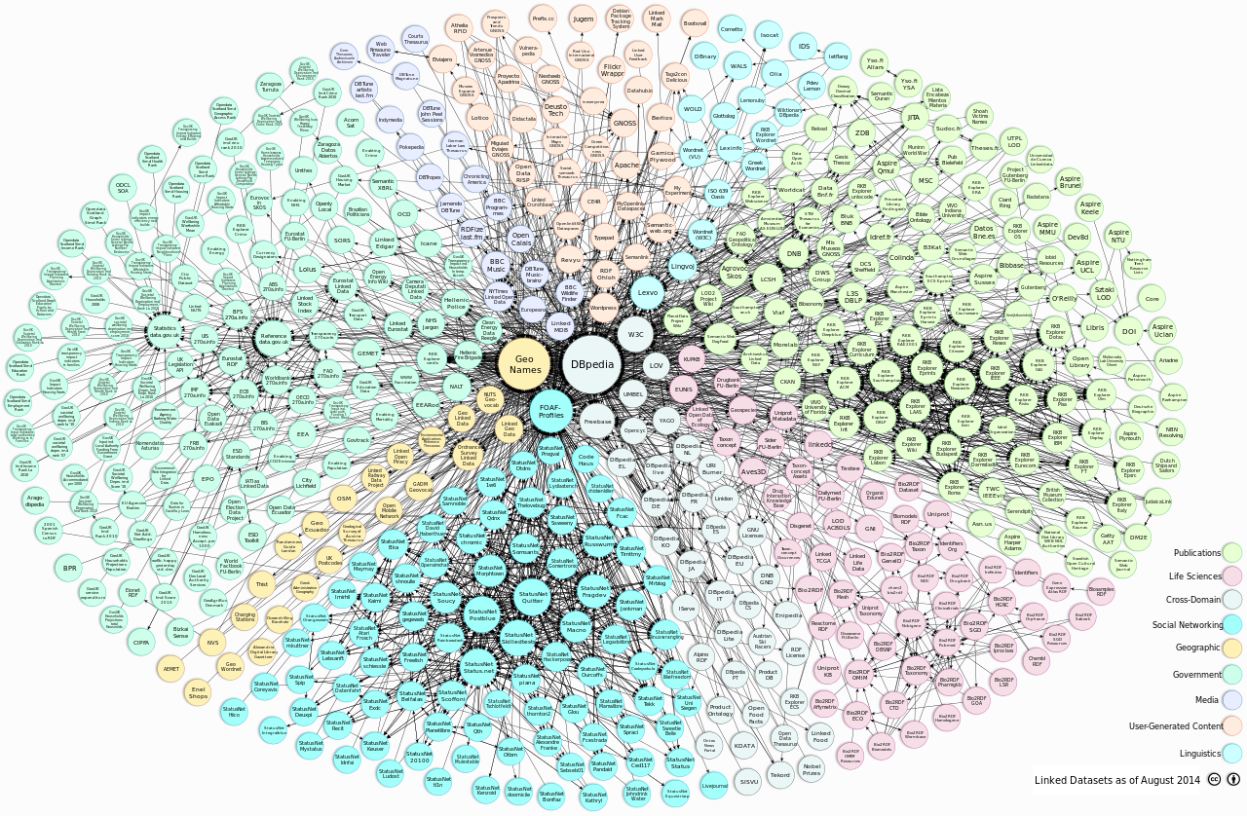
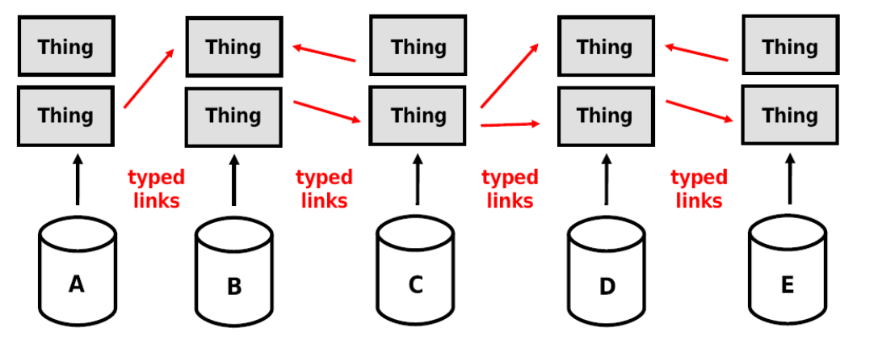
LOD: the benefits (cont.)
… to the Web of Data
  A global database
  Primary objects: Things (or description of things)
  Typed links between things (including documents)
  High degree of structure in (description of) things
  Explicit semantics
  of content and links
  Designed for
    Machines (first)
    Humans (later)

Slide 7
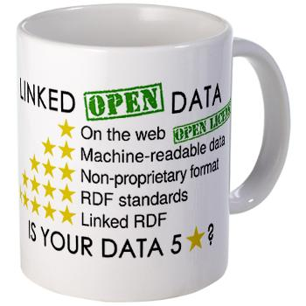
LOD: the principles
Web of things in the world, described by data on the Web
What does LOD mean?
  Use URIs as names for things
  Use HTTP URIs so that people can look up those names.
  When someone looks up a URI, provide useful information, using the standards (RDF*, SPARQL)
  Include links to other URIs, so that they can discover more things.
Tim Berners-Lee 2007
http://www.w3.org/DesignIssues/LinkedData.html

Slide 8
LOD: principle 1
Use URIs as names for things
URI identify:
  Documents and digital contents available on the Web
  Real objects and abstract concepts
Only HTTP URI, not other schemas like URN or DOI, because:
  Provide a simple way to create globally unique names in a decentralized fashion, as every owner of a domain name, or delegate of the domain name owner, may create new URIreferences
  They serve not just as a name but also as a means of accessing information describing the identified entity

Slide 9
LOD: principle 2
Use HTTP URIs so that people can look up those names
HTTP is the universal protocol to access Web resources
All HTTP URI must be “dereferenceable”
When URIs identify real objects, it’s essential distinguish objects from documents that describe them

Slide 10
LOD: principle 3
Use a single data model to publish data on the Web: RDF
RDF data model is very simple and strictly coherent with Web architecture
When someone looks up a URI, provide useful information, using the standards (RDF*, SPARQL)

Slide 11
LOD: principle 4
Links (named RDF links) are “typed”
Set RDF links towards other data sources on the Web
  An external RDF link (having p and/or o defined in an external dataset) allows to access data on remote servers
  The process is repeated in cascade
  External RDF links are the glue that connects data islands into a global, interconnected data space
Include links to other URIs, so that they can discover more things

Slide 12
The LOD five levels
On the web
Available on the web (whatever format) but with an open licence, to be Open Data
Machine-readable data
Available as machine-readable structured data (e.g. excel instead of image scan of a table)
Non-proprietary format
as (2) plus non-proprietary format (e.g. CSV instead of excel)
RDF standards
All the above plus, Use open standards from W3C (RDF and SPARQL) to identify things, so that people can point at your stuff
Linked RDF
All the above, plus: Link your data to other people’s data to provide context

Slide 13
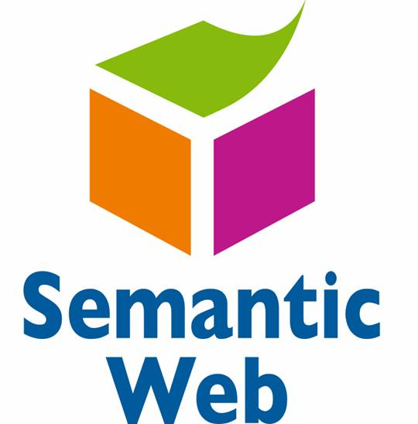
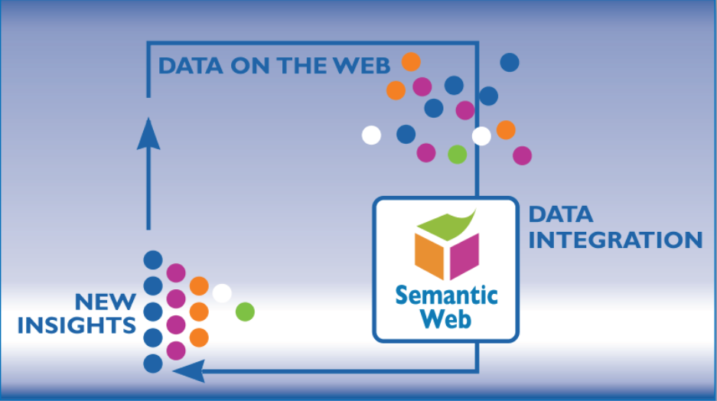
Web of Data and Semantic Web
Semantic Web
  Extends Web principles from documents to data
  Creates the “Web of Data”
Data (and not only data) can be
  shared and reused
  in the Web
RDF
  Resource Description
  Framework
  gives the abstraction
  layer to integrate data
  on the Web

Slide 14
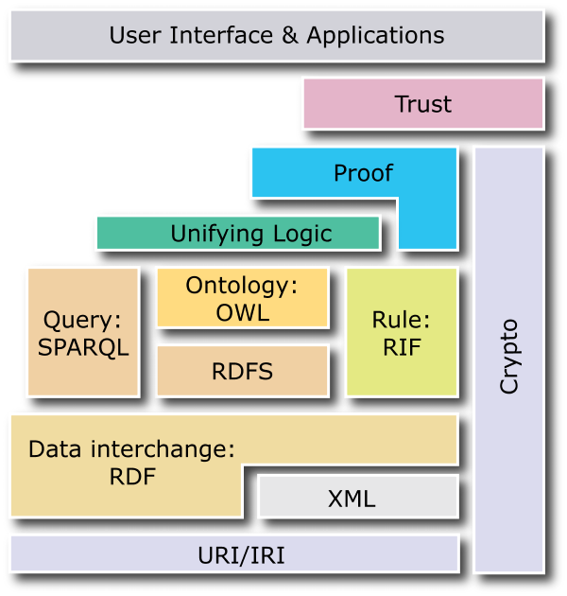

Semantic Web
A “Web of data”
Formalizing, exporting
and sharing knowledge
Ontologies
Inference rules
Data are
machine-understandable
Many technologies:
  RDF, RDFS, OWL, ...

Slide 15
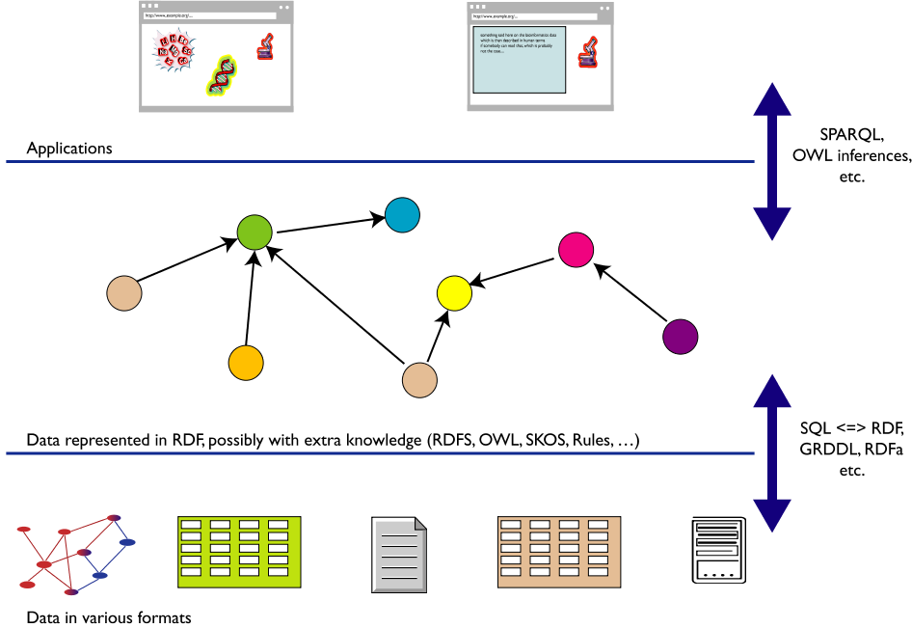
SW and Data Integration
Query, manipulate, etc.
Map,
expose,
etc.
No need to put all your data in RDF!

Slide 16

SW and Data Integration: some advantages
Representation as a graph
  independent of the actual structure of the data
Changes to the format of the local database, etc.
  have no influence on the
  general level
  affect only the level of the
  step of exporting data
  (schema independence)
You can
  add new data
  add more connections
seamlessly, regardless of the structure of other data sources

Slide 17

RDF in a nutshell
A RDF triple (s,p,o)
  is a labelled connection between two resources
  is called "triplet", or "statement"
The s, p, o resources are also called:
  "subject", "property", "object"
  or
  "subject", "predicate", "object"
A RDF triple (s,p,o) is defined in a way such that
  "s", "p" are URI (resources on the Web)
  "o" can be an URI or a "literal"
Names are denoted by URI
Conceptually:
  "p" connects (or states a relationship between) "s" and "o"
Formally:
  RDF triples are "directed, labelled graph"
  (the best way to think about them!)

Slide 18
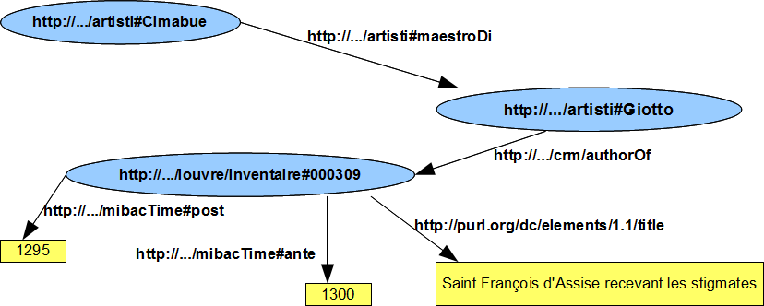
A RDF graph
...a set of s-p-o (subject-predicate-object) triples

Slide 19

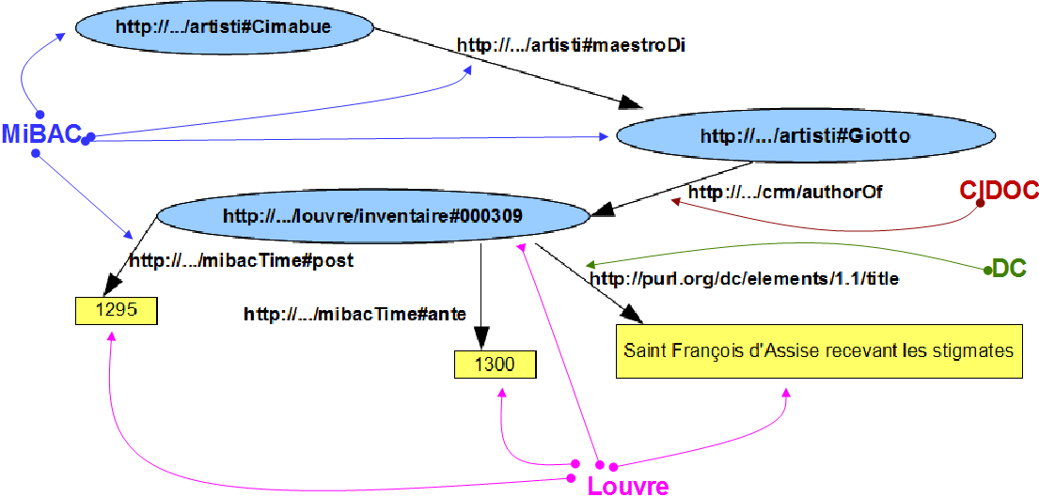
A RDF graph (annotated)
...a set of s-p-o (subject-predicate-object) triples

Slide 20


Is RDF enough?
RDF is a universal language to describe resources using your own vocabulary
Syntactically correct RDF statements (s-p-o triples) can be meaningful or meaningless
  Leonardo authorOf Gioconda
  Cimabue masterOf Giotto
  Michelangelo authorOf Leonardo
We need to express constraints
Here come RDFS, OWL (Ontology languages)

Slide 21

One step forward: ontology
Models knowledge in its:
  Intension (terminological knowledge: definitions of concepts and roles)
  Extension (assertional knowledge: instances or definitions of individuals)
A simple definition (Jim Hendler)
  A set of knowledge terms, including the vocabulary, the semantic interconnections and some simple rules of inference and logic for some particular topic
Many definitions, but:
  clear understanding
  consensus among the ontology community
An ontology includes:
  terms explicitly defined
  knowledge we can infer
An ontology aims to capture consensual knowledge, to reuse and share across software applications and by groups of people
A shared ontology
  Allows machines to understand data
  Makes data really interoperable

Slide 22
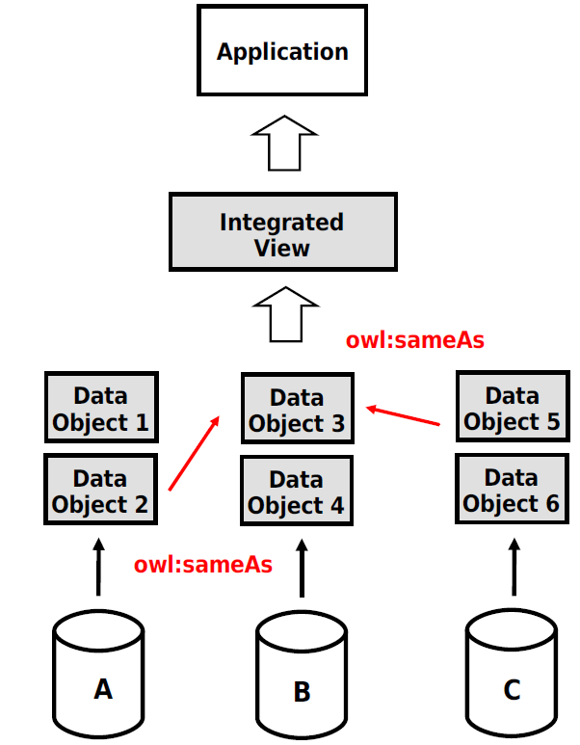
Reconciling differences
For classes:
  owl:equivalentClass: two
  classes have the same individuals
For properties:
  owl:equivalentProperty
For individuals:
  owl:sameAs: two URIs refer to the
  same concept (“individual”)
owl:sameAs
  is a main mechanism of “linking”
<http://louvre.fr/Michel-Ange>
owl:sameAs <http://mibac.it/Michelangelo> ;

Slide 23
Work done?
The ontology (intension):
  Models concepts and relationships
  Supports multilinguality
  Can be referenced by everybody
Data (extension):
  Available as RDF
  Can be queried via SPARQL
  Can be linked by everyone from everywhere
No more a single information silo!
Five stars LOD?

Slide 24
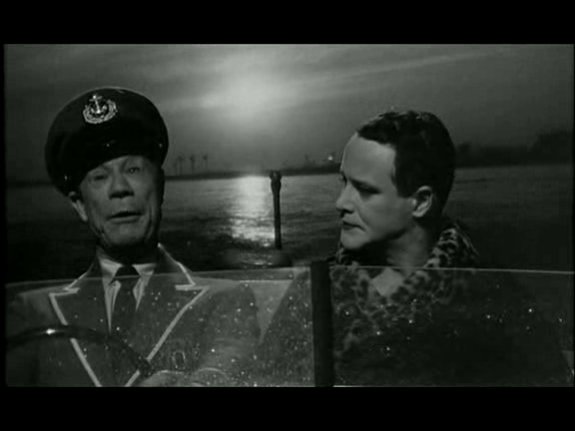
Nobody’s perfect!
Is the ontology a shared ontology?
Does it make reference to well established ontologies?

Slide 25
Building ontologies: a methodology (or a rule of thumb?)
Analyze and model your "world of interest"
Check existing ontologies:
  does one fits perfectly?
  extend one with your own concepts?
  combine several existing ontologies?
  full import or just refer some class/properties?
Based on my own experience:
  creating your own ontology is easier, but less effective
  using/combining/extending existing ontologies is harder, but more effective
  keep intensional and extensional components separated
Content of this slide does not necessary reflect the W3C position

Slide 26
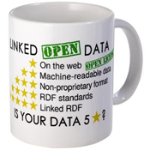
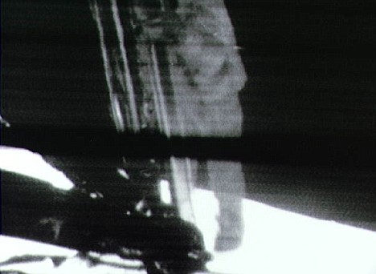
Ready to start?
User requirements
  Integrated view of information
Data fusion: some well known problems
  Schema mapping
  Conflict resolution: inconsistencies
  Trust / Information quality
Reuse issues
  Licences
Implementation issues
  How to publish
  Platforms
Aim: five star dataset, rich and shared ontology.
However:
  The best is the enemy of the good.
  The important is to start, even with raw data
  “One small step for man. One giant leap for mankind.”

Slide 27
Conclusion
LOD have been part of the Web since its inception
The main benefit is to share and improve knowledge
RDF is the basis
SW technologies are crucial
W3C (i.e. W3C members) is leading activities in the field
Share ontologies (intension)!
Keep data decentralized (extension)!
START NOW
?
Questions
Thank you for your attention!
Slides at: http://www.w3c.it/talks/2015/lodjch/

