Slide 1
Trusted Resolution
Checking who may speak for a product before an agent trusts the data
Sven Böckelmann
CTO, benelog GmbH & Co. KG, Cologne · OpenEPCIS
Notes:
20 minutes, then the breakout in the afternoon. Programme title: Who Owns Product Truth on the Agentic Web.

Slide 2
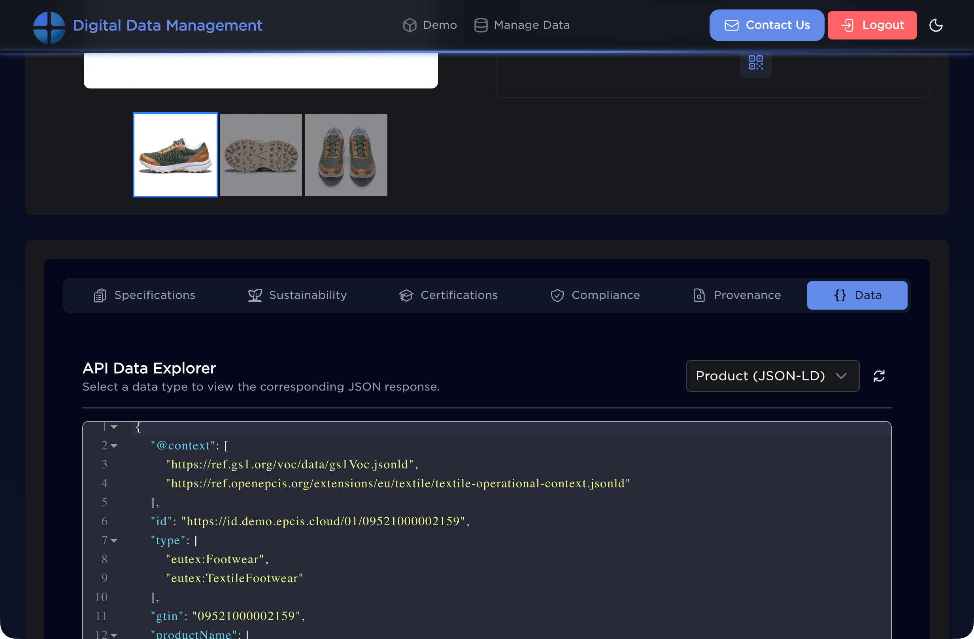
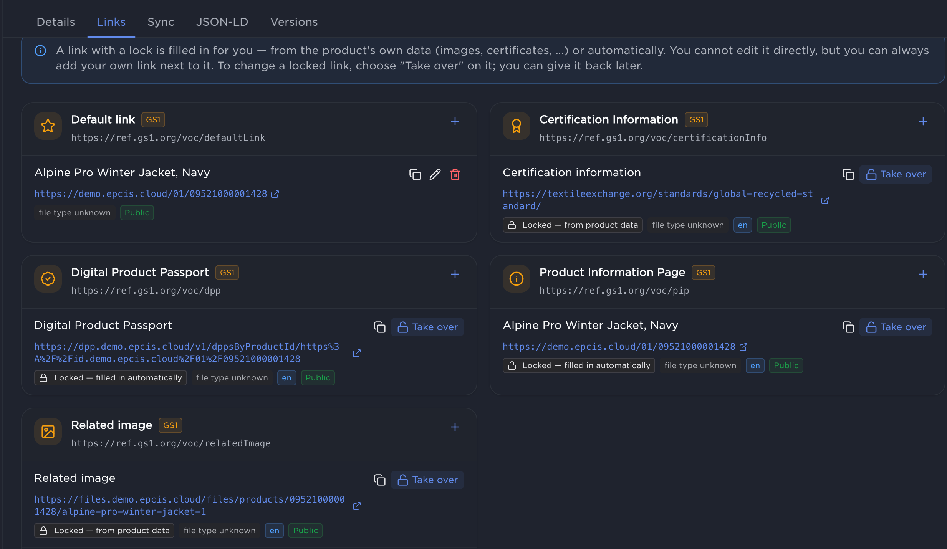
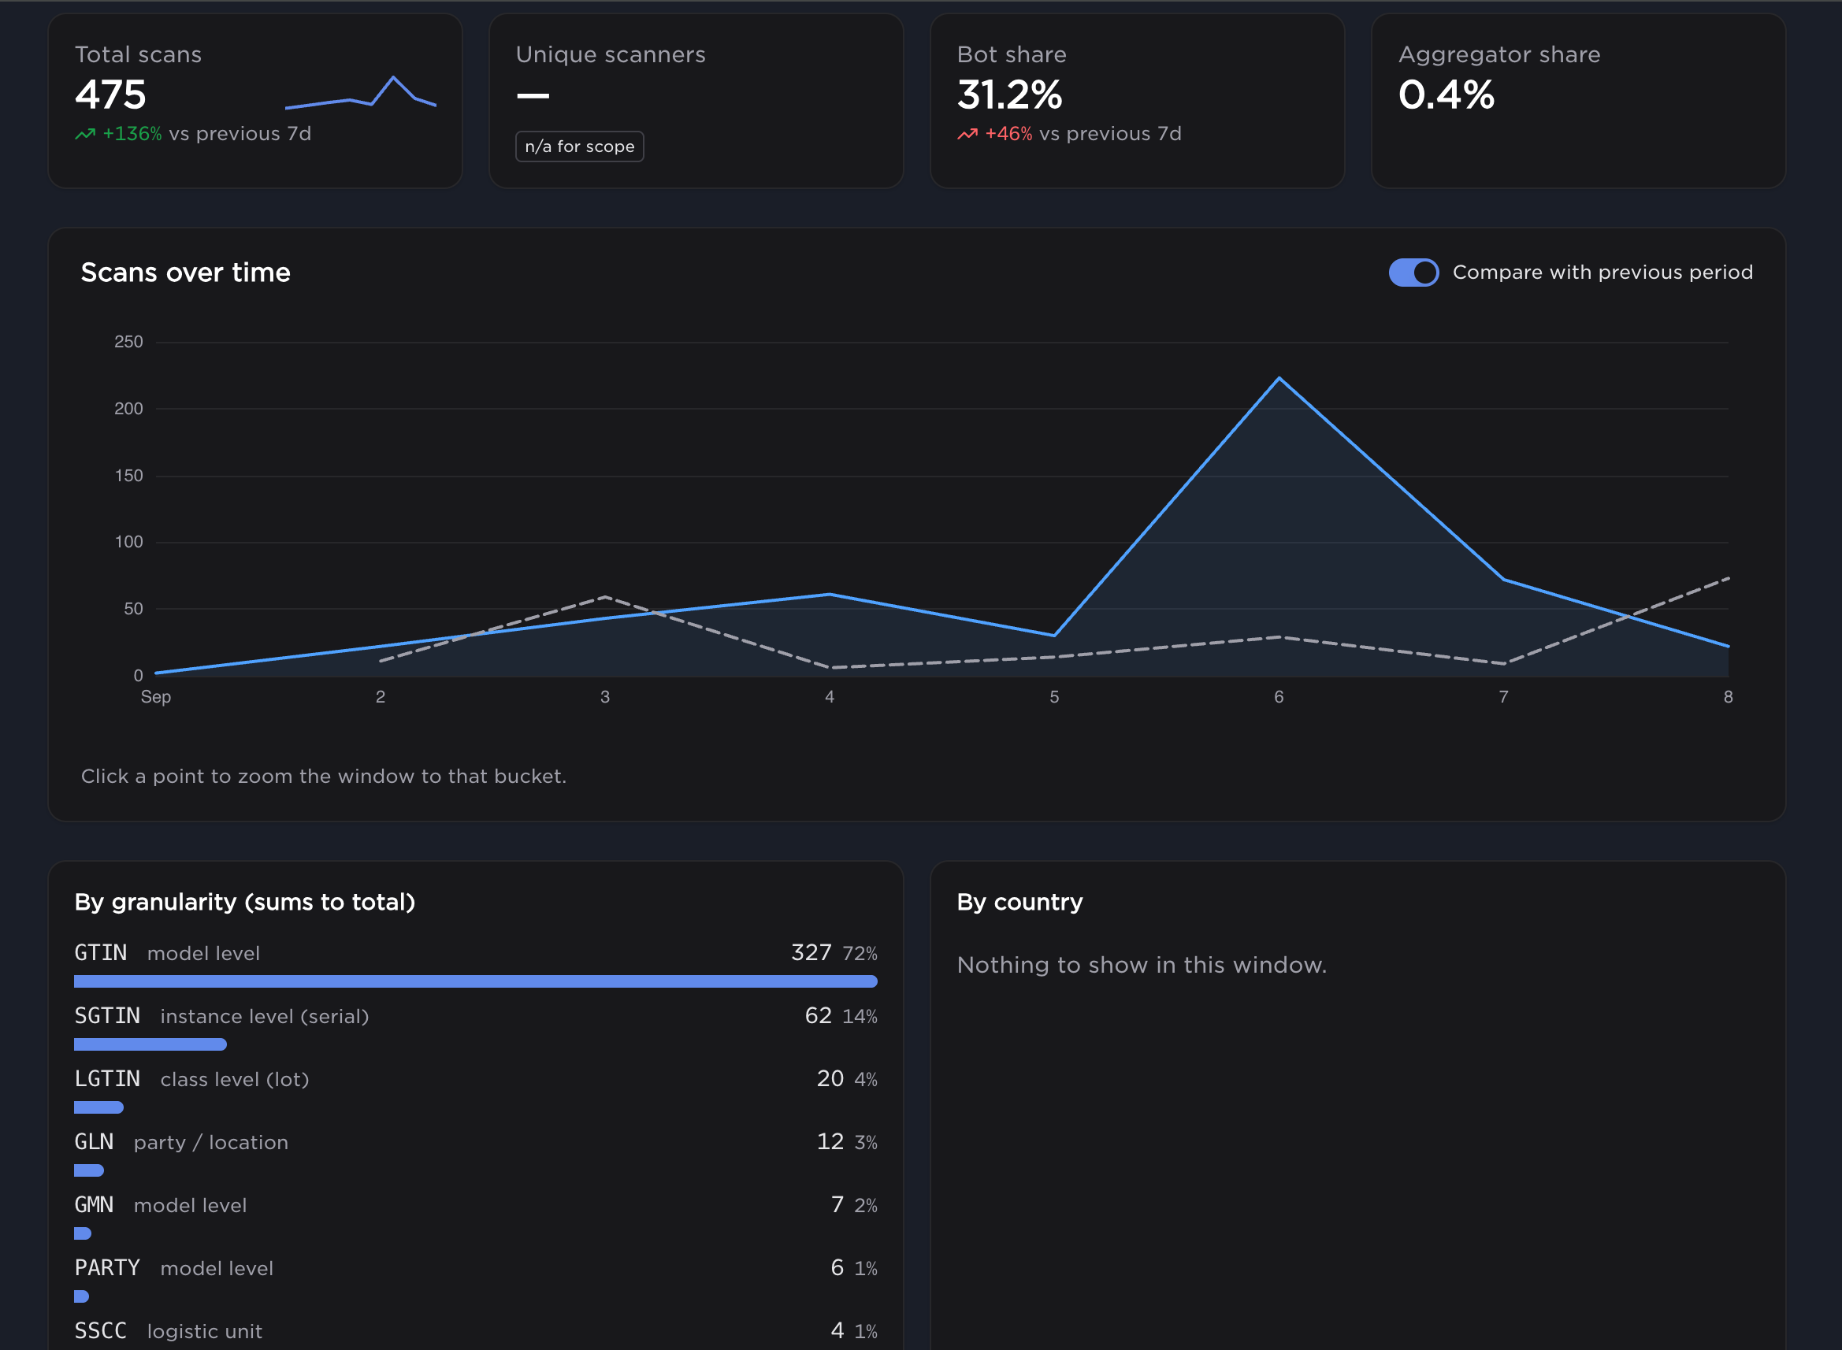
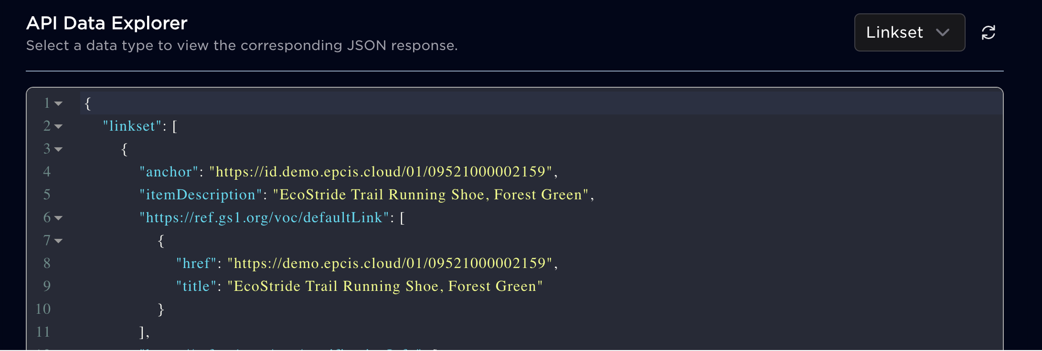
Not Only EPCIS
What we build and provide at benelog.
OpenEPCIS Open-core EPCIS 2.0. EPCIS tools on GS1 Global sandbox.
GS1 Conformant resolver Digital Link for brands: GTIN registry, links, own domains, ERP and PIM connected.
ref.openepcis.io DPP vocabularies. Agentic AI support for governed JSON-LD from us today.
GS1 verification and validation OpenEPCIS checks against “Verified by GS1”, Support for VCs.
Notes:
We are benelog. We maintain OpenEPCIS, the open core EPCIS 2.0 implementation; and the tools on for the GS1 EPCIS Sandbox
We provide a GS1 conformant Digital Link resolver for brands, with their GTIN registry, their links, their own domains, we can connect to their ERP and PIM.
We publish the DPP vocabularies at ref.openepcis.io, so an agent reads governed JSON-LD from us today.
Testing how agents consume all of this is where I kept hitting one gap, and that is the talk.

Slide 3
First things first
The ID, and the link.
THE ID GTIN The number under the barcode, on billions of packages. A GS1 Member Organisation licenses a Company Prefix to a company; the company assigns its GTINs underneath it. 0 9506000 134352 GCP (global company prefix) licensed by GS1 · number assigned to brand The prefix licence is the one thing that ties a GTIN to a company. The Member Organisation knows who holds it; Verified by GS1 is the lookup.
THE LINK GS1 Digital Link The same GTIN written as a URL can be put into a QR code. https://id.gs1.org/01/09506000134352 resolves to a linkset: product page, passport, events Brands may print their own domain. id.gs1.org is the canonical form.
Notes:
Two things to know before the rest makes sense. First, the number. A GTIN is the number under the barcode, on billions of packages. A GS1 Member Organisation, GS1 Germany, GS1 US, GS1 Switzerland, licenses a Company Prefix to the company, and the company assigns its GTINs under that prefix. So the GCP is the one thing that ties a GTIN to a company, and the Member Organisation is the one who knows. Second, the link. GS1 Digital Link is the GTIN written as a URL: https://id.gs1.org/01/ followed by the GTIN, optionally serial or lot. That URL goes into a QR code; by 2027 retail moves from the barcode to that 2D code. When you resolve the URL, a resolver answers with a linkset: a list of links about this product, product page, passport, events. The brand can print its own domain instead of id.gs1.org; the standard defines id.gs1.org as the canonical form. Hold on to two words for the rest of the talk: licence, and linkset.

Slide 4
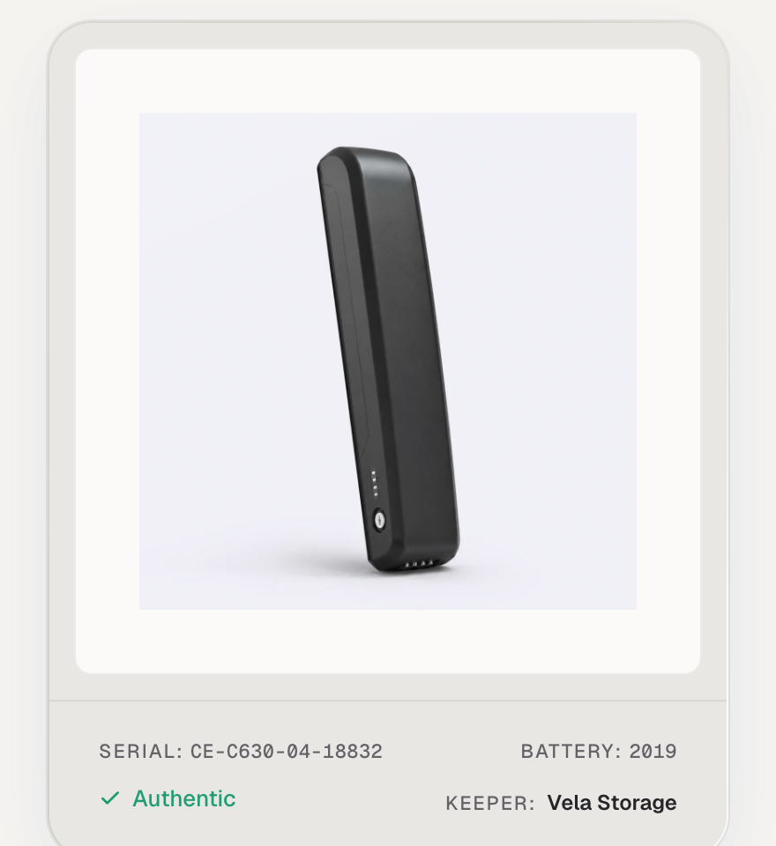
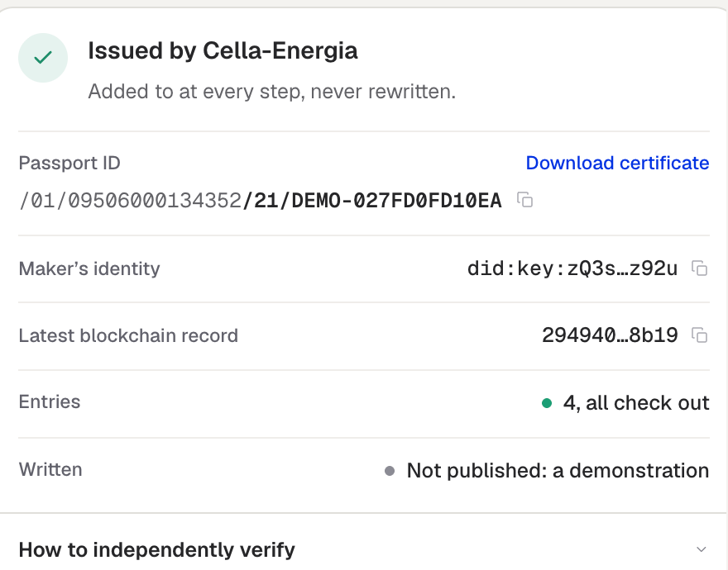
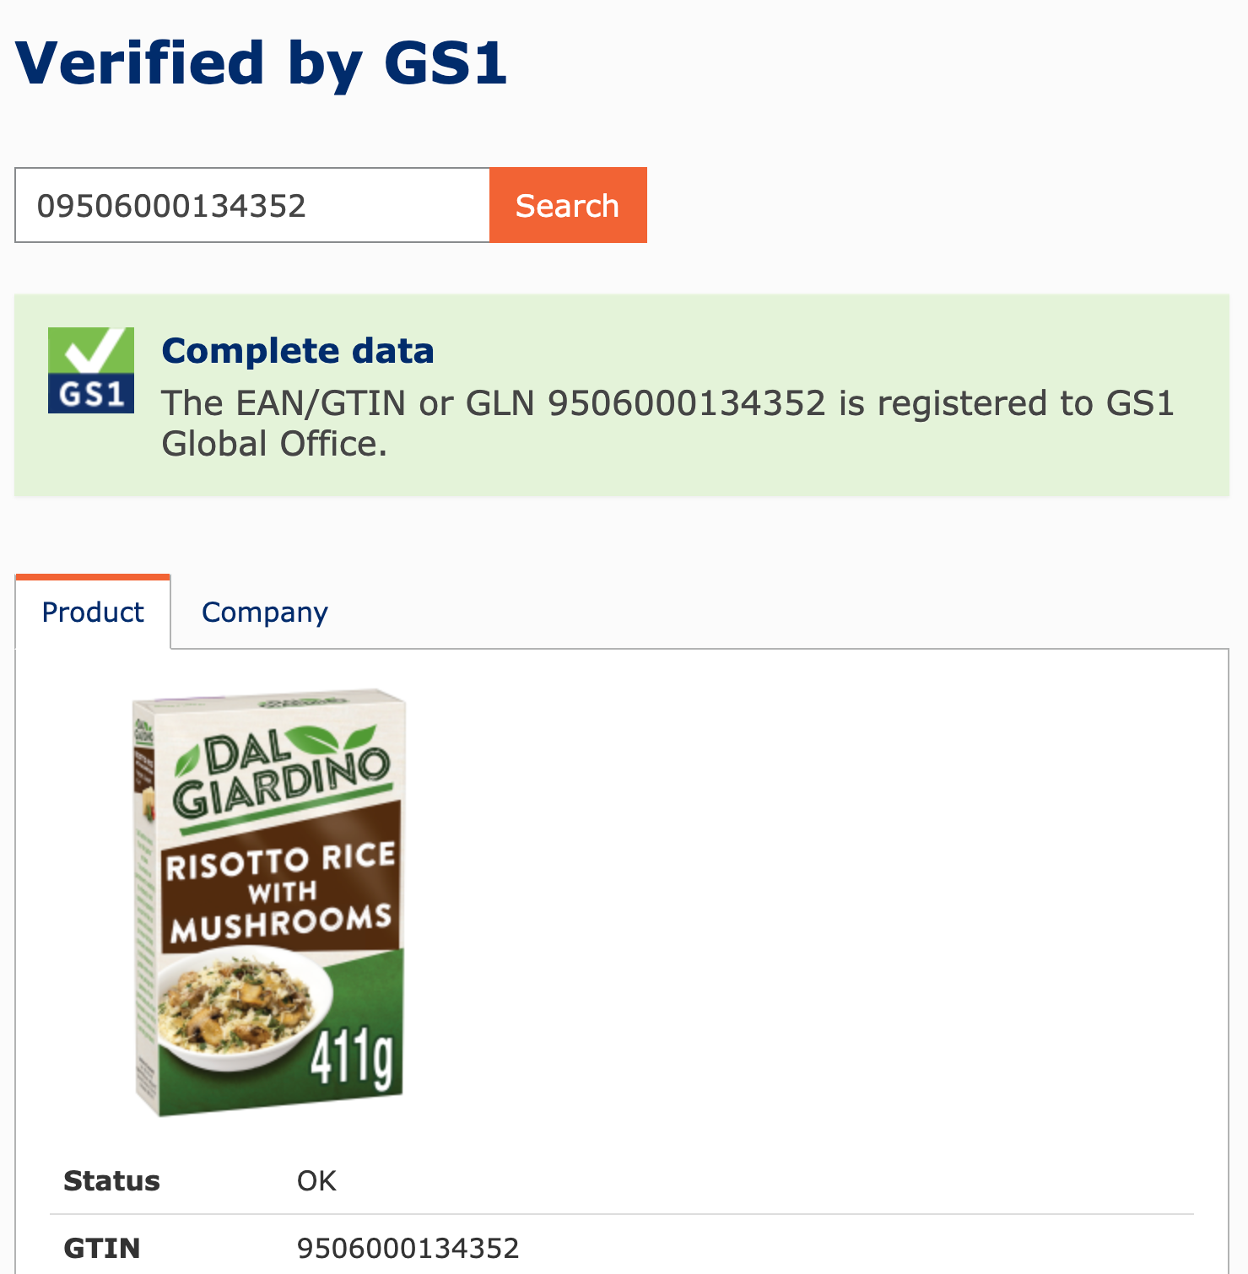
A well-built demo, and a question nobody asked
Battery passport, Official GS1 demo GTIN, every signature valid.
PASSPORT
ISSUER RECORD
VERIFIED BY GS1
CHECKS Authentic ✓ did:key valid ✓ Digital Link ✓ According to GS1: risotto rice.
Notes:
A few weeks ago, in a video call, a team showed me a battery passport. Well built: serials, carbon footprint, charge cycles, everything anchored and verifiable, and correctly published with a GS1 Digital Link. They used GS1's official demo GTIN, which is exactly what GS1 says you should do for a demo. When that GTIN is put into Verified by GS1: risotto rice with mushrooms, registered to GS1 Global Office. The passport says Authentic. The maker's identity is a did:key, a bare key with no anchor to any organisation. Every signature is genuine. Nothing in the stack asks whether the signer may speak for that GTIN. Two things to say with appreciation: the team did everything right, and the demo GTIN only works because GS1 Global Office licensed it to itself; authority over the number came first. Any anchor, a ledger included, anchors the claim, never the authority.
resolution says where, a signature says who, and nothing says who may speak for the product.

Slide 5
Three sources, one GTIN, one choice
Same product, three honest answers, and an agent that has to pick one.
brand.example The brand's page netContent 411 g allergen may contain milk availability InStock signed no
shop.example A retailer netContent 400 g allergen none listed availability InStock; 6,49 EUR signed yes, retailer key
productdata.example A data aggregator netContent 411 g allergen contains celery availability Discontinued signed no
WHAT AN AGENT MAY DO TODAY Pick one, by ranking, by recency, by whoever has the richest markup. Signatures would not help; all three could sign.
Notes:
This is the everyday case, no attacker needed. An agent asks what this product is and gets three answers from three honest sources: the brand's own page, a retailer, a data aggregator. All structured, all plausible, one of them even signed. They disagree in the details that matter: 411 grams or 400, an allergen note or none, in stock or discontinued. The agent has to pick one. Today it picks by ranking, by recency, or by whoever serves the richest markup. Nobody can tell it which of the three is the product's own voice. Signatures do not help, because all three could sign honestly. And once that is the situation, a fourth party can serve its own answer for the same GTIN and it will look no different; on our demo resolver we did exactly that. Verified by GS1 knows who holds the GTIN, but the agent does not ask, and even if it did, nothing says which of the three sources the holder stands behind. That is the gap: which source may speak for the product.

Slide 6
Where. Who signed. Who may.
Every statement has a speaker, a subject and a content. Today we can verify the speaker.
RESOLUTION Where is the data? Digital Link resolves the GTIN to a linkset. Any domain will do. attacker.example/01/09506000134352 → resolves
VERIFICATION Who signed it? The verifier proves the signature, an identity anchor proves the issuer. Neither mentions the GTIN. did:key:z6Mk… → signature valid
AUTHORITY May the signer speak about this GTIN? And may it say this? GS1 knows the holder. Whether the agent ever gets there depends on the printed host. And nothing anywhere says what a party is entitled to say. speaker → ? → subject → ? → statement
Notes:
Three questions an agent should ask before it trusts product data. Two can already be answered today. Resolution: GS1 Digital Link resolves the GTIN to a linkset, TLS proves the domain. attacker.example/01/GTIN resolves just as well. Verification: a credential verifier proves the signature, and a Digital Identity Anchor proves the issuer's legal identity. That verifies the speaker. Every statement has three parts: the speaker, the subject it is about, and what it says.
Two questions remain, and in some situations nothing in the agent's path answers them.
The first is not unanswered: Verified by GS1 knows the licensee, id.gs1.org knows the registered resolver.
Whether the agent ever sees either depends on what is printed on the labels / encoded in the qr code.
A code on id.gs1.org runs through GS1's registry, a code on brand.example or on a provider's host does not have to, and the agent cannot tell the two apart.
Authority currently depends on a choice made at print time. May this speaker speak about this subject at all? And may it make this kind of statement, describe the product, make a recall, a sale event? The first is a question of who holds the GTIN; the second is a question of role. This has a second side: When the agent reads product data, someone has to be authoritative for it. Same tools, other direction.

Slide 7
Many parties speak about one product
Each is legitimate for its part. An agent cannot tell which part is whose.
PARTY | SAYS | AS EPCIS EVENT
Manufacturer | made it, packed it, shipped it | commissioning · packing · shipping
Shipper | moved it | receiving · transporting · shipping
Retailer | sold it | receiving · retail_selling
Repair service | repaired it, replaced a part | repairing · replacing
TWO CHECKS FOR THE AGENT Is this party allowed to speak about this product? And is this the kind of thing it says? A retailer selling: normal. A retailer announcing a recall: not.
WHERE THAT TABLE LIVES In every traceability system, built again for every customer. It never leaves.
EPCIS: the GS1 standard for supply-chain events, one event per step.
Notes:
Over its life, many parties make statements about the same product, and each is legitimate for its part. The manufacturer says it was made and packed. The shipper says it moved. The retailer says it was sold. The repair service says it was repaired. All of them are statements about the same Identifier, and in EPCIS each of them is one event with its own process step. An agent that meets one of these statements has two things to check: is this party allowed to speak about this product at all, and is this the kind of statement that party is allowed to make? A retailer selling is normal; a retailer announcing a recall is not. Every traceability system holds exactly this table, which party contributes which step for which products. Each of us has built it again, for each customer, and none of it leaves the system. The event itself says who reported it. Whether that party was entitled to is not something an agent can find out today.

Slide 8
Ownership of a GTIN is on record in one place
The registry that assigned it. For the GTIN that is GS1, and GS1 has started publishing it.
GS1 Global Office allocates prefix ranges to Member Organisations root of the chain id.gs1.org
Member Organisation licences the Company Prefix to a company Licence Registry, Verified by GS1: APIs in production
Licensee brand owner or manufacturer, holds the GCP licence credentials: specified, verified, issued
GTIN assigned under the prefix, printed on the pack an agent may scan id.brandowner.com
→
→
→
PRECEDENT GLEIF publishes this chain for the LEI, the identifier for legal entities in finance, as credentials: GLEIF, qualified issuer, legal entity, person in a role.
WHAT GS1 HAS TODAY Licence Registry and Verified by GS1 as APIs. A VC data model for the licence chain. A reference verifier (GS1 US). Optional Support for Verifiable Credentials (GS1 NL und BE, LU?).
Notes:
For an assigned identifier, only the assigning registry can say who may speak for it. That is true for every extrinsic identifier. Verified by GS1 can be used. GS1's VC white paper specifies licence credentials up to Global Office. Some GS1 MOs have started to work on VC integration.

Slide 9
Verifying Entitlement
From a Digital Link to a decision. Three steps work today, one needs a format, one needs the roles.
1 Canonicalise Whatever domain is printed, id.gs1.org/01/{gtin}.
works today
2 Resolve and compare id.gs1.org points to the licensee's registered resolver. Compare with the host the data came from.
works today
3 Ask who holds the GTIN Verified by GS1 returns the licensee. Rate-limited and unsigned, but there.
works today
4 Verify the licence chain Global Office → MO → licensee → key. GS1 has model and verifier, Some GS1 MOs issue VCs, our prototype can verify it.
needs discovery
5 Check the role Does this party hold a role for this kind of statement about this product? Published nowhere today.
needs the roles
Notes:
An agent that starts from a Digital Link can run one check before it trusts a statement about a product.
One: canonicalise the URI; brands print their own domain, the standard defines id.gs1.org/01/{gtin}.
Two: resolve it there and compare the host that answered with the host the data came from.
Three: ask Verified by GS1 who holds the GTIN. These three work today, with two requests, and nobody has written them down as a rule.
Four: fetch the licence credential and verify the chain up to Global Office;
GS1 US has published the model and a reference verifier, GS1 Netherlands issues it, and our prototype runs this step today.
Five: check that the party making the statement holds a role for this kind of statement; that is the missing link, it lives in every traceability system and in no register.

Slide 10
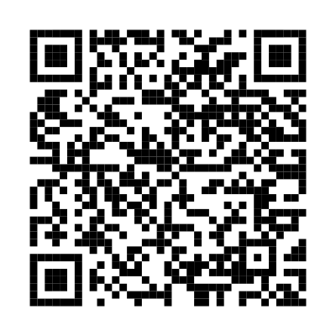

Conclusion
WHERE WE ARE Agents verify who signs. Nobody checks whether the signer may speak about the product, or may say this. Few Member Organisations issue the licence as a credential. Verifiers exist. Resolvers exist.
WHAT IS MISSING 1 Enabling Agents to run required checks in the same way. 2 A way to find the credential for a Digital Link. 3 The roles and permissions: who contributes what, out of the traceability systems and into the open.
Sven Böckelmann · sven.boeckelmann@benelog.com · openepcis.io
Notes:
Conclusion, plainly. Agents verify who signs. Nobody checks whether the signer may speak about the product, or may say this. Two Member Organisations already issue the licence as a credential, verifiers exist, resolvers exist, our prototype verifies the chain. Three things are missing: the check, written down so that agents run it the same way; a way for an agent to find the credential from a Digital Link; and the roles, which live in every traceability system and in no register. I want to work on that, and it needs the people in this room: those who run resolvers, those who issue credentials, those who build agents. This afternoon there is a breakout on it. Four questions on the agenda: the minimum check, linkset or credential, the trust root, and how it lines up with UNTP. Come and tell us what you would need to check before your agent trusts product data. I do not have this solved; that is why I am here.

