Slide 1
NTUA Contributions to TASK 5.2
INDL extensions :
  Extended INDL for supporting wireless features (indl_wireless.owl)
Wireless testbed advertisement in INDL:
  Translator of NITOS/NETMODE Rspec (Advertisement) to INDL (OWL2- RDF/XML) (rspec_owl_v1_2.rb)
  OWL import to SESAME RDF triplestore (import_sesame.rb)
OWL User Request Example
OWL to SPARQL query translation
  SPARQL Query generator for Broker (query.rb)
    Input : request OWL
    Needs to be optimized.

Slide 2
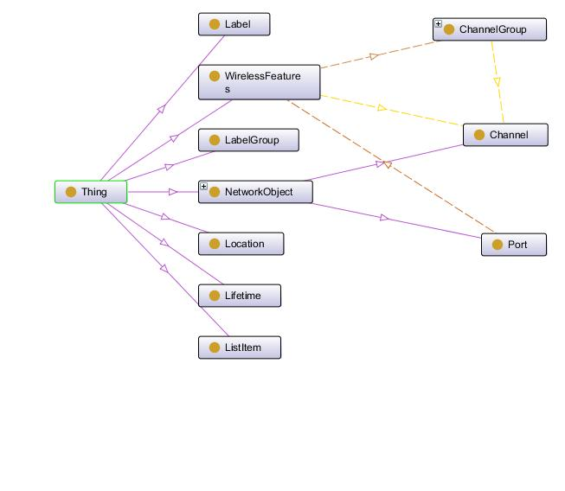
INDL extensions (1)

Slide 3
INDL extensions (2)
INDL- extensions
  Classes (1/3):
    WirelessFeatures is a supporting Class in order to describe wireless characteristics of interfaces such as the Channel. It is related to ports via the object property hasWirelessFeatures
    A WirelessFeatures object may have the following objectproperties
      hasChannel to one or more Channels
      hasChannelGroup to one or more ChannelGroups

Slide 4
INDL extensions (3)
  Classes (2/3):
    Channel is a Class which describes the physical transmission medium. It is related either to WirelessFeatures or to ChannelGroup via the object property hasChannel
    A Channel may have the following dataroperties
      ChannelNo refers to the number of the channel
      Protocol refers to the protocol the channel uses, e.g 802.11b
      Frequency refers to the frequency of the channel

Slide 5
INDL extensions (4)
  Classes (3/3):
    ChannelGroup is a n unordered set of channels. It may be related to WirelessFeatures via the object property hasChannelGroup
    A ChannelGroup may have the following objectproperties
      hasChannel to one or more Channels

Slide 6
INDL extensions (5)
  Object Properties:
      hasWirelessFeatures relates a Port to a WirelessFeatures object
      hasChannel is used to relate a WirelessFeatures or a ChannelGroup to one or more Channels
      hasChannelGroup relates a WirelessFeatures object to one or more ChannelGroups
  Data Properties:
      ChannelNo the number of the channel
      Protocol the protocol the channel uses, e.g 802.11b
      Frequency the frequency of the channel
      Offset the period of time during which a request can start (Related to reservation)

Slide 7
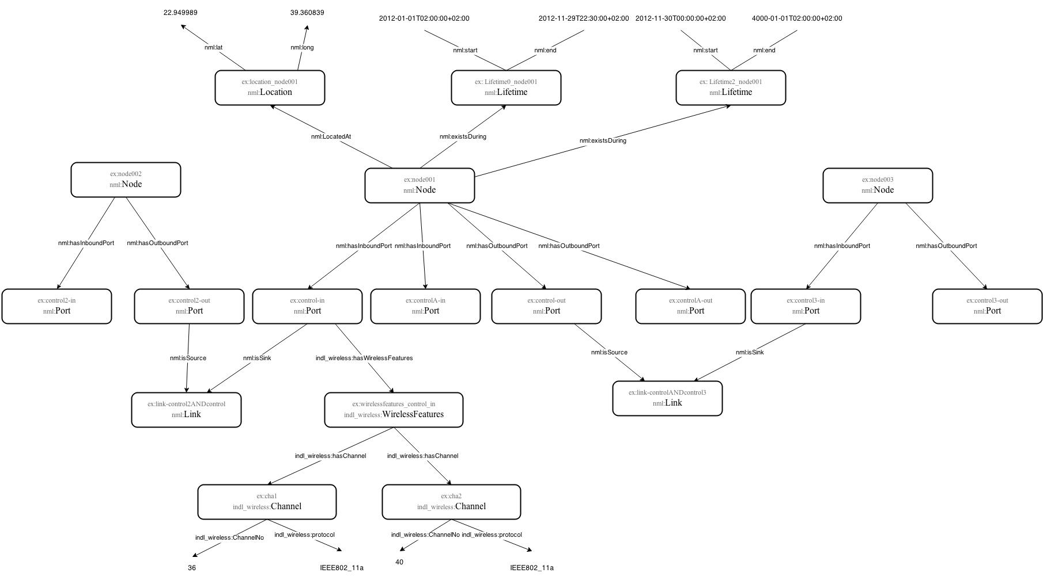
Wireless testbed advertisment in INDL (sample)

Slide 8
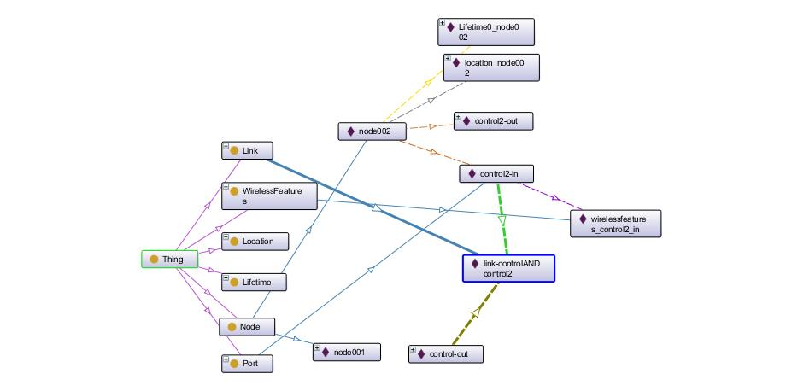
OWL User Request Example

Slide 9
OWL to SPARQL query translation (1/3)
Returns the set of nodes requested (2 nodes)
SELECT DISTINCT ?phnode001 ?phnode002
where { ?phnode001 rdf:type nml:Node.
The Location of the 1rst Node requested
?phnode001 nml:locatedAt ?phnode001Location.
?phnode001Location rdf:type nml:Location.
?phnode001Location nml:long ?phnode001Locationlong.
FILTER (?phnode001Locationlong >= "39.360839"^^xsd:float).
?phnode001Location nml:lat ?phnode001Locationlat.
FILTER (?phnode001Locationlat >= "22.949989"^^xsd:float).
The ports and their wirelessfeaturess
?phnode001 nml:hasOutboundPort ?phnode001controlout.
?phnode001controlout indl_wireless:hasWirelessFeatures ?phnode001controloutwireless.
?phnode001controloutwireless rdf:type indl_wireless:WirelessFeatures.
?phnode001controloutwireless indl_wireless:hasChannels ?phnode001controlouthasChannels.
FILTER (?phnode001controlouthasChannels = "36"^^xsd:string).
?phnode001controloutwireless indl_wireless:hasProtocol ?phnode001controlouthasProtocol.
FILTER (?phnode001controlouthasProtocol = "IEEE802_11a"^^xsd:string).
The duration of the resarvation. It must start before the starttime and ends after the endtime of the request
?phnode001 nml:existsDuring ?phnode001Lifetime0.
?phnode001Lifetime0 rdf:type nml:Lifetime.
?phnode001Lifetime0 nml:start ?phnode001Lifetime0start.
FILTER (?phnode001Lifetime0start <= "2012-01-01T02:00:00+02:00"^^xsd:dateTime).
?phnode001Lifetime0 nml:end ?phnode001Lifetime0end.

Slide 10
OWL to SPARQL query translation (2/3)
FILTER (?phnode001Lifetime0end >= "2012-11-29T22:30:00+02:00"^^xsd:dateTime).
The link to the second node
{ ?phnode001 rdf:type nml:Node.
?phnode001 nml:hasOutboundPort ?phnode001controlout.
?phnode001controlout nml:isSource ?linkcontrolANDcontrol21.
?phnode001controlout rdf:type nml:Port.
?phnode002 rdf:type nml:Node.
?phnode002 nml:hasInboundPort ?linkcontrolANDcontrol21phnode002.
?linkcontrolANDcontrol21phnode002 nml:isSink ?linkcontrolANDcontrol21.
?linkcontrolANDcontrol21phnode002 rdf:type nml:Port.
FILTER (?phnode001 != ?phnode002).
}
The second Node and its characteristics
?phnode002 rdf:type nml:Node.
?phnode002 nml:locatedAt ?phnode002Location.
?phnode002Location rdf:type nml:Location.
?phnode002Location nml:long ?phnode002Locationlong.
FILTER (?phnode002Locationlong >= "39.360839"^^xsd:float).
?phnode002Location nml:lat ?phnode002Locationlat.
FILTER (?phnode002Locationlat >= "22.949989"^^xsd:float).
?phnode002 nml:hasOutboundPort ?phnode002control2out.
?phnode002control2out indl_wireless:hasWirelessFeatures ?phnode002control2outwireless.
?phnode002control2outwireless rdf:type indl_wireless:WirelessFeatures.
?phnode002control2outwireless indl_wireless:hasChannels ?phnode002control2outhasChannels.
FILTER (?phnode002control2outhasChannels = "36"^^xsd:string).
?phnode002control2outwireless indl_wireless:hasProtocol ?phnode002control2outhasProtocol.
FILTER (?phnode002control2outhasProtocol = "IEEE802_11a"^^xsd:string).

Slide 11
OWL to SPARQL query translation(3/3)
?phnode002 nml:existsDuring ?phnode002Lifetime0.
?phnode002Lifetime0 rdf:type nml:Lifetime.
?phnode002Lifetime0 nml:start ?phnode002Lifetime0start.
FILTER (?phnode002Lifetime0start <= "2012-01-01T02:00:00+02:00"^^xsd:dateTime).
?phnode002Lifetime0 nml:end ?phnode002Lifetime0end.
FILTER (?phnode002Lifetime0end >= "2012-01-02T22:30:00+02:00"^^xsd:dateTime).
The link to the second node
{ ?phnode002 rdf:type nml:Node.
?phnode002 nml:hasOutboundPort ?phnode002control2out.
?phnode002control2out nml:isSource ?linkcontrol2ANDcontrol1.
?phnode002control2out rdf:type nml:Port.
?phnode001 rdf:type nml:Node.
?phnode001 nml:hasInboundPort ?linkcontrol2ANDcontrol1phnode001.
?linkcontrol2ANDcontrol1phnode001 nml:isSink ?linkcontrol2ANDcontrol1.
?linkcontrol2ANDcontrol1phnode001 rdf:type nml:Port.
FILTER (?phnode002 != ?phnode001).
}
FILTER (?phnode002 != ?phnode001 ).
}

