Slide 1
Wireless Model
Extensions by NTUA

Slide 2
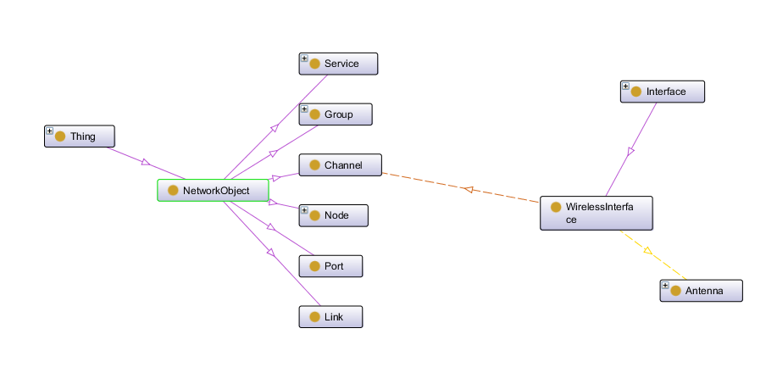
Wireless Model extensions (1)

Slide 3
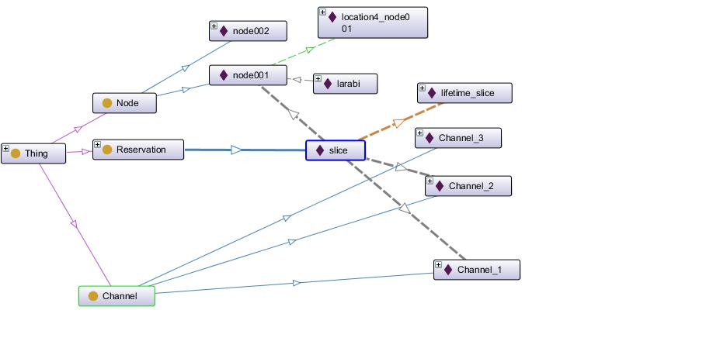
Wireless Model extensions (2)
Example

Slide 4
Wireless Model extensions (3)
  Classes:
    Channel is a Class which describes the physical transmission medium. It is related to WirelessInterface via the object property hasChannel
    A Channel may have the following objectproperties
      SupportsStandard it was used in the draft version of wireless model. Added to relate a Channel instance to a Standard instance
      UsesFrequence to relate a Channel instance to a Frequency instance
    A Channel may have the following dataproperties
      channel_No refers to the number of the channel

Slide 5
Wireless Model extensions (4)
  Information Models:
    Novi Information Model has been imported to express Properties like “exclusive” and “hardware_type”
  Object Properties:
    hasChannel is used to relate a WirelessInterface to one or more Channels
    contains used in Novi model is extended to relate the Group class with Channel
  Data Properties:
    channel_No the number of the channel
    Offset the period of time during which a request can start (Related to reservation)

Slide 6
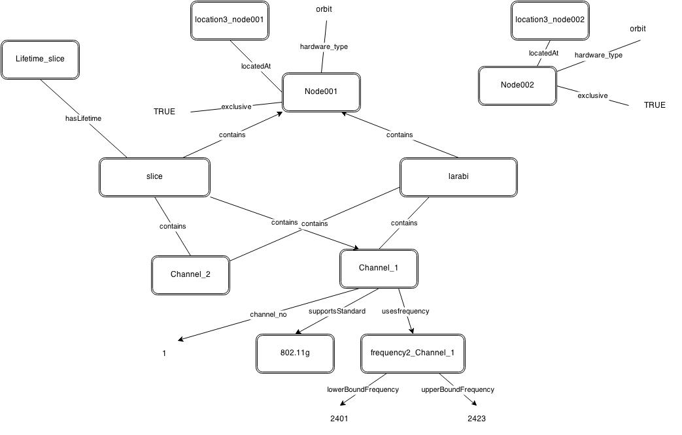
Wireless testbed advertisment (sample)

Slide 7

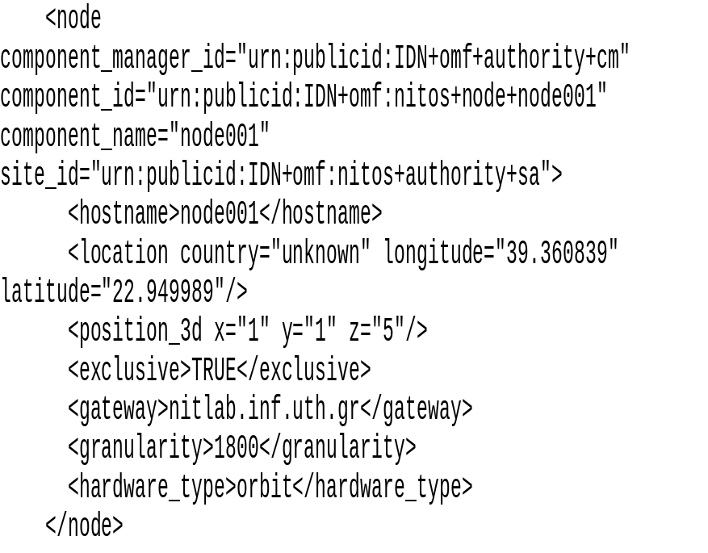
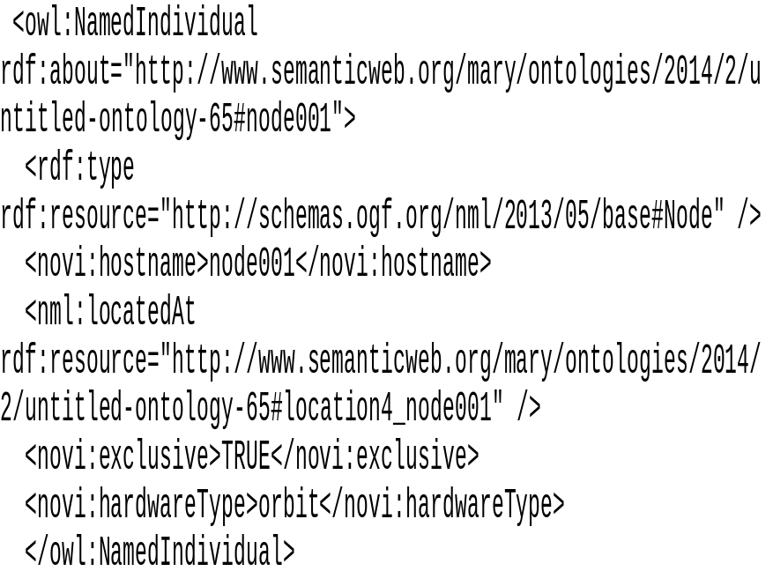
Wireless advertisment (example)(1/4)
Node description
NITOS RSPEC
NITOS OWL

Slide 8
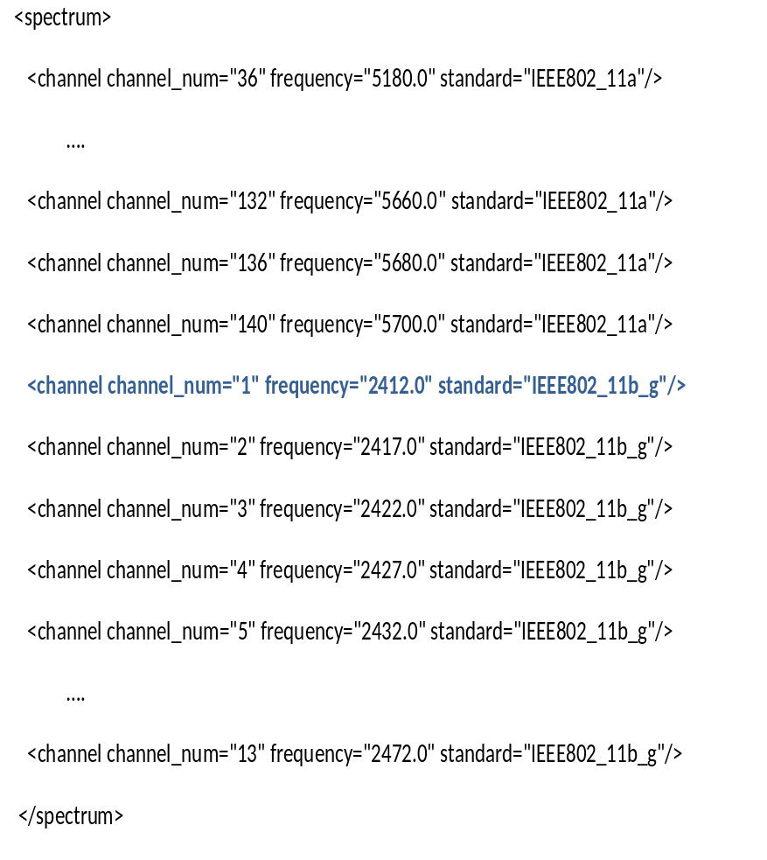
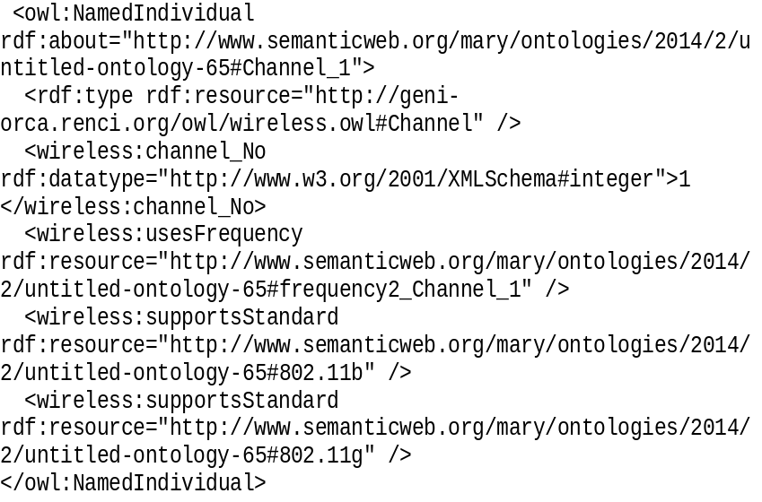
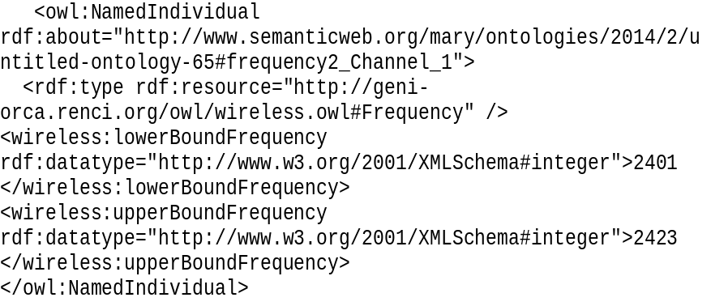
Wireless advertisment (example)(2/4)
Channel description
NITOS RSPEC
NITOS OWL

Slide 9
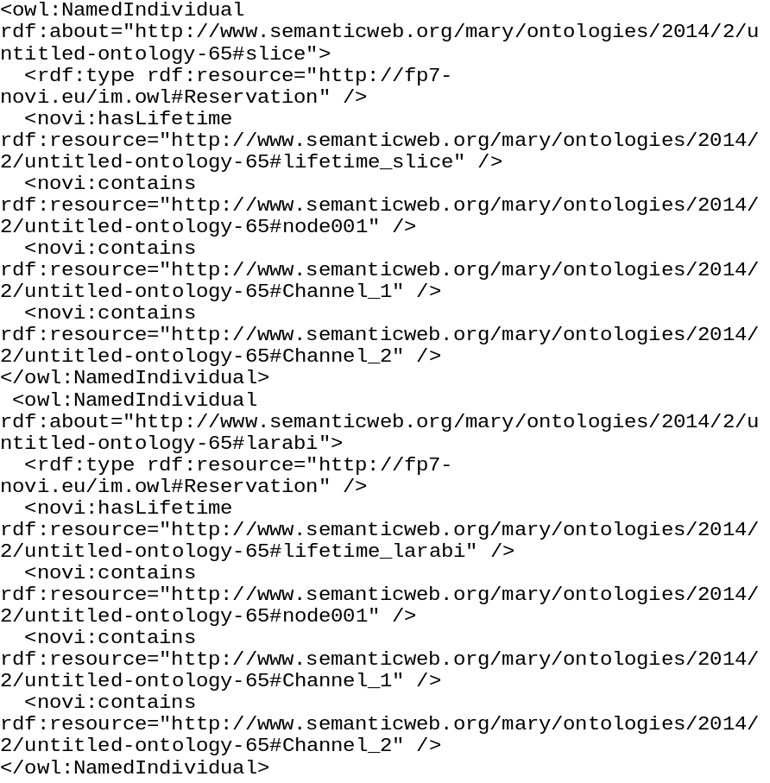
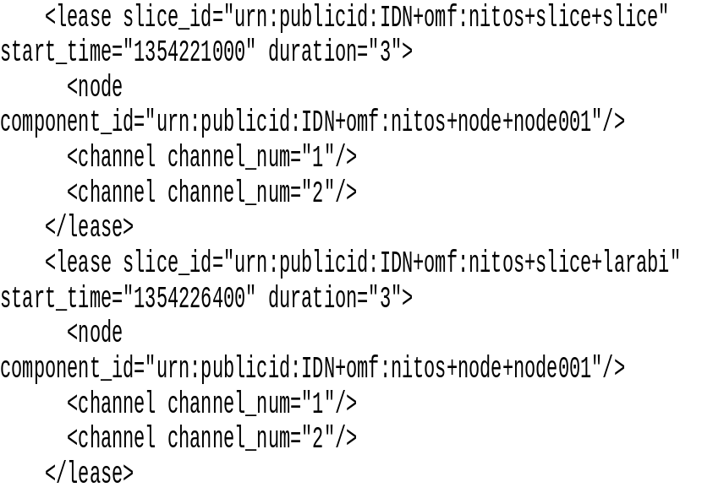
Wireless advertisment (example)(3/4)
Reservation Information
NITOS RSPEC
NITOS OWL

Slide 10
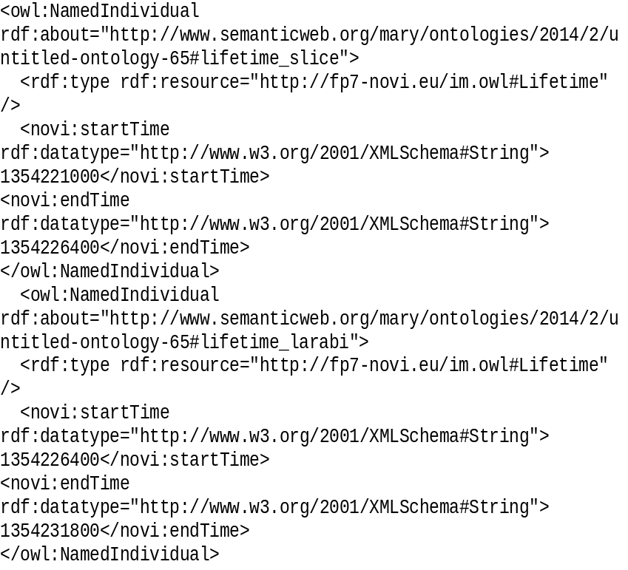
Wireless advertisment (example)(4/4)
Reservation Information (cont.)
NITOS RSPEC
NITOS OWL

