Slide 1
Web-based Digital Twins for Smart Cities at
TPAC 2025
W3C Invited Expert
Professor, Center for Information and Communication Technology, Nagasaki University
Kazuyuki Ashimura
12 November 2025

Slide 2
Agenda for today
Review the discussion so far
Get input from stakeholders
Discussion on the next steps
Notes:
This is just a few of the areas where the IoT is being applied

Slide 3
Discussion so far
Notes:
This is just a few of the areas where the IoT is being applied

Slide 4
Difficulties with Smart Cities
  "Smart Cities" consists of too many stakeholders (vendors, users, governments, …) and technologies (Web, IoT, Software, Hardware, …).
  So strong need:
    To identify and document possible use cases,
    To obtain feedback from all the stakeholders,
    To gather experts’ input on important features, and
    To provide a forum for technical and business discussions.
Notes:
This is just a few of the areas where the IoT is being applied

Slide 5
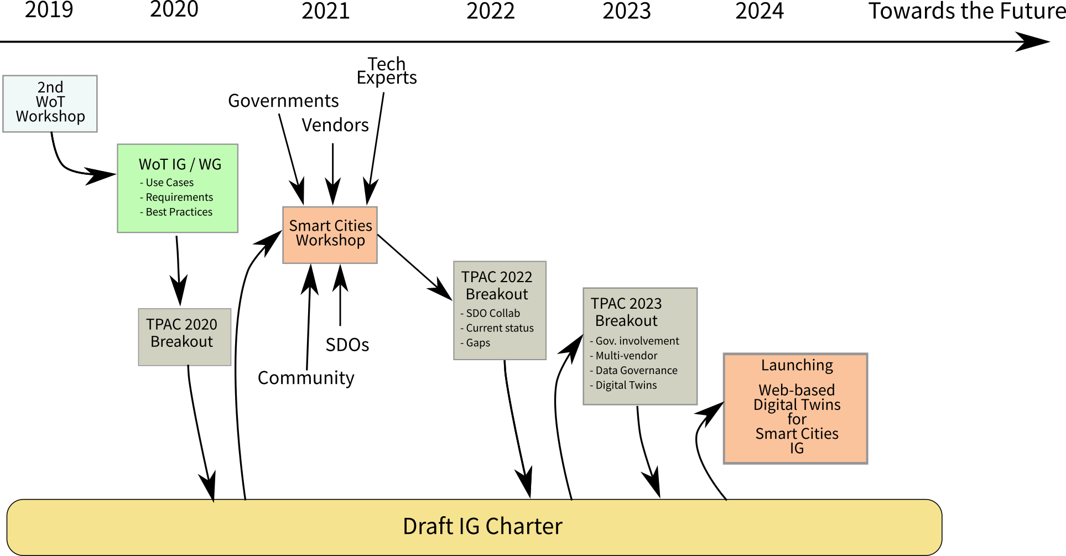
Discussion around Web-based Smart Cities@W3C
Notes:
This is just a few of the areas where the IoT is being applied

Slide 6
Collaboration with related SDOs

Slide 7
ECHONET
  Smart home appliances
    ECHONET spec
    ECHONET Lite spec
    ECHONET Lite Web API spec ⇒ referring to the W3C WoT spec
  New features for real-world system development
    Registration of a set of operations first, then execution later
    History management
    Authentication and authorization
Notes:
This is just a few of the areas where the IoT is being applied

Slide 8
IEC SC3D
  Common Data Dictionary (CDD)
    Methodology and products ontology
      Standardization for representation of technical information along the life cycle of a product
        Services
        Devices
        Systems
        Software
        Plants, etc.
    Classes, Properties, Identification for various industry areas
      Machine-interoperable methodology
      Available for all ISO, IEC products and systems
      Standardized product ontology DB: https://cdd.iec.ch/
Notes:
This is just a few of the areas where the IoT is being applied

Slide 9
IPA DADC
=> Smart Building Co-Creation Organization
  Smart building use cases and system development
    Takenaka Corporation has developed a data platform for smart buildings based on the W3C WoT standard.
      Based on the lambda architecture which is a best practice for real-time data processing.
      WoT is used to implement data models and APIs.
    The platform is the foundation for various services such as energy management, AI control, personal control and digital twin.
      Must manage many devices and tons of associated measurement and control points.
      So it is impossible to generate a WoT TD for each device manually.
      Need to extend the WoT standards for batch property acquisition.
Notes:
This is just a few of the areas where the IoT is being applied

Slide 10
ISO/IEC JTC1
  Various standards on Smart Cities
    ISO/IEC 30146:2019
    ISO/IEC 21972:2020
    ISO/IEC 30145-3:2020
    ISO/IEC 30145-2:2020
    ISO/IEC 30145-1:2021
  Pre-research and gap analysis
    Standards needs and roadmap analysis for smart city standards from the ICT aspects
    Data Use in Smart City
    City digital twin and operating system
    Unified Digital Infrastructure — ICT Reference Architecture
    City Knowledge Trustworthiness Evaluation
    Terminology-Ontology in Smart City System
    ICT support in Public Health Emergency
    ISO/IEC 24039:2022
    ISO/IEC DIS 5087-1
    ISO/IEC CD 5087-2
    ISO/IEC AWI 5087-3
    ISO/IEC CD 5153-1
Notes:
This is just a few of the areas where the IoT is being applied

Slide 11
ITU-T SG20
Already done
  SG20 – Lead group on IoT and Smart Cities & Communities
  FG-DPM (Data Processing and Management)
  Web of Things
  Data models (basic interoperability)
To be done
  Smart cities ontology (semantic interoperability)
  Digital Twin for smart cities
  AI and data context
  Artificial Intelligence of Things: CG-AIoT activities
Notes:
This is just a few of the areas where the IoT is being applied

Slide 12
OGC
OGC Standards and Emerging Digital Twins
  Tools for representing and observing space
    General feature model
    Simple features
    City GML – CityJSON
    3D Tiles –I3S
    WaterML
    GeoSciML
    MUDDI Underground Info
    OGC API Features
    Observations and Measurements
    SensorThings API
    OGC API Processes
    Moving features
    GeoPose
    IMDF
    LAS
OGC Innovation and Future Digital Twins
  Looks the same, behaves the same, is not the same
    Location powers urban digital twins
      Urban digital twin summit
    3D-IoT – Modern spatial data infrastructure
      Integrated digital built environment
    Simulation, Prediction, Digital Twins in the Metaverse
Notes:
This is just a few of the areas where the IoT is being applied

Slide 13
W3C’s Web Standardization related to Smart Cities

Slide 14
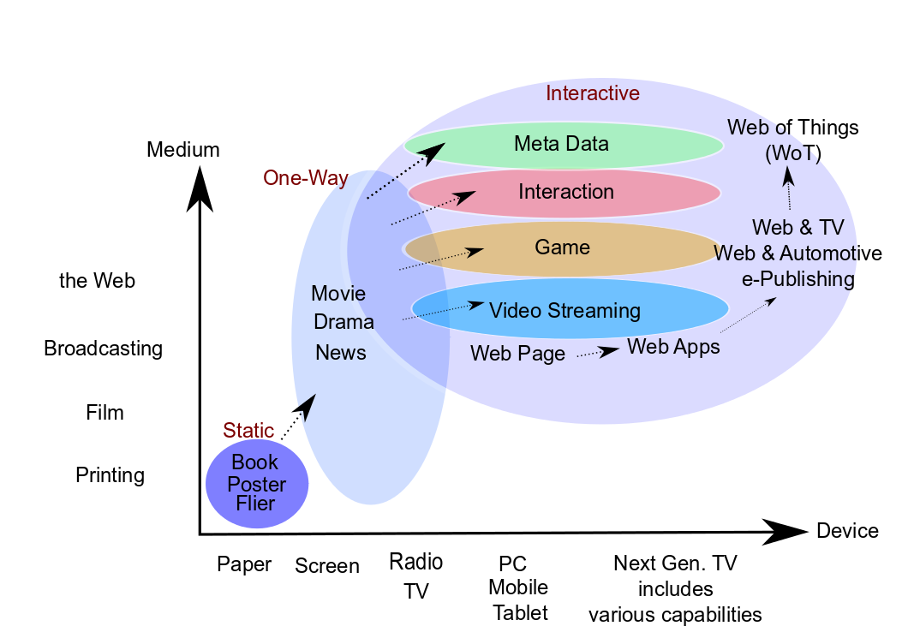
Web as platform for data transfer in general
- Independent from devices or OSs

Slide 15
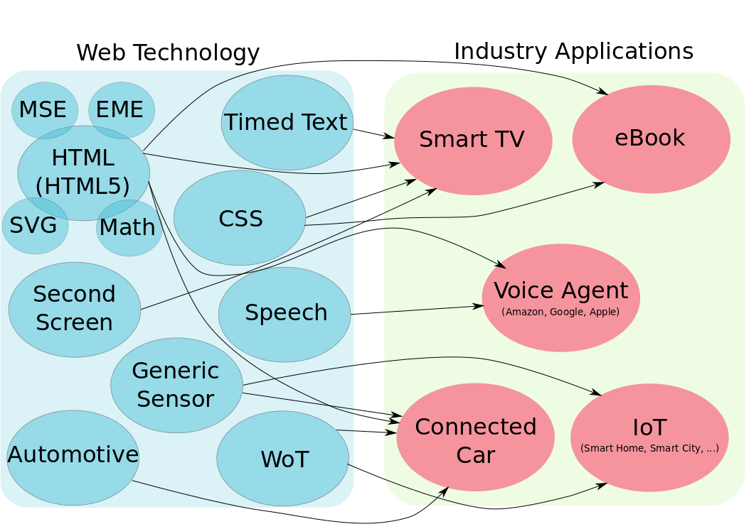
Web standards applied to various industries

Slide 16
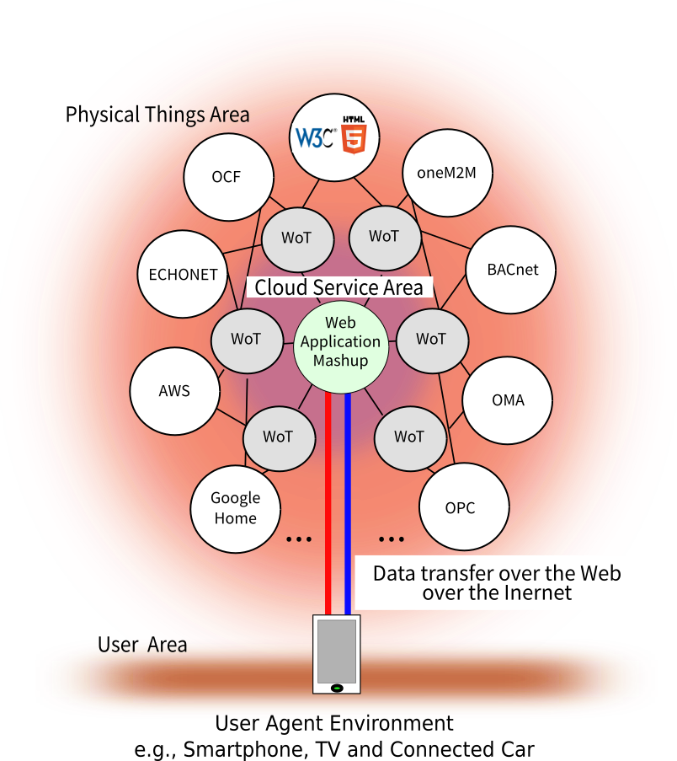
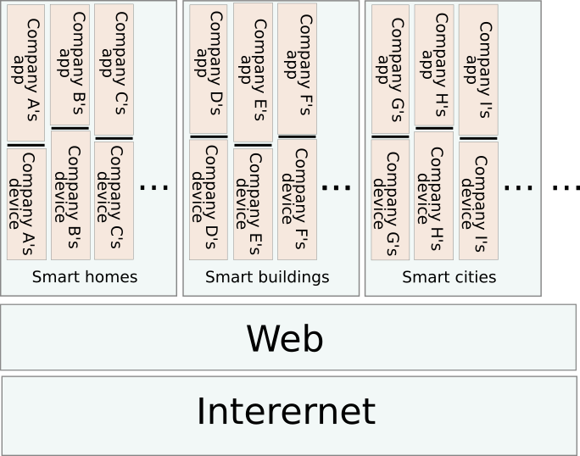
WoT: Interconnection of IoT silos

Slide 17
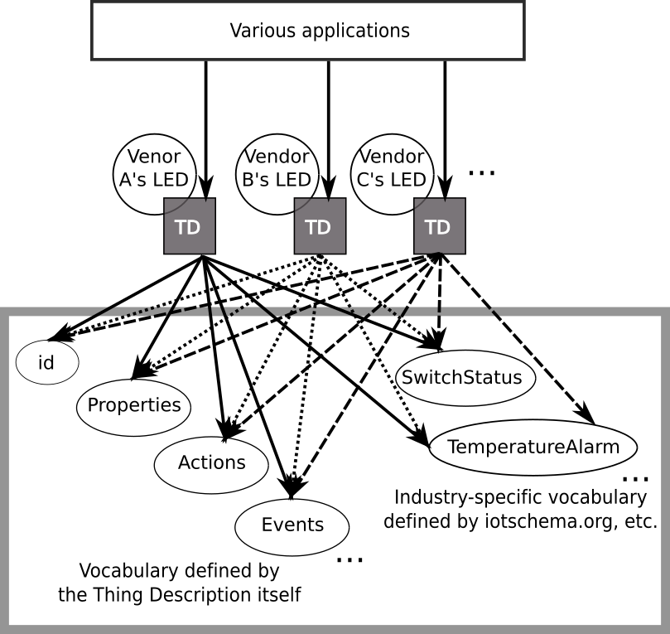
Unified vocabulary references by Thing Description

Slide 18
What is still missing
for global “Smart Cities”?

Slide 19
Strong need for…
  Standardized platform for data transfer and distribution
    Binding among various systems
    ID authentication and management
  Standardized vocabulary
    Semantic interoperability among various systems
    Catalog for easy data access
Notes:
This is just a few of the areas where the IoT is being applied

Slide 20
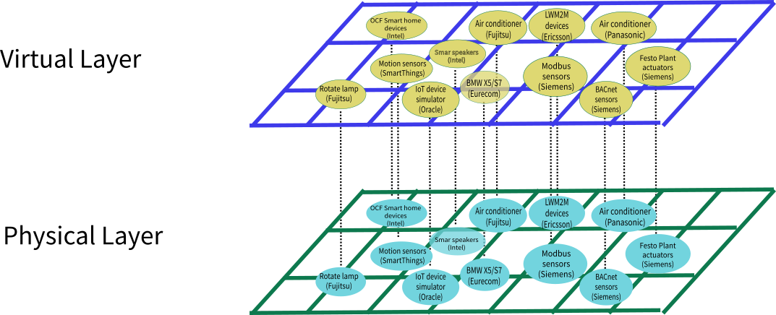
“Digital Twins” as the Key Concept
  Virtualization of
    Devices
    Users
    Services
  Correspondence between:
    Virtual Layer
    Physical Layer
  ⇒ Useful for easy handling from Web Applications
Notes:
This is just a few of the areas where the IoT is being applied

Slide 21
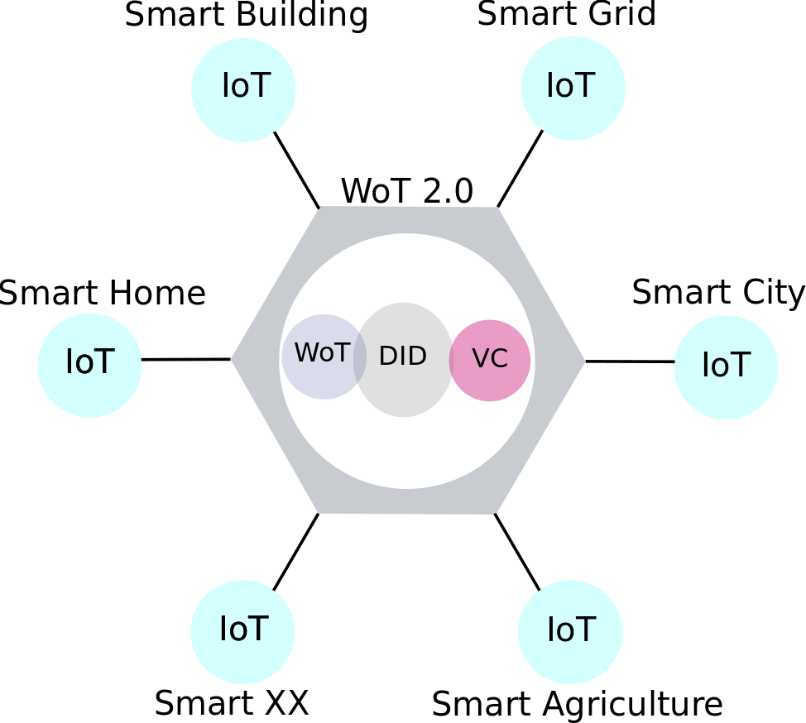
Web-based Digital Twins Framework
  Decentralized Identifiers (DID):
      Unique identifier for the Virtual Layer
      Identify Devices, Users and Services
  Web of Things (WoT):
      Handling Devices on the Virtual Layer
      Mapping to the Physical Devices
  Verifiable Credentials (VC):
      Manage User Credential on the Virtual Layer
      Describe User Credential for Device/Service access
Notes:
This is just a few of the areas where the IoT is being applied

Slide 22
Need for Standardized Vocabulary
  Definition and References
  Ontology standards are provided by W3C:
    RDF and RDF Schemas
    Web Ontology Language (OWL)
    Rule Interchange Format (RIF)
    Data Catalog Vocabulary (DCAT)
  Proposal:
    Let’s have collative discussions at W3C as a hub to clarify what ’s done and what’s missing!
Notes:
This is just a few of the areas where the IoT is being applied

Slide 23
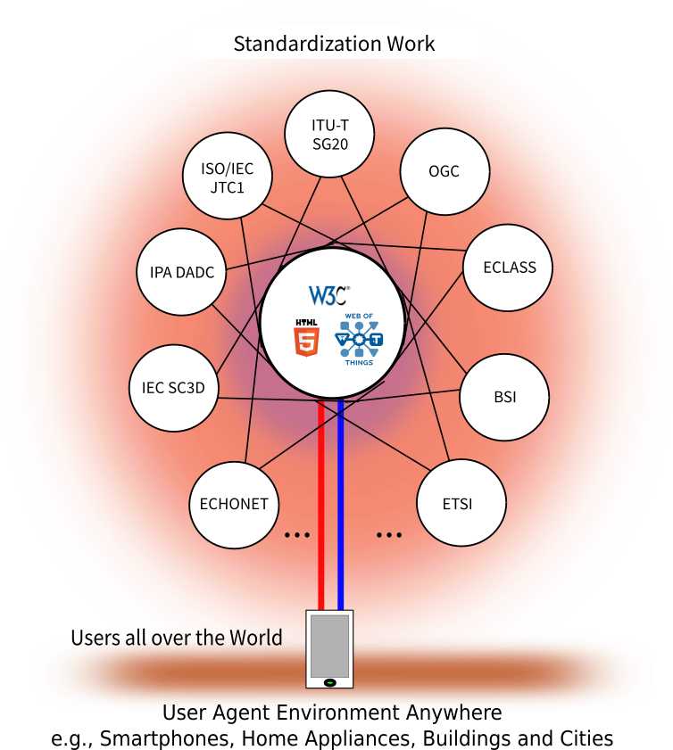
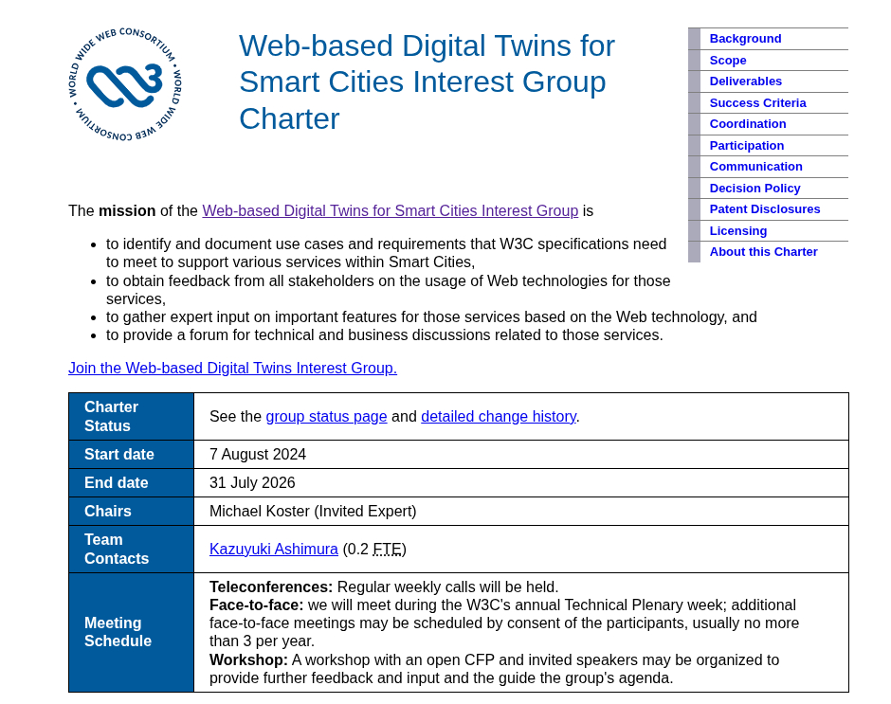
W3C as the Hub for Collaborative Discussions!
  Web-based Digital Twins for Smart Cities Interest Group has been established!!!
  (https://www.w3.org/2024/06/smart-cities/)

Slide 24
Further Collaborations
during the Interest Group Calls

Slide 25
Invited Guests from related SDOs
  Mark Fox, ISO/IEC JTC1/WG11/AHG16
    Terminology and Ontology
  Torbjorn Lahrin, JWG between ISO/IEC JTC1 and IEC/SyC Smart Cities
    Local Digital Twins Sweden Metaverse Including Citiverse
  Juanjo Hierro & Martin Bauer, ETSI / FIWARE
    NGSI-LD, Data Exchange API
  Linda van den Brink, Geonovum
    Geospatial information, e.g., OGC GeoPose
Notes:
This is just a few of the areas where the IoT is being applied

Slide 26
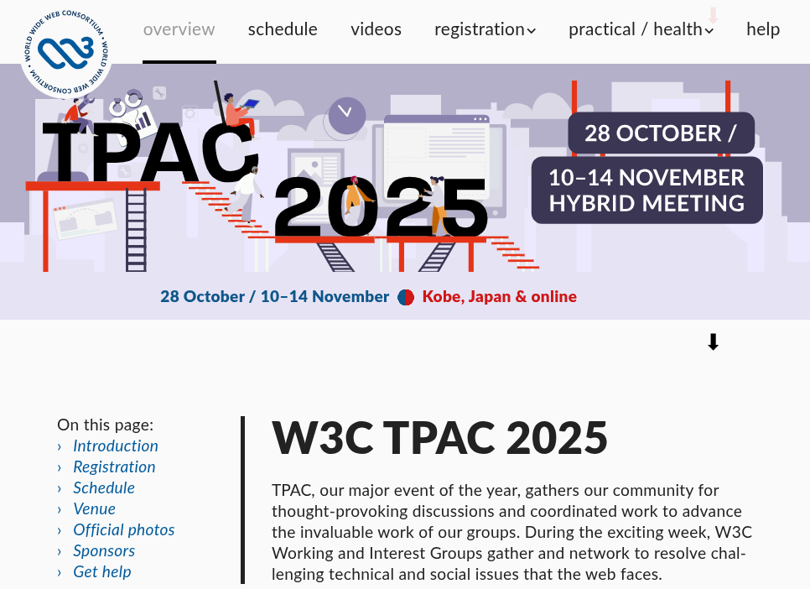
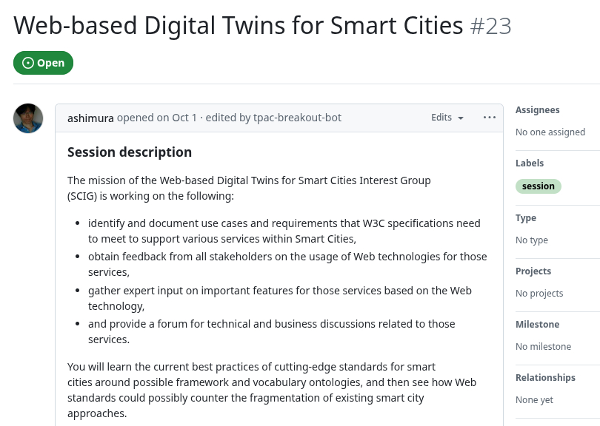
  Continue Discussion on Web-based Smart Cities
  Dedicated session NOW during the W3C TPAC!
  Resources
    https://github.com/w3c/smart-cities/blob/main/technology-categories.md
    https://github.com/w3c/smart-cities/blob/main/resources.md
Notes:
This is just a few of the areas where the IoT is being applied

Slide 27
Get input from stakeholders
- Latest updates, proposals, etc.
  Smart Building Co-creation Organization (SBCO)
  IEC SC3D
  ECHONET
  OGC
  ISO/IEC JTC1
Notes:
This is just a few of the areas where the IoT is being applied

Slide 28
Discussion on the next steps
- How to proceed?
Notes:
This is just a few of the areas where the IoT is being applied

Slide 29
Thank you!
May the Web always be with you
and help you improve the world!
Notes:
Image: show human to human

