Slide 1
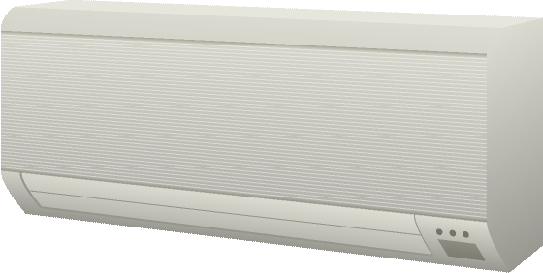

Electronic
Appliance
Remote
Controller
Trusted Environment

Slide 2

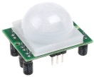
Electronic
Appliance
Control Agent
Trusted Environment

Slide 3
Remote
Controller
Electronic
Appliance
Remote
Controller
Trusted Environment

Slide 4
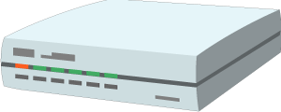
Remote
Controller
Gateway
Electronic
Appliance
Trusted Environment

Slide 5
Proxy
Electronic
Appliance
Remote
Controller
Trusted Environment

Slide 6
Appliance Twin
Electronic
Appliance
Remote
Controller
Trusted Environment

Slide 7
Appliance Twin
Gateway
Electronic
appliance
Remote
controller
Trusted Environment

Slide 8
Appliance Twin
Gateway
Electronic
appliance
Remote
controller
Trusted Environment

Slide 9
Digital Twin
Device Client
Connected devices
Trusted Environment

Slide 10
Digital Twin
Gateway
Device
Client
Connected devices
Trusted Environment

Slide 11
Connected devices
Digital Twin
Connected devices
Device Client
Connected devices

Slide 12


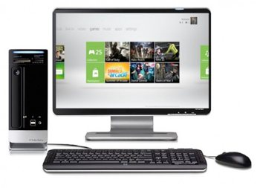
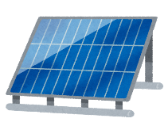
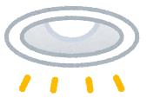



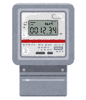
Services
Remote Access
Remote Monitoring
KNX /ECHONET
ZigBee /DECT ULE
/Wi-SUN

Slide 13



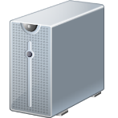
OLD Figure, don’t use it anymore
Services
Monitor
RS-485
EtherCAT

Slide 14


Services
Monitoring, Prediction

Slide 15
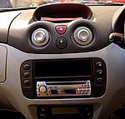
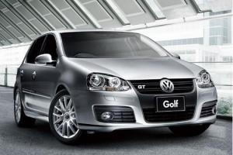

Services
DCU
Gateway
CAN
CAN
ECU
ECU
ECU

