Slide 1

WoT Architecture
Princeton, NJ, USA, January 2019

Slide 2
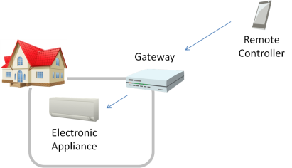
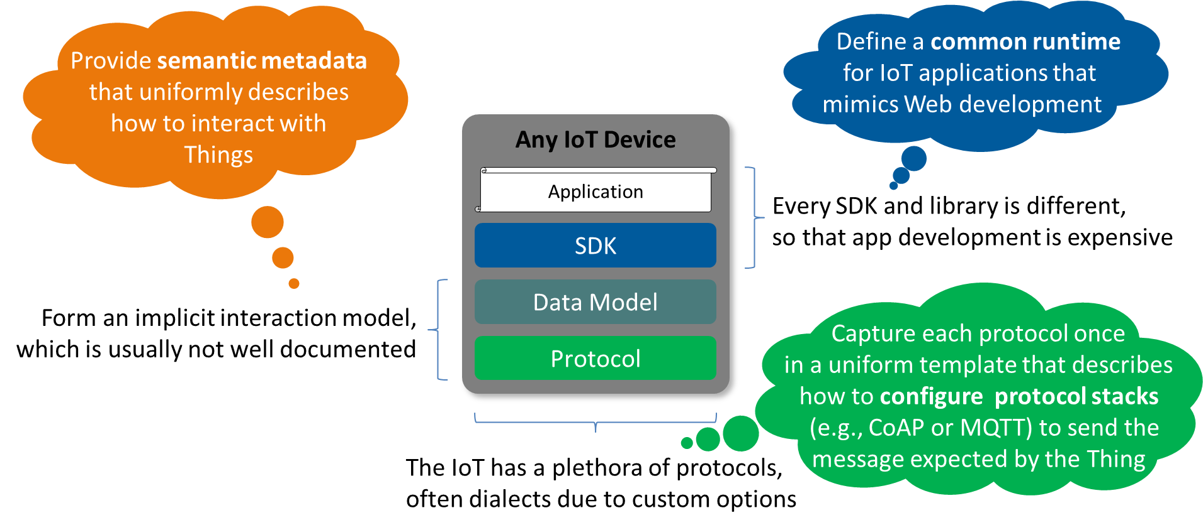
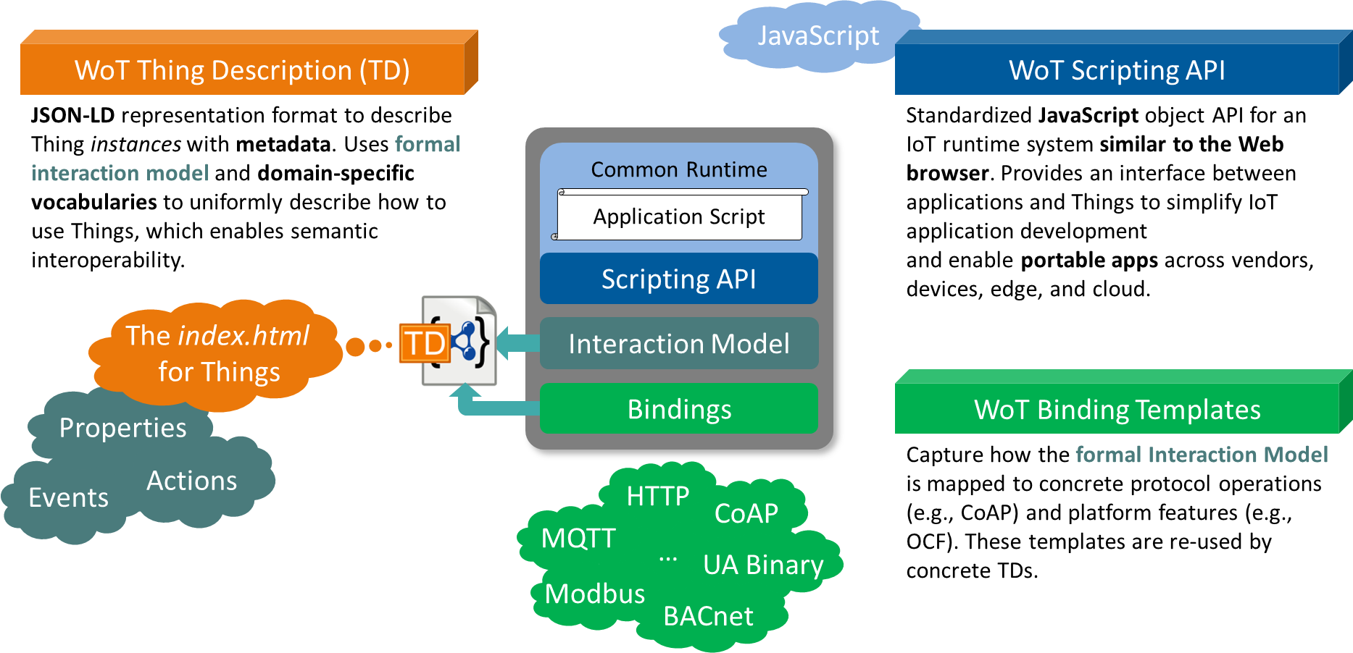

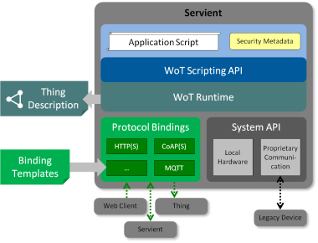
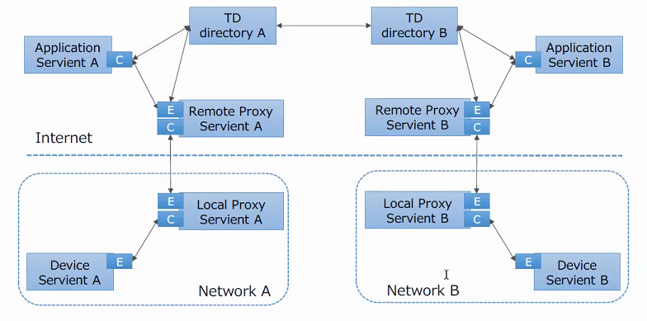
Lyon Restructured Outline
Introduction
Terminology
Use Cases
Functional Requirements
WoT Architecture
Abstract IoT Architecture
WoT concepts and Normative Assertions
Interaction Patterns and Message Flows
WoT Building Blocks (Documents)
WoT Servients (Implementation) Lifecycle
WoT Deployments
Device Servients
Proxy Servients
Application Servients
Directories
Integrations
Security and Privacy Considerations
Toru-san, Lagally
Matthias
Arch
TD
API
Matsukura-san
McCool, Elena

Slide 3
Introduction
Terminology
Terminology (Toru-san)
Use Cases
Functional Requirements
Functional Requirements (Toru-san)
Technical Requirements (Matsukura-san)
WoT Servient Architecture (Matsukura-san)
WoT Building Blocks
WoT Servient Architecture
Deployments Scenario (Matsukura-san)
WoT Deployment Scenarios and Guidelines
Security and Privacy Considerations
Summary
Working Branch Outline

Slide 4
Introduction
Terminology
Terminology (Toru-san)
Use Cases
Functional Requirements
Functional Requirements (Toru-san)
Technical Requirements (Matsukura-san)
WoT Servient Architecture (Matsukura-san)
WoT Building Blocks
WoT Servient Architecture
Deployments Scenario (Matsukura-san)
WoT Deployment Scenarios and Guidelines
Security and Privacy Considerations
Summary
Replace 2
(generate from .md)
Replace 5
Introduces Devices, Applications, Proxies, Directories. ➔ Too early, should be in 11
Clean-up Proposal (MK)
Should be „WoT Architecture“ and have normative assertions for MUST use URIs etc. and define interaction patterns
Update with all documents (and remove Thing)
„WoT Servient Implementation“
Move content into 10 and remove

Slide 5
Introduction
Terminology (Toru-san)
Use Cases (Lagally)
Functional Requirements (Toru-san)
WoT Architecture (Matthias)
Abstract IoT Architecture (Generic stack: Application / SDK / Data Model / Protocols)
Architecture Constraints (URIs, fixed set of methods, Links, Forms = Uniform Interface and Hypermedia)
Interaction Model (Properties, Actions, Events)
WoT Building Blocks
WoT Thing Description
WoT Binding Templates
WoT Scripting API
(WoT Linked Data) (where is the JSON-LD TD Note?)
WoT Servient Implementation (Matthias)
Servient Overview
WoT Runtime (Scripting API vs Native)
Protocol Bindings
System API (System Things Abstraction)
Deployments Scenario (Matsukura-san)
Device Servients
Proxy Servients
Application Servients
Directories
Integrations
Security and Privacy Considerations (McCool)
Summary
Result

Slide 6
Contact
Matthias Kovatsch
matthias.kovatsch@huawei.com

