Slide 1
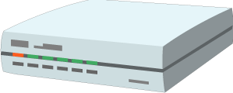



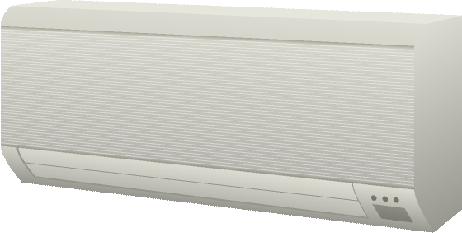
W3C WoT Architecture Patterns
Cloud
Edge Hubs
Servient
Digital Twiin
Orchestr. Client
Servient
Digital Twiin
Virtual Thing
Scripting API
Orchestr. Client
Interaction Model
Proxy Thing
Binding Templates
Scripting API
Interaction Model
Binding Templates
Web Browser
Direct Thing-to-Thing
Interaction
App Script
Scripting API
Thing
Thing
Existing Device
Interaction Model
App Script
Classic Firmware
Binding Templates
Scripting API
+
Web Integration
Interaction Model
Interaction Model
⇒
Thing
Protocol
Protocol
Complement Existing Devices

Slide 2
WoT Servient
Application
Scripting API
Thing Description
Interaction Model
Binding Templates
System
Web
OCF
Local Hardware
Proprietary Communi- cation
…
oneM2M
Web Client
OCF Device
Legacy Device
WoT Servient

Slide 3
WoT Servient
Application Script
Security Metadata
Scripting API
Thing Description
Runtime System
Protocol Bindings
System API
HTTP(S)
CoAP(S)
Local Hardware
Proprietary Communi- cation
Binding Templates
…
MQTT
Web Client
OCF Device
Legacy Device
WoT Servient

Slide 4
Protocol Binding
“Standard Body” × “Media Type” × “Transfer Protocol” × “Security”
Web
with JSON
over HTTP
using “nosec”
OCF
with CBOR
over CoAP
using DTLS
oneM2M
with JSON
over MQTT
using TLS
LWM2M
with SenML
over CoAP
using DTLS
Web with CBOR over CoAP u/ COSE+CWT
…
Binding Templates

Slide 5
Browser (Web Client)
WoT Servient
Browser with JS Library
Runtime System
Application Script
Application Script
Security Metadata
Scripting API
Scripting API
Thing Description
Thing Interaction Model
WoT JS Library
Protocol Bindings
Protocol Bindings
System API
HTTP(S)
(S)RTP
HTTP(S)
CoAP(S)
Local Hardware
Proprietary Communi- cation
…
FTP
…
MQTT

Slide 6
Browser (Web Client)
WoT Servient
Application Script
Application Script
Security Metadata
Scripting API
Scripting API
Thing Description
Browser + Library
Runtime System
Protocol Bindings
Protocol Bindings
System API
HTTP(S)
(S)RTP
HTTP(S)
CoAP(S)
Local Hardware
Proprietary Communi- cation
…
FTP
…
MQTT

Slide 7
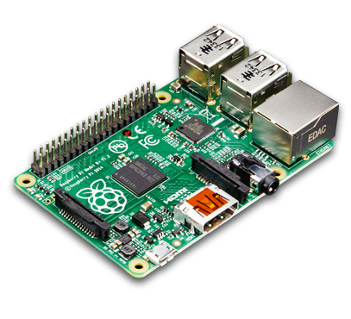
Browser (Web Client)
Device (WoT Servient)
Browser with JS Library
Runtime System
Application Script
Application Script
Security Metadata
Scripting API
Scripting API
Thing Description
Thing Interaction Model
WoT JS Library
Protocol Binding
Protocol Binding
System API
HTTP(S)
(S)RTP
HTTP(S)
CoAP(S)
Local Hardware
…
FTP
…
MQTT

Slide 8
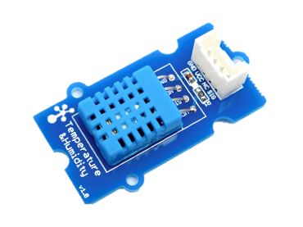
Browser (Web Client)
Device (WoT Servient)
Application Script
Application Script
Security Metadata
Scripting API
Scripting API
Thing Description
Browser + Library
Runtime System
Protocol Bindings
Protocol Bindings
System API
HTTP(S)
(S)RTP
HTTP(S)
CoAP(S)
Local Hardware
…
FTP
…
MQTT

Slide 9
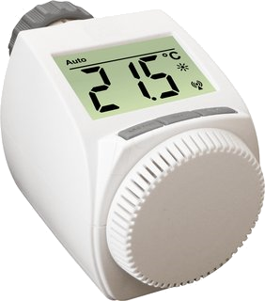
Browser (Web Client)
Device (Minimal WoT Servient)
Browser with JS Library
Firmware
Application Script
Scripting API
Thing Description
WoT JS Library
Protocol Binding
Protocol Binding
System API
HTTP(S)
(S)RTP
HTTP(S)
Local Hardware
…
FTP

Slide 10
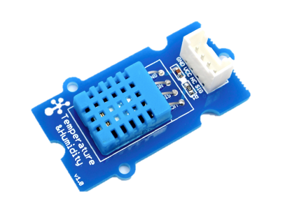
Browser (Web Client)
Device (Minimal WoT Servient)
Firmware
Application Script
Scripting API
Thing Description
Browser + Library
Protocol Bindings
Protocol Impl.
Driver Impl.
HTTP(S)
(S)RTP
CoAP(S)
Local Hardware
…
FTP

Slide 11


Browser (Web Client)
Smartphone (WoT Servient)
Browser with JS Library
Runtime System
Application Script
Gateway Script
Security Metadata
Scripting API
Scripting API
Thing Description
Thing Interaction Model
WoT JS Library
Protocol Binding
Protocol Binding
System API
HTTP(S)
(S)RTP
HTTP(S)
CoAP(S)
Proprietary Communi- cation
…
FTP
…
MQTT
Legacy Device

Slide 12
Browser (Web Client)
Smartphone (WoT Servient)
Application Script
Gateway Script
Security Metadata
Scripting API
Scripting API
Thing Description
Browser + Library
Runtime System
Protocol Bindings
Protocol Bindings
System API
HTTP(S)
(S)RTP
HTTP(S)
CoAP(S)
Proprietary Communi- cation
…
FTP
…
MQTT
Legacy Device

Slide 13
Smartphone (Browser with WoT)
Runtime System
Visualization Script
Security Metadata
Scripting API
Thing Interaction Model
Protocol Binding
System API
HTTP(S)
CoAP(S)
Proprietary Communi- cation
…
MQTT
Legacy Device

Slide 14

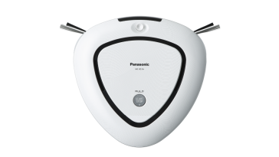
Browser (Web Client)
Edge Hub (WoT Servient)
Browser with JS Library
Runtime System
Application Script
Application Script
Security Metadata
Scripting API
Scripting API
Thing Description
Thing Interaction Model
WoT JS Library
Protocol Binding
Protocol Binding
System API
HTTP(S)
(S)RTP
HTTP(S)
CoAP(S)
Proprietary Communi- cation
…
FTP
…
MQTT
Thing
Legacy Device
Thing

Slide 15
Browser (Web Client)
Edge Hub (WoT Servient)
Application Script
Integration Script
Security Metadata
Scripting API
Scripting API
Thing Description
Browser + Library
Runtime System
Protocol Bindings
Protocol Bindings
System API
HTTP(S)
(S)RTP
HTTP(S)
CoAP(S)
Local Hardware
Proprietary Communi- cation
…
FTP
…
MQTT
Thing
Legacy Device
Thing

Slide 16
Browser (Web Client)
Cloud (WoT Servient)
Edge Hub (WoT Servient)
Browser with JS Library
Browser with JS Library
Runtime System
Application Script
Mirror Script
Application Script
Security Metadata
Scripting API
Scripting API
Scripting API
TD
TD
Thing Interaction Model
WoT JS Library
Thing IM
Protocol Binding
Protocol Binding
Protocol Binding
System API
HTTP(S)
(S)RTP
HTTP(S)
(S)RTP
HTTP(S)
CoAP(S)
Proprietary Communi- cation
…
FTP
…
FTP
…
MQTT
Thing
Legacy Device
Thing

Slide 17
Browser (Web Client)
Cloud (WoT Servient)
Edge Hub (WoT Servient)
Mirror Script
Mirror Script
Integration Script
Security Metadata
Security Metadata
Scripting API
Scripting API
Scripting API
TD
TD
Browser + Library
Runtime System
Runtime System
Protocol Bindings
Protocol Bindings
Protocol Bindings
System API
HTTP(S)
(S)RTP
HTTP(S)
CoAP(S)
HTTP(S)
CoAP(S)
Local Hardware
Proprietary Communi- cation
…
FTP
…
MQTT
…
MQTT
Thing
Legacy Device
Thing

Slide 18
Browser (Web Client)
Cloud (WoT Servient)
Browser with JS Library
Runtime System
Application Script
Application Script
Security Metadata
Scripting API
Scripting API
TD
Thing Interaction Model
WoT JS Library
Protocol Binding
Protocol Binding
System API
HTTP(S)
(S)RTP
HTTP(S)
CoAP(S)
Proprietary Communi- cation
Legacy Hub
…
FTP
…
MQTT
Legacy Device
Legacy Device

Slide 19
Browser (Web Client)
Cloud (WoT Servient)
Application Script
Integration Script
Security Metadata
Scripting API
Scripting API
Thing Description
Browser + Library
Runtime System
Protocol Bindings
Protocol Bindings
System API
HTTP(S)
(S)RTP
HTTP(S)
CoAP(S)
Proprietary Communi- cation
Legacy Hub
…
FTP
…
MQTT
Legacy Device
Legacy Device

Slide 20
WoT Servient
Application Script
Security Metadata
Semantic Metadata
Runtime System
Protocol Bindings
System API
HTTP
MQTT
Proprietary Communi- cation
Local Hardware
CoAP
…
WoT Servient
Web Server
Legacy Device
Web Client
WoT Servient

Slide 21
WoT Servient
App Script A
App Script B
Security Metadata
Security Metadata
Discovery API
Client API
Server API
Scripting API
Thing Description
User Thing A
User Thing B1
Echonet Proxy
Local Sensor
User Thing B2
Binding Templates
System API
Web
oneM2M
Proprietary Communi- cation
Local Hardware
OCF
…
WoT Servient
Web Server
Legacy Device
Web Client
WoT Servient

Slide 22
Runtime Environment
Application Script A
Application Script B
Application Script C
Security Metadata
Security Metadata
Security Metadata
Discovery API
Client API
Server API
Scripting API
Thing Description
ExposedThing A
ExposedThing B1
ExposedThing B2
ConsumedThing C
Protocol Bindings
“Standard Body” × “Media Type” × “Transfer Protocol” × “Security”
oneM2M
with JSON
over HTTP
using TLS
oneM2M
with JSON
over MQTT
using TLS
OCF
with CBOR
over CoAP
using DTLS
LWM2M
with SenML
over CoAP
using DTLS
Web
with JSON
over HTTP
u/ JOSE+JWT
…

