Slide 1

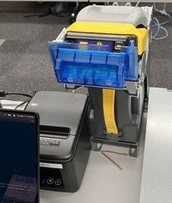
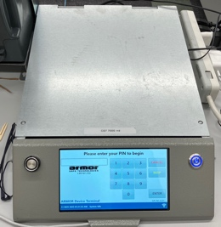
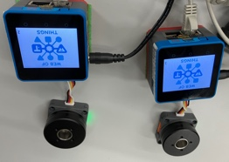
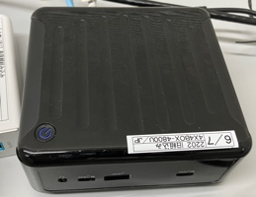
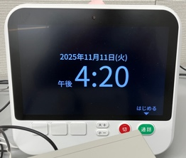
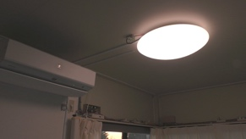
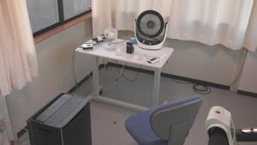
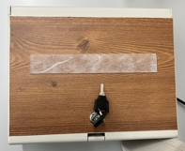
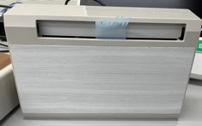
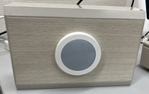
TPAC2025 WoT plugfest network configuration
Room 307
Plugfest wifi / Ethernet
TPAC
WiFi
Internet
Conexxus
Cash Deposit Device
Hitachi
Motor/Encoder
ECHONET
WoT Proxy
Consumers
(Hitachi, Conexxus, ...)
ECHONET lite Web API GW
mobile router
ECHONET lite
controller
ECHONET
remote devices
(in Ishikawa)
Door
AirCon
Light

Slide 2
TPAC2025 WoT Plugfest network configuration
Room 307
Plugfest wifi / Ethernet
10.1.0.0/16
TPAC
WiFi
192.168.1.1
Internet
192.168.1.8
192.168.1.16
192.168.1.12,17
192.168.1.11
Conexxus
Cash Deposit Device
ECHONET
WoT Proxy
Hitachi
Motor/Encoder
Consumers
(Hitachi,
Cellular
ECHONET lite Web API GW
ECHONET lite
controller
mobile router
Ethernet
Door
AirCon
Light
other remote devices
(on JAIST, Ishikawa)

Slide 3
W3C TPAC2025 Web of Things Plugfest Outcome
2025-11-12

