Slide 1
Yet another Action model
Trying to describe action queues and dynamic resources

Slide 2
Problem
How to describe complex action interaction models of the IoT world.
Features of complex action models:
Actions can last longer of a regular protocol request
Users can stop or query or perform other operation on an action Request
Users might queue an action requests

Slide 3
Problem
Query/Cancel
Action Request
Consumers
Query/Cancel
Action Request0
Query/Cancel
Query/Cancel
Action Request1
QueryAll/CancelAll
Action RequestN
Consumers
Action Queue

Slide 4
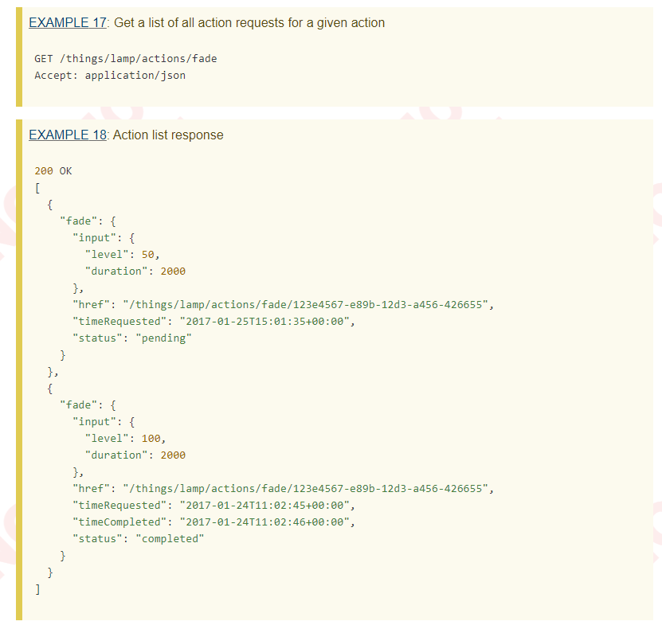
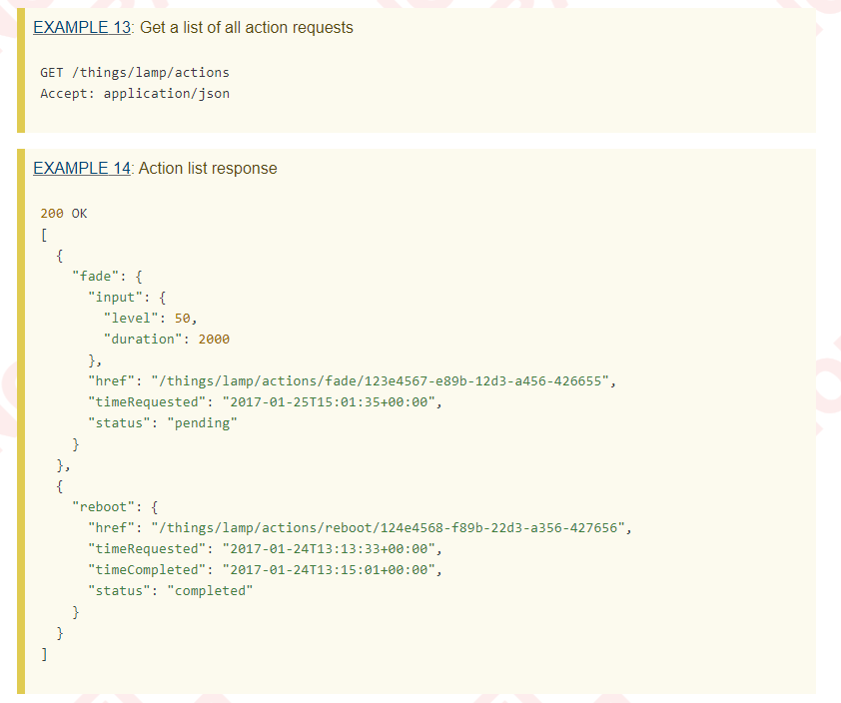
Use cases: webthings.io
Each action affordance has its own queue, there is a global queue per WebThing where all actions requests are scheduled.
Examples:

Slide 5
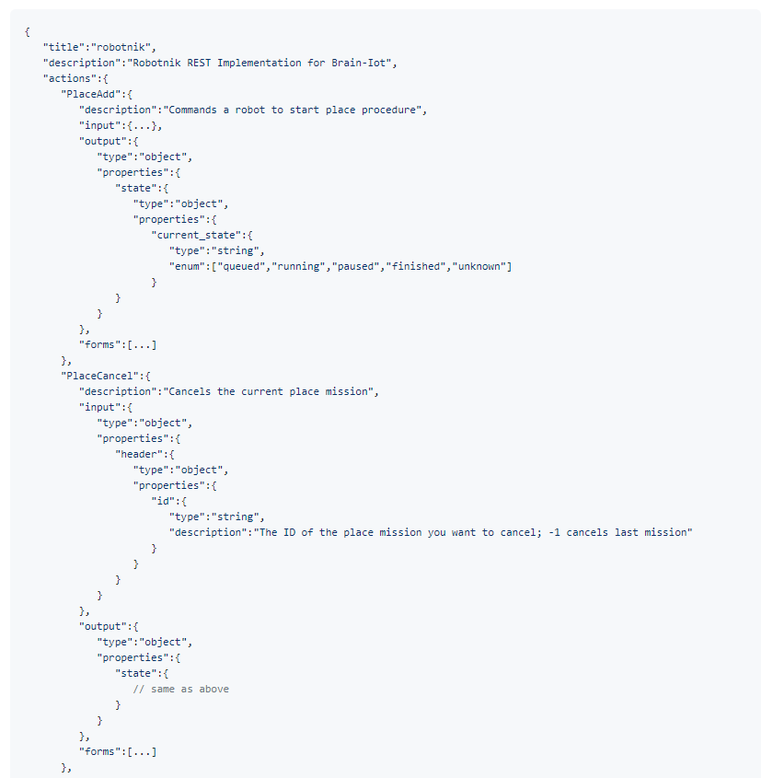
Use cases: BRAIN-IOT TD example

Slide 6
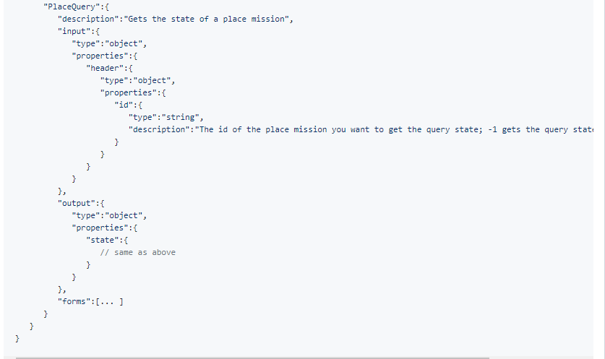
Use cases: BRAIN-IOT TD example cont.

Slide 7
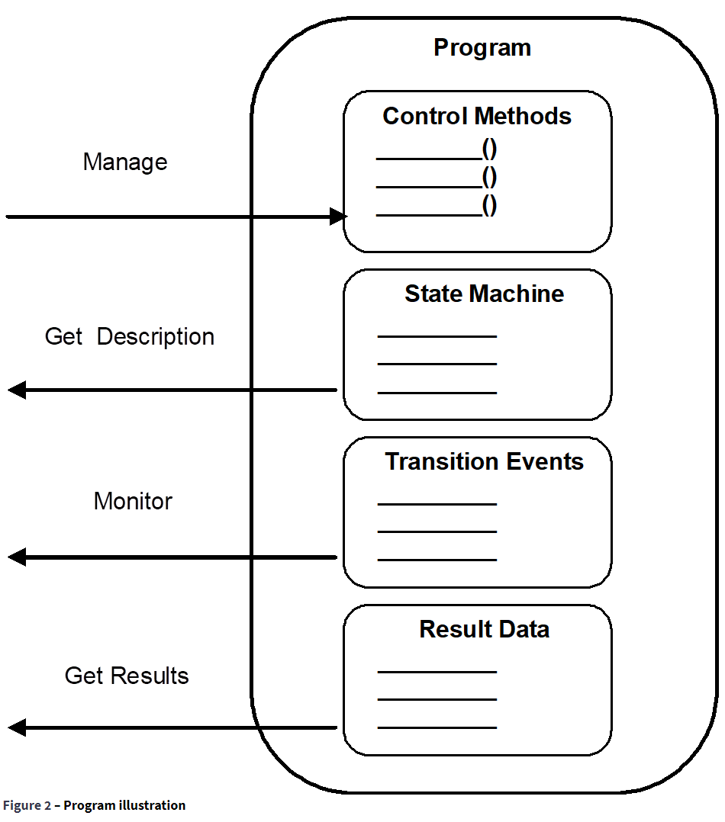
Use cases: OPCUA
Programs are complex Functions in a Server or underlying system that can be invoked and managed by a Client. Programs can represent any level of functionality within a system or process in which Client control or intervention is required and progress monitoring is desired.

Slide 8
State of the art
Dynamic TDs
Describe different forms to access Action Request and queues with a dynamic TD. The TD is update every once a new action request is issued.
Group found this solution to be troublesome:
Caching issues
Consumers needs to keep track of TD changes
Security concerns (?)
No static description of the possible operation. (Bad for documentation)
New Ops and URI templates
Describes Action queues and operations on Action Requests with new op member. Use URI template to describe dynamically changing Forms.
Group welcomed this solution. Nonetheless there are some concerns about how consumers would understand URI templates without out-of-band information.

Slide 9
Proposal: Leverage on Thing Models and Action Thing Descriptions
The idea is to use a Thing Model to describe further operations that the consumer can do after an invokeaction operation. At runtime consumers will build a Action Thing Description that can be use to access further operations like querying the status or cancel the action execution.
This approach should work for both green and brown field devices.
Early ideas can be found here

Slide 10
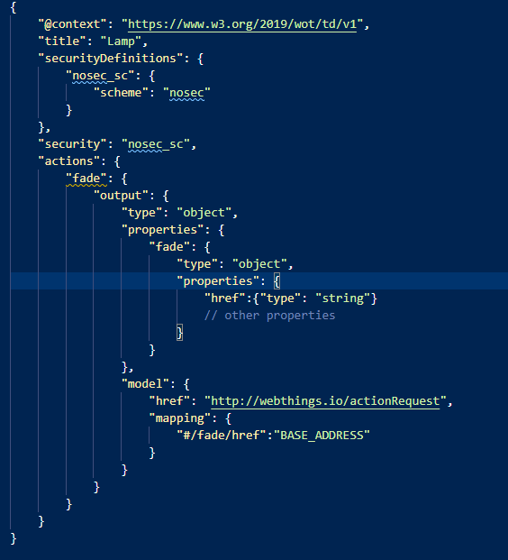
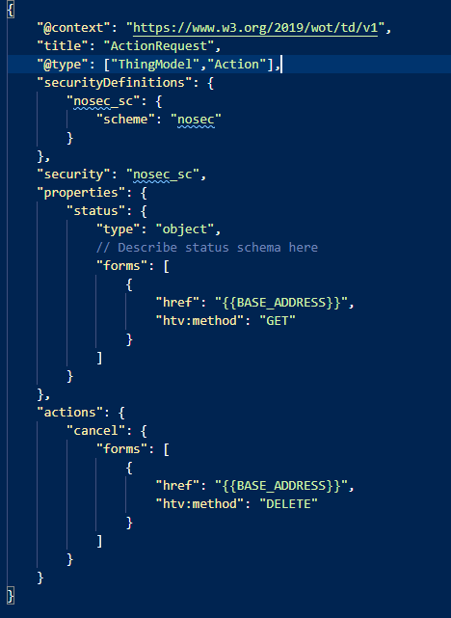
Proposal: Leverage on Thing Models and Action Thing Descriptions
Thing Model
Thing Description

Slide 11
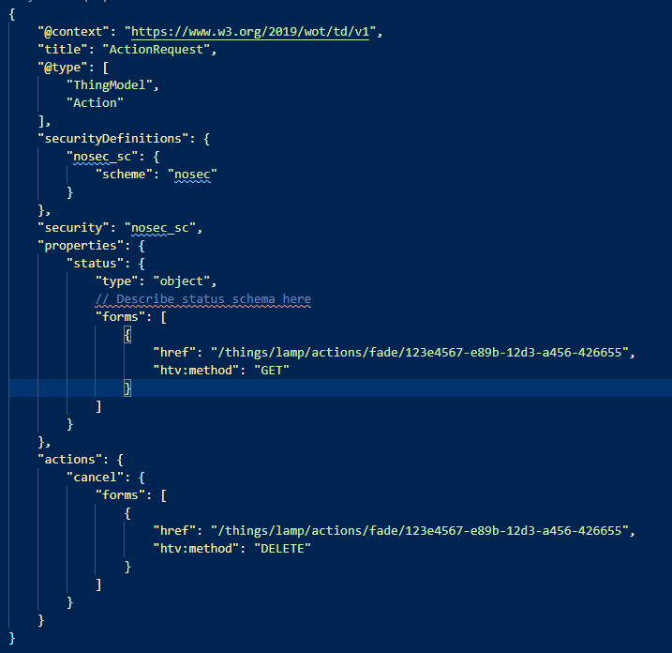
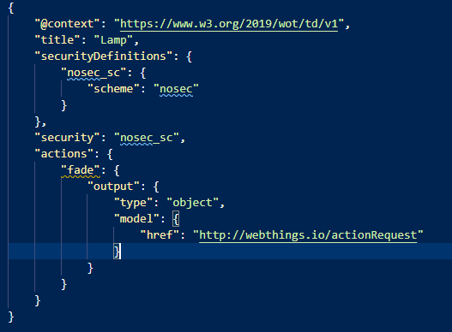
Proposal: GreenField (core profile?)
Action Thing Description
Thing Description
Use model as a validation hint for the returned json object. Thanks to the advancement in json schema community it is possible to define new validation terms.

Slide 12
Pros
No id tracking
Statically describe Action Request operations thanks to the TM
Backward compatible
Flexible (it covers green field and brown filed devices). it might as well be used for other use cases: used in properties it might describes operations that can be performed on collections of Web Things (to be verified)
As a side effect we get the ability to specify a TM as a validation parameter of affordances (w3c/wot-discovery#182)
Compact: it does not add too many new parameters
Lightweight: Consumers of a particular profile can just use the model reference as a tag and process the returned object according to their specification.

Slide 13
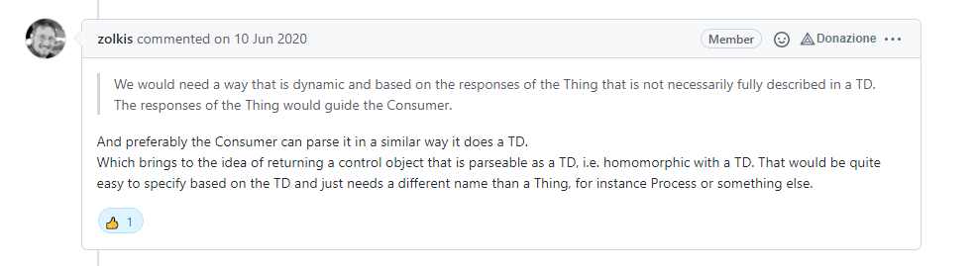
About Action Thing Description semantic
Thing Descriptions should describe physical devices.
Action Requests are not physical devices.
Semantically speaking we should expand our ontology model to cover also this use case. Options:
Be less restrictive with what can be described by a Thing Description (we already forcing the definition a little bit with TDDs and ThingLinks)
Introduce a new entity type

Slide 14
Open question do we still need new operation types?
Operation types might be used in the TM as well. But are they useful?
Consumers will use the TM as a semantic annotation for forms.
We might need to standardize a common Thing Model for actions or define Affordances Types to tag Action TM .

Slide 15
Open question do we still need new operation types?
Action Thing Descriptions work well for indicating operations that can be performed on a Action Request. However, we are still missing to describe endpoints for action queues.
In this case, a new operation type works well because the action queue is a static resource. For example: queryactions and cancelactions

Slide 16
Conclusions
The proposal is taking the best of the current approaching. It is able to describe dynamic resources without losing the ability to statically describe the operations. Moreover, it solves the id tracking problem leveraging on Thing Models mapping rules. Finally it uses the new operation types to describe action queues.

