Slide 1

Marketing
TPAC Report and Discussion
Ege Korkan, Siemens AG, @egekorkan
Fady Salama, Siemens AG, @FadySalama21

Slide 2
Agenda
Chair Changes
Summary of the Work
WoT Communication Platform

Slide 3
Chair Change
Chair until September: Sebastian Käbisch
Chair between September and now: Fady Salama
Chair after TPAC: Ege Korkan
Chair for Testing after TPAC: Fady Salama

Slide 4

Summary of the Work
Explainer Video: https://www.youtube.com/watch?v=WMFXg-kni0U

Slide 5
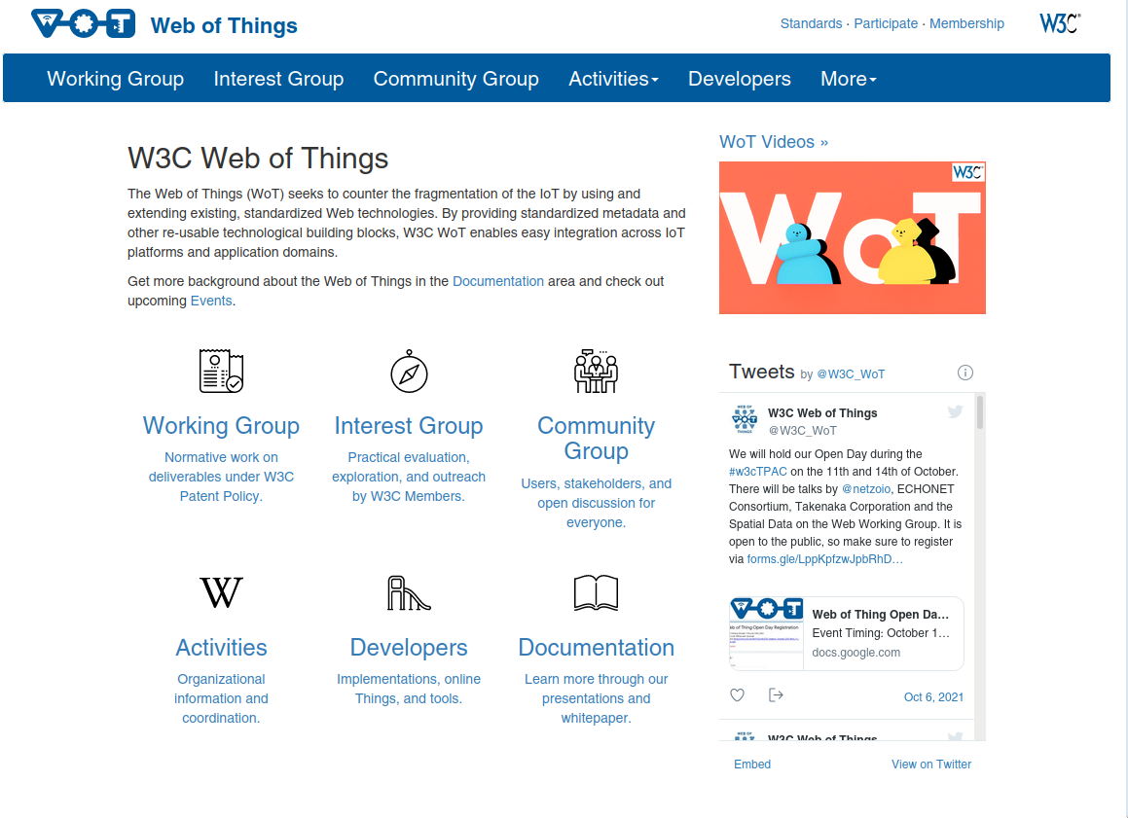
Summary of the Work
Continuous UI Improvements

Slide 6

Summary of the Work
A new WoT Logo Animation by @relu91: https://github.com/w3c/wot-marketing/tree/main/material/logo-animation

Slide 7
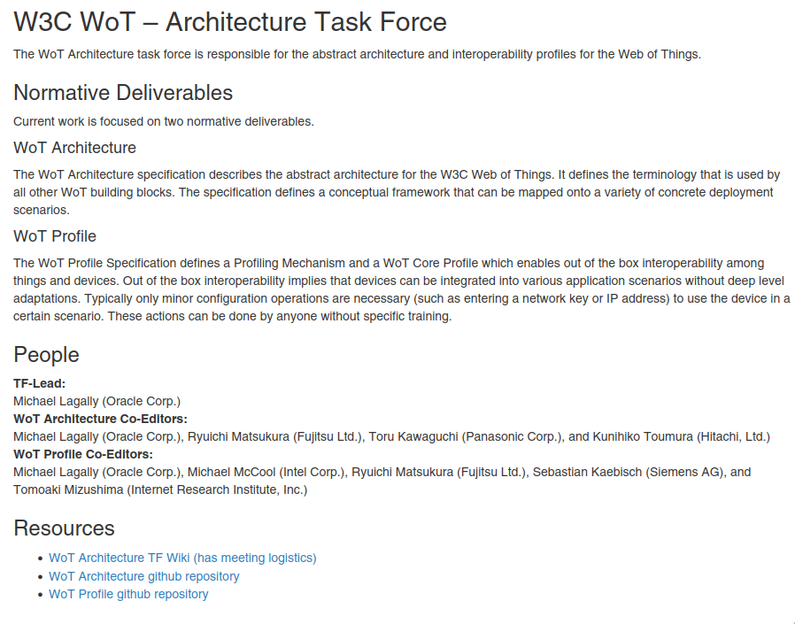
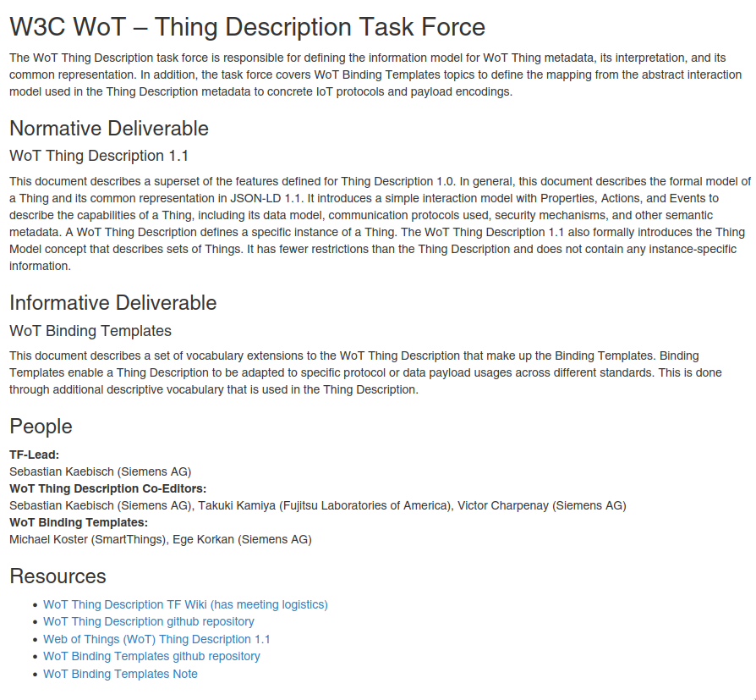
Summary of the Work
Task Force Descriptions: https://www.w3.org/WoT/activities/general/

Slide 8
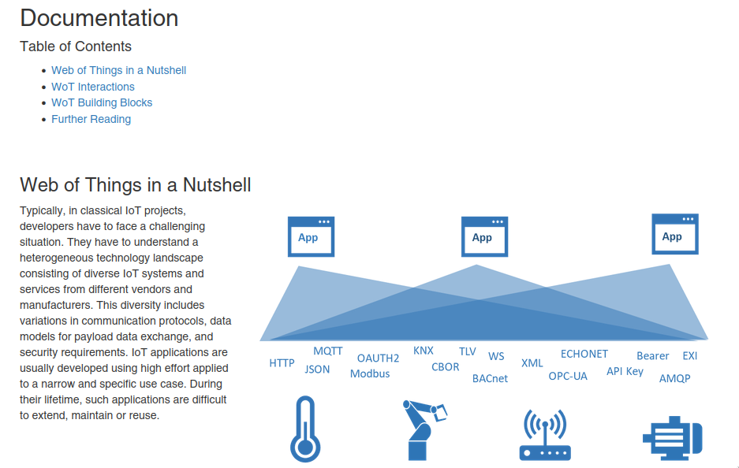
Summary of the Work
Documentation/Tutorial by @sebastiankb :
https://www.w3.org/WoT/documentation/

Slide 9
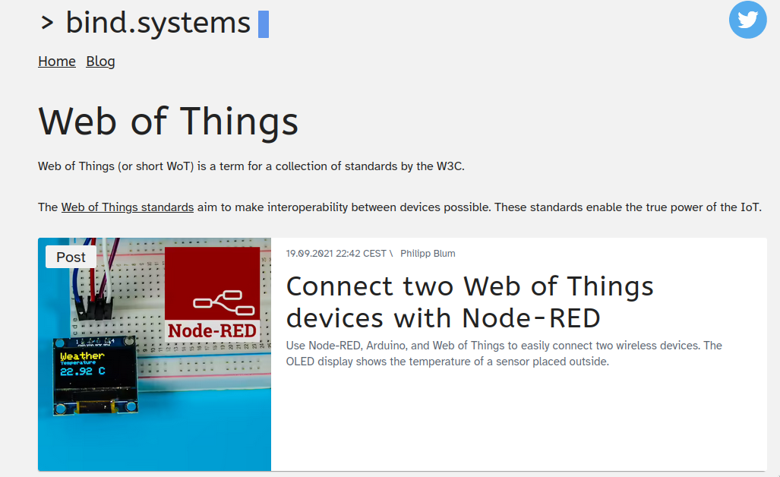
Summary of the Work
Tutorial:
  TUM/Siemens: Coming Soon
  Philipp Blum: https://bind.systems/tags/web-of-things/

Slide 10

Summary of the Work
Putting WoT Videos together: https://www.w3.org/WoT/videos/

Slide 11
Summary of the Work
Twitter
  332 followers
  Analytics available at https://analytics.twitter.com/user/W3C_WoT/home

Slide 12
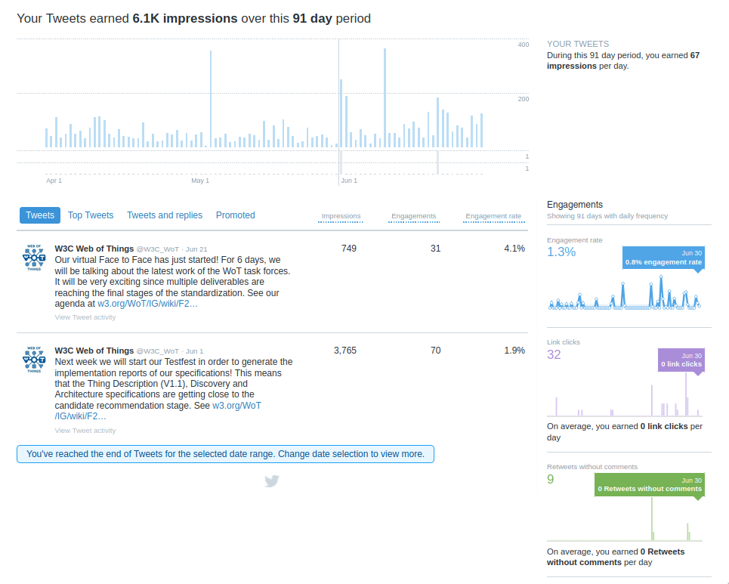
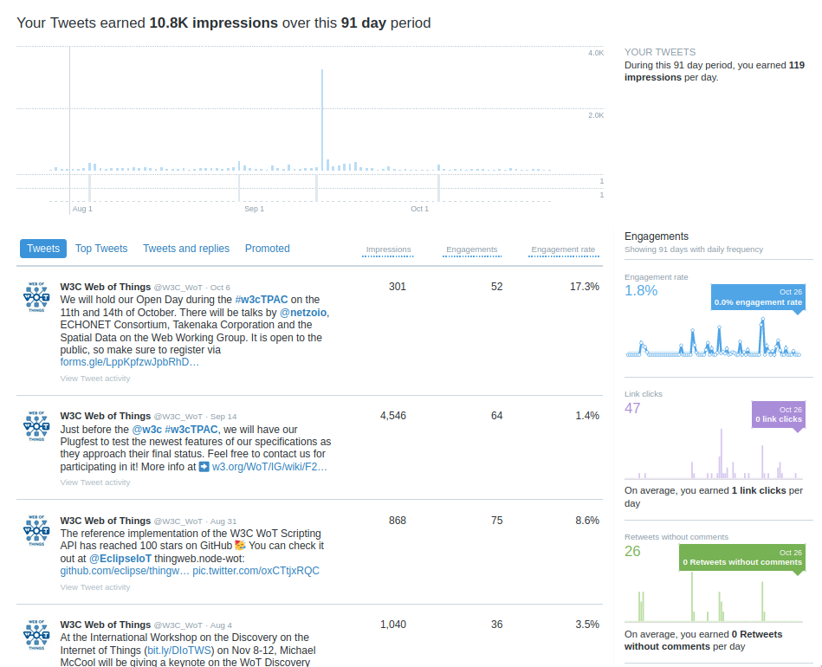
Summary of the Work

Slide 13
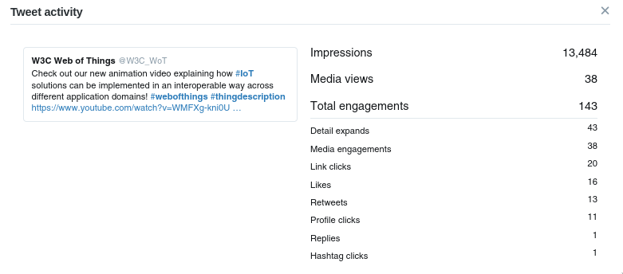
Summary of the Work

Slide 14
Summary of the Work

Slide 15
Communication Platforms with Interested Parties

Slide 16
Communication Platforms with Interested Parties
https://github.com/w3c/wot-marketing/issues/146
Goal: We want non W3C members to have easier discussions with the WoT WG and IG
Why: Make WoT more approchable

Slide 17

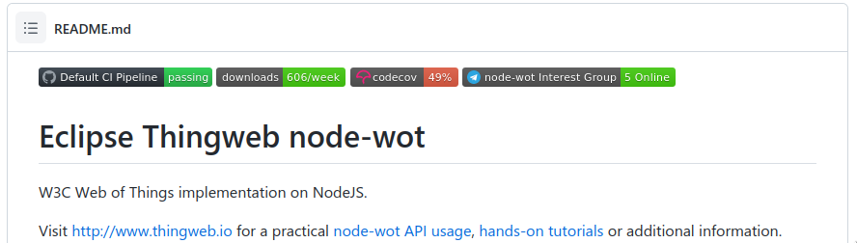
Communication Platforms with Interested Parties
Example from node-wot:
  Telegram

Slide 18

Communication Platforms with Interested Parties
Example from JSON Schema
  Slack (Invite Link)
  2546 members
  Daily ~ 5 questions

Slide 19
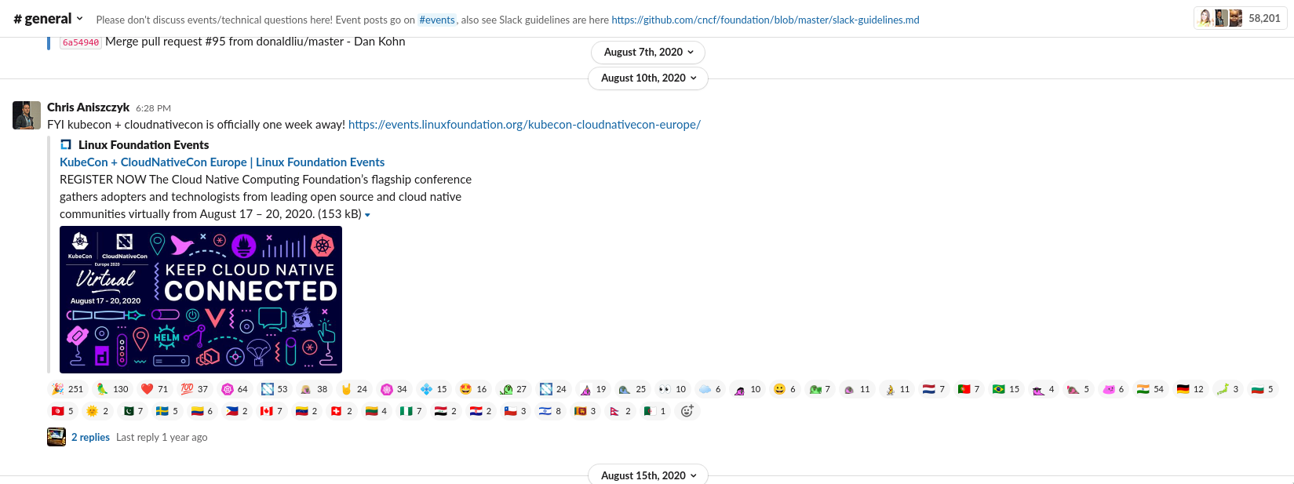
Communication Platforms with Interested Parties
Example from Cloud Native Foundation
  Slack (Invite Link)
  58k members

Slide 20
Communication Platforms with Interested Parties
W3C has Slack for the staff, AC Reps, TAG etc.
https://lists.w3.org/Archives/Public/public-web-and-tv/2020Mar/0028.html

Slide 21
Possible Solutions
GitHub Issues:
  - Off-putting to some due to “offensive” nature of the issue word
  - Repository specific
GitHub Discussions:
  + More approachable than GitHub Issues
  - Repository specific

Slide 22
Possible Solutions
StackOverflow (our tag)
  + More approchable than GitHub Issues
  - We cannot moderate it
  - Recommendation-like questions and answers are not welcome, i.e. solution oriented

Slide 23
Possible Solutions
Chat-based Platforms
  WhatsApp, Telegram, Signal, etc.
    - Product
    - Single discussion thread, no channels
    - Requires mobile number
    - No need to join different space for each group
    + Most people have one

Slide 24
Possible Solutions
Chat-based Platforms
  Slack
    - Product
    - Smaller community focus → More for teams
    + We already have one
    - Limitation on the amount of saved messages

Slide 25
Possible Solutions
Chat-based Platforms
  Discord
    - Product
    + Community Oriented
    - Used to be more associated to gaming

Slide 26
Possible Solutions
Chat-based Platforms
  Matrix
    + Communication standard with your own clients (like IRC)
    - Less polished than Slack or Discord
    - Not well suited for video and audio calls

Slide 27
Communication Platforms with Interested Parties
Other ideas?
Discussion

