Slide 1
Day 1 Opening
Sebastian Käbisch
November 13, 2025
TPAC 2025

Slide 2
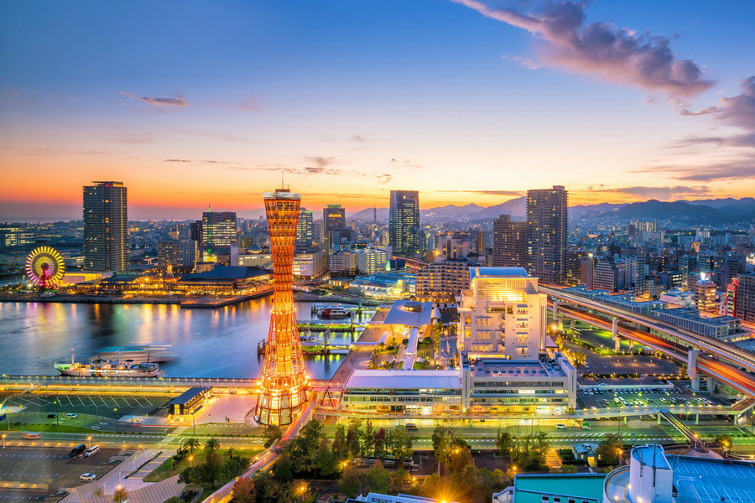
Warm Welcome to 神戸市
Image source: https://www.advantour.com/japan/kobe.htm

Slide 3
Policies and Procedures
TPAC Policies
  https://www.w3.org/policies/code-of-conduct/
  Please speak slowly and clearly!
Hybrid Meeting
  Use Zoom for speaker queue
  Use Etherpad for minutes and latest agenda:
  https://pad.w3.org/p/2025-11-13-wot
  Meeting materials:
    get pptx templates
    find presentations from the F2F meeting
    https://github.com/w3c/wot/tree/main/PRESENTATIONS/2025-11-tpac
  Scribe: TDB

Slide 4
Agenda: Day 1
09:00-09:15: Opening (Sebastian)
09:15-10:15: PlugFest Summary
10:15-10:30: Reports from joint or relevant group meetings (e.g., JSON-LD)
10:30-11:00: Coffee Break
11:00-12:30: Charter WG plans (Sebastian / Michael)
12:30-13:45: Lunch
13:45-15:00: Thing Description (Ege / Michael)
15:00-15:30: Coffee Break
15:30-16:45: Scripting API (Daniel / Cristiano)
16:45: End of day
19:00: WoT Dinner

