Slide 1
Thing Description Sessions
Ege Korkan, Siemens
29 October 2026
W3C TPAC 2026

Slide 2
Agenda
Today
  Summaries (20 mins), Ege:
    TD Work (common definitions, data mapping, underlying stuff, toolchain)
    New bindings and changes
    Binding Registry
  Specification Toolchain (20 mins), Mahda
Tomorrow
  TD roadmap / Prioritization / Who is responsible of specific tasks (20 mins), Ege
  Data Mapping User Stories to Specification Feature (15 mins), Christian
  Subprotocols, URI Schemes, and how to identify and manage bindings (30 mins), Ege

Slide 3
Summaries
TD, Bindings, Registry

Slide 4
Landscape
Binding A – v1
Binding A – v2
TD Spec:
Core Information Model and Serialization
Binding Registry
extends
Binding C
governs
explains
extends
Binding Mechanism
Binding D

Slide 5
Thing Description

Slide 6
TD
Getting Organized
Common Definitions
Data Mapping
Media Streaming
Core Design Challenges

Slide 7
Getting Organized
Work Item Planning
  https://github.com/w3c/wot-thing-description/blob/main/planning/README.md contains the summarized work items and analyses
Architecture Specification Assertions
  We worked on moving normative assertions in the Architecture specification to the TD
  https://github.com/w3c/wot-thing-description/issues/2126 and was tracked by https://github.com/w3c/wot-thing-description/blob/main/planning/work-items/other-documents-sync/arch.md

Slide 8
Common Definitions
First big refactoring and almost a feature of TD 2.0
Waiting for toolchain refactoring to move to Editor’s Draft
https://github.com/w3c/wot-thing-description/tree/main/proposals/common-definitions
Plugfest TDs with common definitions: https://github.com/w3c/wot-testing/pull/641
Upcoming examples are from https://github.com/w3c/wot-thing-description/blob/main/proposals/common-definitions/tooling/tds.js

Slide 9
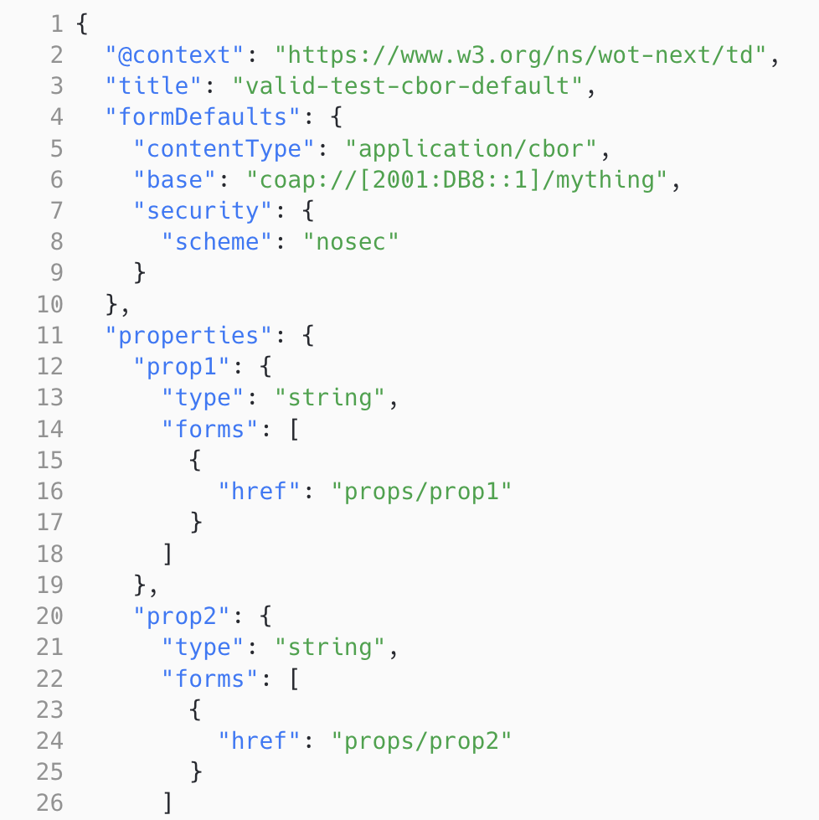
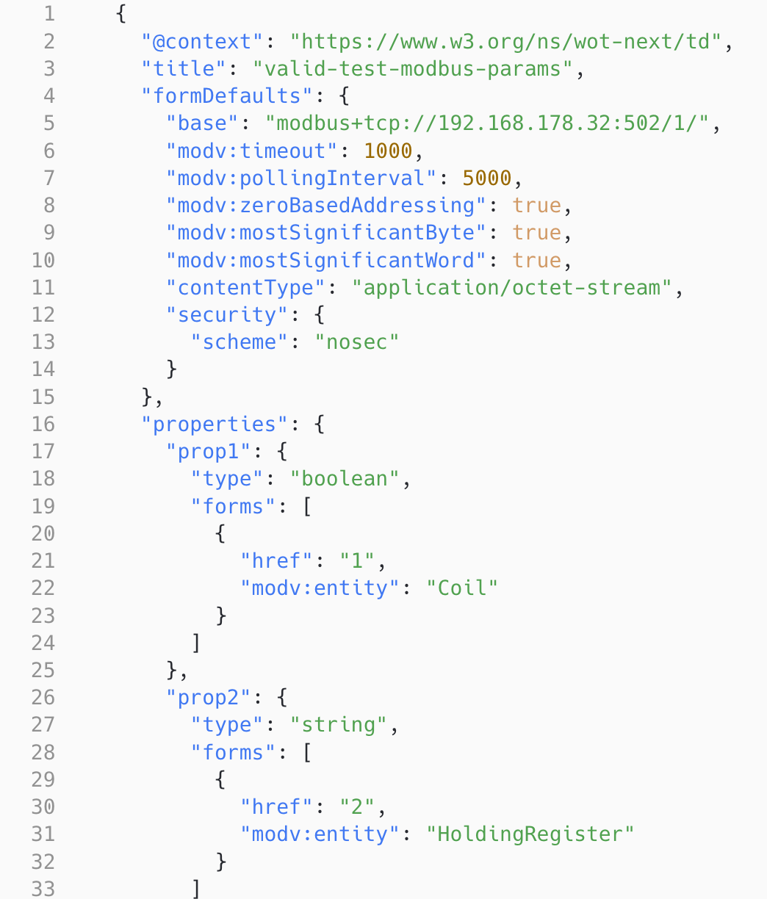
Common Definitions: Simple Case

Slide 10
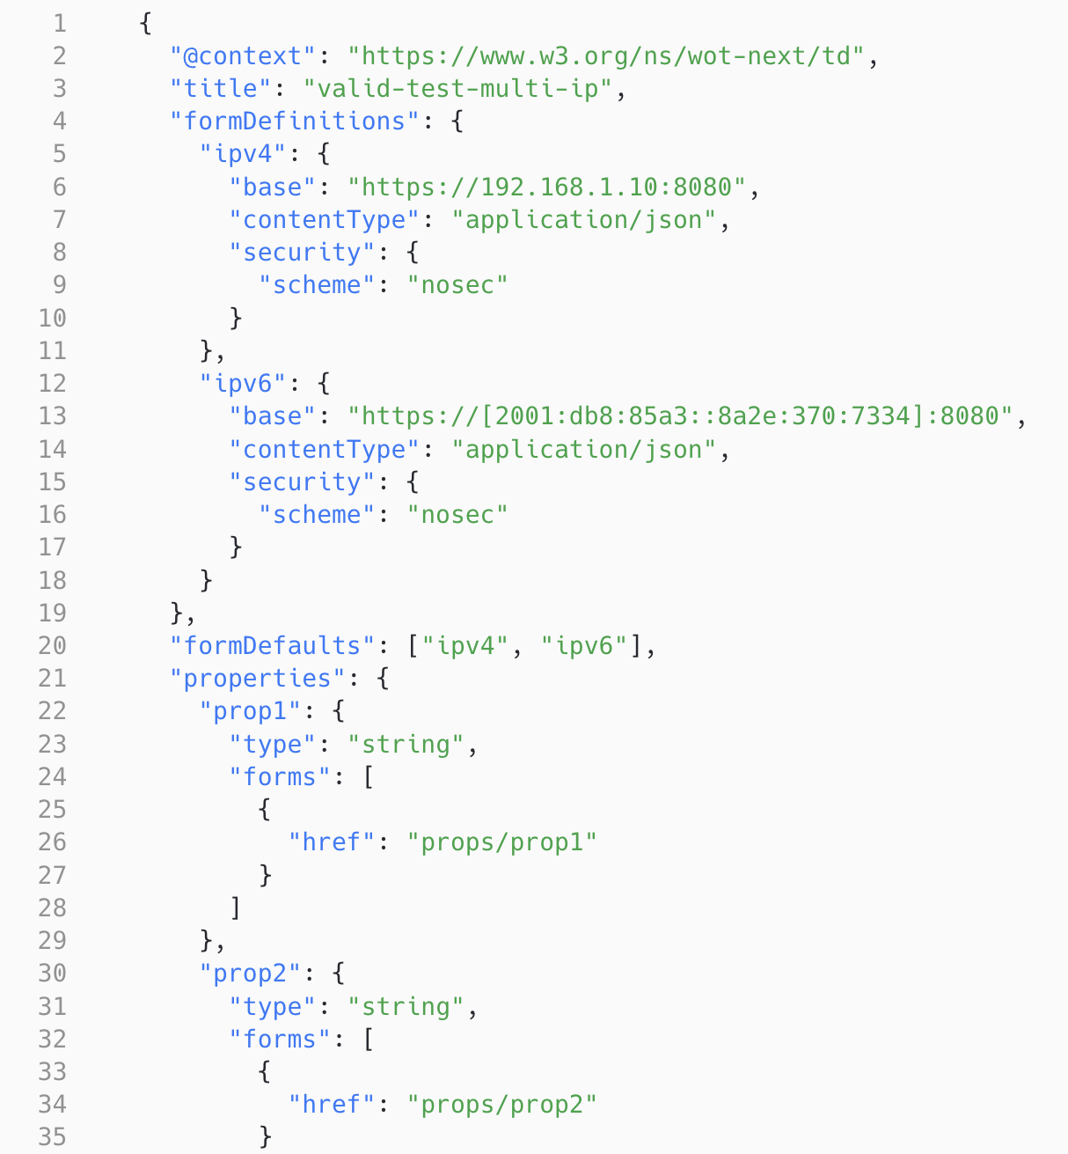
Common Definitions: Multiple Form Defs.

Slide 11
Data Mapping
Christian will go deeper into it
Developed at https://github.com/w3c/wot-thing-description/blob/main/planning/work-items/analysis/data-mapping/analysis-data-mapping-summary.md

Slide 12
Media Streaming
How can we handle media streams that are not simple fetching of media. Early analysis that will be extended from Plugfest results.
Driven by Toumura-san
https://github.com/w3c/wot-thing-description/blob/main/planning/work-items/analysis/analysis-media-streaming.md

Slide 13
Core Design Challenges
Discussion about the fundamentals of the TD. Difficult to summarize each point ☺
  Subprotocols, URI Schemes, and how to identify and manage bindings: Deeper discussion tomorrow
  readOnly, writeOnly and how these influence input and outputs
    Failed PR: https://github.com/w3c/wot-thing-description/pull/2206
    Next discussion: https://github.com/w3c/wot-thing-description/issues/2215 and https://github.com/w3c/wot-thing-description/blob/main/planning/work-items/analysis/readOnly-writeOnly.md

Slide 14
Bindings

Slide 15
Bindings: Changes
Not much change to existing bindings
HTTP Binding: Not anymore part of TD
  https://github.com/w3c/wot-thing-description/pull/2123
Modbus: Zero based addressing
  https://github.com/w3c/wot-binding-templates/pull/479

Slide 16
Bindings: New Bindings
LoRaWAN: https://w3c.github.io/wot-binding-templates/bindings/protocols/lorawan/index.html
EtherNet/IP: https://w3c.github.io/wot-binding-templates/bindings/protocols/ethernetip/index.html
S7Comm: https://w3c.github.io/wot-binding-templates/bindings/protocols/s7comm/index.html
Other SDOs:
  OPC UA: https://reference.opcfoundation.org/specs/OPC-10101
  CAN: https://github.com/w3c/wot-binding-templates/issues/465
  SNMP: https://github.com/w3c/wot-binding-templates/issues/464
  IO Link: Link to be provided but it is in IDTA

Slide 17
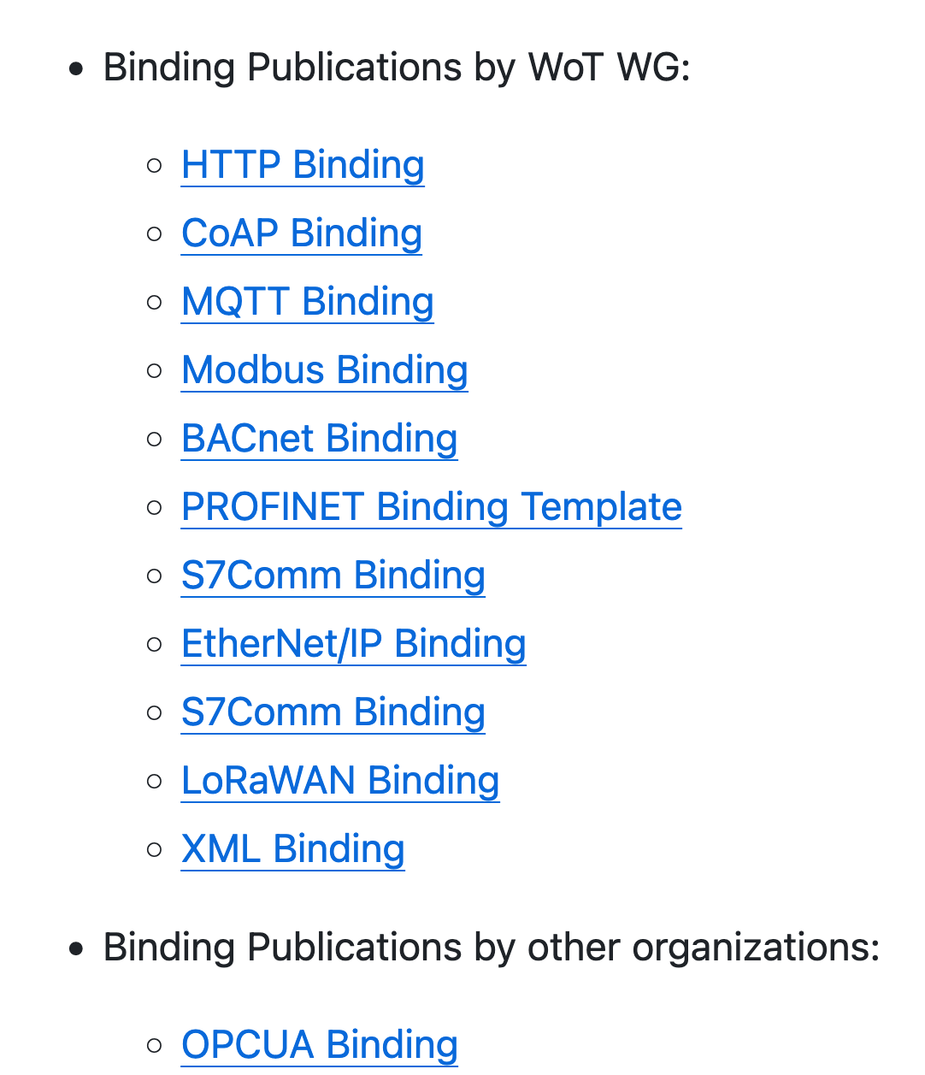
All we have
https://github.com/w3c/wot-binding-templates/#publications

Slide 18
Binding Registry

Slide 19
Registry
It is just a table!
https://w3c.github.io/wot-binding-registry/
However, we define how that table is governed. That makes things a bit more difficult and “administrative”
Some support would be appreciated here

Slide 20
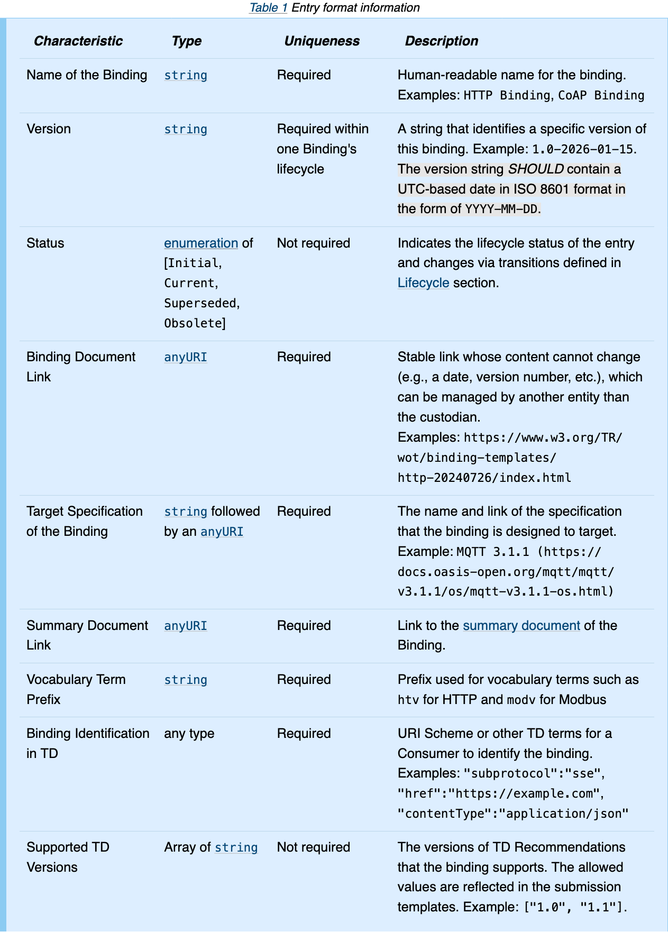
What goes into the table

Slide 21
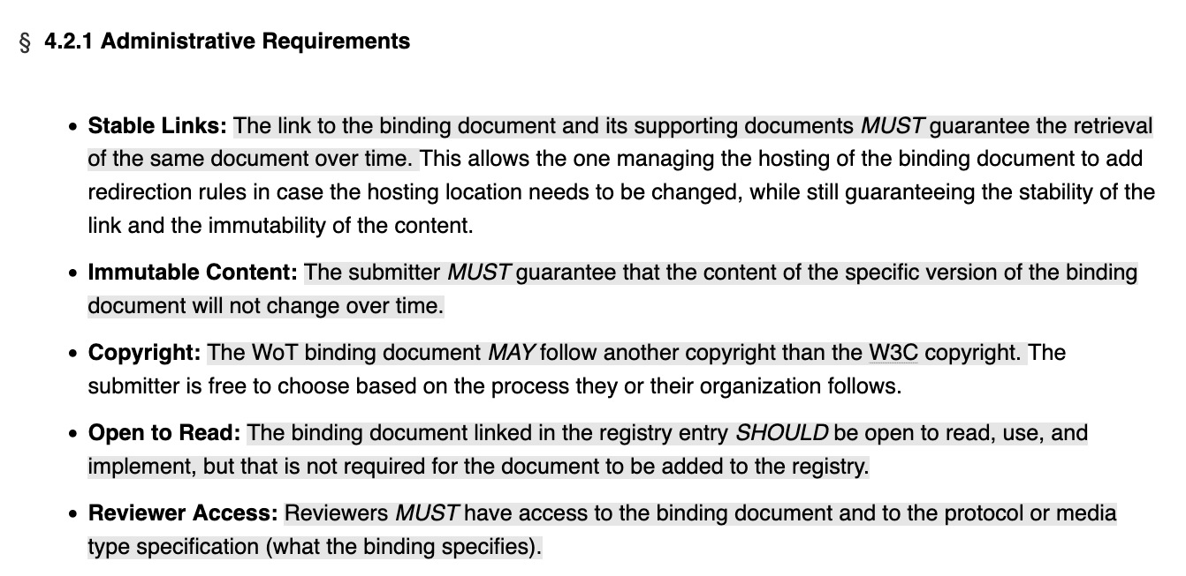
Some rules in the registry

Slide 22
Toolchain
Presentation by Mahda – Switch to her screen

Slide 23
Roadmap
This should be a very open discussion and understanding the contribution plans of everyone. Who can do what, who wants to what?

Slide 24
What needs to be done
Bold: Someone takes care of it
Italic: Shared work or cannot be assigned to one
Underline: Need support
No style: No one takes care of it
Thing Description:
Toolchain – Mahda, Abror
Core design changes
Simple improvements
Common Definitions - Ege
Data Mapping - Christian
Media Streaming – Toumura-san
Historical Data – Rob Warren
Manageable Affordances
Signing and Canonicalization
Splitting Security into Bindings – Kaz and Matsumura
Generic Tasks:
Overall meeting organization - Ege
Publication of Specs and of Resources - Ege
Triaging Issues and Work - Ege
Bindings-related:
Binding Authoring
Binding Review (via Registry or not)
Registry document writing - Ege
Publication of Bindings - Sebastian
Best practices & Primer:
TBD but relates to the TD Task Force

Slide 25
Data Mapping
Presentation by Christian – Switch to his screen

Slide 26
Subprotocols, URI Schemes, and how to identify and manage bindings

