Slide 1

Binding Templates
Restructuring
Ege Korkan, Siemens AG
@egekorkan

Slide 2
Agenda
Explaining Restructuring
Submission Procedure for New Bindings

Slide 3
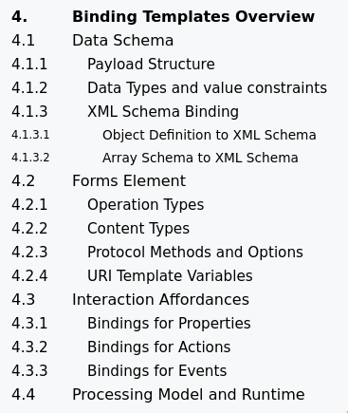
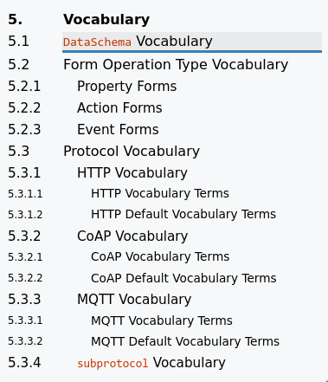
Previous Editor’s Draft

Slide 4
Previous Editor’s Draft
Platforms/Standards
e.g. LWM2M, SenML
Media Types
Belongs to TD?

Slide 5
Previous Editor’s Draft
Already in TD
Protocols

Slide 6
Current Editor’s Draft
General Idea:
  Categorize Binding types
  Externalize specific Bindings

Slide 7
Current Editor’s Draft
General Idea:
  Categorize Binding types
    Protocols
    Media Types
    Platforms (and Standards)

Slide 8
Current Editor’s Draft
General Idea:
  Categorize Binding types
    Protocols
    Media Types
    Platforms (and Standards)
  Externalize specific Bindings
    One document per Binding with different authors and publication date

Slide 9
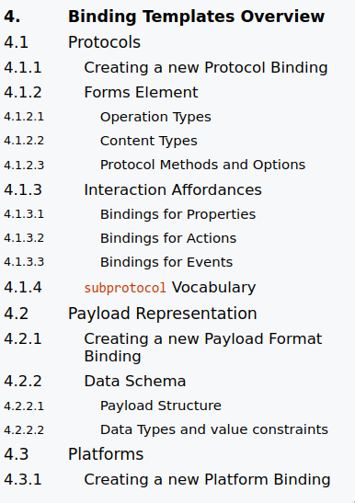
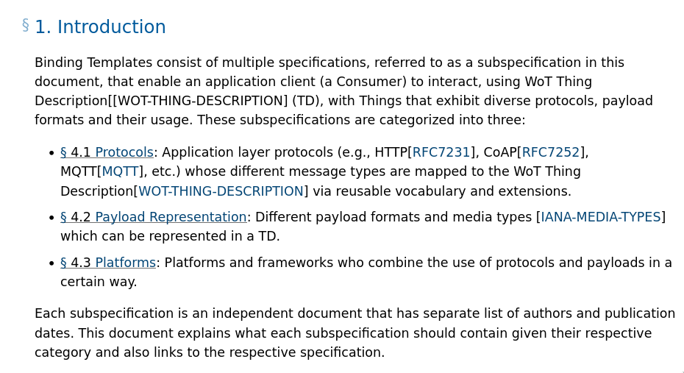
Current Editor’s Draft

Slide 10
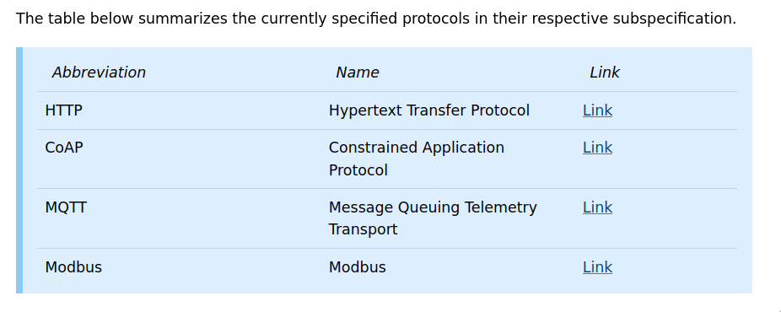
Current Editor’s Draft

Slide 11
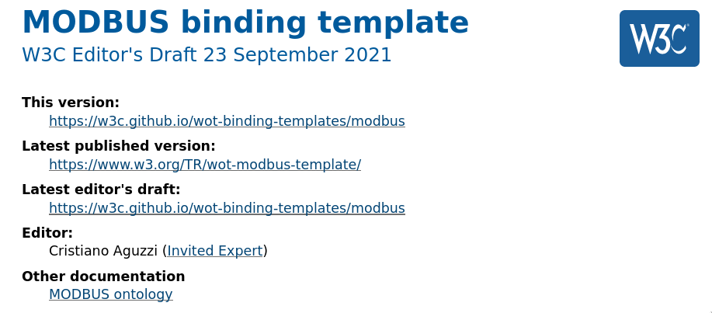
Current Editor’s Draft

Slide 12
Please Review!
There is significant restructuring. Thus, a more intensive review is required before proceeding to a Working Group Note

Slide 13
Submission Procedure
Currently, each type of Binding (protocol, media type, platform) has a list of requirements.

Slide 14
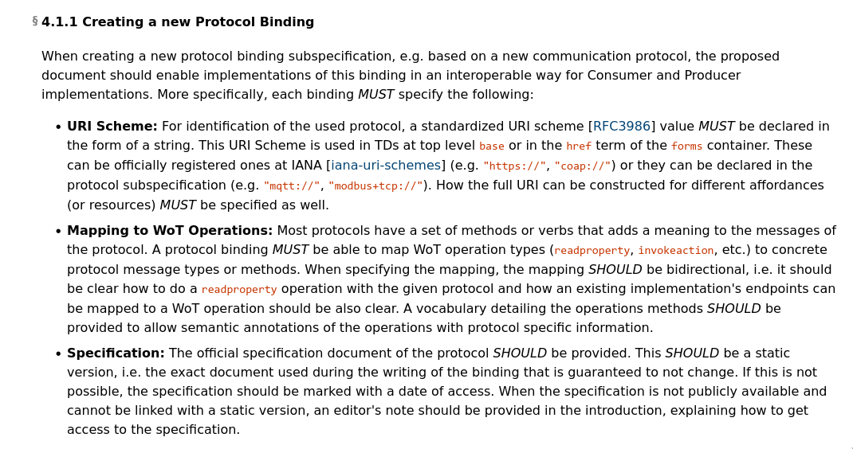
Submission Procedure

Slide 15
Submission Procedure
How to deal with further Binding submissions?
  https://github.com/w3c/wot-binding-templates/issues/124
  A registry like the DID WG has ?

