Slide 1
WoT Testing Framework
Overview of Current Tools and Future
Ege Korkan, Siemens AG
@egekorkan

Slide 2
Thing Description Playground

Slide 3
TD Playground
Notes from the group:
- Can be also called TD
Validator
Current version being only a validation tool, we need a real playground! Like JSON-LD Playground
We are including the following new features and are looking for new ideas :)
Github: https://github.com/thingweb/thingweb-playground
Online: http://plugfest.thingweb.io/playground/

Slide 4
New Features
Notes from the group:
- TDs should be in the
gists of the Thingweb
account
Live validation
Saving TD as a gist online:
  Could be saved in the user’s GitHub or W3C or Thingweb for documentation/statistics purposes → Opinions?
Filling the editor with an example TD
  What kind of TDs are annoying to understand and would be helpful for beginners?

Slide 5
New Features
Notes from the group:
- Locating the error is
very difficult at the
current version
Optional Assertion Testing on the front-end
  Implies some “heavy” data exchange
Importing TD from a URL or computer
Better error messages

Slide 6
Demo

Slide 7
Future Work
Notes from the group:
- Both are needed
Script based validation as an npm package?
A server to send TDs and get validation results?
Any pain points at the moment?

Slide 8
Behavior Testing: Exposed Things

Slide 9
Exposed Thing Testing
A tool to fuzz test all the interactions of the Thing
Available here
WoT Test Bench is being updated to generate the server side assertion results (.csv) on behavior
Assertion IDs:
server-data-schema, server-data-schema-extras, server-uri-template

Slide 10
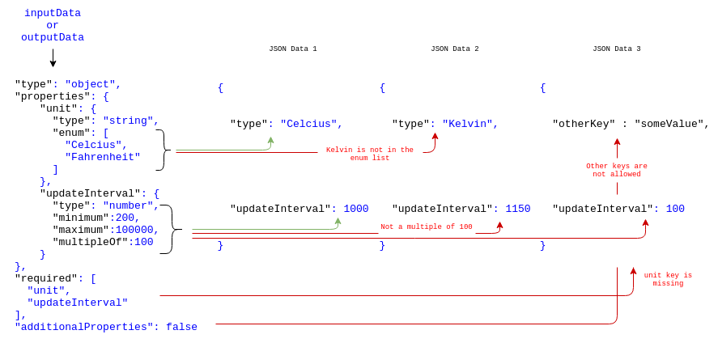
Exposed Thing Testing

Slide 11
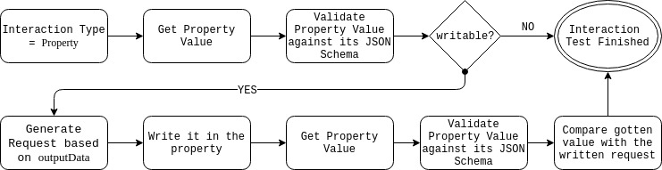
Exposed Thing Testing
Notes from the group:
- Note that testing
whether your write was
succesful is not an
assertion
Similar for Actions

Slide 12
Exposed Thing Testing
Server should describe accurately → One test is enough? How many?

Slide 13
Behavior Testing: Consumers

Slide 14
Deployment – Opinions!
How would you be able / like to to use it?
As an online server → Access to only online Exposed Things
Installing on your own machine → Installation overhead
Testing from the browser → Restriction to HTTP
Notes from the group:
- The 1st and 3rd can be combined so that when connection to the device is not possible, we
revert to HTTP only or ask to download and install the tool

Slide 15
Consumer Capability Testing
What about testing the consumer side?
Client-data-schema
  A Thing acting as a Consumer when interacting with another target Thing described in a WoT Thing Description MUST generate data organized according to the data schemas given in the corresponding interactions.
client-data-schema-accept-extras
  A Thing acting as a Consumer when interacting with another Thing MUST accept without error any additional data not described in the data schemas given in the Thing Description of the target Thing.
client-data-schema-no-extras
  A Thing acting as a Consumer when interacting with another Thing MUST NOT generate data not described in the data schemas given in the Thing Description of that Thing.
client-uri-template
  A Thing acting as a Consumer when interacting with another Thing MUST generate URIs according to the URI Templates, base URIs, and form href parameters given in the Thing Description of the target Thing.

Slide 16
Virtual Thing
Virtual Thing (on npm) to generate possible Things,
  Can be used to generate a report.
  Can be hosted online on Thingweb.
We need to identify important TDs that cover many features, as our test set that a client should pass.

Slide 17
Behavior Testing: Break Them!
Safety testing
  Sending invalid inputs to Exposed Thing
  Returning invalid data to Consumers
Security testing
  Penetration testing based on security information on the TD
  Invalid security information on Exposed Things

