Slide 1
LoRaWAN and AI Agents
MAHDA: Feel free to change the title. Not sure what Sebastian wrote
Mahda Noura, Ege Korkan (Siemens)
28 October 2026
W3C TPAC 2026

Slide 2
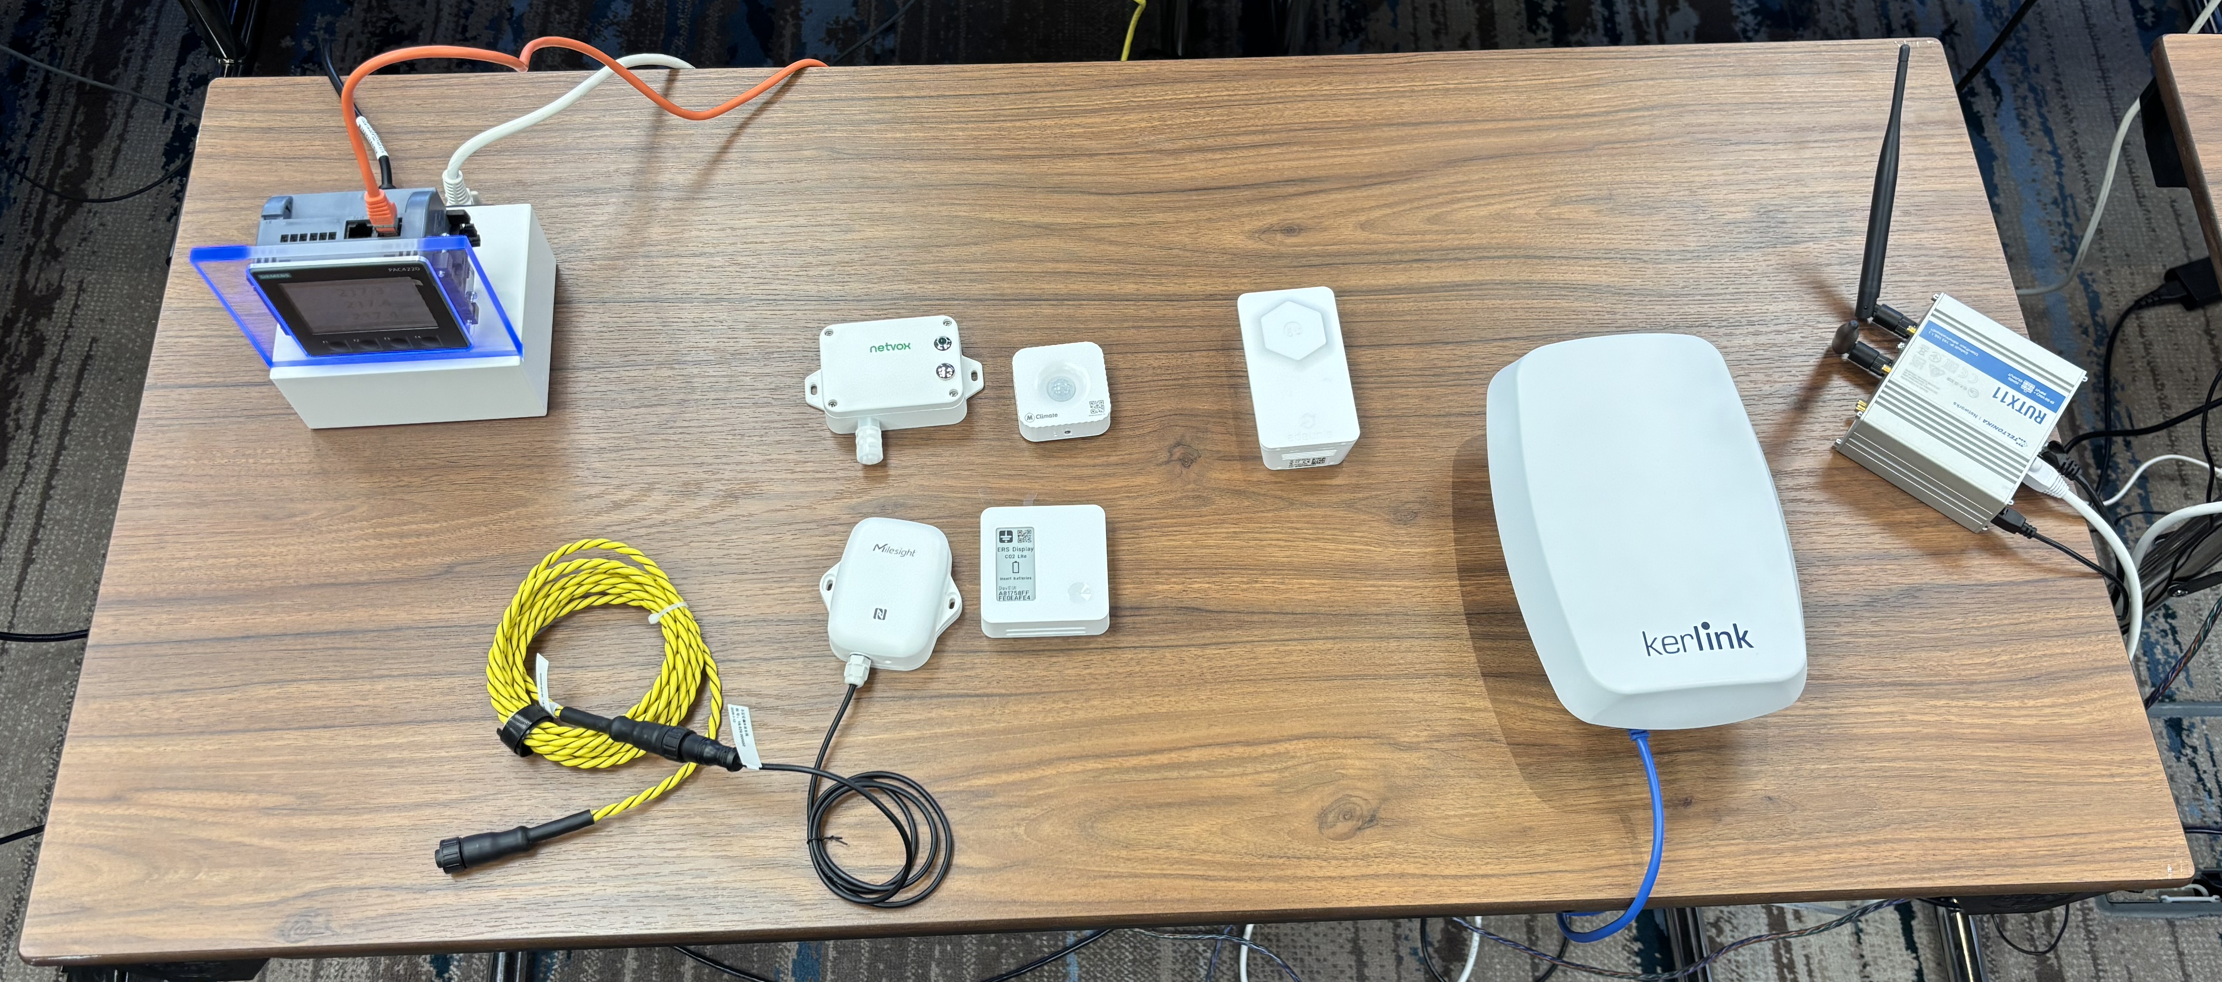
LoRaWAN Setup
LoRa Application Server
Zenoh Broker

Slide 3
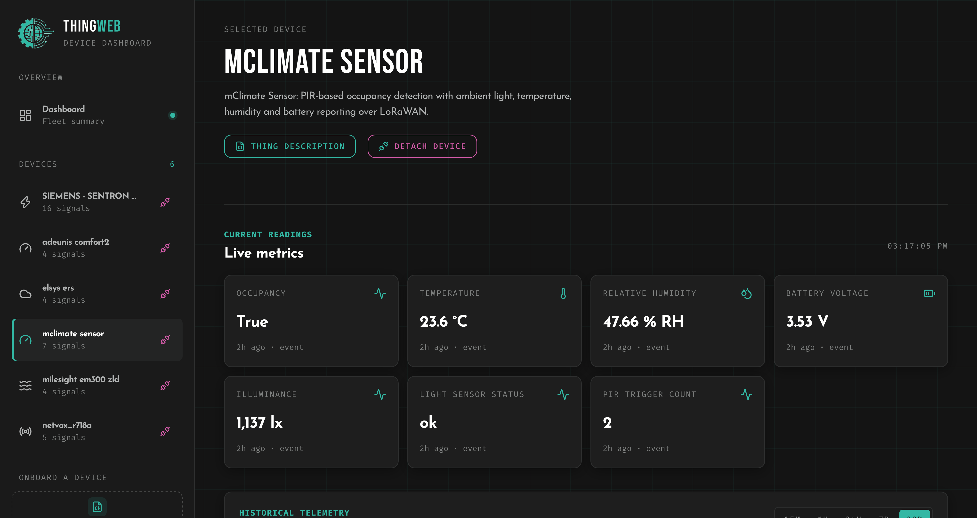
LoRaWAN Setup: One way to use it
Zenoh Broker

Slide 4
Another way to use it
AI Agent
Zenoh Broker
Modbus Device
Modbus Device
Modbus Device

