Slide 1
Registry Track
Ege Korkan
Siemens AG
WoT Charter Discussion - 18.01.2023

Slide 2
Goal of this Presentation
Summarize important points about registry track from W3C Process Document
With some interpretation indicated separately
Give outlook to the future of binding templates, and possibly profiles and introduction mechanisms for discovery

Slide 3
Definition from W3C Process Document
Working Groups can also publish registries in order to document collections of values or other data. These are typically published in a separate registry report, although they can also be directly embedded in Recommendation Track documents as a registry section. Defining a registry requires wide review and consensus, but once set up, changes to registry entries are lightweight and can even be done without a Working Group. See § 6.5 The Registry Track for details.

Slide 4
Meaning
We can continue as a normal Recommendation/Note
Include a Registry Section in the recommendation/note
Switch to a Registry Report

Slide 5
Overall Structure
A registry documents a data set consisting of one or more associated registry tables, each table representing an updatable collection of logically independent, consistently-structured registry entries.
Analogy: Looking at the binding templates document, the core document is the registry document which has 3 registry tables: protocols, payloads and platforms. Each table has multiple entries, e.g. protocols has HTTP, CoAP etc.

Slide 6
Overall Structure
A registry has three associated components:
the registry definition, defining how the registry tables are structured and maintained
Analogy: How to write a protocol in the binding templates
one or more registry tables, holding the data set represented by the registry (the registry data)
Analogy: 3 tables with list of bindings
one or more referencing specifications, which make use of the registry
Analogy: The individual bindings

Slide 7
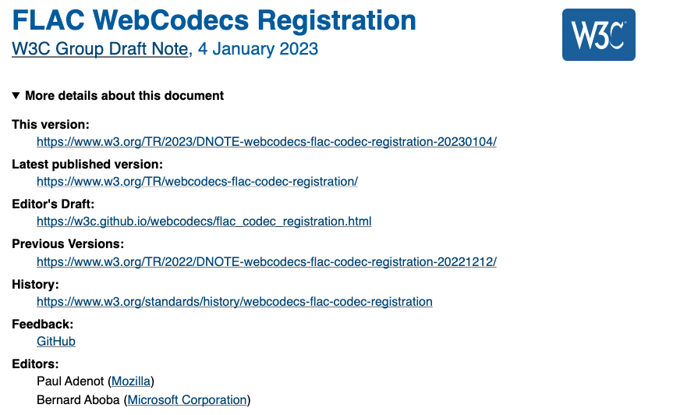
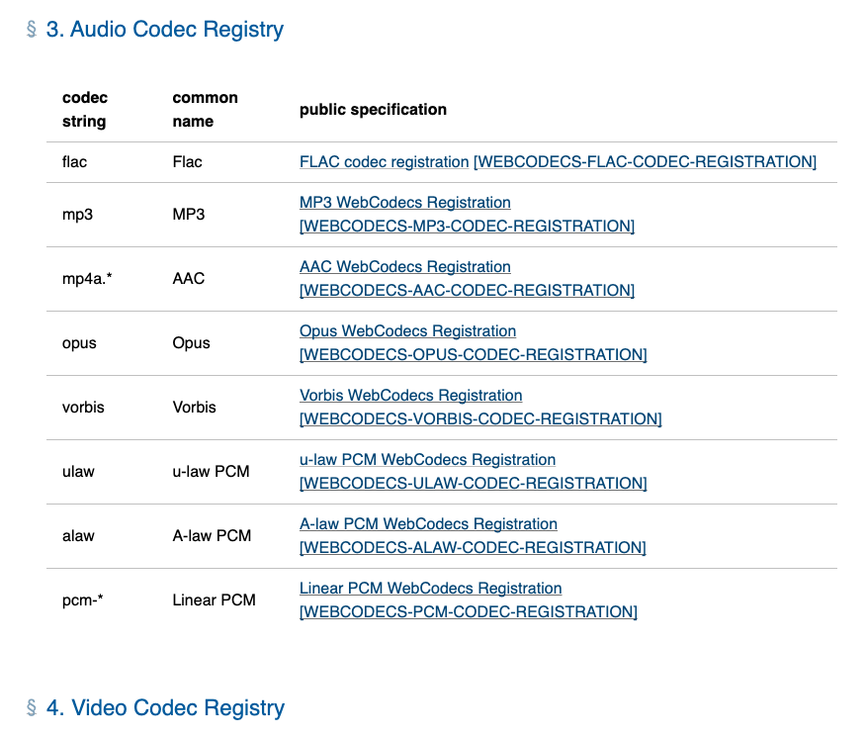
Example Registry Report
WebCodecs Codec Registry
There is also WebCodecs Recommendation

Slide 8
Questions?

Slide 9
Patent Policies
A registry report or registry section is purely documentational, is not subject to the W3C Patent Policy, and must not contain any requirements on implementations. For the purposes of the Patent Policy [PATENT-POLICY], any registry section in a Recommendation track document is not a normative portion of that specification.
Interpretation for Binding Templates: If the core document is a registry report, it cannot contain normative parts other than registry definition that applies for individual bindings.

Slide 10
Way Forward
Core Document: Going for a normal REC track would not allow updating the list of bindings as the time goes on. A new REC publication is necessary even if we publish (separately) just another protocol binding and want to reference it in the core document.
Each binding being published as a REC is not the issue, referencing them in the core document is.

Slide 11
Way Forward
Registry Tables are definitely needed. There are two ways to have them:
Binding Templates Core Document goes for REC with 3 registry sections
Binding Templates Core Document goes for Registry Track with 3 registry tables
I do not see a big difference between the two in our case. Updating purely informative text (e.g. what is a binding) needs to be clarified for the registry track.

Slide 12
Questions?

