Slide 1
W3C WoT – Plugfest TPAC 2025
Modbus Binding – Missing Term ReadFileRecord
  Updated the ontology, JSON Schema and JSON-LD context files
  https://github.com/w3c/wot-binding-templates/pull/445
  Main Finding: Inconsistencies in how we define some terms, in TD 2.0 we need to possibly consider this
WoT Specification Generator Toolchain
  Main finding: In the current toolchain, we need to provide all the cross-references to internal documents, external docs, glossary and bibliography with correct HTML tags and IDs.
  Implemented a new feature to enhance this mechanism by providing vocabulary lists and generating the cross-references.

Slide 2
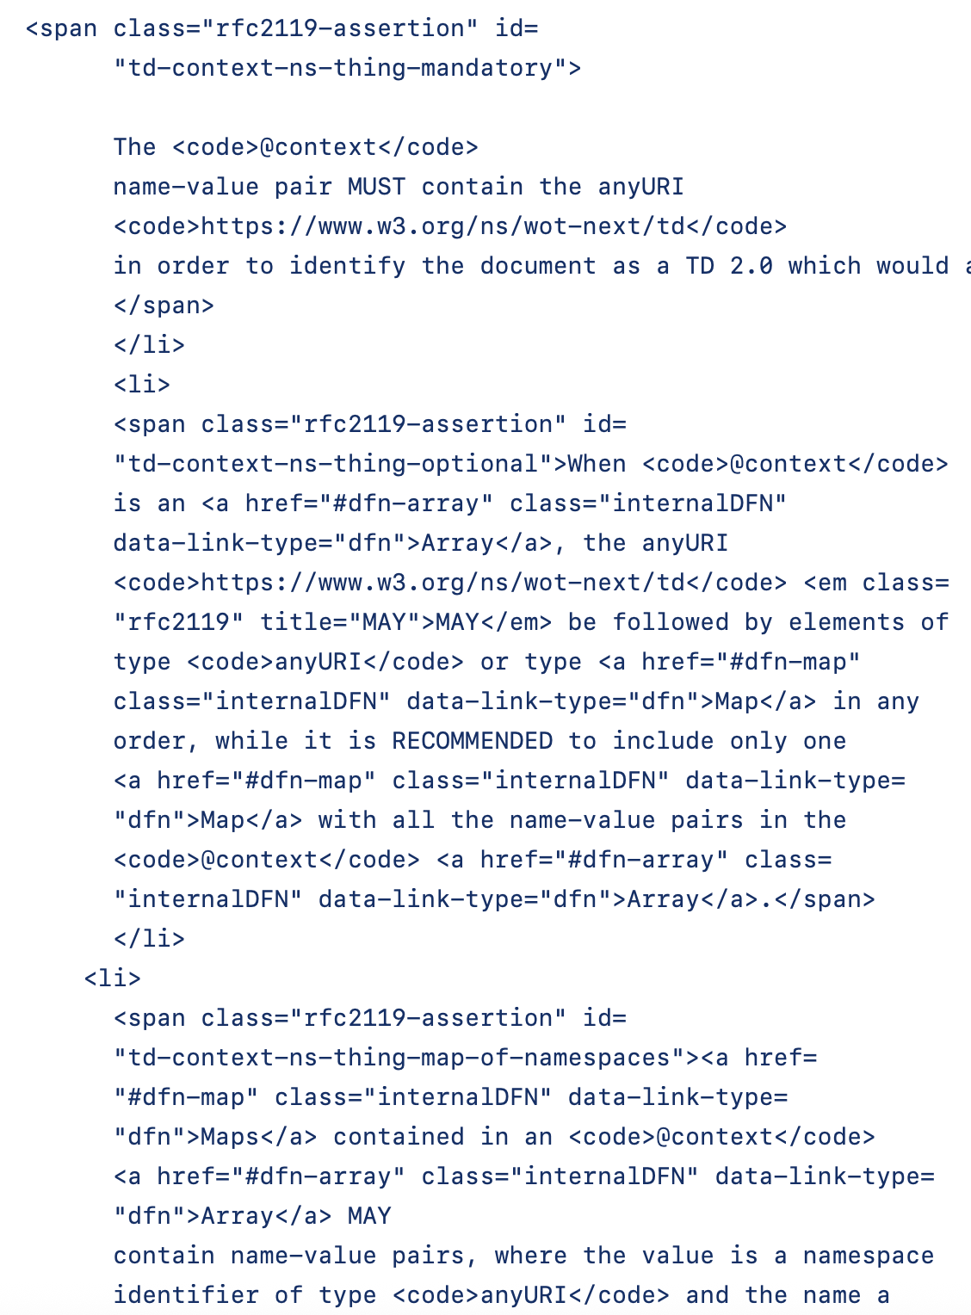
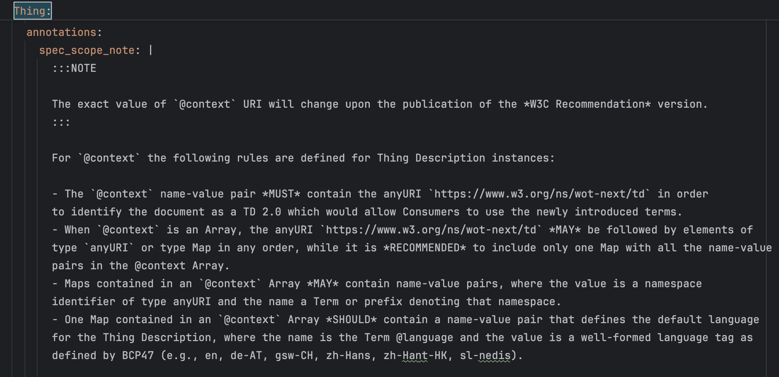
From HTML markup → markdown Automatic xref

