Slide 1
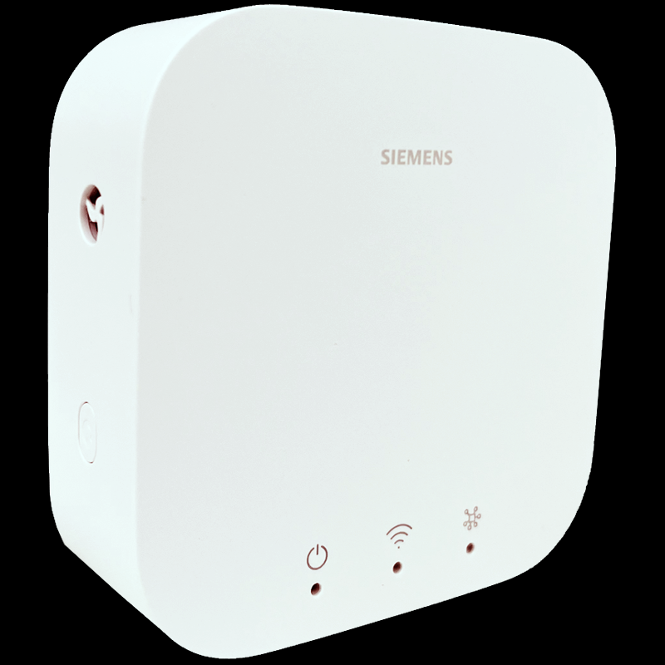
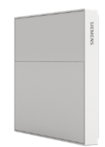

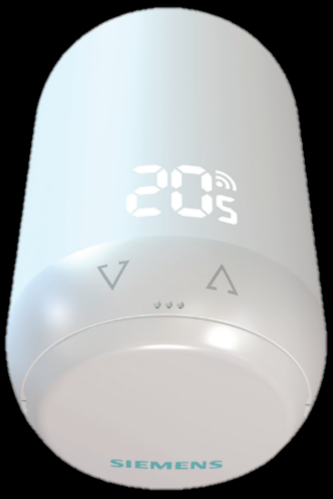
W3C WoT – Plugfest Nov 2024
Ethernet + IPv6
Thread-connected KNX IoT devices
Thread Border Router (Ethernet to Thread (wireless)
Room unit (user interface to choose setpoint etc.)
Sensors (room temperature, relative humidity, CO2)
Valve actuator (PID controller + motor controls)
Main findings
Sleepy devices: W3C WoT curently has no support
Periodic wake-up, announced via mDNS (via TBR)
Also common for Matter devices
Security Schemes: OSCORE and SPAKE2+
OSCORE scheme missing (any collaborators?)
Combinations with different security bootstrapping mechanisms
Discovery
mDNS over IPv6 requires a lot of configuration on host OS
IEEE 802.15.4
+ 6LoWPAN
+ Thread MLE
CoAP
(+ OSCORE
+ SPAKE2+)

