Slide 1

Marketing
TPAC Report and Discussion
Ege Korkan, Siemens AG, @egekorkan
Fady Salama, Siemens AG, @FadySalama21

Slide 2
Agenda
Chair Changes
Summary of the Work
WoT Communication Platform

Slide 3
Chair Change
Chair until September: Sebastian Käbisch
Chair between September and now: Fady Salama
Chair after TPAC: Ege Korkan
Chair for Testing after TPAC: Fady Salama

Slide 4

Summary of the Work
Explainer Video: https://www.youtube.com/watch?v=WMFXg-kni0U

Slide 5
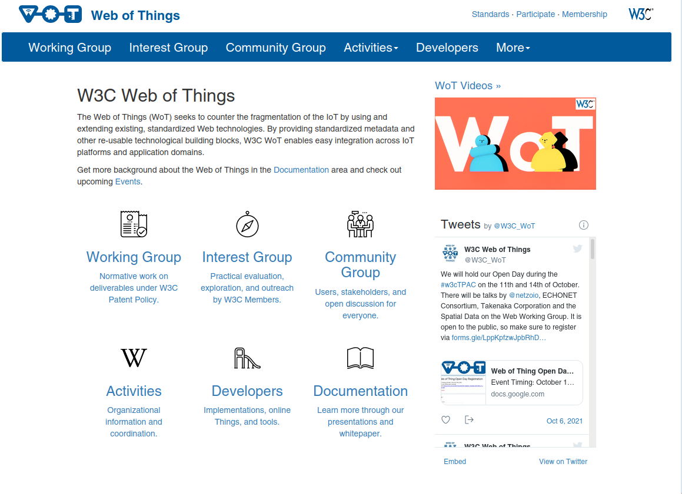
Summary of the Work
Continuous UI Improvements

Slide 6

Summary of the Work
A new WoT Logo Animation by @relu91: https://github.com/w3c/wot-marketing/tree/main/material/logo-animation

Slide 7
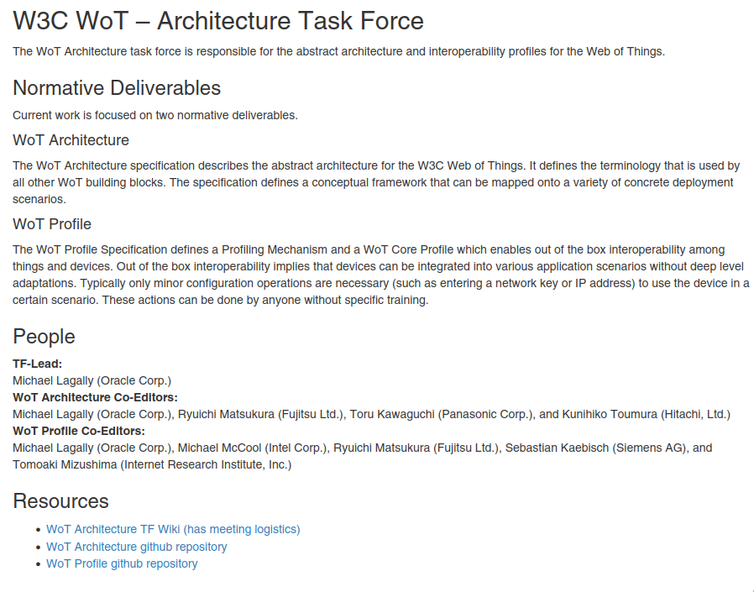
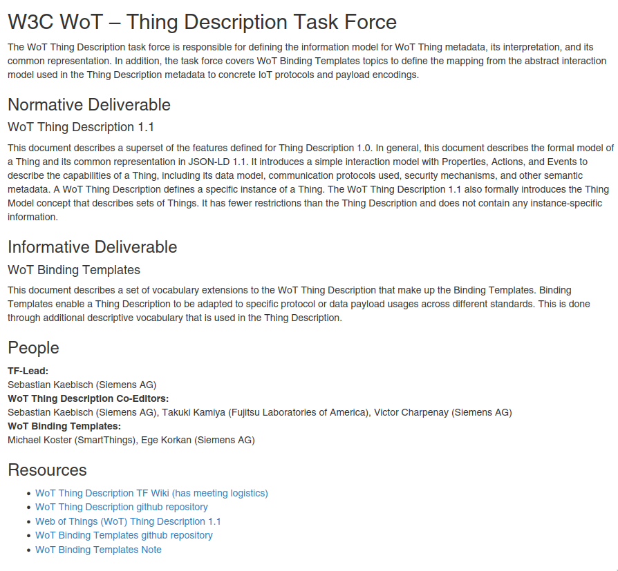
Summary of the Work
Task Force Descriptions: https://www.w3.org/WoT/activities/general/

Slide 8
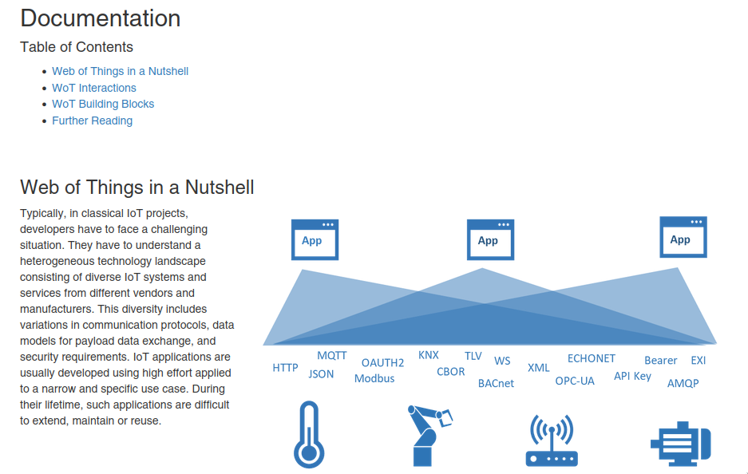
Summary of the Work
Documentation/Tutorial by @sebastiankb :
https://www.w3.org/WoT/documentation/

Slide 9
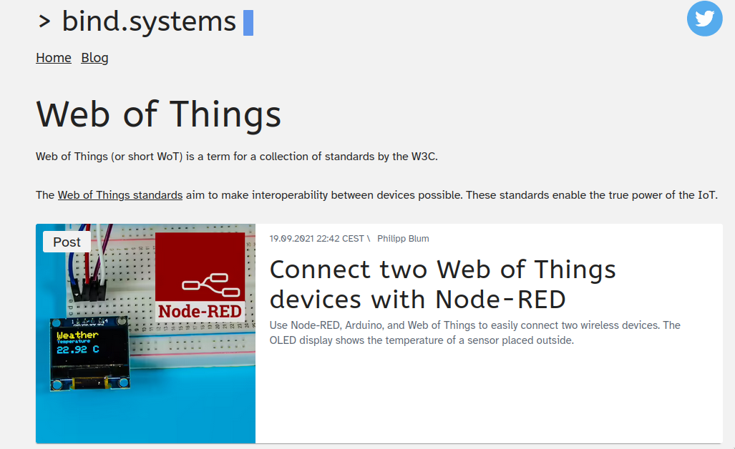
Summary of the Work
Tutorial:
  TUM/Siemens: Coming Soon
  Philipp Blum: https://bind.systems/tags/web-of-things/

Slide 10
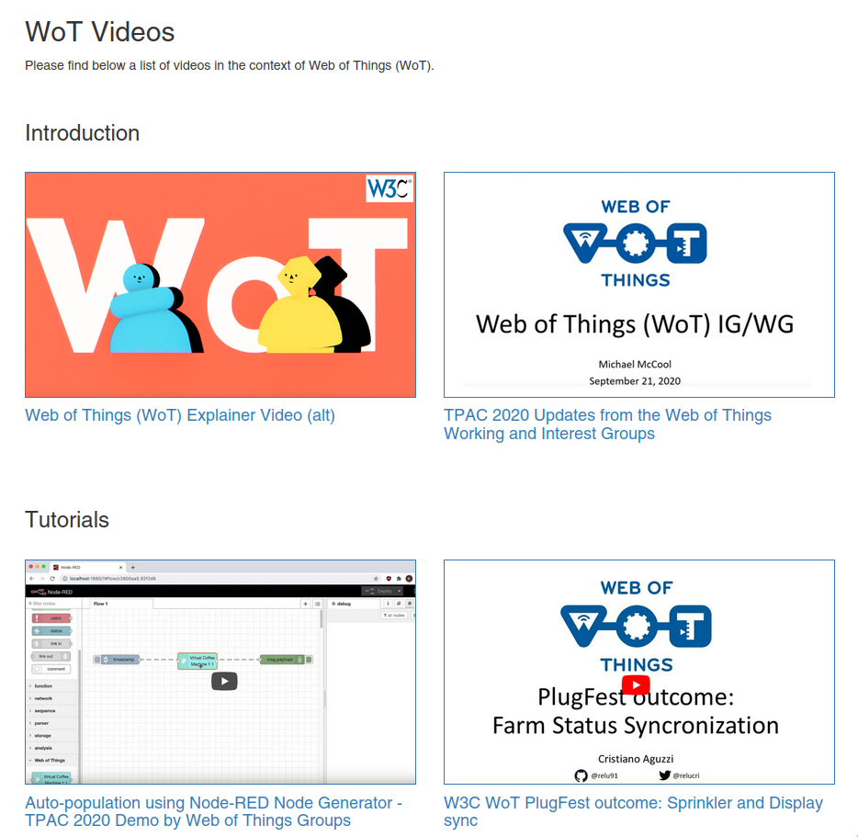
Summary of the Work
Putting WoT Videos together: https://www.w3.org/WoT/videos/

Slide 11
Communication Platforms with Interested Parties
https://github.com/w3c/wot-marketing/issues/146
Goal: We want non W3C members to have easier discussions with the WoT WG and IG
Why: Make WoT more approchable

Slide 12

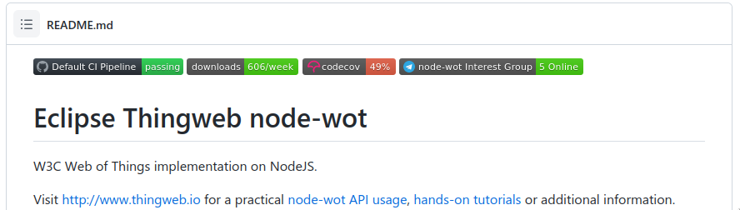
Communication Platforms with Interested Parties
Example from node-wot:
  Telegram

Slide 13

Communication Platforms with Interested Parties
Example from JSON Schema
  Slack (Invite Link)
  2546 members
  Daily ~ 5 questions

Slide 14
Possible Solutions
GitHub Issues:
  - Off-putting to some due to “offensive” nature of the issue word
  - Repository specific
GitHub Discussions:
  + More approachable than GitHub Issues
  - Repository specific

Slide 15
Possible Solutions
StackOverflow (our tag)
  + More approchable than GitHub Issues
  - We cannot moderate it
  - Recommendation-like questions and answers are not welcome, i.e. solution oriented

Slide 16
Possible Solutions
Chat-based Platforms
  WhatsApp, Telegram, Signal, etc.
    - Product
    - Single discussion thread, no channels
    - Requires mobile number
    - No need to join different space for each group
    + Most people have one

Slide 17
Possible Solutions
Chat-based Platforms
  Slack
    - Product
    - Smaller community focus → More for teams
    + We already have one
    - Limitation on the amount of saved messages

Slide 18
Possible Solutions
Chat-based Platforms
  Discord
    - Product
    + Community Oriented
    - Used to be more associated to gaming

Slide 19
Possible Solutions
Chat-based Platforms
  Matrix
    + Communication standard with your own clients (like IRC)
    - Less polished than Slack or Discord
    - Not well suited for video and audio calls

Slide 20
Communication Platforms with Interested Parties
Other ideas?
Discussion

