Slide 1
WoT Protocol Bindings
Protocol Vocabularies and Next Work Items
Ege Korkan, Siemens AG
@egekorkan

Slide 2
Protocol Vocabularies
Thanks to Victor Charpenay, initial vocabulary files for CoAP and MQTT are created. They are also used to render the HTML versions to generate more human-readable documentation.

Slide 3
Protocol Vocabularies
Turtle files at the GitHub repository
  https://github.com/w3c/wot-binding-templates/tree/master/ontology
Rendered HTML available online
  CoAP: https://w3c.github.io/wot-binding-templates/ontology/coap
  MQTT:
  https://w3c.github.io/wot-binding-templates/ontology/mqtt

Slide 4
Protocol Vocabularies
Some improvements are still needed but a very good starting point and workflow

Slide 5
Interest Check: Protocols
The first issue was created to collect the interest in protocols
→ We have worked on most of these, what is next?

Slide 6
Interest Check: Protocols
Identifying Next Protocols to Work: https://github.com/w3c/wot-binding-templates/issues/92

Slide 7
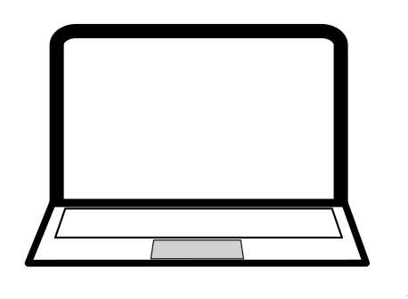


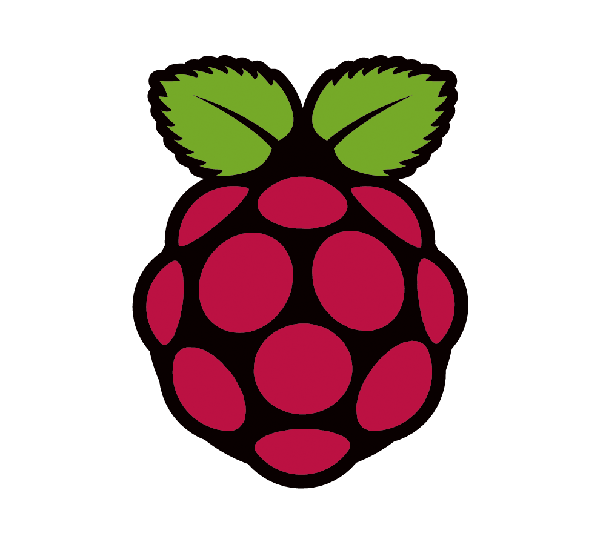
Interest Check: Protocols
Robotic Operating System (ROS)
USB
Ethernet
WiFi
...
Program with ROS libraries

Slide 8
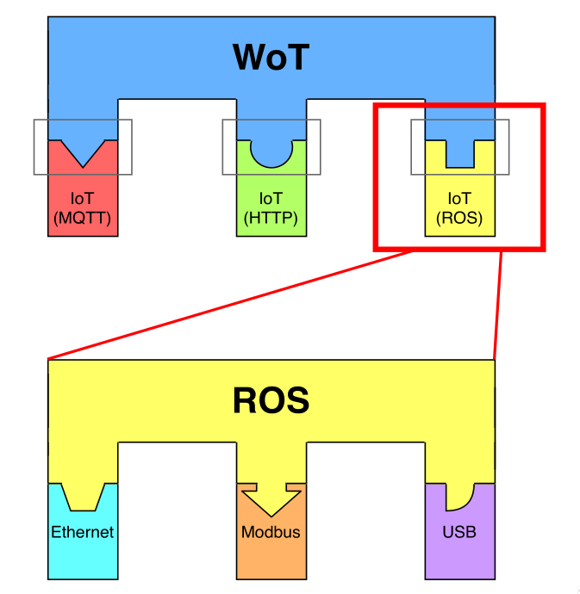
Interest Check: Protocols
ROS: Has similar goals to the WoT

Slide 9
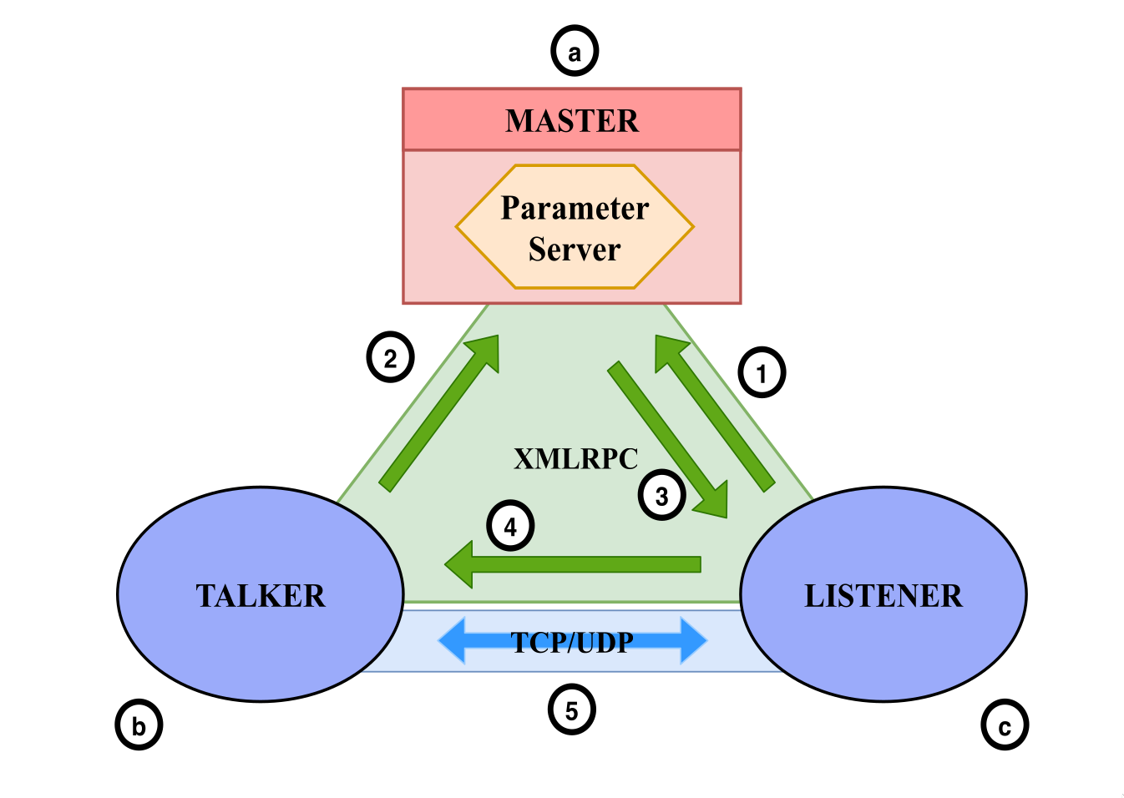
Interest Check: Protocols
ROS: Mixed broker and P2P communication

Slide 10
Interest Check: Protocols
ROS: Binding Proposal to the WoT almost ready, will be presented on 3rd of July

Slide 11
Interest Check: Protocols
What about subprotocols?
Server Sent Events
  Unidirectional eventing from the Server side
  Available (experimental) in node-wot
    https://github.com/eclipse/thingweb.node-wot/pull/247
  Used in OpenHAB (home automation)

Slide 12
Interest Check: Protocols
What about subprotocols?
MQTT over WS (x over WS)
  No Thing implementation required, can be done in the broker
  Experimental implementation from Motius (Benjamin Braun)
  Seems to be supported by reference MQTT implementations

Slide 13
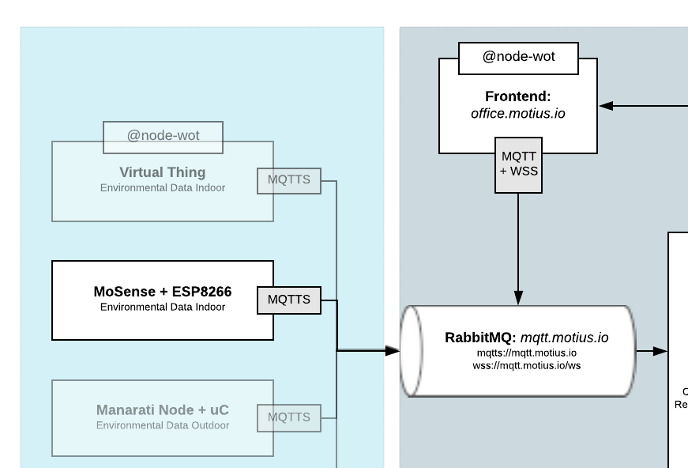

Slide 14
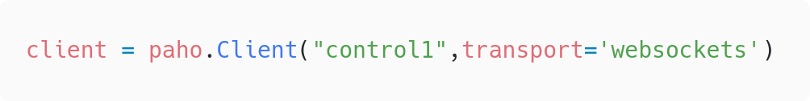
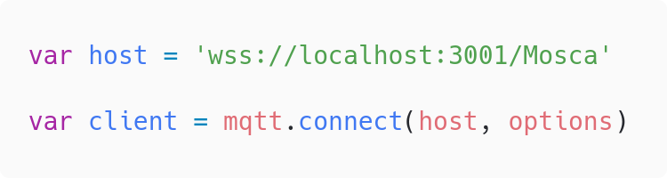
Paho in Python
MQTT.js in Node.js
Notes:
Identify common brokers and how they deal with this, also security

Slide 15
Next Work Items
Improving Protocol Vocabularies
Error Mapping as mentioned in Scripting API
ROS Binding
Given that node-wot has OPC-UA, NETCONF and Modbus, should they be in Binding Templates?
Notes:
OPCUA: Wait for the OPC group

Slide 16
Any other ideas or inputs?

