Slide 1
Web Thing REST API
TDfying and Differences
Ege Korkan, Siemens AG
@egekorkan

Slide 2
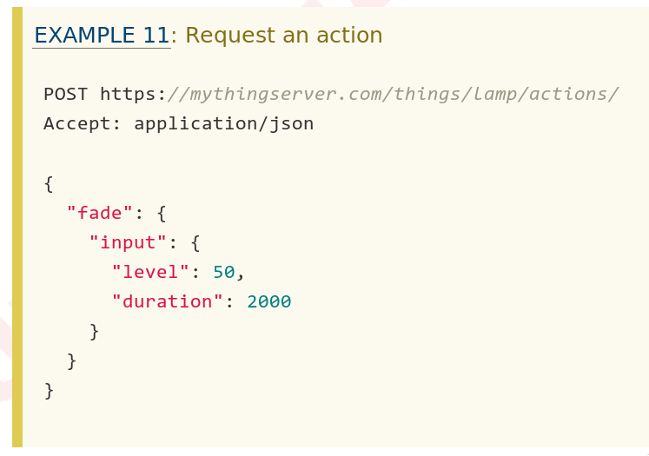
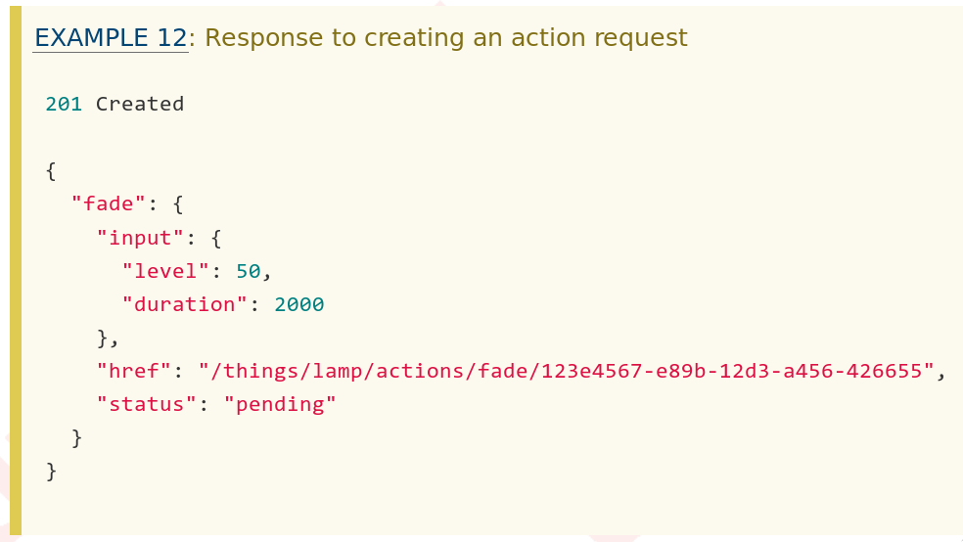
Web Thing REST API
Documentation of how the REST API works with example request and responses

Slide 3
Web Thing Description
{
"title": "Virtual Actions & Events Thing",
"@context": "https://iot.mozilla.org/schemas",
"href": "/things/virtual-things-10",
"actions": {
"basic": {
"title": "No Input",
"description": "An action with no inputs, fires an event",
"links": [{
"rel": "action",
"href": "/things/virtual-things-10/actions/basic"
}]
},
"single": {
"title": "Single Input",
"description": "An action with a single, non-object input",
"input": {
"type": "number"
},
"links": [{
"rel": "action",
"href": "/things/virtual-things-10/actions/single"
}]
},

Slide 4
Web Thing Description
"events": {
"virtualEvent": {
"description": "An event from a virtual thing",
"type": "number",
"links": [{
"rel": "event",
"href": "/things/virtual-things-10/events/virtualEvent"
}]
}
},
"links": [ {
"rel": "properties", "href": "/things/virtual-things-10/properties"
}, {
"rel": "actions", "href": "/things/virtual-things-10/actions"
}, {
"rel": "events", "href": "/things/virtual-things-10/events"
}, {
"rel": "alternate", "href": "ws://localhost:8080/things/virtual-things-10"
} ],
"id": "http://localhost:8080/things/virtual-things-10",
"base": "http://localhost:8080/",
"securityDefinitions": {...}
"security": "oauth2_sc"
}

Slide 5
Building the Requests
Web Thing Description is not enough on its own to build the requests.
It is required to read the Web Thing REST API Specification, similar to knowing the default values in the W3C TD.

Slide 6
Building the Requests
Example: Invoking (Requesting) an Action called basic with no Input
Request:
{
"basic":{
"input":null
}
}
Response:
{
“basic”:{
“input”:null,
“href”:”actions/fade/123”,
“status”:”created”
}
}
Example: Writing to a Property called on with bool input
Request:
{
“on”: true
}
Response:
{
“on”: true
}
Same for
property read
{
"fade": {
"input": {
"level": 50,
"duration": 2000
},
"href": "/things/lamp/actions/fade/123e4567-e89b-12d3-a456-426655",
"status": "pending"
}
}

Slide 7
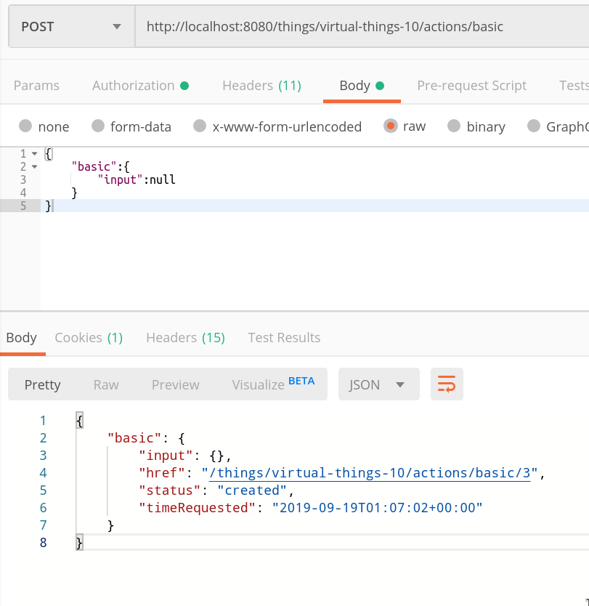
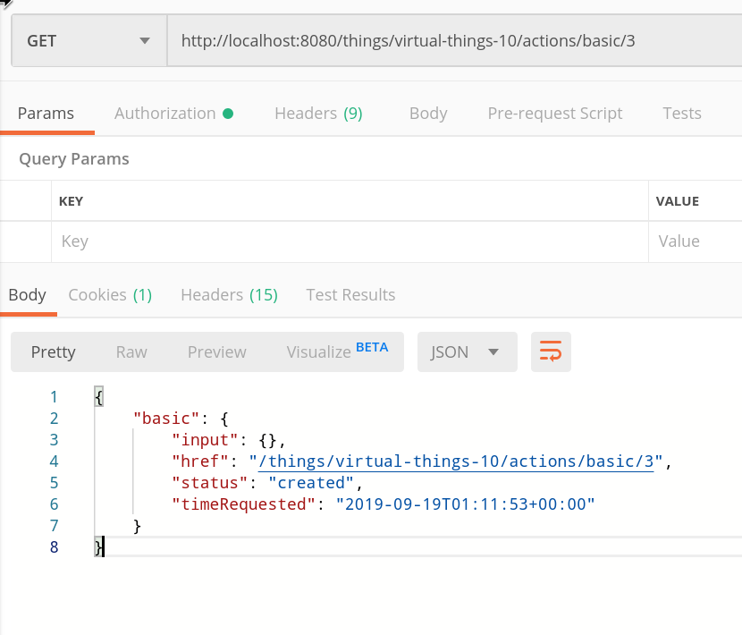
Screenshots from Postman
This href also accepts DELETE and PUT

Slide 8
Building the Requests
Thus the sent and received data are always wrapped in a certain object structure. This results in the WebThing TD type being valid only inside this object.
This is easy to fix and we can describe WebThing payloads in a W3C TD Payload. See the attached TD.

Slide 9
Queues
Event queues for:
Checking the past events
Also Events are only a queue in HTTP, so not asynchronous
Can be described with a W3C TD but not a clear semantic definition

Slide 10
Queues
Action queues for:
Monitoring actions’ runtime => Can be described with a W3C TD
Updating or canceling an action => Cannot be described with a W3C TD since the modifying an action requires the unique id that is assigned by the gateway when the action is invoked also we do not have an op value for these
  Old issue by Kajimoto-san

Slide 11
W3C TD Transformation
Most of the WebThing API can be described in a single TD which results in a very long TD.
Steps:
  Transform all the JSON Schemas into an object
  Add 2 Property Affordances, one for event and one for action queues
  Add a Property Affordance for each single event and action queue (not unique)
Check the supplied TDs for all the information

Slide 12
What We Need
We would need the following the be able to describe the Web Thing REST API in a W3C TD
  op values for updating and deleting actions
  A way to describe dynamic hrefs
    RFC6570 → http://example.com/things/mything/actions/myaction/{actionID}
  A way to pass “variables” between different positions of a TD
    Using something like JSON Pointers → actionID is #/actions/*/output/href

Slide 13
Summary of Findings
Describing simple capabilities of a Web Thing device is possible through W3C TD
Describing the full capabilities of the Web Thing Gateway needs more features in the TD or another protocol
WebThing API is purely about the gateway, client never accesses the end device

