Slide 1
R join_a=b S join_b=c T
R(a):
1000 tuples
Primary tree index
R.a uniform: 0-1000
S(b)
500 tuples
Primary heap file
Secondary hash index on b
S.b uniform: 0-50
T(c)
10000 tuples
Primary tree index
Secondary tree index
T.c uniform: 0-10
ICARD(T.c) = 10
R(a) index:
leaf/data pages: 1000(tuples) / 10 (tuples/page) = 100 pages
Each directory page can point to 100 child pages
100 data pages / 100 de/page = 1 parent page of leaves
Height = 1
Selectivity of a=?: 1/1000
R(a = ?): 1 directory page + 1 data page to read 1000*1/1000 tuples
S(b) secondary index:
Selectivity(b=?): 1/50
Cardinality(b=?): 500 / 50 = 10
S(b=?): 500 tuples/100 (de/page) = 5 / 50 buckets = pages/bucket = 1 data page + # tuples = 11 pages.
T(c) primary index:
Data pages = 1000
Height = 2
Selectivity of c=?: 1/10
T(c=?): 2 dir pages + (1000*1/10) = 102 pages.
T(c) secondary index:
Data pages = 10000 / 100 = 100
Height: 1
Cardinality of c=?: 10000 * selectivity = 1000
T(c=?): 1 + (100*1/10) data pages + (# tuples) = 1 + 10 + 1000 = 1011.
Tuples: 100bytes
Page: 1000 bytes
DE: 10 bytes
Fill factor: 100%
Tuples/page: 10
DE/page: 100

Slide 2
R join_a=b S join_b=c T
R(a):
1000 tuples; 100 pgs
Primary tree index
R.a uniform: 0-1000
S(b)
500 tuples: 50 pgs
Primary heap file
Secondary hash index on b
S.b uniform: 0-50
1 bucket per S.b value
T(c)
10000 tuples: 1000 pgs
Primary tree index
Secondary tree index
T.c uniform: 0-10
ICARD(T.c) = 10
Cost copied from previous slide
R(a) index:
R(a = ?): 2
S(b) secondary index:
S(b=?): 11 pages.
T(c) primary index:
T(c=?): 2 dir pages + (1000*1/10) = 102 pages
T(c) secondary index:
T(c=?): 1 + (100*1/10) data pages + (# tuples) = 1 + 10 + 1000 = 1011.
Bestjoin(R join S):
R join S.
R NL S: 100 + 100* 50 = 5100 pages
R INL S: 100 + 1000 * 11 = 11100 pages
R HJ S: 50 + 100 + 1000 * (10) = 10000 + 150 = 10150
S join R
S NL R: 50 + 50 * 100 = 5050
S INL R: 50 + 500 * 2 = 1000 + 50 = 1050
S HJ R: 100 + 50 + 500 * 1 = 650
Bestjoin(S, T)
Bestjoin(R, T)
Bestjoin(Bestjoin(R, S), T)
Bestjoin(Bestjoin(S, T), R)
Bestjoin(Bestjoin(R, T), S)
Tuples: 100bytes
Page: 1000 bytes
DE: 10 bytes
Fill factor: 100%
Tuples/page: 10
DE/page: 100

Slide 3
R join_a=b S join_b=c T
R(a):
1000 tuples; 100 pgs
Primary tree index
R.a uniform: 0-1000
S(b)
500 tuples: 50 pgs
Primary heap file
Secondary hash index on b
S.b uniform: 0-50
1 bucket per S.b value
T(c)
10000 tuples: 1000 pgs
Primary tree index
Secondary tree index
T.c uniform: 0-10
ICARD(T.c) = 10
Cost copied from previous slide
R(a) index:
R(a = ?): 2
S(b) secondary index:
S(b=?): 11 pages.
T(c) primary index:
T(c=?): 2 dir pages + (1000*1/10) = 102 pages
T(c) secondary index:
T(c=?): 1 + (100*1/10) data pages + (# tuples) = 1 + 10 + 1000 = 1011.
Bestjoin(R join S):
S HJ R: 100 + 50 + 500 * 1 = 650
Cardinality of R join S?
* 1000 * 500 * (1/max(1000,50)) = 500 tuples = 50 pages
Bestjoin(Bestjoin(R, S), T):
SQ NL T: 650 + 50 * 1000 = 50000 + 650 = 50650
SQ INL T: 650 + 500 * 102 = 51000 + 650 = 51650
SQ HJ T: 1000 + 650 + 500 * 1000 = 500000 + 1650 = 501650
Tuples: 100bytes
Page: 1000 bytes
DE: 10 bytes
Fill factor: 100%
Tuples/page: 10
DE/page: 100

Slide 4
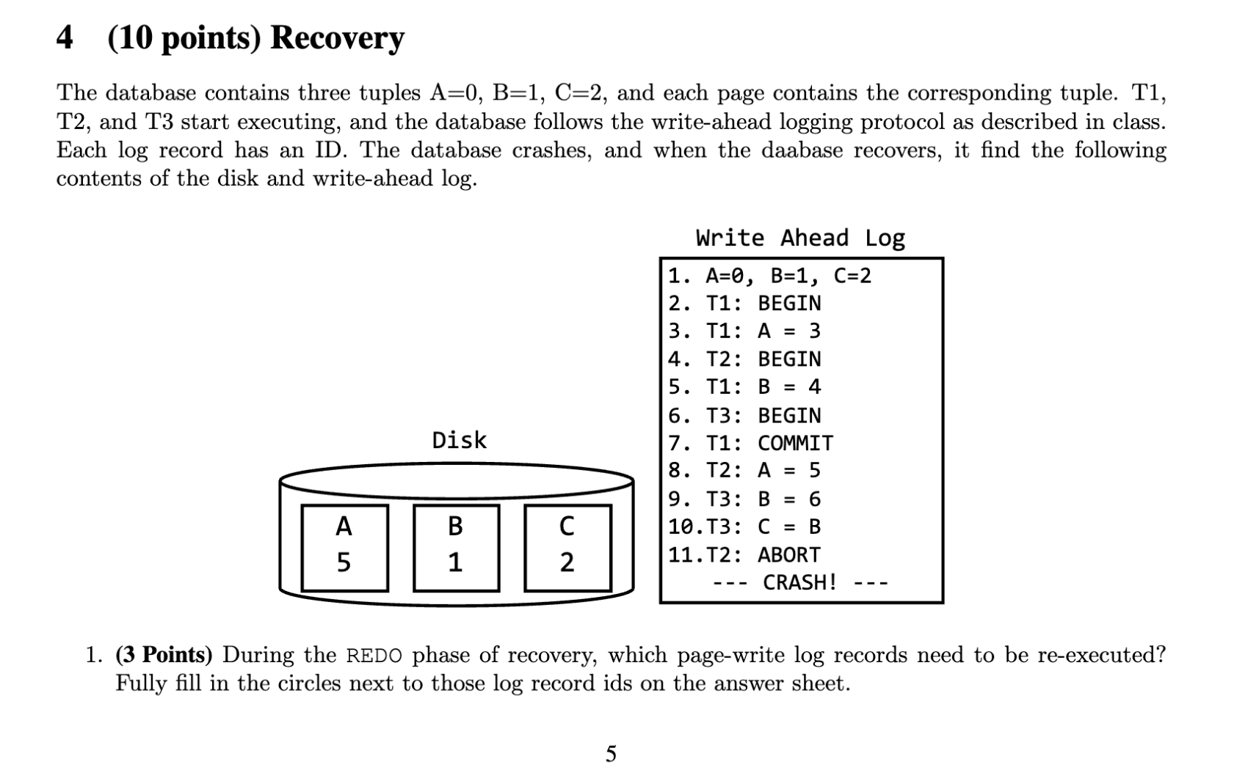

Analysis:
T1: committed
T2: abort
T3: abort
Which log records are reflected on the data pages on disk? And which need to be redone?
3: no redo
5: redo
8: no redo
9: redo
10: redo
Redo: 5, 9, 10
Undo: 10, 9, 8

Slide 5
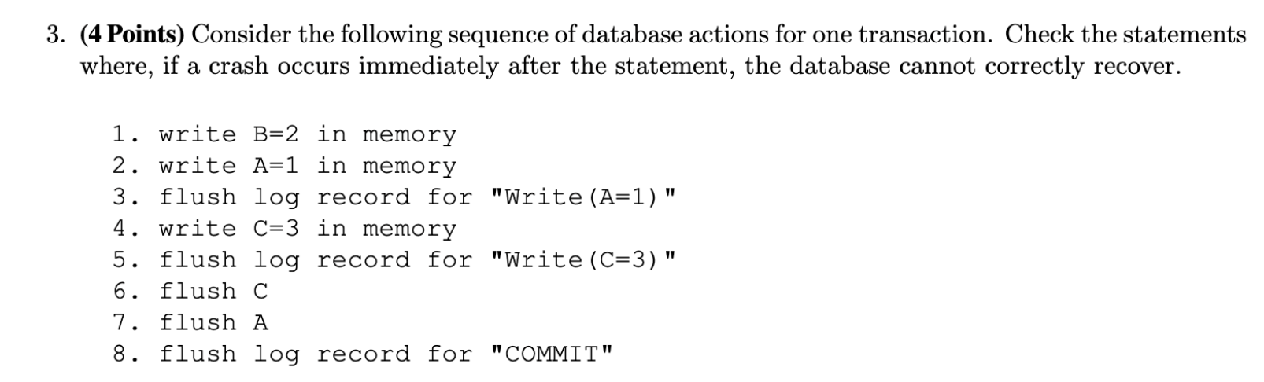
1 ok
2 ok
3 ok
4 ok
5 ok
6 ok
7 ok
8. no
unsafe

