Slide 1
CUDA
Parallel programming on pixels
Pangfeng Liu, Parallel Programming 2009, National Taiwan University

Slide 2
Disclaimer
All pictures in this PowerPoint file are taken from the slides by professor Wen-Mei W. Hwu, distributed by NVidia.
Pangfeng Liu, Advanced Computer Programming 2004, National Taiwan University

Slide 3
GPU
Graphical Processing Unit
Used to display 3D graphics on your PC
Consists of very a very large number of transistors.
Highly parallel computation
Cost-effective
  The only part that you might consider updating in your PC.
Pangfeng Liu, Advanced Computer Programming 2004, National Taiwan University

Slide 4
CPU vs. GPU
Less data cache and flow control
More Computation
Control
ALU
ALU
ALU
ALU
CPU
GPU
Cache
DRAM
DRAM
Pangfeng Liu, Advanced Computer Programming 2004, National Taiwan University

Slide 5
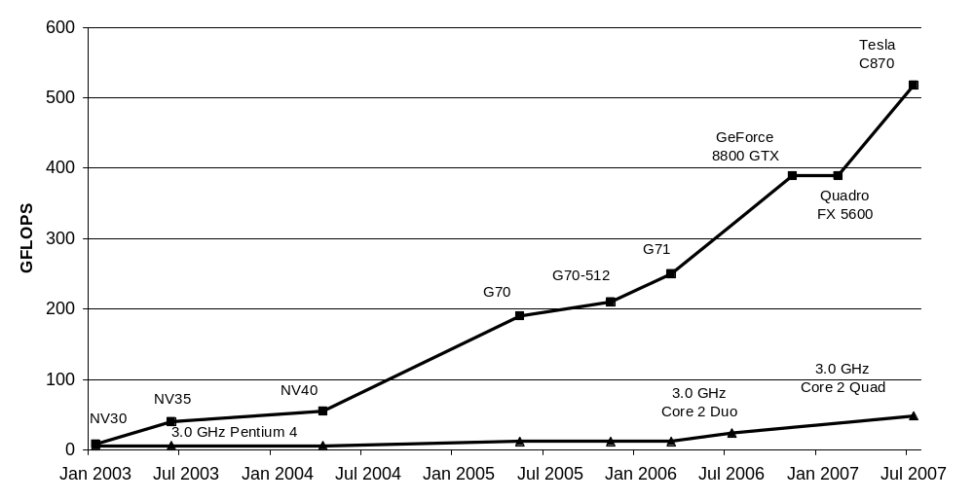
Performance in Gflops
Pangfeng Liu, Advanced Computer Programming 2004, National Taiwan University

Slide 6
GPGPU
General Purpose computation using GPU -- not only for pixels.
Pangfeng Liu, Advanced Computer Programming 2004, National Taiwan University

Slide 7
Advantages
Large data arrays, streaming throughput
Very large memory bandwidth
Fine-grain SIMD parallelism
  A very large number of threads
Low-latency floating point (FP) computation
  High power computation capability
Piggyback on the fast advancing GPU technology
Pangfeng Liu, Advanced Computer Programming 2004, National Taiwan University

Slide 8
GPGPU Applications
Tons of application on GPGPU.org and Nvidia websites.
http://www.nvidia.com/object/cuda_home.html#
  Game effects (FX) physics
  image processing
  Physical modeling
  computational engineering
  matrix algebra
  Convolution
  correlation, sorting
Pangfeng Liu, Advanced Computer Programming 2004, National Taiwan University

Slide 9
Implication
Suitable for data-parallel processing
  The same computation is performed on many data elements in parallel
  Low control flow overhead
  high floating point arithmetic intensity
Computation intensive threads on large number of data hide large memory latency for each
  No need for large data cache
Pangfeng Liu, Advanced Computer Programming 2004, National Taiwan University

Slide 10
Why not before?
Graphics API only
Addressing modes is limited by texture size/dimension
Limited outputs due to shader capabilities
No instruction on integer and bits
No interaction between pixels
Pangfeng Liu, Advanced Computer Programming 2004, National Taiwan University

Slide 11
CUDA in a Long Sentence
Compute Unified Device Architecture
A general purpose parallel computing architecture that leverages the parallel compute engine in NVIDIA graphics processing units (GPUs) to solve many complex computational problems in a fraction of the time required on a CPU.
Pangfeng Liu, Advanced Computer Programming 2004, National Taiwan University

Slide 12
CUDA in a Short Sentence
Integrates CPU+GPU application C program by running serial parts on CPU and highly parallel parts on GPU.
Pangfeng Liu, Advanced Computer Programming 2004, National Taiwan University

Slide 13
CUDA in You PC
Can run on your PC with NVIDIA display card.
  NVIDIA CUDA-enabled products
  http://www.nvidia.com/object/cuda_learn_products.html
CUDA download
  http://www.nvidia.com/object/cuda_get.html
Pangfeng Liu, Advanced Computer Programming 2004, National Taiwan University

Slide 14
An Illustration
CPU Serial Code
Grid 0
GPU Parallel Kernel
KernelA<<< nBlk, nTid >>>(args);
. . .
CPU Serial Code
Grid 1
GPU Parallel Kernel
KernelB<<< nBlk, nTid >>>(args);
. . .
Pangfeng Liu, Advanced Computer Programming 2004, National Taiwan University

Slide 15
Terminology
Host
  CPU
Device
  GPU
Kernel
  Computation intensive C functions running on devices as threads.
Grid
  The view of cores within a device
Block
  A basic unit in a device
Pangfeng Liu, Advanced Computer Programming 2004, National Taiwan University

Slide 16
The Programming Model
The host runs the sequential part of the application.
The parallel data intensive parts are written as kernel functions, and sent to devices for execution (as threads).
The blocks are the unit for computation and they are organized as a grid.
Pangfeng Liu, Advanced Computer Programming 2004, National Taiwan University

Slide 17
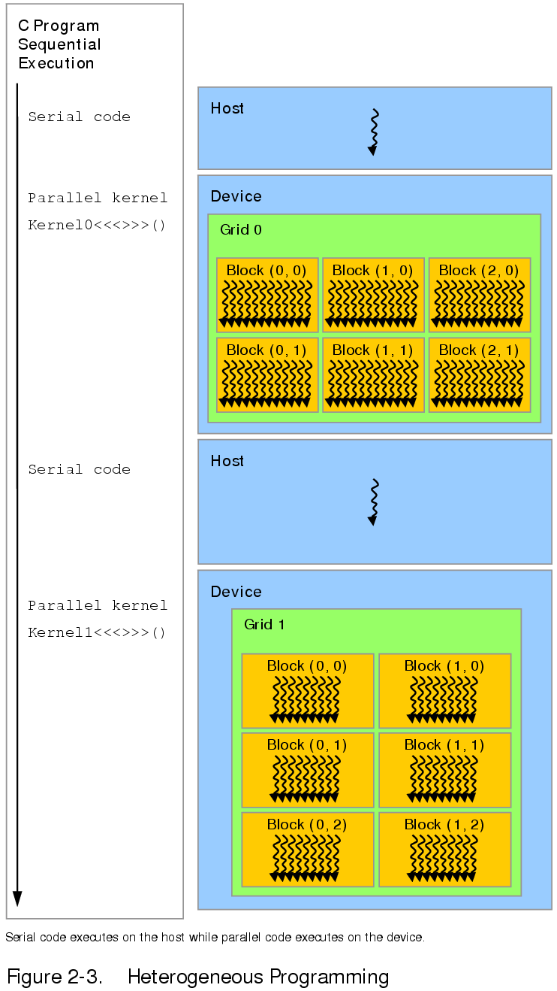
Pangfeng Liu, Advanced Computer Programming 2004, National Taiwan University

Slide 18
GPU and CPU Thread
GPU threads are very lightweight and have very little creation overhead, but CPU thread creation overhead is very high.
The implication is that GPU can use a huge number of threads to achieve high performance, but CPU can only use a relatively small number of threads.
Pangfeng Liu, Advanced Computer Programming 2004, National Taiwan University

Slide 19
Thread id
Each thread has an id so that it will be able to determine which part of data it is supposed to handle.
  The thread id is stored in a variable threadIdx
  The contents of threadIdx depends on the dimensionality of the grid.
Pangfeng Liu, Advanced Computer Programming 2004, National Taiwan University

Slide 20
Thread Blocks
A block is an N-dimensional array of threads.
  N could be 1, 2, or 3.
The coordinates of a thread within a block are stored within the variable threadId as a vector of three elements, as x, y, and z.
When the host calls the kernel function to run on the devices, it can specify the thread block layout between the name of the kernel function and the parameter list.
  initialize <<<1, 5>>> (int_array);
Pangfeng Liu, Advanced Computer Programming 2004, National Taiwan University

Slide 21
The ThreadIdx
The kernel function can retrieve the thread index by referenceing threadIdx variable.
  Int_array[threadIdx.x] = threadIdx.x;
  Note that this is for a one-dimensional layout, so we use the x element only.
Pangfeng Liu, Advanced Computer Programming 2004, National Taiwan University

Slide 22
Global Memory
The host and devices can share memory.
This special global memory must be allocated using special allocation routine. Note that the prototypes of cudaMalloc is different from malloc.
  cudaMalloc(&pointer, size);
    The first argument is the address of the pointer.
  cudaFree(pointer);
Pangfeng Liu, Advanced Computer Programming 2004, National Taiwan University

Slide 23
Host Memory
The host can allocate and free its own memory using malloc and free.
Pangfeng Liu, Advanced Computer Programming 2004, National Taiwan University

Slide 24
CUDA Computation
The host allocates and initializes it memory.
The host allocates the global memory.
The host copies the host memory into global memory.
The hosts calls kernel function to performs computation on the global memory.
The host copies the global memory back to the host memory.
The host outputs the results.
Pangfeng Liu, Advanced Computer Programming 2004, National Taiwan University

Slide 25
Memory Transfer
Host to device
  cudaMemcpy(device_memory, host_memory, cudaMemcpyHostToDevice);
Device to host
  cudaMemcpy(host_memory, device_memory, size, cudaMemcpyDeviceToHost);
Note that it is always from the second argument to the first argument.
Pangfeng Liu, Advanced Computer Programming 2004, National Taiwan University

