Slide 1
Developing An Attention Detection System
2019-01-21
Yijhen Chen

Slide 2
Attentional Lapses in Daily Scenarios
Retrospective memory failures (Freeman & Gelernter, 2007; Karger, 2007)
Task resumption failure (context restore): it is significantly more difficult to switch to tasks that require ‘returning to’ after an interruption (Czerwinski et al., 2004:178-9)
Habituation errors Automacity refers to an effect that once an action learned, it could perform without conscious awareness, regardless right or wrong (Raskin, 2000).
Notes:
It suggests that the uninformative peripheral
cues cause less automatic shifts of attention for the high-MW group

Slide 3
Attentional Shift & Affective States
Higher frequencies of oﬀ task thinking, has been associated with:
(i) positive and negative mood induction procedures (Seibert & Ellis, 1991) (ii) dysphoria in variety of undergraduate samples (Smallwood et al., 2004; see also Lyubomirsky, Krasri, & Zehm, 2003).
→ Attentional states are somehow observable through affective states.
However, compared with many relatively mature emotion recognition systems, it is still challenging to identify attentional states only by observing facial expressions: agreement between external observers and self-reports also is very low (D’Mello et al., 2008; D’Mello, Dowell, & Graesser, 2013; Graesser et al., 2006) and training increases only agreement between observers but not between the self and observer (D’Mello, 2016).

Slide 4
Objective
Developing an affective feature criterion that can be used to identify individual’s current attentional state.
This system should have the following characteristics :
Sensitivity (for both users and the environment)
Generalizability (to different individuals)
Workflow:
Find the behavioral indexes that are sensitive to attentional dynamics.
Develop an algorithm which is able to extract the most critical affective components (with computer vision) that closely related to these behavioral indexes.
Examine the generalizability by applying the algorithm to different subjects & under different environments.
Notes:
https://www.sciencedirect.com/science/article/pii/S1053810007000323

Slide 5
Sustained to Response Task
Sustained attention : the ability to self-sustain mindful, conscious processing of stimuli whose non repetitive, non-arousing qualities would otherwise lead to habituation and distraction to other stimuli (Robertson et al., 1997)
The pattern of response time performed in SART was able to distinguish between normal and brain injured patients (Robertson et al., 1997).
Lowered the frequency of the task-irrelevant stimuli, was observed to associate with high levels of TUT (Barron, 2011)
Momentary lapses of attention and reengaging in task set after the detection of errors (Jackson & Balota, 2011; Robertson et al., 1997; Smallwood et al., 2004). This pattern of speeding and slowing would increase the variability of RT (Johnson et al., 2007)
Notes:
It suggests that the uninformative peripheral cues cause less automatic shifts of attention for the high-MW group

Slide 6
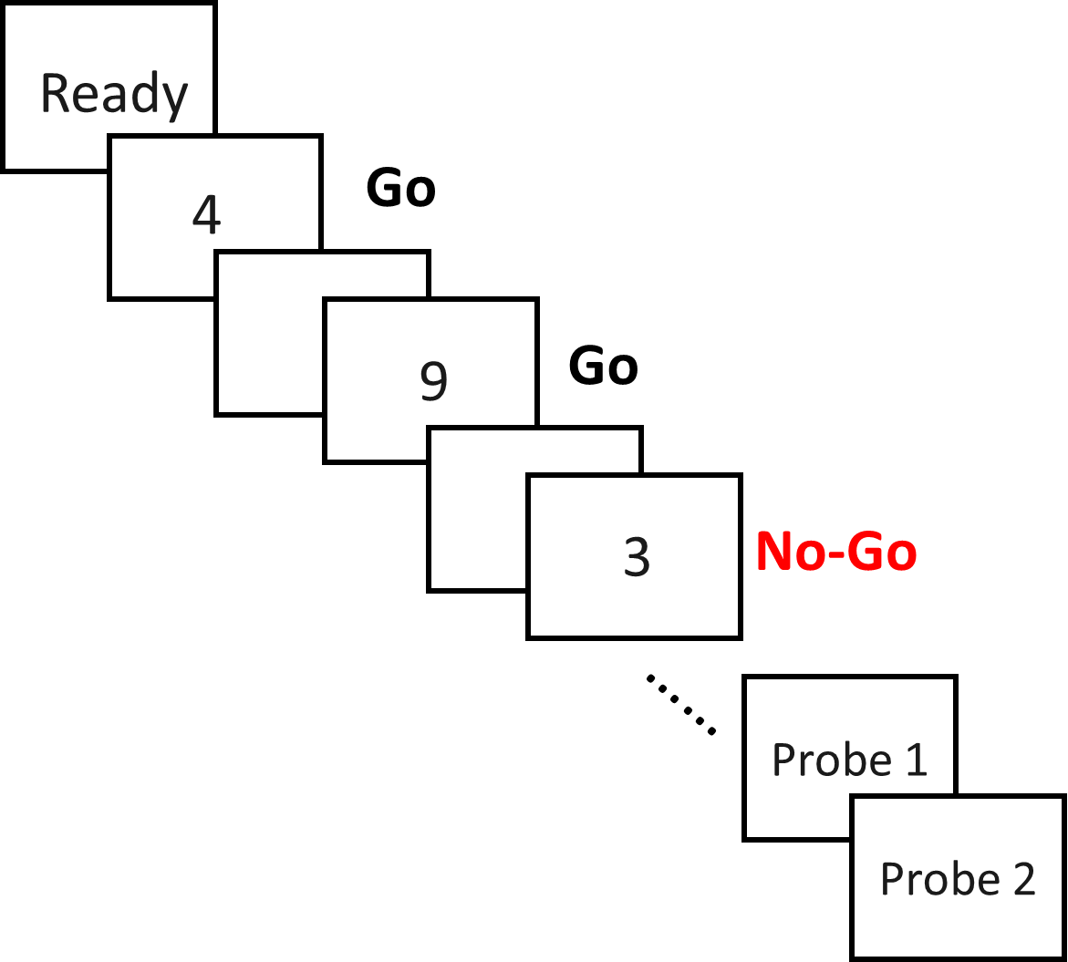
The modified version of SART
20 trials
x
40 runs
nonTarget
500ms
20 runs, Low: p (Target) = 0.1
20 runs, High: p (Target) = 0.5 across subjects counterbalancing
nonTarget
ISI 2000ms
Target
The probe will present while:
Error of Commission (Target error )
Omission (non target error) > 50%

Slide 7
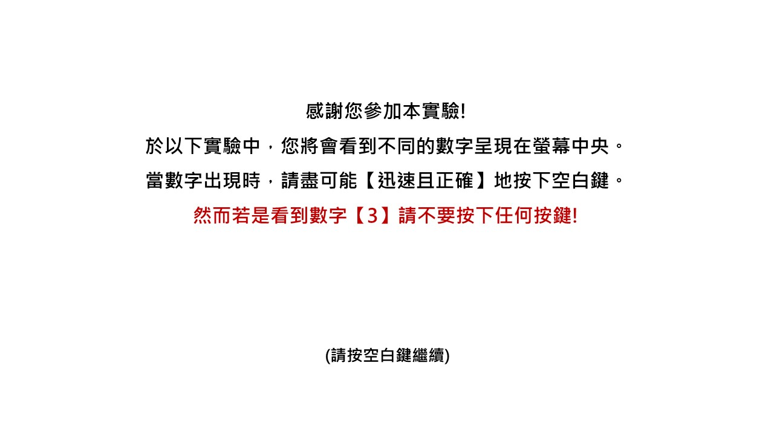

Slide 8
2

Slide 9
7

Slide 10
9

Slide 11
3

Slide 12
2

Slide 13
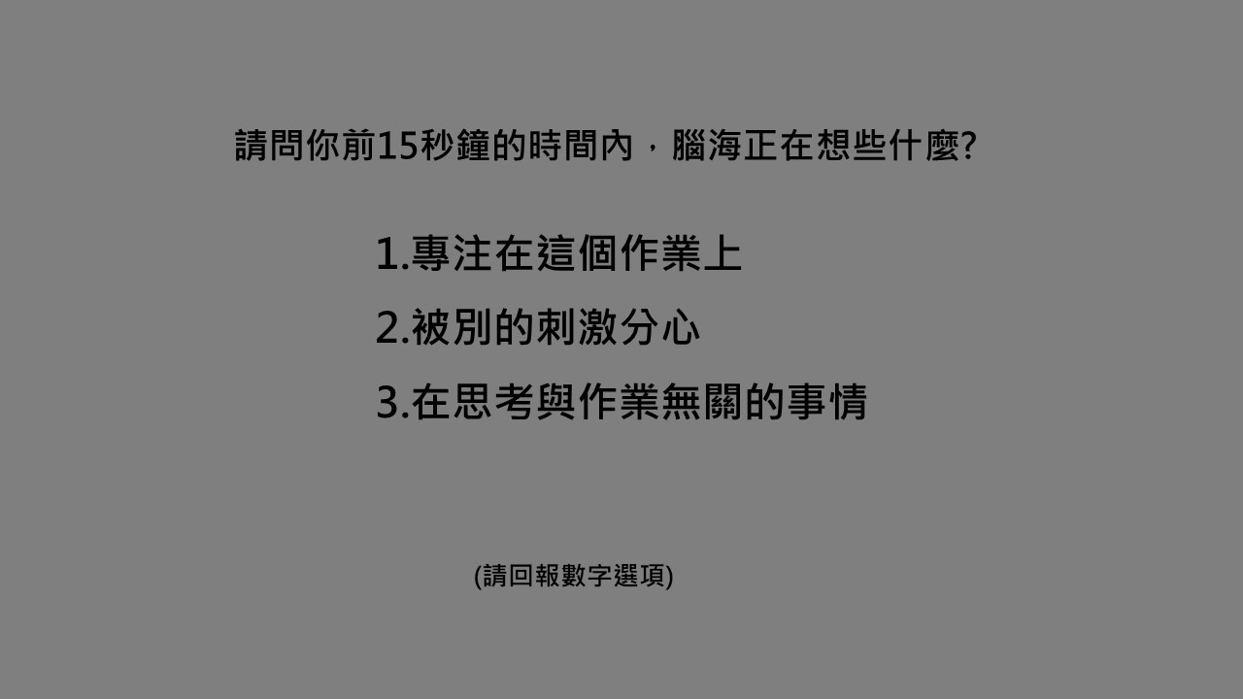

Slide 14
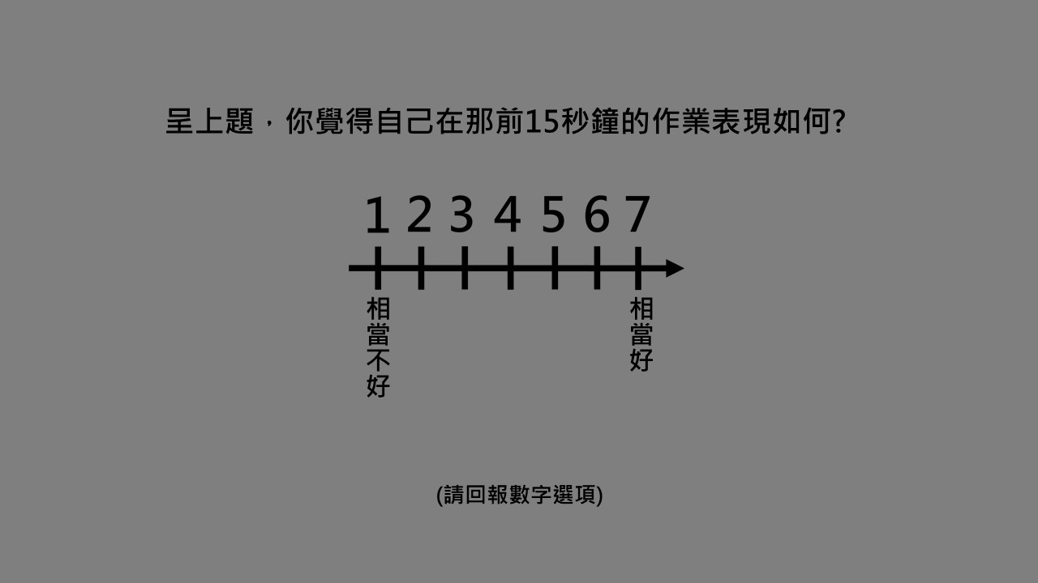

Slide 15
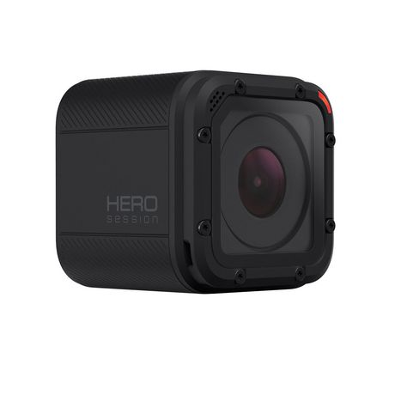

Procedure
~ 30 min
Pre –Sleepiness rating (1-4)
Sustained to Response Task, SART
Post –Sleepiness rating (1-4)
Questionnaires
匹茲堡睡眠量表 C-PSQI (Tsai, P. et al., 2005)
止觀覺察量表 C-MMAS (張仁和、林以正、黃金蘭，2011)
BSSS-V (林素貞，2012)
Notes:
CMMAS: 了解個體能否接受並覺察當下所有的經驗，以做為測量止觀傾向個別差異的工具

Slide 16
Variables
Objective Attentional Dynamic: SART performances
Error of Commission (%) - fail to withhold keypress while target 3 presented
Omission (%) – fail to perform keypress while nontarget presented
nonTarget Mean RT (ms)
Anticipation - non-target RTs less than 100ms
RT coefficient variability (RTCVs) - coefficients of nontarget RT (>200ms) variability
(Cheyne et al., 2009; Hu et al., 2012)
Subjective Attentional States: Probe questions
Focus/ distracted/ mind-wandering
Self-aware performance (1-7)

Slide 17
Result- Demographic characteristics
24 subjects (male = 12, AgeMean = 24.8, AgeSD = 3.1)
no probe was presented: 1 subjects
Questionnaires
N= 23
PSQI: Total score = 21, the higher the score the worse the sleep quality
C-MMAS: Total score = 90, higher score indexing better capacity to accept and perceive all experience in the present
SSS: Total score = 8, higher score indexing the stronger the sensation seeking tendency

Slide 18
Result- Correlation Matrix
Objective Attentional Dynamic
Subjective Attentional States
Questionnaires
There was a significant correlation between Error of Commission and all subjective reported attention states reported
RTCVs shown significant correlation between most of the subjective attentional states, except distraction.
CMMAS has negatively correlated with RTCVs.
Notes:
(probe only presented when errors were detected ).

Slide 19
Result- Paired T-Test
SART performances
Condition | Error Of Commission |  |  | Omission |  |  | nontarget MeanRT |  |  | Anticipation |  |  | RTCVs
 | M | SD |  | M | SD |  | M | SD |  | M | SD |  | M | SD
Low | 0.036 | 0.005 |  | 0.087 | 0.036 |  | 0.356 | 0.013 |  | 0.015 | 0.350 |  | 0.0062 | 0.0021
High | 0.055 | 0.012 |  | 0.090 | 0.018 |  | 0.400 | 0.019 |  | 0.009 | 0.171 |  | 0.0062 | 0.0037
***
*
***

Slide 20
Result- Paired T-Test
Probe questions
Condition | Focus |  |  | Distracted |  |  | MW |  |  | Self-aware Performance
 | M | SD |  | M | SD |  | M | SD |  | M | SD
Low | 42.52 | 0.15 |  | 18.45 | 0.17 |  | 19.03 | 0.17 |  | 4.07 | 0.28
High | 51.20 | 0.08 |  | 11.74 | 0.15 |  | 17.06 | 0.21 |  | 4.05 | 0.42

Slide 21
Summary
Objective attentional parameters, including Error of Commissions, RTCVs had shown significant correlations with subjective attentional states, especially both negatively correlated with self-report mind-wandering.
Objective attentional parameters: Error of Commission, Anticipation and Mean RT to non-target, all shown significant differences between low and high target presentation probability.
Error of commission toward target was higher while more targets were presented, along with the longer mean reaction time to nontarget.
On the other hand, the number of Anticipation (reaction time less than 100 ms) was higher under fewer target condition.

