Slide 1
Data
Computer
Output
Program
Data
Computer
Program
Output

Slide 2
Business
Understanding
Data
Deployment
Understanding
Data
Data
Evaluation
Preparation
Modeling

Slide 3
Business
Understanding
Data
Deployment
Understanding
Data
Data
Evaluation
Preparation
Modeling

Slide 4
Business
Understanding
Data
Deployment
Understanding
Data
Data
Evaluation
Preparation
Modeling

Slide 5
Business
Understanding
Data
Deployment
Understanding
Data
Data
Evaluation
Preparation
Modeling

Slide 6
Business
Understanding
Data
Deployment
Understanding
Data
Data
Evaluation
Preparation
Modeling

Slide 7


Election
Education
Partisanism
Unemployment
Poverty
Population
Data Cleaning
Data Integration

Slide 8
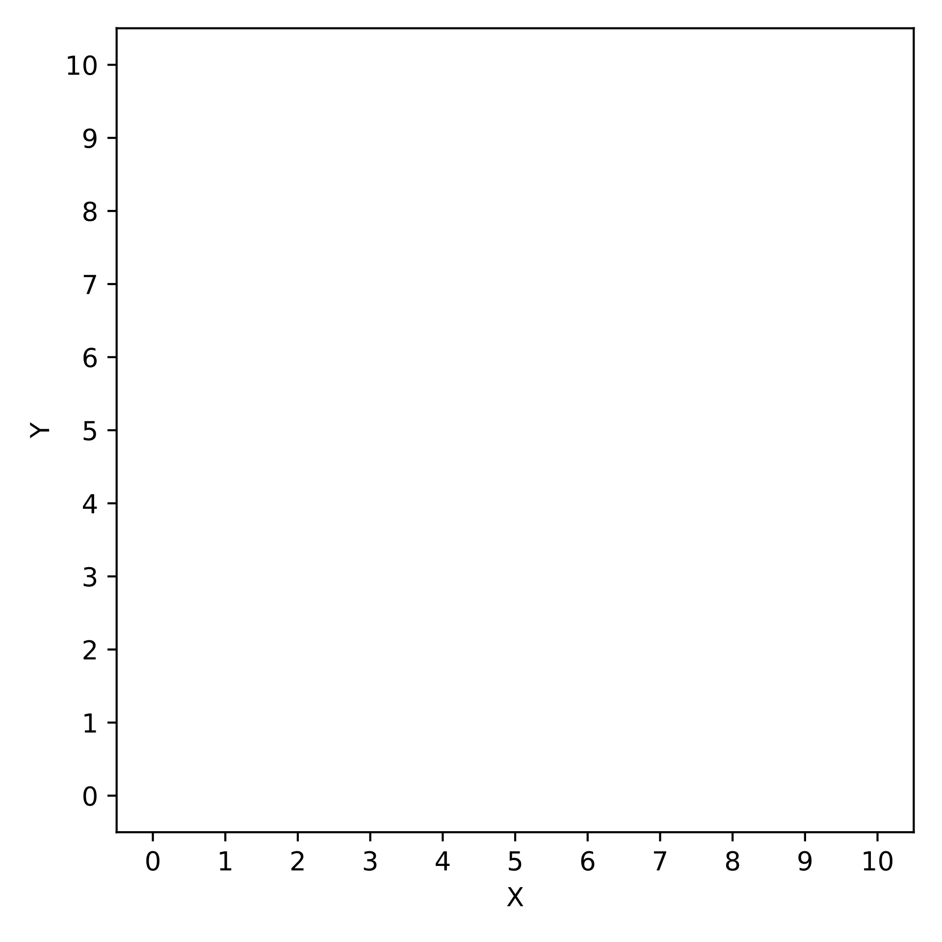
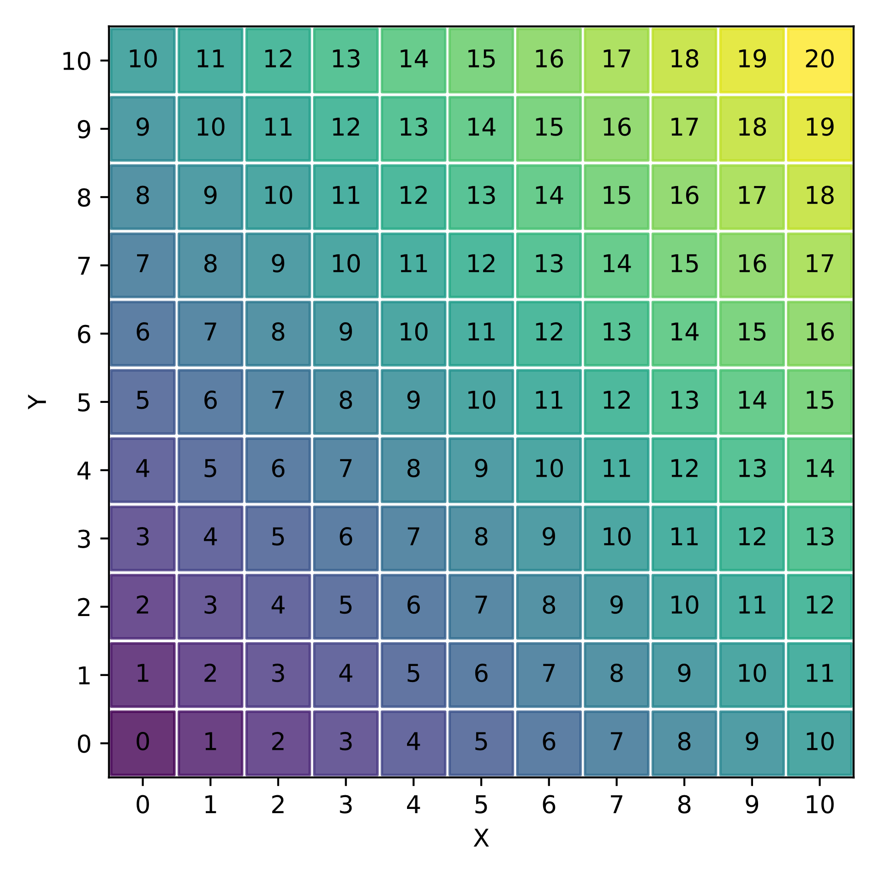
Data
[ (x=0, y=0),
(x=1, y=0),
(x=0, y=1),
...
]
Output
Computer
Program (python)
def sum(x, y):
return x + y

Slide 9

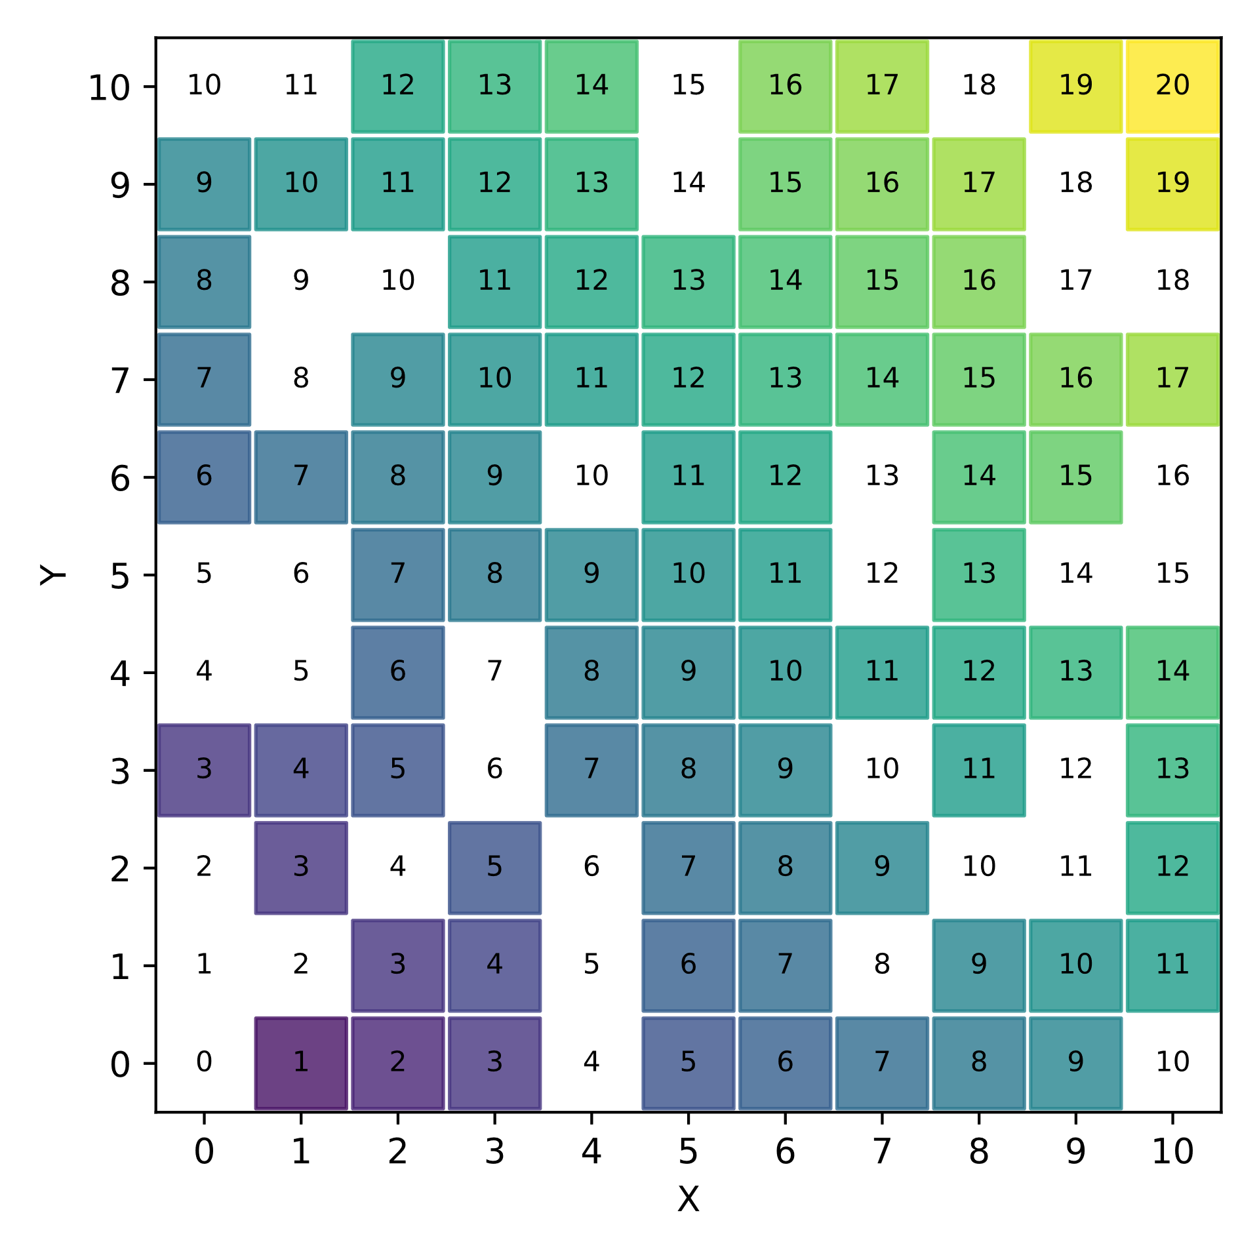
Data (training data)
[ (x=0, y=0),
(x=1, y=0),
(x=0, y=1),
...
]
Program
Computer
Output (labels = ground truth)
ML
model

Slide 10
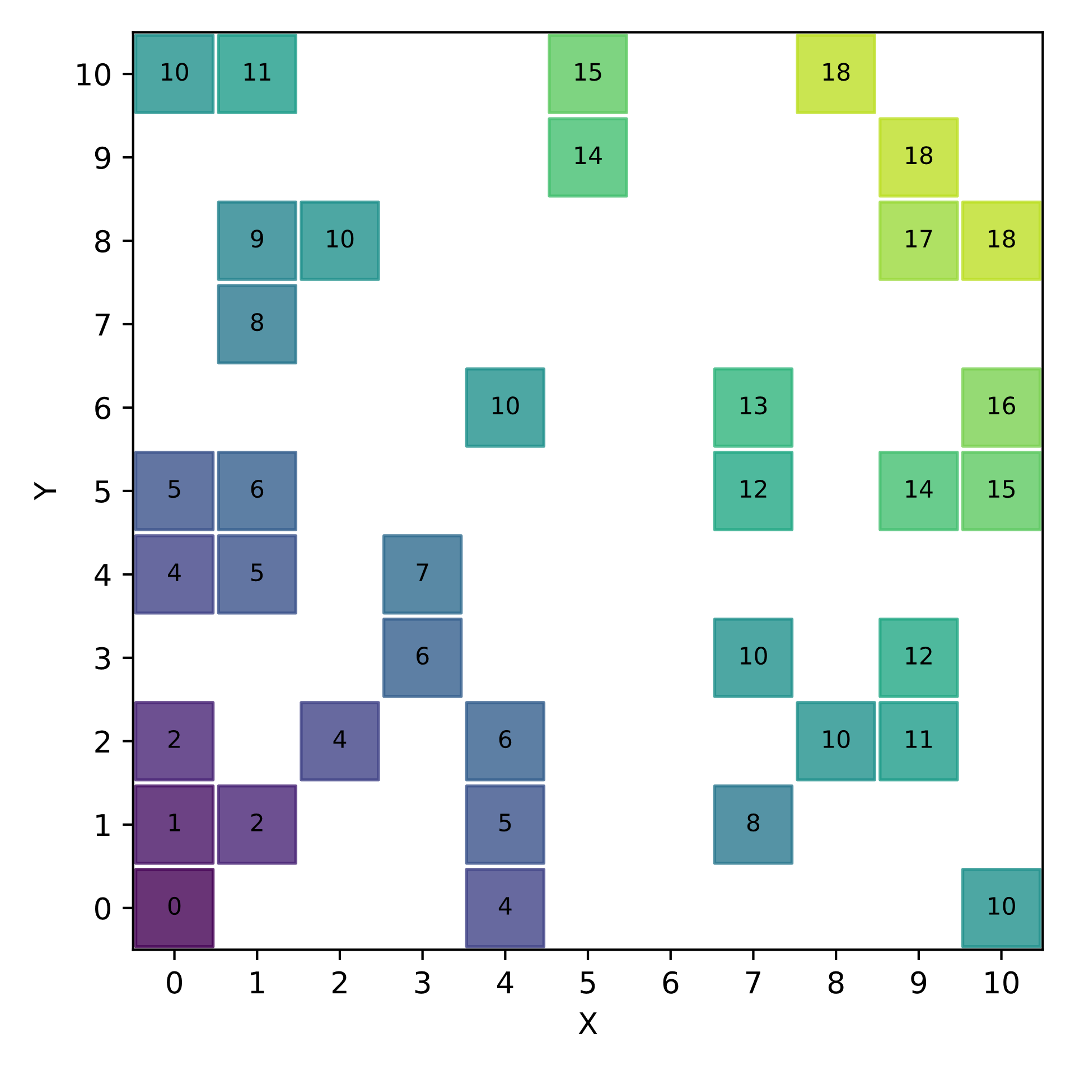
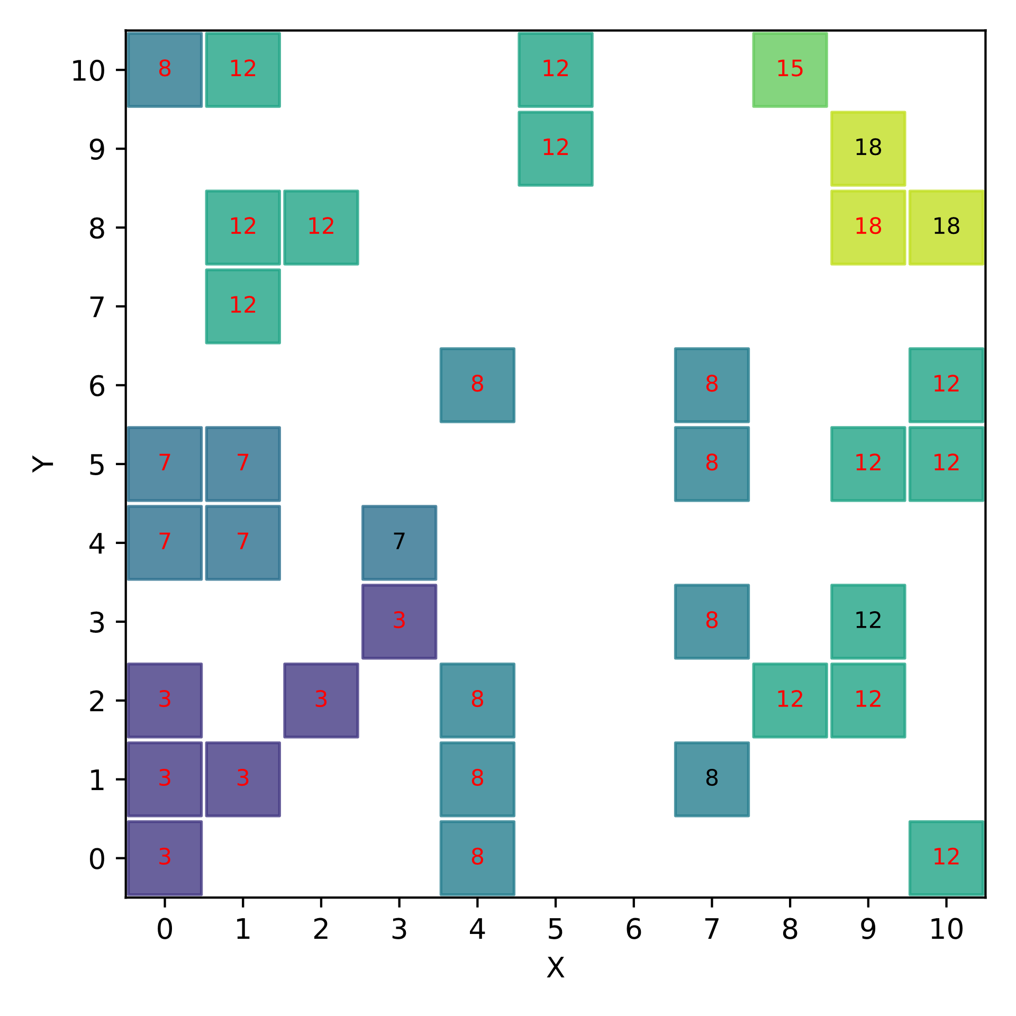
Data (test data)
Data (training data)
[ (x=1, y=0),
(x=2, y=0),
...
]
Predictions (in red the wrong ones)
Program
Computer
Output (labels = ground truth)
ML
model

Slide 11


Data (training data)
import numpy as np
from sklearn.tree import DecisionTreeRegressor
X = # [[0, 0], [0, 1], [1, 1], ...] Training data y = # [0, 1, 1, ...] Labels reg = DecisionTreeRegressor(max_depth=4) reg.fit(X, y) reg.score(X, y) reg.predict(...)
[ (x=0, y=0),
(x=1, y=0),
(x=0, y=1),
...
]
weka
Computer
ML algorithm
ML
model
Output (labels = ground truth)

Slide 12
Decision Tree
X+Y=3 if x < 3.5 and y < 3.5
X+Y=12 if x >= 7.5 and y < 7.5

Slide 13
m
…
n

Slide 14
n

Slide 15
Analysis
Decision
Action
Descriptive
What happened?
Diagnostic
Why it happened?
Data
Predictive
What will happen?
Prescriptive
What should I do to make it happen?
Decision support
Decision automation

Slide 16
Analisi
Decisione
Azione
Descrittivi
Cosa è accaduto?
Diagnostici
Perché è accaduto?
Dati
Predittivi
Cosa accadrà?
Prescrittivi
Cosa fare perché ciò accada?
Supporto
Automazione

Slide 17
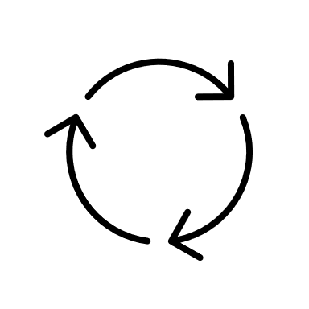



V₁ | V₂ | V₃ | C
a1 | b2 | c1 | □
a1 | b1 | c4 | ○
a2 | b1 | c3 | ○
Training
ML model
Training set
ML algorithm
Learning
Dataset
V₁ | V₂ | V₃ | C
a1 | b2 | c1 | □
a1 | b1 | c4 | ○
a2 | b1 | c3 | ○
a3 | b3 | c2 | □
a1 | b5 | c2 | □
Test set
Prediction
V₁ | V₂ | V₃
a3 | b3 | c2
a1 | b5 | c2
C
○
□
Testing
Real Data Sources
Prediction
Deploying
Action

Slide 18
V₁ | V₂ | V₃ | C
a1 | b2 | c1 | □
a1 | b1 | c4 | ○
a2 | b1 | c3 | ○
Addestramento
Modello ML
Training set
Algoritmo ML
Apprendimento
Dataset
V₁ | V₂ | V₃ | C
a1 | b2 | c1 | □
a1 | b1 | c4 | ○
a2 | b1 | c3 | ○
a3 | b3 | c2 | □
a1 | b5 | c2 | □
Test set
Previsione
V₁ | V₂ | V₃
a3 | b3 | c2
a1 | b5 | c2
C
○
□
Test
Sorgenti dati reali
Previsione
Utilizzo in
contesti reali

