Slide 1

Information Systems & Business Intelligence
Data Mining and Machine Learning
DWH
Databases
Relational DB
Big Data and Cloud Platforms
NoSQL DB
Data Lake
Data Lakehouse

Slide 3
time
pool

Slide 4


Slide 5



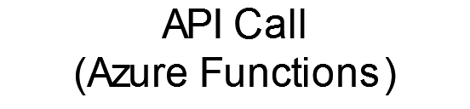
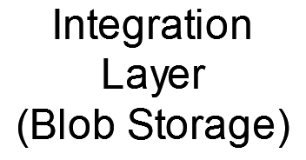

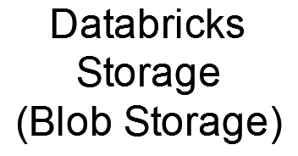




A Company Department
Another Company Department
Other applications
ML
Old DWH

Slide 6
{ w, x, y, z }
{ w, x, y }
{ w, x, z }
{ w, y, z }
{ x, y, z }
{ w, x }
{ w, y }
{ w, z }
{ x, y }
{ x, z }
{ y, z }
{ w }
{ x }
{ y }
{ z }
{ }
{ w, x, y, z }
{ w, x, y }
{ w, x, z }
{ w, y, z }
{ x, y, z }
{ w, x }
{ w, y }
{ w, z }
{ x, y }
{ x, z }
{ y, z }
{ w }
{ x }
{ y }
{ z }
{ }

