Slide 1

Information Systems & Business Intelligence
Data Mining and Machine Learning
DWH
Databases
Relational DB
Big Data and Cloud Platforms
NoSQL DB
Data Lake
Data Lakehouse

Slide 3
time
pool

Slide 4


Slide 5




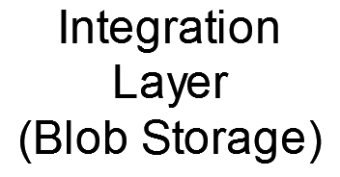

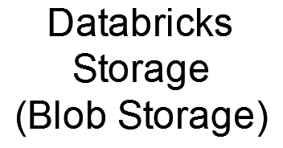




A Company Department
Another Company Department
Other applications
ML
Old DWH

